Slide 1
CHAPTER 1:
Introduction
SUBMITTED BY:
GANGOTRI MISHRA
16BCS2513
NON-KARGIL “ 1”

Slide 2
Why “Learn”?
Machine learning is programming computers to optimize a performance criterion using example data or past experience.
There is no need to “learn” to calculate payroll
Learning is used when:
  Human expertise does not exist (navigating on Mars),
  Humans are unable to explain their expertise (speech recognition)
  Solution changes in time (routing on a computer network)
  Solution needs to be adapted to particular cases (user biometrics)

Slide 3
What We Talk About When We Talk About“Learning”
Learning general models from a data of particular examples
Data is cheap and abundant (data warehouses, data marts); knowledge is expensive and scarce.
Example in retail: Customer transactions to consumer behavior:
  People who bought “Da Vinci Code” also bought “The Five People You Meet in Heaven” (www.amazon.com)
Build a model that is a good and useful approximation to the data.

Slide 4
Data Mining/KDD
Definition := “KDD is the non-trivial process of
identifying valid, novel, potentially useful, and
ultimately understandable patterns in data” (Fayyad)
Applications:
Retail: Market basket analysis, Customer relationship management (CRM)
Finance: Credit scoring, fraud detection
Manufacturing: Optimization, troubleshooting
Medicine: Medical diagnosis
Telecommunications: Quality of service optimization
Bioinformatics: Motifs, alignment
Web mining: Search engines
...

Slide 5
What is Machine Learning?
Machine Learning
  Study of algorithms that
  improve their performance
  at some task
  with experience
Optimize a performance criterion using example data or past experience.
Role of Statistics: Inference from a sample
Role of Computer science: Efficient algorithms to
  Solve the optimization problem
  Representing and evaluating the model for inference

Slide 6
Growth of Machine Learning
Machine learning is preferred approach to
  Speech recognition, Natural language processing
  Computer vision
  Medical outcomes analysis
  Robot control
  Computational biology
This trend is accelerating
  Improved machine learning algorithms
  Improved data capture, networking, faster computers
  Software too complex to write by hand
  New sensors / IO devices
  Demand for self-customization to user, environment
  It turns out to be difficult to extract knowledge from human experts→failure of expert systems in the 1980’s.
Alpydin & Ch. Eick: ML Topic1

Slide 7
Applications
Association Analysis
Supervised Learning
  Classification
  Regression/Prediction
Unsupervised Learning
Reinforcement Learning

Slide 8

Learning Associations
Basket analysis:
P (Y | X ) probability that somebody who buys X also buys Y where X and Y are products/services.
Example: P ( chips | beer ) = 0.7
Market-Basket transactions

Slide 9
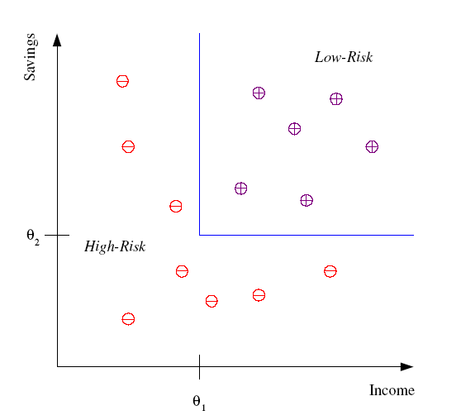
Classification
Example: Credit scoring
Differentiating between low-risk and high-risk customers from their income and savings
Discriminant: IF income > θ₁ AND savings > θ₂
THEN low-risk ELSE high-risk
Model

Slide 10
Classification: Applications
Aka Pattern recognition
Face recognition: Pose, lighting, occlusion (glasses, beard), make-up, hair style
Character recognition: Different handwriting styles.
Speech recognition: Temporal dependency.
  Use of a dictionary or the syntax of the language.
  Sensor fusion: Combine multiple modalities; eg, visual (lip image) and acoustic for speech
Medical diagnosis: From symptoms to illnesses
Web Advertizing: Predict if a user clicks on an ad on the Internet.

Slide 11








Face Recognition
Training examples of a person
Test images
AT&T Laboratories, Cambridge UK
http://www.uk.research.att.com/facedatabase.html

Slide 12
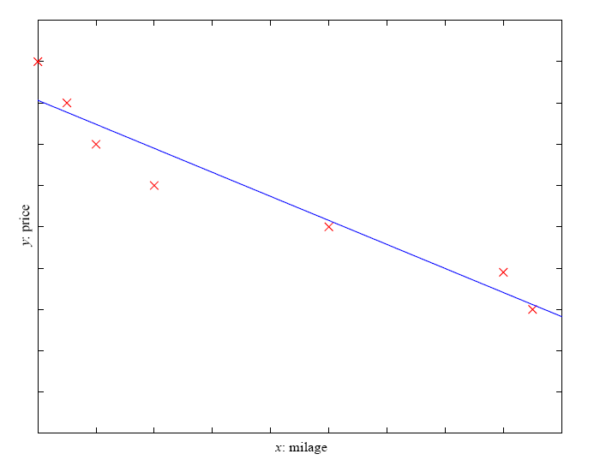
Prediction: Regression
Example: Price of a used car
x : car attributes
y : price
y = g (x | θ )
g ( ) model,
θ parameters
y = wx+w₀

Slide 13
Regression Applications
Navigating a car: Angle of the steering wheel (CMU NavLab)
Kinematics of a robot arm
(x,y)
α₁= g₁(x,y)
α₂= g₂(x,y)
α₂
α₁

Slide 14
Supervised Learning: Uses
Example: decision trees tools that create rules
Prediction of future cases: Use the rule to predict the output for future inputs
Knowledge extraction: The rule is easy to understand
Compression: The rule is simpler than the data it explains
Outlier detection: Exceptions that are not covered by the rule, e.g., fraud

Slide 15
Unsupervised Learning
Learning “what normally happens”
No output
Clustering: Grouping similar instances
Other applications: Summarization, Association Analysis
Example applications
  Customer segmentation in CRM
  Image compression: Color quantization
  Bioinformatics: Learning motifs

Slide 16
Reinforcement Learning
Topics:
  Policies: what actions should an agent take in a particular situation
  Utility estimation: how good is a state (→used by policy)
No supervised output but delayed reward
Credit assignment problem (what was responsible for the outcome)
Applications:
  Game playing
  Robot in a maze
  Multiple agents, partial observability, ...

Slide 17
Which Topics Deserve More Coverage
—if we had more time?
Graphical Models/Belief Networks (just ran out of time)
More on Adaptive Systems
Learning Theory
More on Clustering and Association Analysis→covered by Data Mining Course
More on Feature Selection, Feature Creation
More on Prediction
Possibly: More depth coverage of optimization techniques, neural networks, hidden Markov models, how to conduct a machine learning experiment, comparing machine learning algorithms,…
Alpydin & Ch. Eick: ML Topic1

Slide 18
STOCK MARKET ANALYSIS
Our aim is to create software that analyzes previous stock data of certain companies, with help of certain parameters that affect stock value. We are going to implement these values in data mining algorithms and we will be able to decide which algorithm gives the best result. This will also help us to determine the values that particular stock will have in near future.
We will determine the patterns in data with help of data mining algorithms.
Alpydin & Ch. Eick: ML Topic1

Slide 19
SCOPE OF PROJECT
3.1 Application of Analysis of stocks in our selected domain:
Stock Market Analysis of stocks using data mining will be useful for new investors to invest in stock market based on the various factors considered by the software.
Stock market includes daily activities like Sensex calculation, exchange of shares. The exchange provides an efficient and transparent market for trading in equity, debt instruments and derivatives.
Alpydin & Ch. Eick: ML Topic1

Slide 20
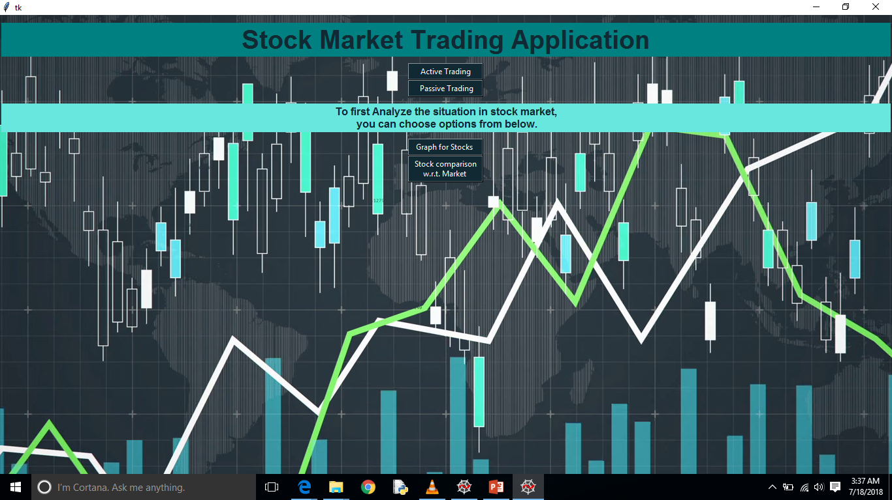
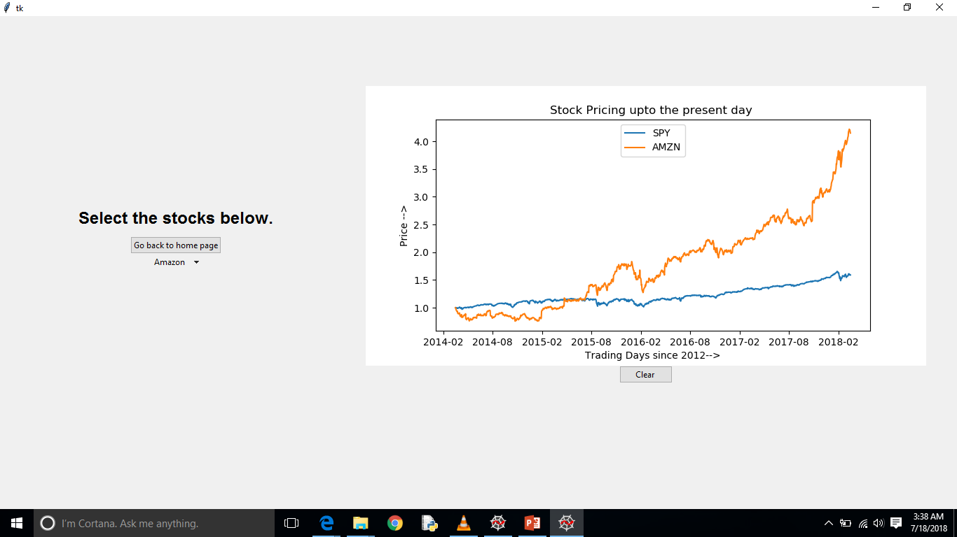
SCREENSHOTS

Slide 21
ADVANTAGE
Helps the users in detecting the market trend patterns and other conditions.
The project report contains a number of filter elements ranging as per the market trends that helps the users to analyze the registered stocks
The project report contains a number of shares, their prices and Volume Breakouts
It contains stocks that have an unanticipated rise in the business volume and a rapid rate escalation in terms of cost.
Alpydin & Ch. Eick: ML Topic1

Slide 22
DISADVANTAGE
Requires an active internet connection.
May generate inaccurate results if data inputted incorrectly.
Alpydin & Ch. Eick: ML Topic1

