Slide 1
Introduction To C++ Programming
Assignment 5
Draw a Map with SFML Image
Objectives: Primary objective is to learn how to use the C++ loops to read in data from an input file, which is a map file.
The second objective is to create SFML Image object using the data read from the input file.
Instructions: You first need to create a CLion C++ project using the “Check out from Version Control” option with Git tool.
Link to Github project 6 repository
https://github.com/gangryunguh/cop3014-drawMap.git
Second, you need to implement six tasks specified in the cloned C++ template file – DrawMapSFML.cpp. The following is the detailed instruction for these 6 tasks.
Task 1: (a) Read in the name of the map file from keyboard and open the input file for reading, i.e, "resources/usa.txt", and "resources/germany.txt" (b) If the file cannot be opened, then print error message and immediately return EXIT_FAILURE error status.
Task 2: Read in two integer values from input file stream, which are width and height in pixels to for the drawing,
Task 3: create SFML Image object according to the dimension that you read from Task 2 - The background color for the SFML Image is black The detailed reference and example for SFML Image can be found from https://www.sfml-dev.org/documentation/2.4.0/classsf_1_1Image.php

Slide 2
Task 4: Initialize SFML Image object as being described below: Repeat the following steps until there is no more data from input file stream. :
step a) Read a pair of double values from input file stream, which represent pixel location in 2D Image. step b) Convert these two double values to unsigned integer values since the data type for the SFML Image pixel must be unsigned int. step c) Set the SFML Image pixel location with according to these integer pixel values using C++ switch statement:
if the product of these two integer values are divisible by 4, assign the color Red, else if the remainder value of the product divided by 4 is equal to 1, then assign the color White, else if the remainder value of the product divided by 4 is equal to 2, then assign the color Red, else if the remainder value of the product divided by 4 is equal to 3, then assign the color White,
Close input file stream when the SFML Image object initialization is done.
Task 5: Create SFML window and 2D Sprite object (a) The SFML window's size must be the same size as the SFML Image size in Task 4, and the SFML window's name must be the input file name. (b) Using the loadFromImage SFML texture method, set The SFML Sprite's texture with the SFML Image object which being created in the above Task 4 Reference: https://www.youtube.com/watch?v=1ND_VRJChO4
Task 6: Draw the SFML Sprite object created in Task 5 in the SFML window Reference: Programming Assignment 4 - HelloSFML

Slide 3
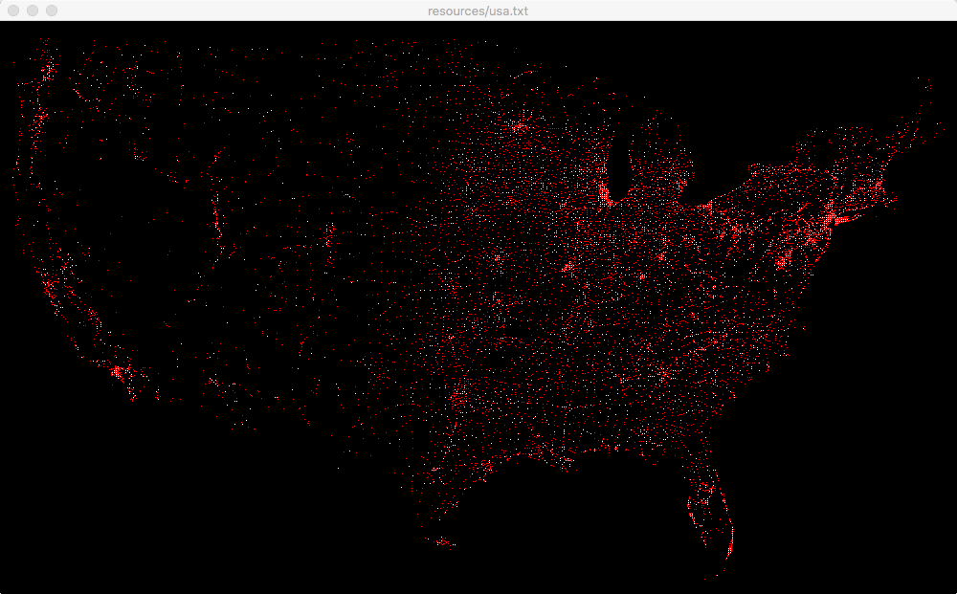
Sample program run:
Input the map file to render with SFML: resources/usa.txt

