Slide 1



Water Quality Prediction

Slide 2

Learning Objectives
The learning objectives of Water Quality Prediction include understanding key water quality parameters and their impact on ecosystems and human health. Learners will collect and preprocess real-world data, apply statistical and machine learning techniques to predict water quality or Water Quality Index (WQI), and evaluate model performance using appropriate metrics. They will also visualize and interpret results to provide actionable insights for environmental monitoring. Additionally, learners will explore ethical and practical considerations in applying predictive models for sustainable water resource management.
GOAL
Source :
www.freepik.com/

Slide 3
Tools and Technology used
Water Quality Prediction relies on a range of tools and technologies. Data analysis and modeling are commonly performed using programming languages like Python or R, with libraries such as Pandas, NumPy, Scikit-learn, TensorFlow, and Keras for machine learning. Visualization tools like Matplotlib, Seaborn, and Plotly help interpret data trends. Geographic and environmental data may be processed using GIS software (e.g., QGIS or ArcGIS). For data collection, IoT sensors, remote sensing, and automated water monitoring systems are used. Cloud platforms such as Google Colab, AWS, or Azure often support scalable computing and data storage.

Slide 4
Methodology
The methodology for Water Quality Prediction typically begins with data collection from sources like IoT sensors, satellite imagery, or public datasets. This is followed by data preprocessing, which involves cleaning, handling missing values, normalization, and feature selection. Next, exploratory data analysis (EDA) is conducted to understand trends and correlations among water quality parameters. Suitable machine learning models (e.g., regression, decision trees, random forest, or neural networks) are then trained and validated using historical data. Model evaluation is performed using metrics like accuracy, RMSE, or R². Finally, the results are visualized and interpreted to predict the Water Quality Index (WQI) and support decision-making for environmental management.

Slide 5
Problem Statement:
Access to clean and safe water is essential for public health, agriculture, and ecosystem sustainability. However, monitoring water quality in real time is challenging due to the high cost, limited coverage, and manual effort involved in traditional sampling methods. There is a need for an accurate and efficient system to predict water quality using data-driven techniques. This project aims to develop a predictive model that can estimate water quality parameters or the Water Quality Index (WQI) using historical and real-time environmental data, enabling proactive decision-making and better resource management.
Therefore, the core objective of this project is to develop an accurate and scalable water quality prediction system that leverages data science techniques to estimate water quality indicators and WQI. This system aims to support decision-making in public health, environmental conservation, and water resource management by providing actionable insights and enabling proactive measures.

Slide 6
Solution:
To address the challenges of traditional water quality monitoring, this project proposes a data-driven predictive system that leverages machine learning to estimate water quality parameters and compute the Water Quality Index (WQI) in real time. The solution involves collecting water quality data from multiple sources, including IoT sensors, government databases, and satellite observations. This data is then preprocessed—cleaned, normalized, and analyzed—to identify trends and correlations among key parameters like pH, turbidity, dissolved oxygen, BOD, and nitrates.
Using this processed data, various machine learning models—such as Random Forest, Support Vector Machine (SVM), or Neural Networks—are trained to predict individual water quality indicators and the overall WQI. Model performance is evaluated using standard metrics (e.g., RMSE, accuracy, R²), and the best-performing model is selected for deployment. The predictions are visualized through dashboards or maps for easy interpretation by policymakers, environmental agencies, and the general public.
This automated, scalable solution not only enables timely and accurate water quality assessment but also supports proactive decision-making, early pollution detection, and efficient resource management—ultimately contributing to improved public health and sustainable water use.

Slide 7
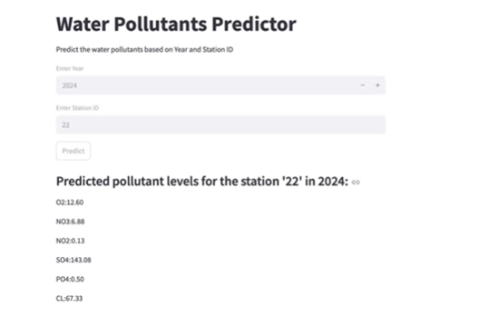
Screenshot of Output:

Slide 8
Conclusion:
This Water Quality Prediction project successfully demonstrated how data-driven techniques can be used to monitor and predict the quality of water based on key parameters such as pH, turbidity, dissolved oxygen, BOD, and nitrate levels. By leveraging machine learning models and real-world data, the system provides timely and accurate estimates of the Water Quality Index (WQI), enabling better environmental management and decision-making. The predictive approach not only helps identify potential pollution risks early but also supports sustainable water resource management, ultimately contributing to public health and ecosystem protection. Future work can focus on integrating real-time sensor data and expanding the model to cover larger geographic areas for improved monitoring efficiency.

Slide 9
THANK YOU

