Slide 1
Link Cut Tree and its Applications
n

Slide 2
Introduction
A link/cut tree is a data structure for representing a forest, a set of rooted trees, Invented in 1982 . And invented by Daniel Dominic Sleator Robert Endre Tarjan. And offers the following operations:
make_tree
Link
Cut
find_root
path_aggregate

Slide 3
Make Tree Operation
Returns a new vertex in a singleton tree. This operation allows us to add elements and later manipulate them
This Operation takes O(1) time.

Slide 4
Path_aggregate Operation
pathaggregate(v) – Returns an aggregate, such as max/min/sum, of the
weights of the edgeson the path from the root of the tree to nodev.
It is also possible to augment the datastructure to return many kinds of
statistics about the path.

Slide 5
The first thing we do is access(v). An auxiliary tree representing the path down to to node v. We augment the auxiliary tree.
Path-Aggregate(v)
-access(v)
- return v.subtree-sum (augmentation within each auxiliary tree)

Slide 6
Link Operation
link(p,q): p is a tree root, and q is any node in another tree. make p a child of q.
Amortized time complexity of this operation is O(logn).
Steps that has to follow:
access(p)
access(q)
left(p)<- q

Slide 7
Cut Operation
Cut(v) : Deletes the edge between vertex v and its parent, parent(v) where v is not the root. Therefore there are two trees of aux trees after the cut operation.
CUT(v)
Access
let(v)<---NULL

Slide 8
Find Root Operation
findroot(p) : Return the root of thr tree containing p.
FIND_ROOT(v)
- access(v)
-set v to the smallest element in the auxillary tree, i.e to the root of the represented tree
v<---left(v) until left(v) is null
-access r
-return r

Slide 9
Preferred-Path decomposition
Link-cut trees are all about paths in the tree, so we want to split a tree into paths.
Preferred child: Thepreferred child of node v is equal to its i-th child if the last access with in
v’s subtree was in the i-th subtree, and it is equal to null if the last access within v’s subtree was to v itself or if there were no accesses to v’s subtree at all.
Preferred Edge: A preferred edge is an edge between a preferred child and its parent.
Preferred Path: A preferred path is a maximal continuous path of preferred edges in a tree, or a single node if there is no preferred edges incident on it.

Slide 10
Represented tree and Auxiliary tree
Represented trees : The abstract trees that the data structure represents called as represented trees.
Auxiliary trees : Link-Cut Trees represent each tree T in the forest as a tree of auxiliary trees, one auxiliary tree for each preferred path in T.
Auxiliary trees are Splay trees with each node keyed by its depth in its represented tree.
Auxillary trees are joined together using path-parent pointers.

Slide 11
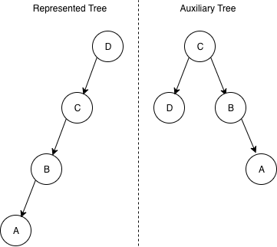
Represented Tree and Auxillary Tree

Slide 12
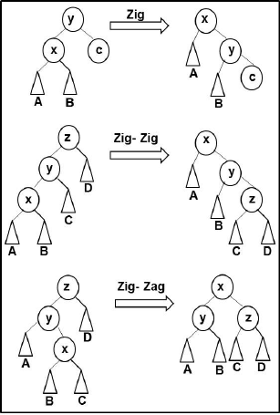
Splay trees:
A splay tree is a self-balancing binary search tree with the additional property that recently accessed elements are quick to access again
Operations: Splaying
Join
Split
Insertion
Deletion

Slide 13
Access Operation
All operations are implemented using an access(v) subroutine. It restructures the treeT of auxiliary trees that contains vertex v so that it looks like v was just accessed in its represented tree R. When we access a vertex v some of the preferred paths change. A preferred path from the root of R down to v is formed. When this preferred path is formed every edge on the path becomes preferred and all the old preferred edges in R that had an endpoint on this path are destroyed, and replaced by path-parent pointers.
he nodes in auxiliary trees are keyed by their depth in R. Thus nodes to the left of v are higher than v and nodes to the right are lower. Since we access v, its preferred child becomes null. Thus, if before the access v was in the middle of a preferred path, after the access the lower part of this path becomes a separate path, This means that we have to separate all the nodes less than v in a separate auxiliary tree. The easiest way to do this is to splay on v, i.e. bring it to the root and then disconnect it right subtree, making it separate auxiliary tree.

Slide 14
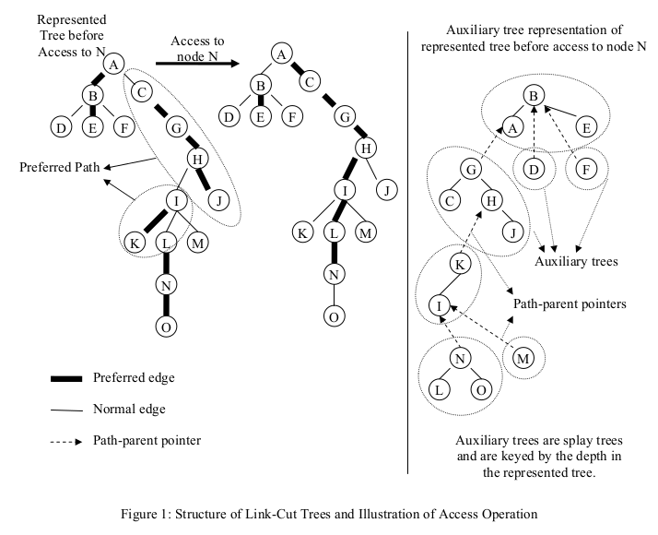

Slide 15
ACCESS(v)
Splay v with in its auxiliary tree, i.e. bring it to the root. The left subtree will contain all the elements higher than v and right subtree will contain all the elements lower than v
Remove v’s preferred child.
path-parent(right(v))←v
right(v)←null( + symmetric setting of parent pointer)
loop until we reach the root
w←path-parent(v)
splay w
switch w’s preferred child
path-parent(right(w))←w
right(w)←v( + symmetric setting of parent pointer)
path-parent(v)←null
v←w
splay v just for convenience

Slide 16
Applications
Using Link-Cut tree data structure, new fast algorithms are obtained for the following problems:
1) Computing nearest common ancestors.
2) Solving various network flow problems including
finding maximum flows, blocking flows,and acyclic flows.
3)Implementing the network simplex algorithm for minimum-cost-flows
The most significant application is (2); an O(mn log n) time algorithm is obtained to find a maximum flow in a network of n vertices and m edges, beating a factor of logn the fastest algorithm previously know for sparse graphs.

Slide 17
Computing Nearest Common Ancestor

Slide 18
References :
https://courses.csail.mit.edu/6.851/spring12/scribe/L19.pdf
https://www.cs.cmu.edu/~avrim/451f12/lectures/lect1009-linkcut.txt
https://www.cs.cmu.edu/~sleator/papers/dynamic-trees.pdf
https://www.spoj.com/problems/DYNALCA/

