Slide 1
Design and analysis of genome-wide circadian experiments

Slide 2
What’s happening
“Golden Rules”: a brief introduction
Workshop part I
Intro to R & Metacycle
Sampling resolution & the errors of Venn diagrams
Coffee & discussion
Workshop part II
RNA-seq read depth: “something clever”
Wrap-up: mind your P’s & Q’s!

Slide 3
Golden Rules
Brief introduction

Slide 4
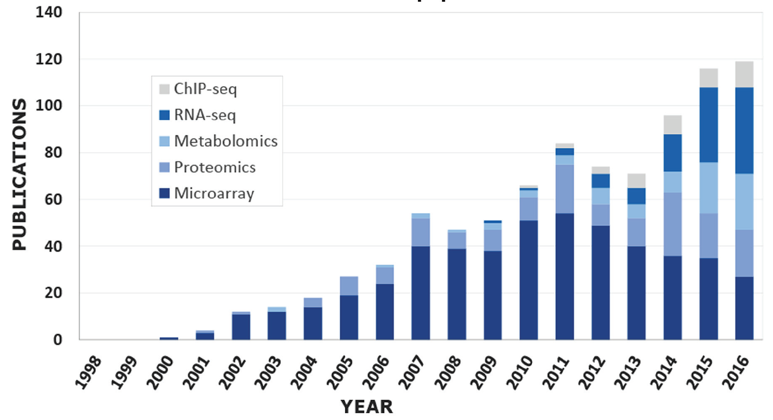
Circadian ‘omics on the rise
Hughes M. E. et al., J Biol Rhythms. 2017.

Slide 5
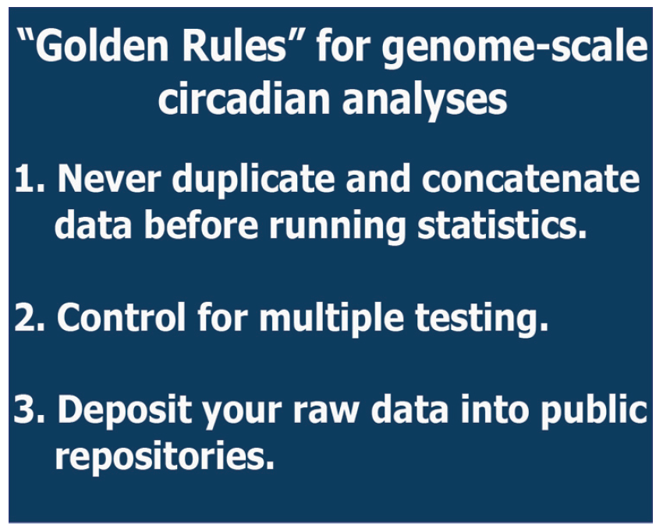
Golden Rules
Hughes M. E. et al., J Biol Rhythms. 2017.

Slide 6
Begin workshop part 1

Slide 7
Which algorithm should I use to analyze periodic data?
 | Pros^{#1} | Cons^{#2}
ARSER | Low false negative rate in analyzing low resolution data^{#3} Less influenced by noise Less periodic curve bias Uniform P-value distribution based on simulated datasets | High false positive rate in analyzing high resolution data Limited sampling pattern (evenly sampled without missing value and replicates) Low computational efficiency Decreased power in analyzing datasets covering only one cycle
JTK_CYCLE | Robust to outliers High computational efficiency Improved power in analyzing datasets with duplicate samples | Dispersed output parameters (P-value, period and phase) for low resolution data False negative issue for low resolution data Less accurate phase for low resolution data Cosine curve bias
Lomb-Scargle | Not restricted by the sampling pattern High computational efficiency Good classifier of periodic signals and noise | High false negative rate in analyzing low sampling resolution data The calculated amplitude is not good
meta2d | Convenient Correcting the major Cons of the single method Rarely give the worst results comparing with a single method Improved accuracy in phase prediction | The used Fisher method require independent P-values given by ARSER, JTK_CYCLE and Lomb-Scargle False positive issue in analyzing high sampling resolution data if including ARSER
Notes:
#1 and #2: Summary from users’ experience and evaluation work in several papers (Deckard A. et al., Bioinformatics. 2013; Wu G. et al., J Biol Rhythms. 2014; Hutchison A. L., et al., PLoS Comput Biol. 2015; Wu G. et al., Bioinformatics. 2016; Hutchison A. L., et al., bioRxiv 118547. 2017).
#3: high resolution data (no less than 12 time points within one cycle and covering at least two cycles) and low resolution data (less than 12 time points within one cycle and covering less than two cycles).

Slide 8
Method selection based on the sampling pattern in studying circadian transcriptome
Non-human studies^{#1}
Time points | Total number of samples | E.g. sampling pattern | Suggested method^{#2}
>= 6 | >= 48 | 1h/3days 1h/2ays 2h/2days (two replicates at each time points) | meta2d(JTK) or meta2d(LS)
 | [24, 48) | 2h/2days 3h/2days (two replicates at each time points) | meta2d(JTK, LS) or meta2d(ARS, JTK, LS)^{#3}
 | [6, 24) | 3h/2days 4h/2days 4h/1day (with/without replicates) | meta2d(ARS, JTK, LS)^{#3}
[3, 5] | >=2 biological replicates at each time point | 0,0, 5,5, 10,10, 15,15, 20,20 0,0, 6,6, 12,12, 18,18 0,0,0, 8,8,8, 16,16,16 | ANOVA
2 | >=2 biological replicates at each time point | 0,0,0, 12,12,12 | T-test
Notes:
#1: Try meta3d for studying circadian transcriptome in multiple human subjects.
#2: Other rhythmic detection methods, e.g. RAIN (Thaben P. F., et al., J Biol Rhythms. 2014), BIO_CYCLE (Agostinelli F. et al., Bioinformatics. 2016) and BooteJTK (Hutchison A. L., et al., bioRxiv 118521. 2017).
#3: MetaCycle will automatically skip ARS for analyzing datasets with replicates and/or missing values, and skip ARS and JTK for analyzing un-evenly sampled datasets.

Slide 9
Begin workshop part 2

Slide 10
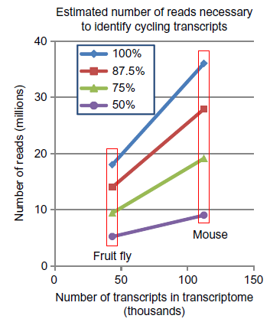
Importance of read depth for identifying oscillating transcripts
Li J. et al., Methods Enzymol. 2015.

Slide 11
Wrap-up
Mind your P’s & Q’s
Take home messages
Additional resources

Slide 12
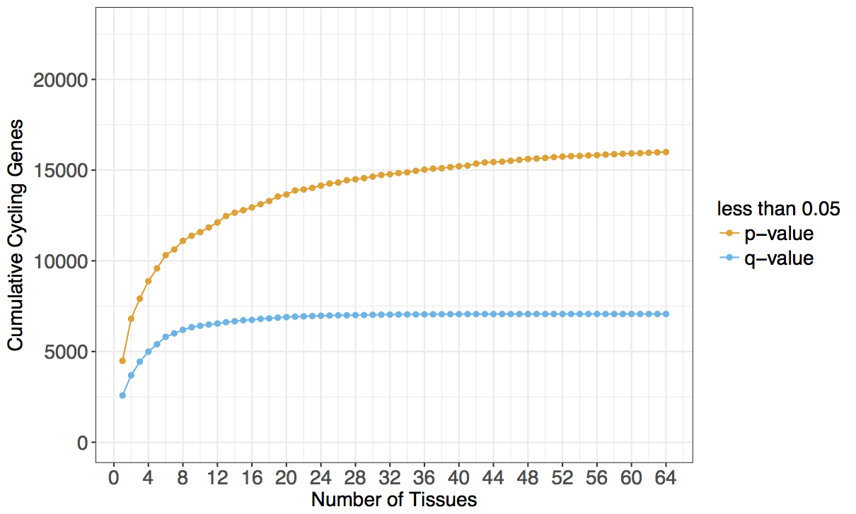
Multiple hypothesis testing: mind your P's and Q's!
Notes:
Note: 11 of the 64 tissues had NO significant genes using Qvalue < 0.05

Slide 13
Take home messages…
Genome-wide studies offer an incredible opportunity for discovery – “30K shots on goal”.
But…design and analysis is critical:
Match your experimental design to your objective.
For example, day versus night is an entirely different animal than analyzing global circadian regulation of <latest sequencing method>
Array versus RNAseq?
Always discuss study limitations
Validate your conclusions, especially when you’re underpowered.

Slide 14
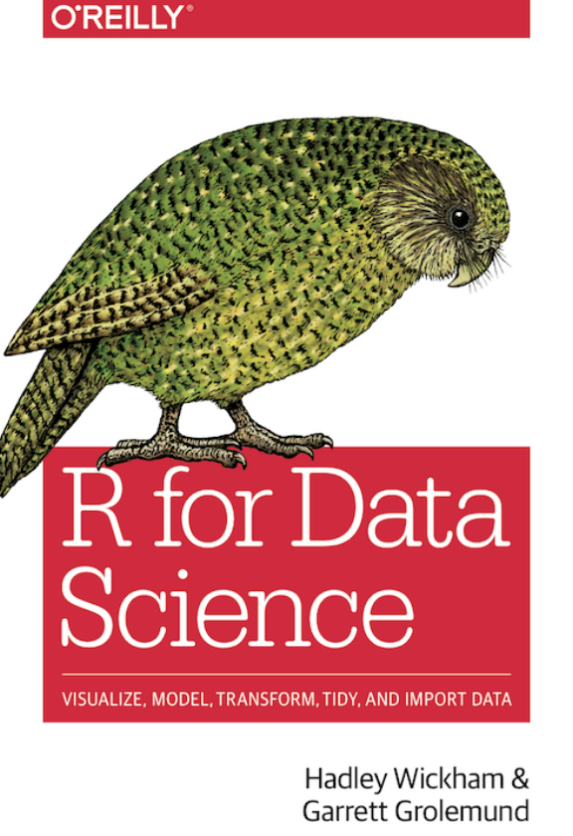
Additional resources
Excellent resource for lots of additional information on programming in R…
…and it’s free…
http://r4ds.had.co.nz/

Slide 15
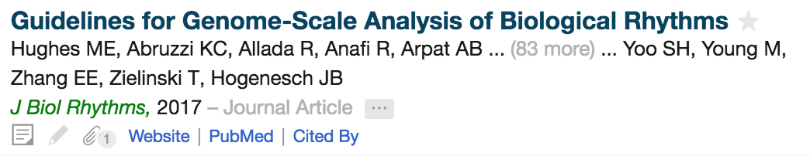
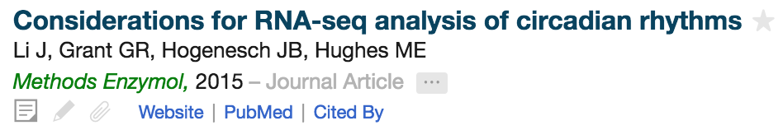
Additional resources

