Slide 1
Skills Workshop: RNA-seq Analysis Part II (Gene Set Enrichment Analysis)
10.06.2021
Gang Wu

Slide 2
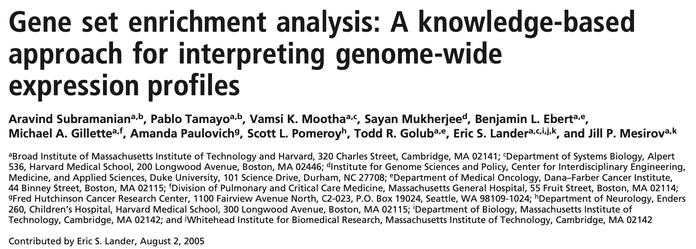
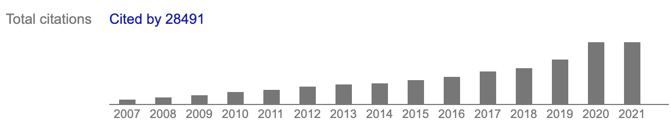
~4500
~1000

Slide 3
Issues addressed by GSEA
Limitations when using a cut-off (e.g, FDR, fold change)
After correcting for multiple hypothesis testing, no individual gene may meet the statistical significance cut-off
A long list of statistically significant genes without any unifying biological theme
Single-gene analysis may miss important effects at pathway level
increase of 20% in all genes in a pathway V.S. a 20-fold increase in a single gene
Little overlap among significant genes from different research groups

Slide 4
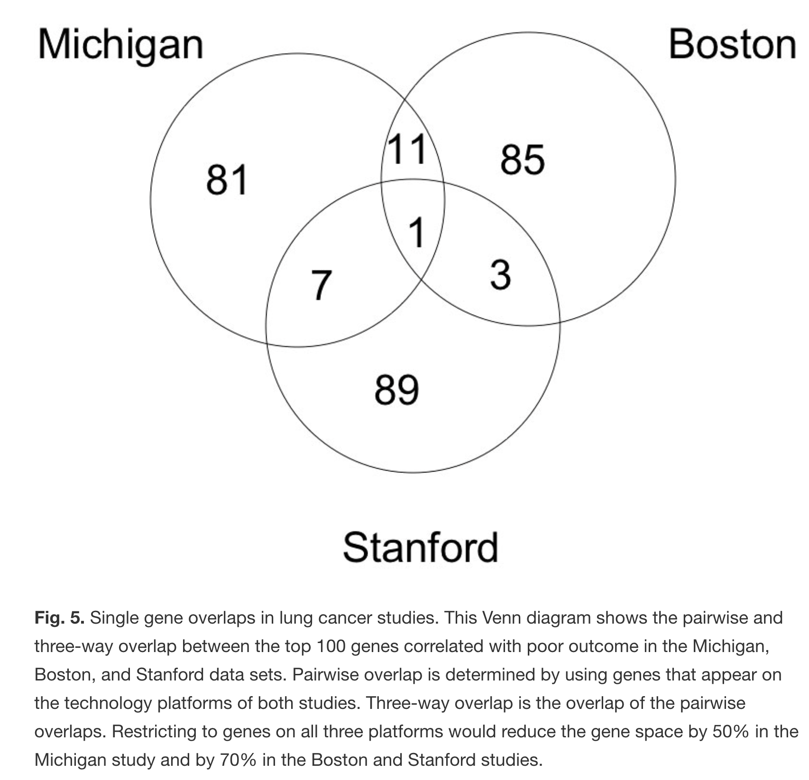
Only one gene overlapped among three groups

Slide 5
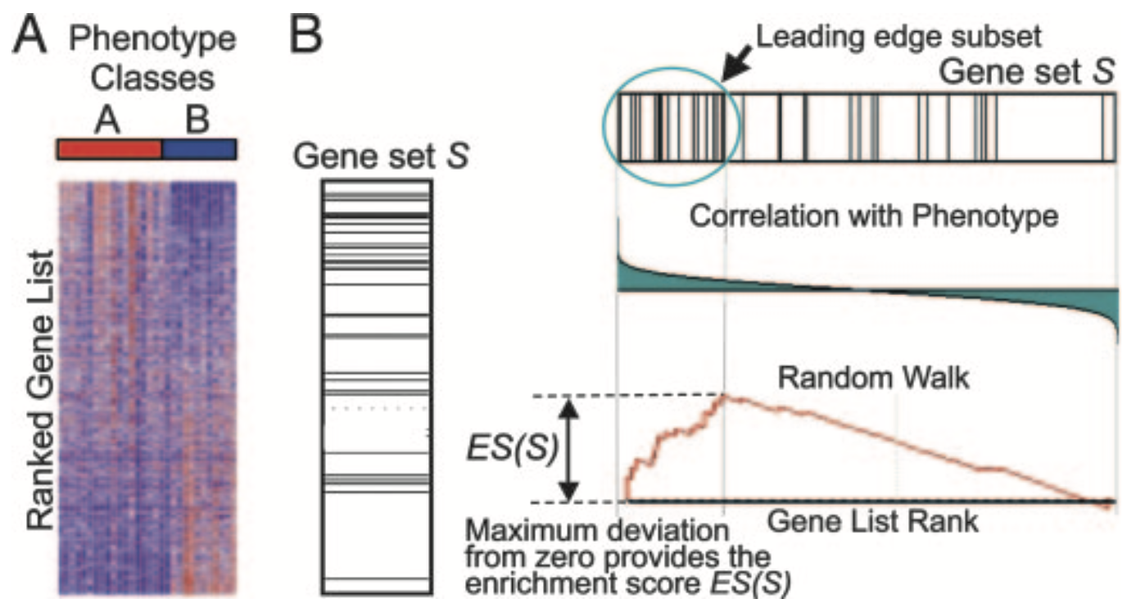
A GSEA overview illustrating the method
Normalized enrichment score (NES): normalize the ES for each gene set to account for the size of the set. The normalized enrichment scores (NES) can be used to compare analysis results across gene sets.

Slide 6
How to run GSEA
User guide for GSEA
https://www.gsea-msigdb.org/gsea/doc/GSEAUserGuideFrame.html
Ways of running GSEA
a platform-independent desktop application with a graphical user interface (https://www.gsea-msigdb.org/gsea/downloads.jsp)
GSEA analyses can be run on the command line as described in Running GSEA from the Command Line. You can download a .zip file with this version of GSEA from the Downloads page.
R packages
GSEA_R (https://github.com/GSEA-MSigDB/GSEA_R)
fgsea (http://bioconductor.org/packages/release/bioc/html/fgsea.html)
“A future web-based GSEA server to allow users to run their own analysis directly on the web site.”
runGSEA (https://github.com/gangwug/runGSEA)

Slide 7
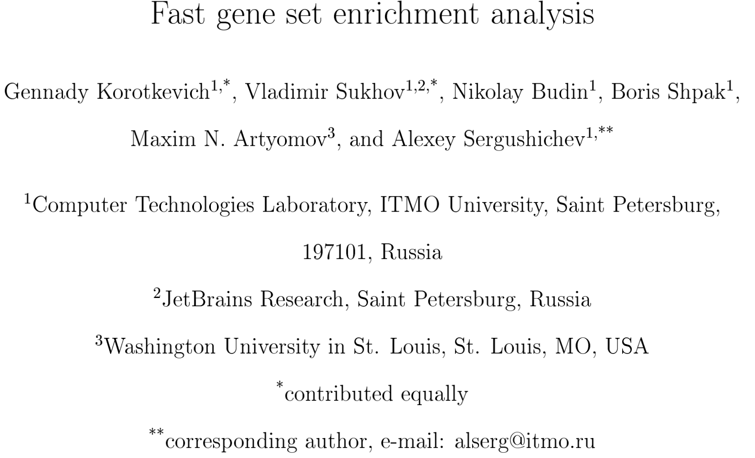
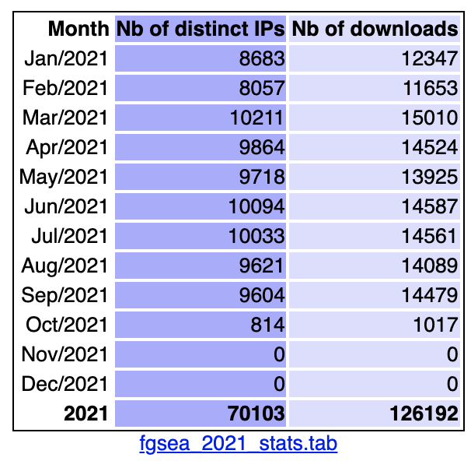
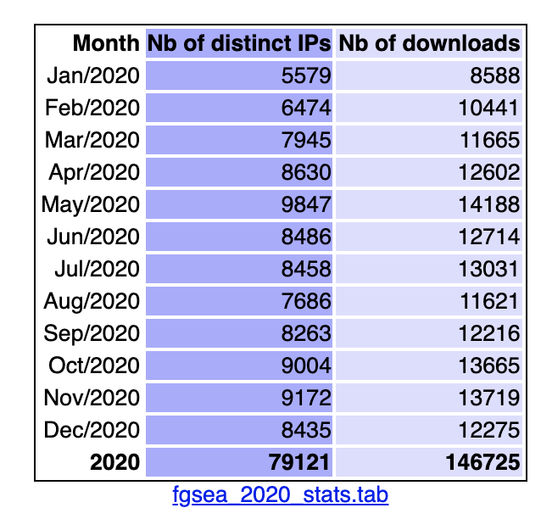
Fast gene set enrichment analysis (fgsea)

Slide 8
Issues addressed by fgsea
Issues caused by permutation test in GSEA
Slow
Can not accurately estimate small p-values
Limited sensitivity due to multiple hypothesis correction procedure
FDR < 0.25 used in the original PNAS paper
More and more gene sets are available in public database

Slide 9
Demo time of runGSEA
Step 1
Take a look at the example files
Step 2
Run the app
Step 3
Discuss the output file
Step 4
Q&A

Slide 10
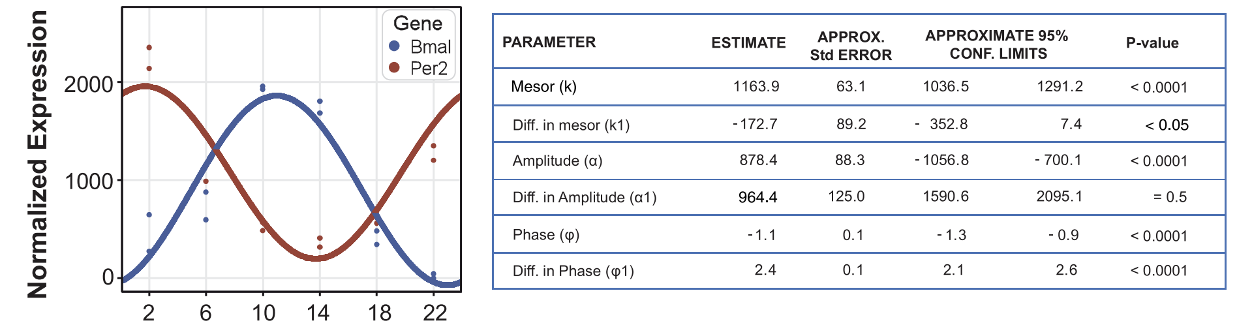
About MetaCycle
Great demo files in the 2018 workshop lead by Marc
(https://github.com/gangwug/SRBR_SMTSARworkshop2018)
About CircaCompare
(https://cran.r-project.org/web/packages/circacompare/vignettes/circacompare-vignette.html)
Parsons P et al., Bioinformatics, 2020

