Slide 1


CMR TECHNICAL CAMPUS UGC (Autonomous) Kandlakoya, Medchal Road, Hyd-501 401 Department of Electronics & Communication Engineering Real Time Project Review ANTI-SLEEP ALARM
BATCH NO : 12
Project Guide :
Name: Ms. P. Santhuja
Designation: Assistant Professor
Project Coordinator :
Name: Mr. G. Pavan Kumar
Designation: Assistant Professor
ROLL NUMBERS :
227R1A05A1-M.Ganesh
227R1A0583-G.Poorna Sekhar
227R1A0589-J.Anand

Slide 2
CONTENTS
Abstract
Introduction
Literature Survey
Proposed Technology
Implementation and Architecture
Results and Discussion
Conclusion and Future Scope
Reference

Slide 3
ABSTRACT
This abstract introduces the concept of an anti-sleep alarm system designed using IoT technology. It highlights the innovation and practical application of IoT in enhancing safety and alertness, particularly in contexts where drowsiness can pose risks. The project aims to address the critical need for effective alert systems to prevent accidents caused by driver fatigue or sleepiness.

Slide 4
INTRODUCTION
In today's fast-paced world, where efficiency and safety are paramount, the issue of drowsiness and its potential consequences cannot be overlooked. The development of an anti-sleep alarm using IoT (Internet of Things) technology represents a significant advancement in addressing this challenge. This introduction sets the stage for exploring how IoT can be leveraged to create a proactive solution that enhances alertness and prevents accidents caused by sleep deprivation or fatigue.

Slide 5
LITERATURE SURVEY
S.No. | Name of Author | Title of the paper | International journal/ conference | Volume No. | Issue | ISBN/ ISSN | Indexing
1. | Prashant J. Mahajan; Kalyani V. Pagare | PIR Based Automatic Fever Testing | International Journal of Electronics Engineering Research.(IRJET) | 07 | 04 , Apr 2020 | e-ISSN: 2395-0056 p-ISSN: 2395-0072 | 1345-1347
2. | Akshay Sharma A S | Review on Automatic Sanitizer Dispensing Machine | International Journal of Electronics Engineering Research.(IRJET) | 09 | 07, July-2020 | ISSN: 2278-0181 | 725-726
3. | Pooja Ajmera | Infrared Sensor | International Journal of Electronics Engineering Research.(IRJET) | 05 | 05,May-2019 | e-ISSN: 2581-0181 p-ISSN: 1559-1577

Slide 6
PROPOSED METHODOLOGY
The proposed system is an anti-sleep alarm utilizing IoT technology to monitor and detect signs of drowsiness in real-time. By integrating sensors such as eye-tracking cameras or wearables that measure physiological signals like heart rate variability and facial expressions, the system continuously assesses the user's alertness levels. Upon detecting potential drowsiness, it triggers timely alerts through audiovisual cues or vibrations to awaken the user, thereby preventing accidents caused by impaired vigilance. This proactive approach not only enhances safety but also promotes awareness and responsiveness in critical situations.

Slide 7
IMPLEMENTATION
Eye Blink Sensor Integration: Integrate an eye blink sensor onto a wearable device or within a vehicle dashboard to monitor eyelid movements.
Data Processing: Process signals from the eye blink sensor to detect patterns indicating drowsiness, such as prolonged eyelid closures or irregular blinking.
Alert Mechanism: Connect a vibrator module to the wearable device. Configure it to activate upon detecting signs of drowsiness, providing tactile feedback to alert the user.
Power Unit: Ensure the system is powered by a reliable power source, such as a rechargeable battery or vehicle power supply, to sustain continuous operation.

Slide 8
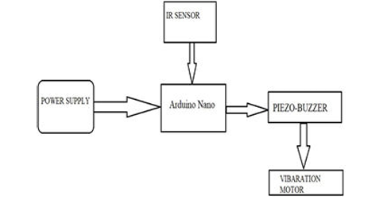
ARCHITECTURE

Slide 9
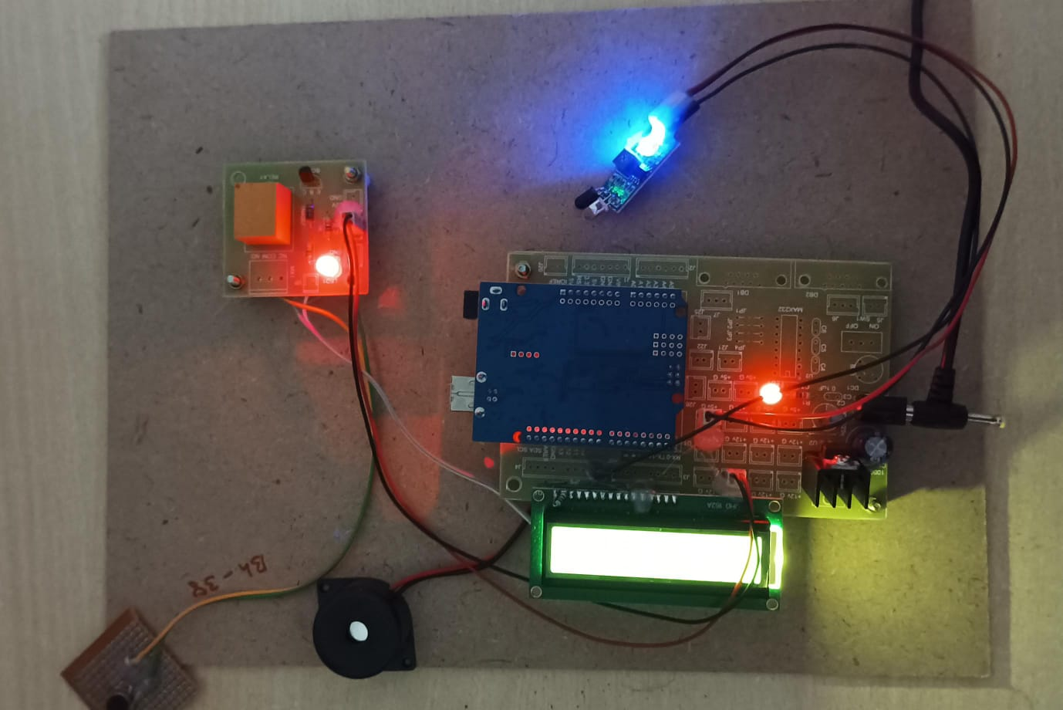
RESULTS & DISCUSSION

Slide 10
CONCLUSION AND FUTURE SCOPE
The implementation of an anti-sleep alarm system using an eye blink sensor, vibrator, and power unit offers a practical solution to mitigate the risks associated with drowsiness. By monitoring eye movements and providing timely tactile alerts, this system enhances user awareness and prevents potential accidents due to impaired vigilance.
The future scope for the anti-sleep alarm system is promising, with potential advancements in technology and applications that could significantly enhance safety, health monitoring, and user experience in various domains.

Slide 11
REFERENCES
Prashant J. Mahajan; Kalyani V. Pagare, “PIR based automatic fever testing”, International Research Journal of Engineering and Technology(IRJET),vol-07,issue no-04,pp.1345-1347,2020.
Pooja Ajmera, “INFRARED SENSOR” , International Research Journal of Engineering and Technology(IRJET), ISSN: 2278-0181 vol-05,issue no-23,1559-1557.
Hanzhong, “DESIGN OFA NON-CONTACT INFRARED THERMOMETER”, International Research Journal of Engineering and Technology(IRJET),ISSN: 2581-0181 vol-08,issue no-13,1859-183
Rohit Ramagade , Uday Thak, Harshad pidurkar, Lokesh Kathale; ”INNOVATIVE TECHNOLOGIES FOR TEMPERATURE MEASUREMENT OF AERO ENGINE COMPONENT”, International Research Journal of Engineering and Technology(IRJET), ISSN: 2395-0056 vol-05,issue no-23, 2395-0072
Akshay Sharma A S, “ Review on Automatic Sanitizer Dispensing Machine”, International Research Journal of Engineering and Technology(IRJET),vol-09,issue no-07,pp.725-726,2020.

Slide 12
Q&A

Slide 13
THANK YOU

