Slide 1
Advertisement
TEAM NAME:
PIKACHU
TEAM MEMBERS:
MD USMAN GANI SYED (LabId: 3-1)
MADHUKAR REDDY VURADI (LabId: 3-1)
CHAITANYA SAILESH TONDEPU (LabId: 3-2)
SAI KRISHNA TEJA KUNISETTY (LabId: 3-2)

Slide 2
WWW of our Project
Who am I?
I am a simple web application built on Augumented Reality
What can I do?
I can scan the surrounding areas
Detect objects
Give suggestions on what to buy based on objects detected
Why am I?
I will ease your process of online purchase

Slide 3
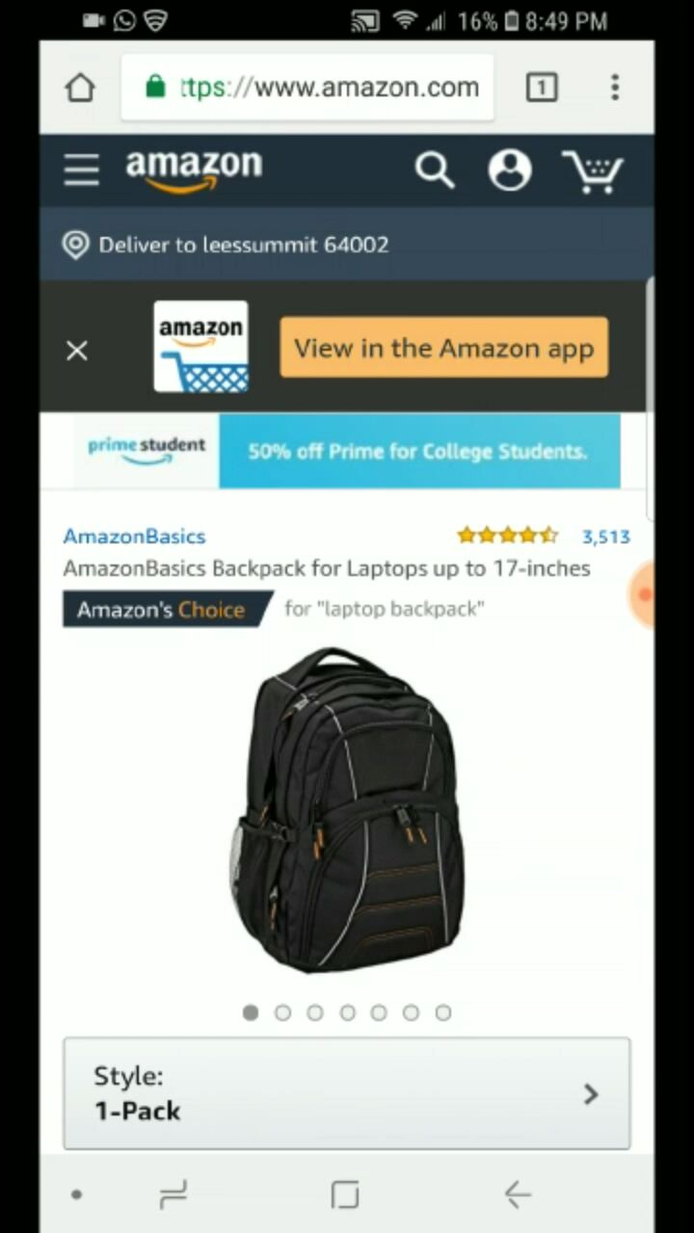
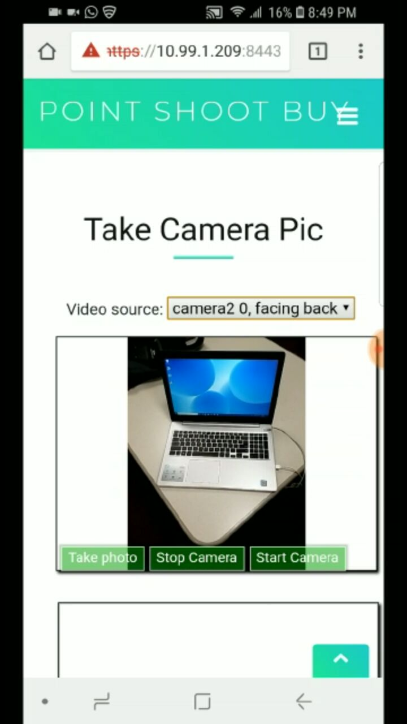
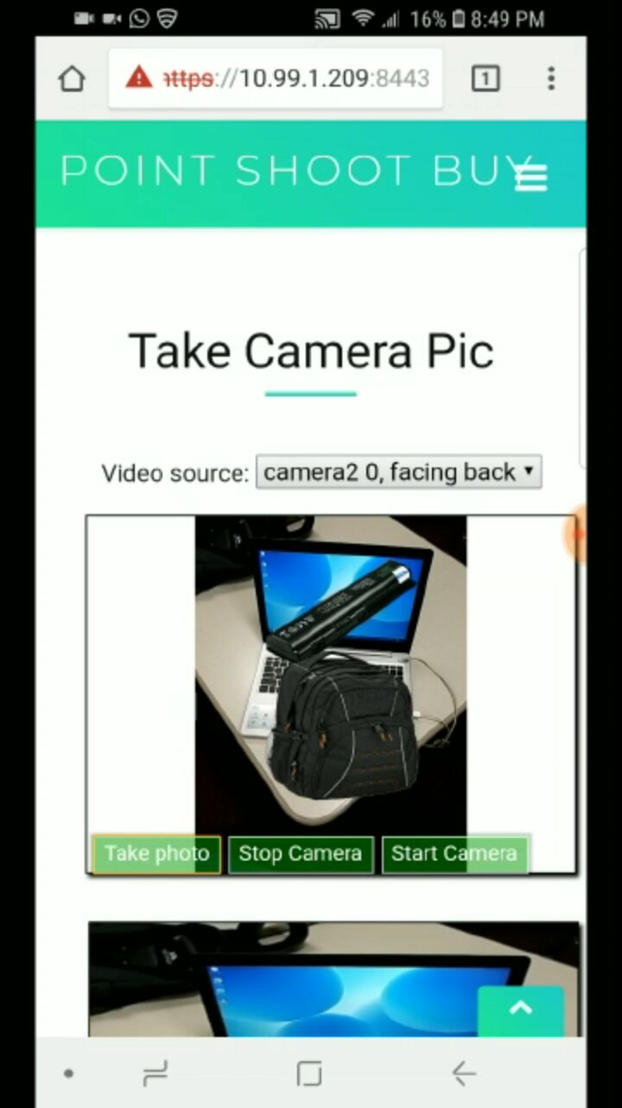
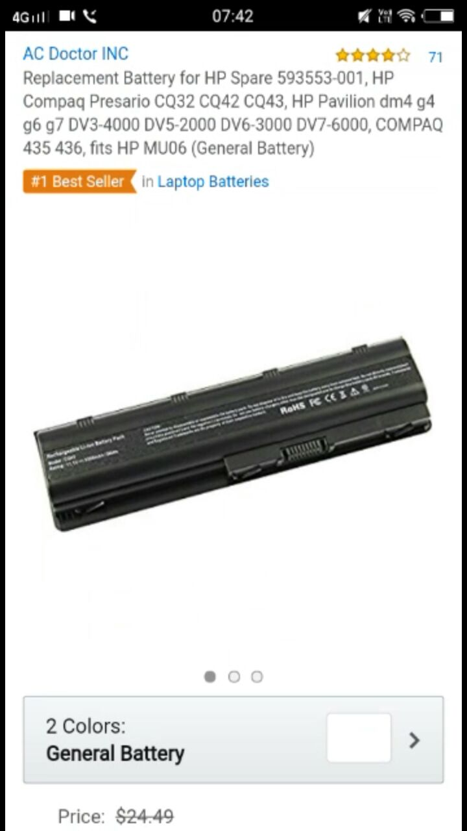

Slide 4
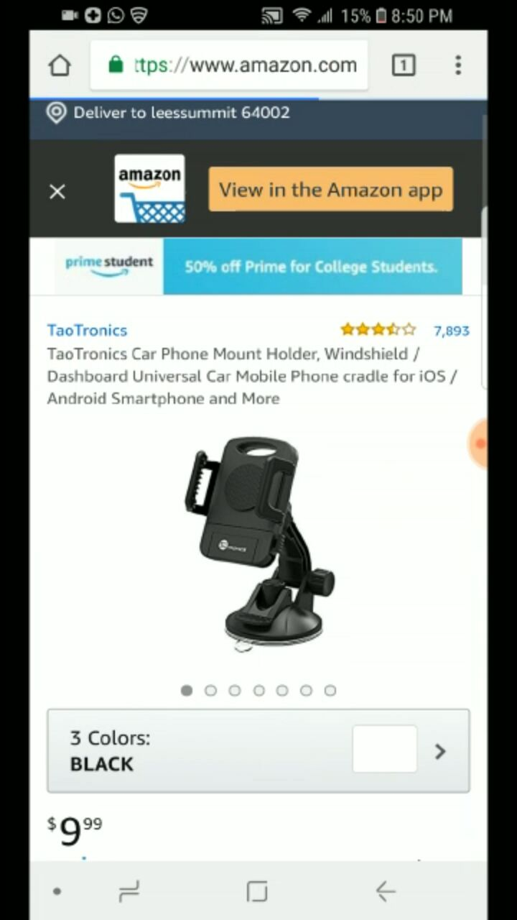
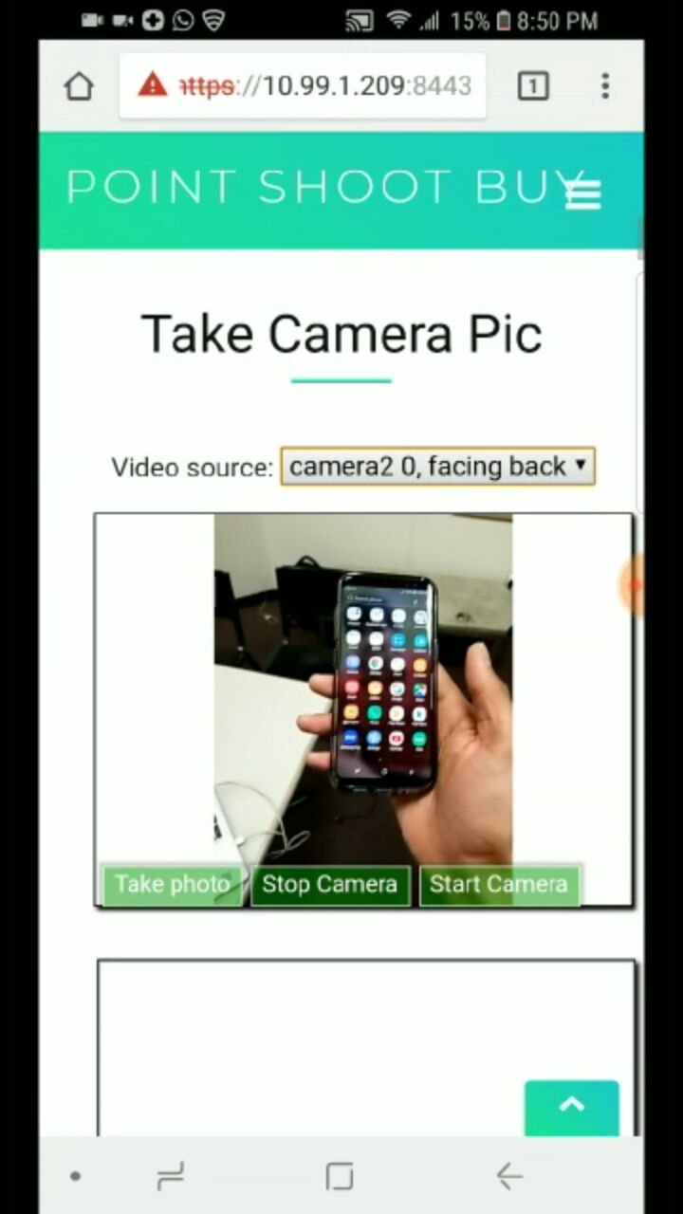
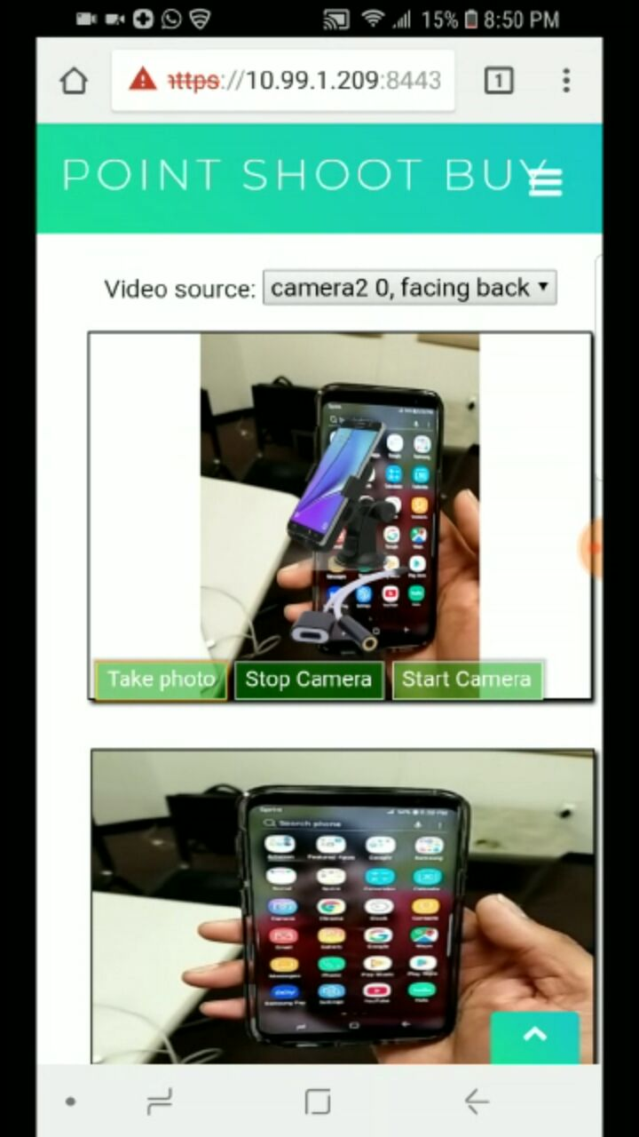
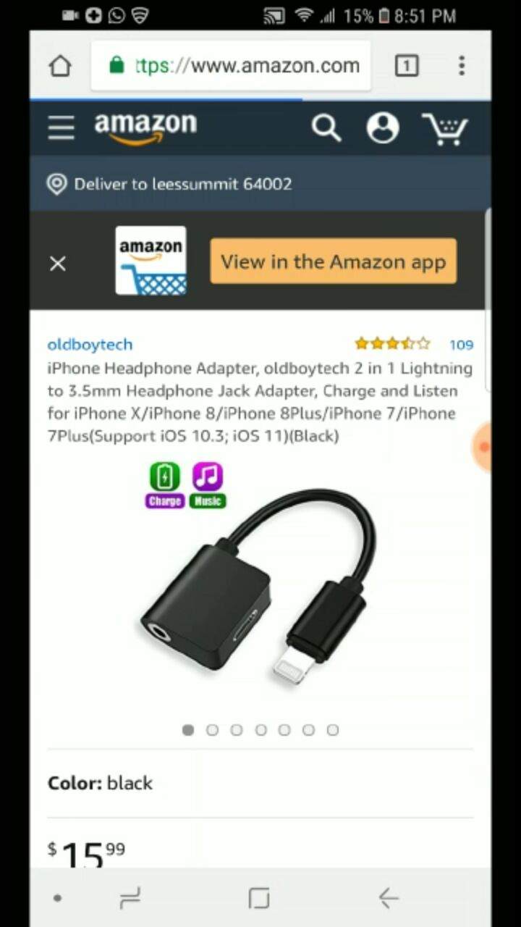

Slide 5
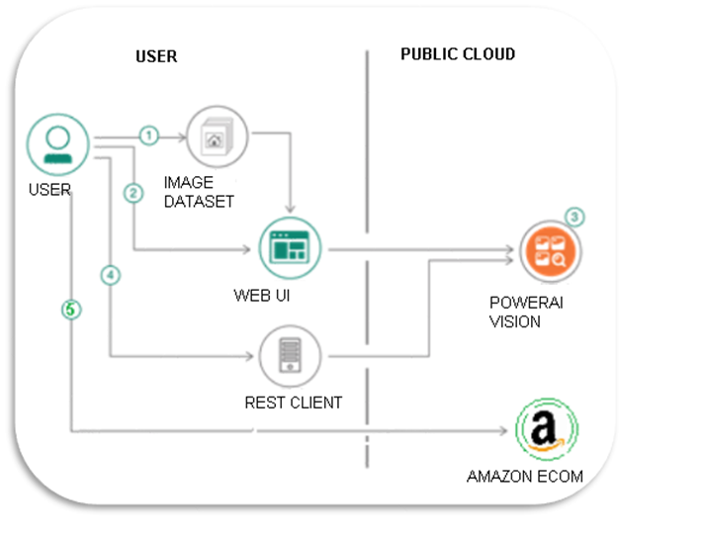
Architecture

Slide 6
Technologies Used
HTML
CSS
JS, NodeJs
IBM cloud vision Object detection

Slide 7
Limitation
Currently limited to detect only two objects.
The more training we give, the more number of objects we can detect.

Slide 8
VIDEO DEMO

