Slide 1
What will we learn
Grammar of Graphics
Plotting Systems in R
What is ggplot2?
Bar Plot
Pie Chart
Box-Whisker Plot
Histogram

Slide 2
About Data Visualization
What is Data Visualisation?
It is the visual representation of data generally in the form of graphs and plots
Why is it important? It enables us to
See the data and get insights in one glance
Allows us to grasp difficult/ complex data in an easy manner
Helps us to identify patterns or trends easily

Slide 3
Principles of Visualization
Show distribution (overall and by groups)
Show correlation and causality
Show multivariate data; real world is complex
Integration of evidence
Describe and document evidence with appropriate labels, sources, scales, etc.
Content is King

Slide 4
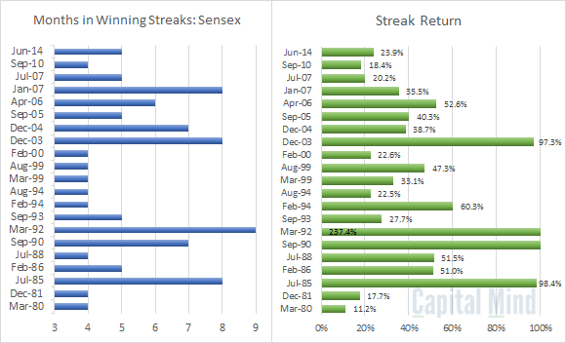
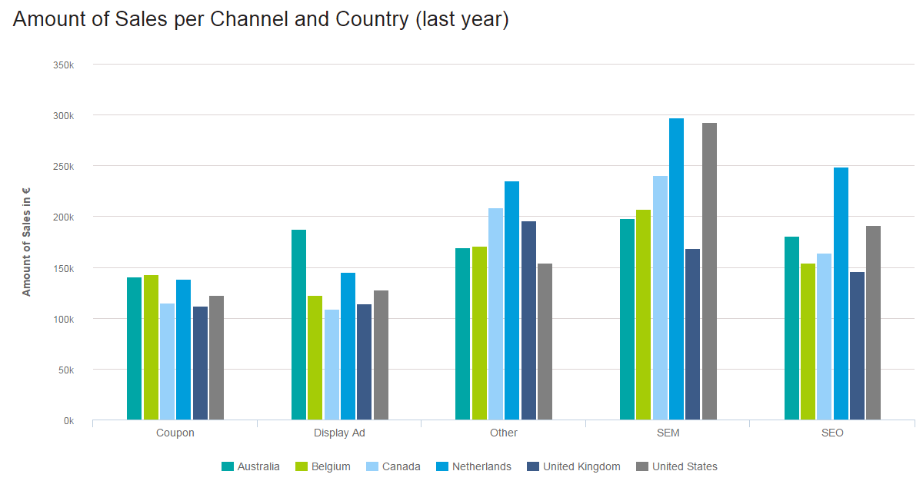
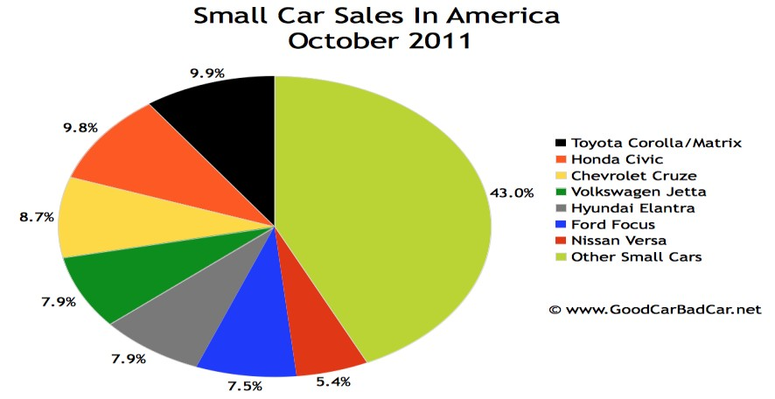
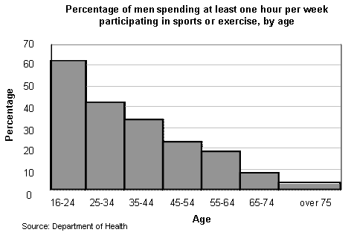
Application Areas
Sensex Charts
Sales Charts
Sales Charts
Survey Results

Slide 5
What is ggplot2?
An implementation of Grammar of Graphics by Leland Wilkinson
Written by Hadley Wickham (while he was a graduate student of
Iowa State)
A “third” graphics system for R (along with Base and Lattice)
Available from CRAN via
install.packages("ggplot2")
library(ggplot2)
Website: http://ggplot2.org (better documentation)
# R base package and lattice package also provide rich
graphics
6

Slide 6
What is ggplot2?
Grammar of Graphics represents an abstraction of graphics ideas/objects
Think “verb”, “noun”, “adjective” for graphics
Allows for a “theory” of graphics on which to build new
graphics and graphics objects
Shorten the distance from mind to page
Plots are made up of aesthetics (size, shape, color) and geoms
(points, lines)

Slide 7
Import Telecom Data Sets
#Import two data Sets
demographic<-read.csv(file.choose(), header=TRUE) head(demographic)
transaction<-read.csv(file.choose(), header=TRUE) head(transaction)

Slide 8
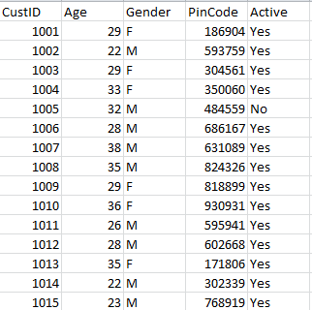
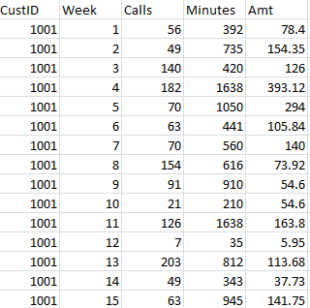
Data Snapshots
demographic
transaction

Slide 9
Aggregate and Merge
#Aggregating and Merging
tcalls<-aggregate(Calls~CustID, data=transaction, FUN=sum)
head(tcalls)
working<-merge(demographic, tcalls, by=("CustID"), all=TRUE)
head(working)
working$age_group<-cut(working$Age,
breaks=c(0,30,45,Inf), labels=c("18-30","30-45",">45"))
head(working)

Slide 10
Simple Bar Chart
A Bar Chart is the simplest and basic form of graph.
In this graph, for each data item, we simply draw a ‘bar’ showing
its value
Simple Bar Chart: It is a type of chart which shows the values of different categories of data as rectangular bars with different lengths.
The values are generally :
Frequency
Mean
Totals
Percentages

Slide 11
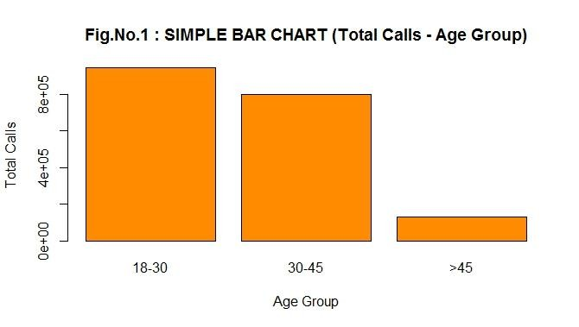
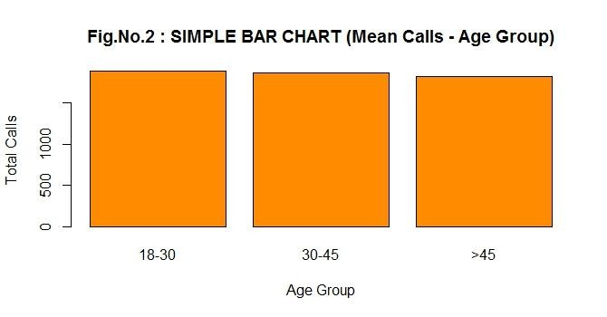
Simple Bar Chart..
This graph simply gives the distribution of the total number of calls across different age groups.
By plotting the average calls we can see that, though there is quite a difference in total calls in each age group, the average number of calls across age groups is similar

Slide 12
Simple Bar Chart..
#Bar chart showing age groups on x axis and total calls on y axis
ggplot(working,aes(x=age_group,y=Calls))+
geom_bar(stat="identity",fill="green")+
labs(x="Age Groups",y="Total Calls",title="Bar Diagram")
ggplot() | is a function in ggplot2 which yields a different types of plots
working | specifies the data to be used
aes() | specifies the variables to be used on each axis
geom_bar() | is used to call shapes and colors
stat=“identity” | using the height of the bar will represent the values in a column of the data frame
labs() | can be used to label the various features of the graph

Slide 13
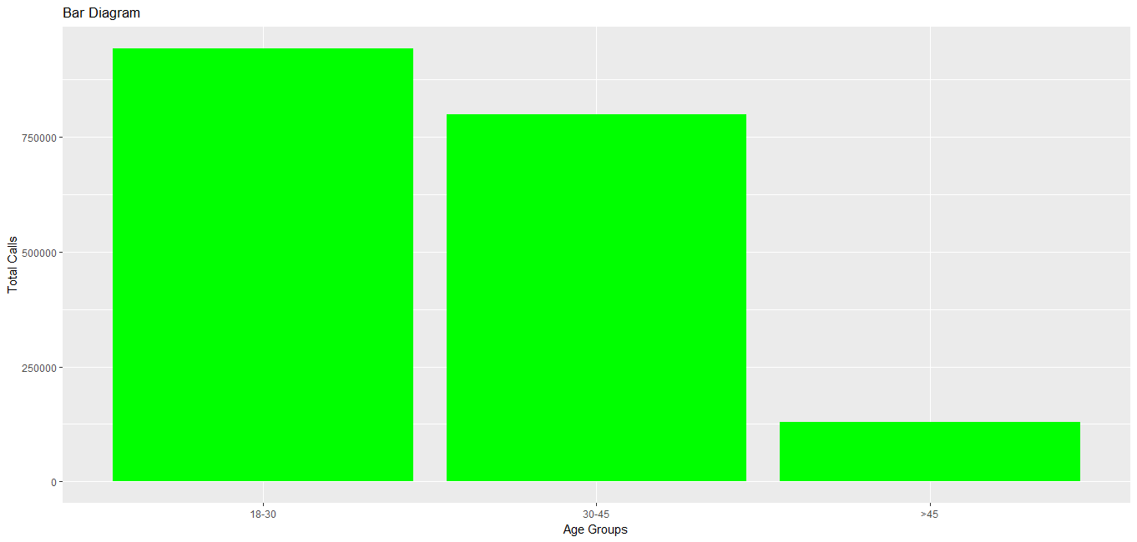
Simple Bar Chart R Output
#Bar chart showing total calls for customers in each age group

Slide 14
Simple Bar Chart Change Order of the Bars
# Order bars as per value
ggplot(working,aes(reorder(age_group,Calls),Calls))+
geom_bar(stat="identity",fill="green")+
labs(x="Age Groups",y="Total Calls", title="Bar Diagram”)
#reorder() orders levels of a factor variable (First argument) by
values of a second variable, usually numeric (Second argument)

Slide 15
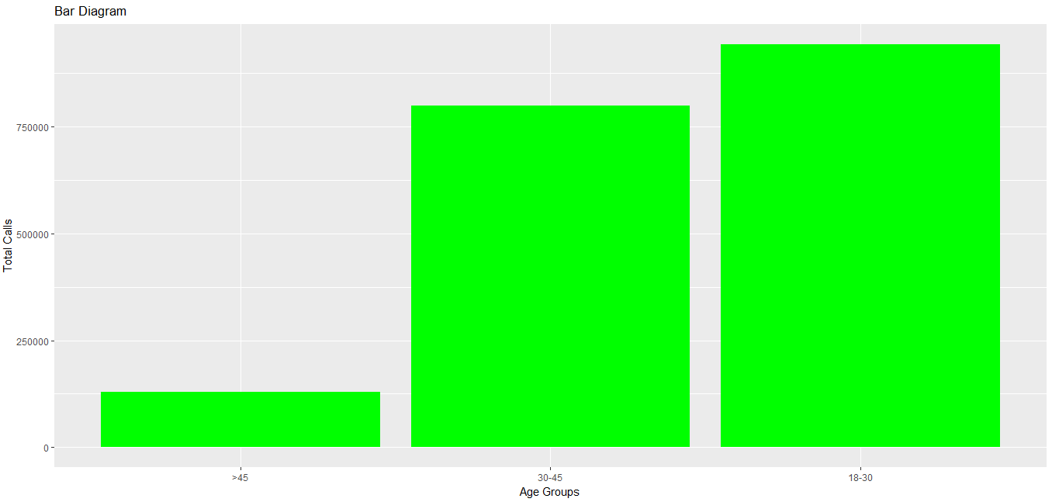

Simple Bar Chart Change Order of the Bars
R Output
#Bar chart (ordered by value)

Slide 16
Simple Bar Chart Some modifications
# Replace Age Groups by Gender and use maroon color
ggplot(working,aes(x=Gender,y=Calls))+ geom_bar(stat="identity",fill="maroon")+ labs(x="Gender",y="Total Calls",title="Bar Diagram")
#Note the format of writing the commands. It is intuitive by
adding a single part to the graph each time with a “+” sign

Slide 17
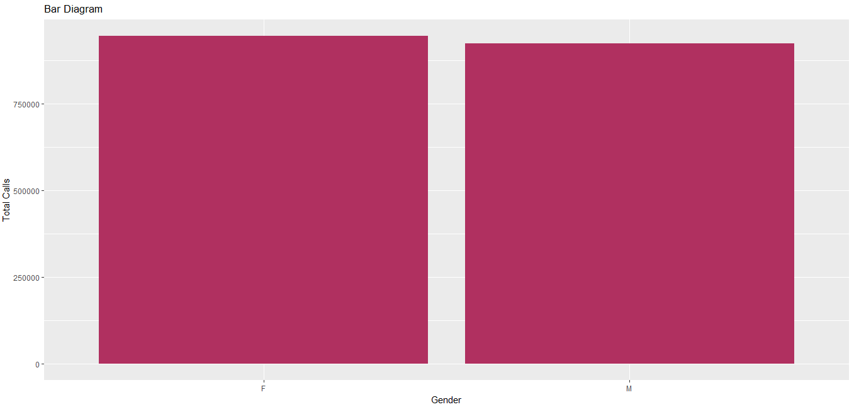
Simple Bar Chart Some modifications R Output
#Bar chart showing total calls for Males and Females (and maroon color)

Slide 18
Simple Bar Chart Horizontal View
#Make bar graph horizontally oriented
ggplot(working,aes(x=age_group,y=Calls))+
geom_bar(stat="identity",fill="orange")+
labs(x="Age Groups",y="Total Calls",title="Bar Diagram")+ coord_flip()
# coord_flip makes bar graph horizontal

Slide 19
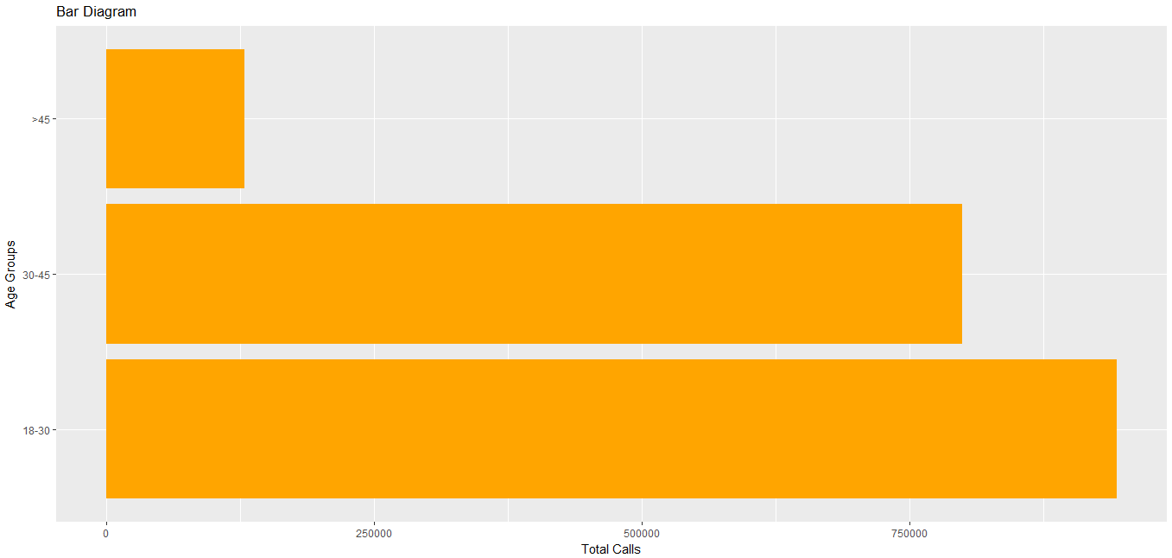
Simple Bar Chart Horizontal View R Output
#Horizontal Bar Plot by Age Group

Slide 20
Simple Bar Chart Modify horizontal view
#Obtain horizontal Bar chart with Gender on x axis
ggplot(working,aes(x=Gender,y=Calls))+ geom_bar(stat="identity",fill="seagreen")+ labs(x="Gender",y="Total Calls",title="Bar Diagram")+ coord_flip()

Slide 21
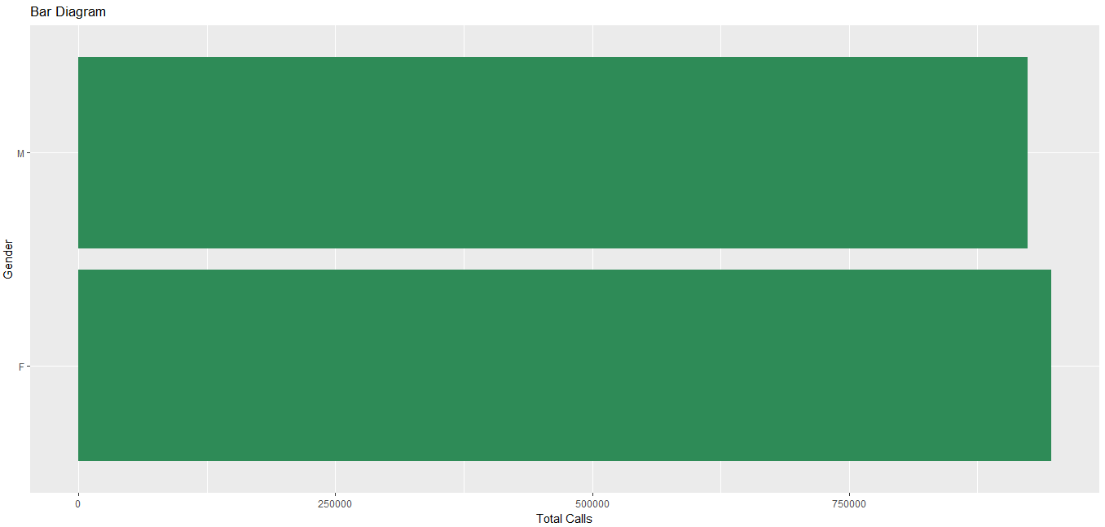
Simple Bar Chart Modify horizontal view R Output
#Horizontal Bar chart with Gender on x axis

Slide 22
Simple Bar Chart Show Text
#Obtain bar chart showing average ‘total calls’ by Gender and
print values on the chart
avgcalls<-
aggregate(Calls~Gender,data=working,FUN=mean)
ggplot(avgcalls,aes(x=Gender,y=Calls))+ geom_bar(stat="identity",fill="darkblue")+ geom_text(aes(label=Calls), vjust=-0.5, colour="black",
size=4)+
labs(x="Gender",y="Average Calls",
title="Bar Diagram with Text")
# geom_text adds labels to the chart
23

Slide 23
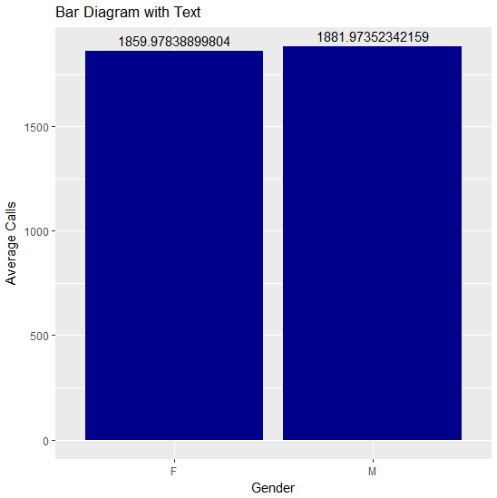
Simple Bar Chart Show Text R Output
#Average ‘total calls’ by Gender

Slide 24
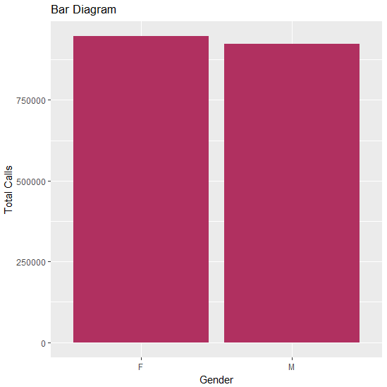
Simple Bar Chart
#Total calls v/s Average ‘total calls’ by Gender

Slide 25
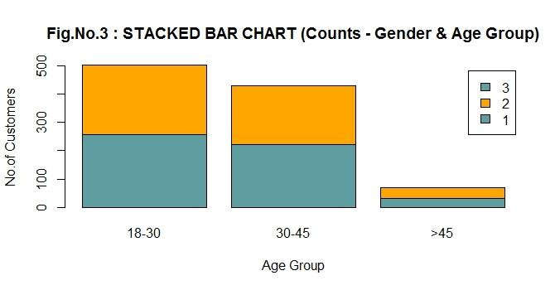
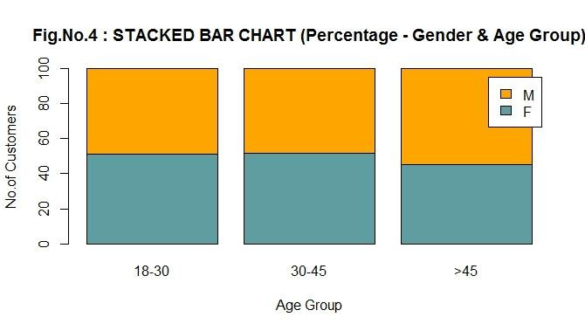
Stacked Bar Chart
Sub Divided or Stacked Bar Chart: It further divides the bar into different categories within the variable.
This graph further divides the number of customers in each age group by Gender. However, this graph has absolute counts and is difficult to compare the gender wise distribution across the Age Groups.
Plotting a percentage stacked graph makes it efficient to compare the gender wise distribution

Slide 26
Stacked Bar Chart..
#Stack the plot with Gender
ggplot(working, aes(x=age_group))+
geom_bar(aes(fill=Gender))+
labs(x="Age Group", y="No. of customers", title="Stacked bar chart")
#Normalized Bars
Add position=“fill” to geom_bar() to produce stacked bar with
normalized height
geom_bar(aes(fill=Gender),position=“fill”)

Slide 27
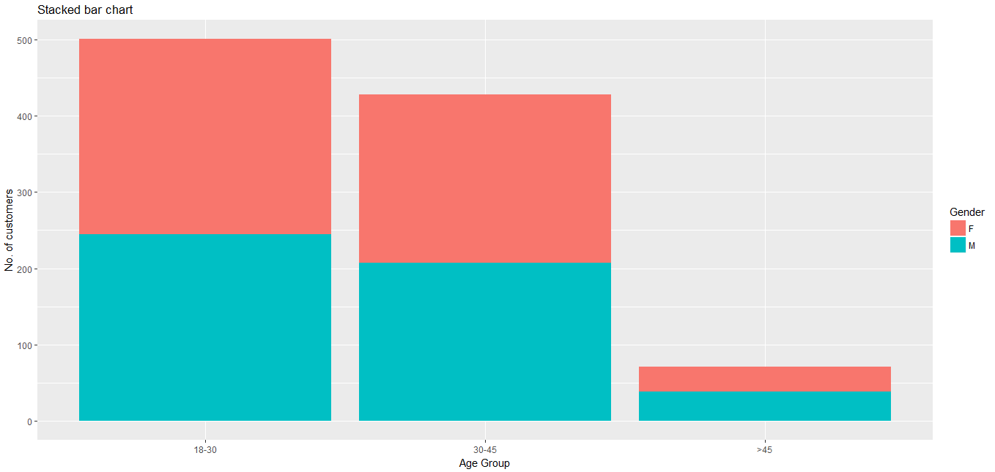
Stacked Bar Chart R Output
#Stack the plot with Gender

Slide 28
Stacked Bar Chart Some modifications
#Stack the plot with Gender and Add your colours
ggplot(working, aes(x=age_group))+
geom_bar(aes(fill=Gender))+
labs(x="Age Group", y="No. of customers", title="Stacked bar chart")+
scale_fill_manual(values=c("red","green"))
#Change size and style of the plot title, add (with a ‘+’ sign):
theme(plot.title = element_text(size = 20, face = "bold"))

Slide 29
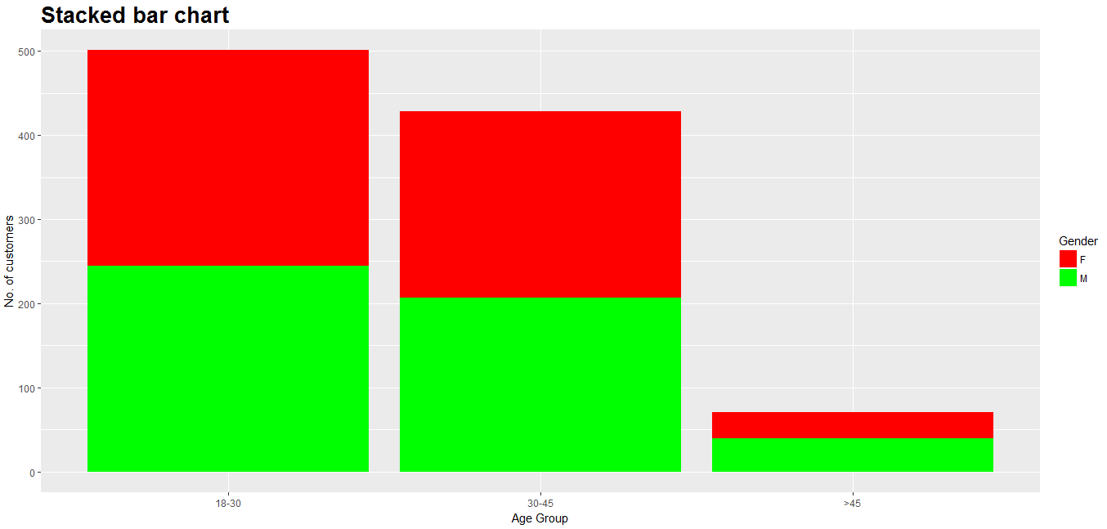
Stacked Bar Chart R Output
#Stack the plot with Gender and Add your colours and customise title size and style

Slide 30
Stacked Bar Chart Horizontal View
#Try with flipping the coordinate and stacking with age group on Gender
ggplot(working, aes(x=Gender))+
geom_bar(aes(fill=age_group))+
labs(x="Age Group", y="No. of customers", title="Stacked bar chart")+
coord_flip()

Slide 31
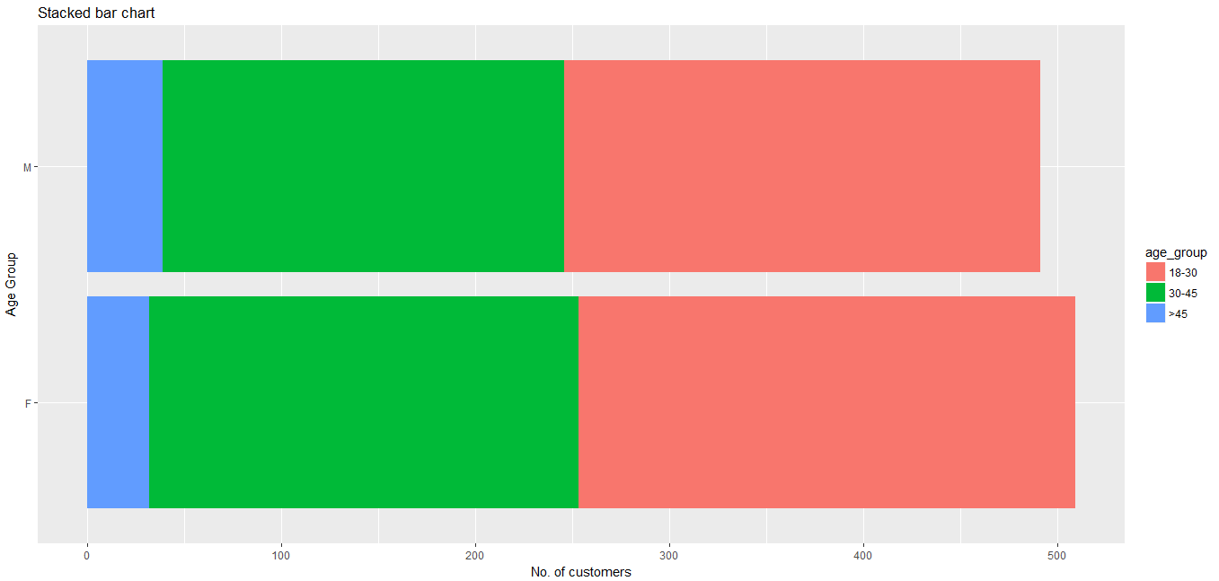
Stacked Bar Chart Horizontal View R Output
#Try with flipping the coordinate and stacking with age group on Gender(R code next slide)

Slide 32
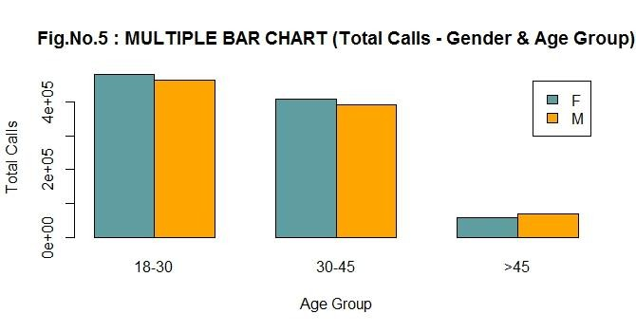
Multiple Bar Chart
Multiple or Grouped Bar Chart: It divides the bar into different categories within the variable and places it one besides the other. By multiple bars diagram two or more sets of inter-related data are represented.
This bar chart can be used when we wish to see the gender-wise distribution of number of calls across age groups and the total number of calls in age group is not a very important objective

Slide 33
Multiple Bar Chart
#Multiple bars, side by side
ggplot(working, aes(x=age_group))+
geom_bar(aes(fill=Gender), position="dodge")+
labs(x="Age Group", y="No. of customers", title="Multiple bar chart")

Slide 34
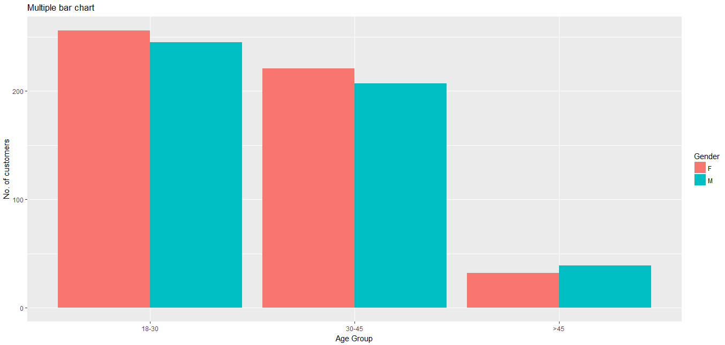
Multiple Bar Chart R Output
#Multiple bars, side by side

Slide 35
Multiple Bar Chart Reordering Bars
#Levels of a factor variable
levels(working$age_group)
[1] "18-30" "30-45" ">45"
ggplot(working, aes(x=factor(working$age_group,levels=sort(unique(workin g$age_group),decreasing=TRUE)), fill=Gender))+
geom_bar(position="dodge")+
labs(x="Age Group", y="No. of customers", title="Multiple
bar chart (Reordered)")

Slide 36
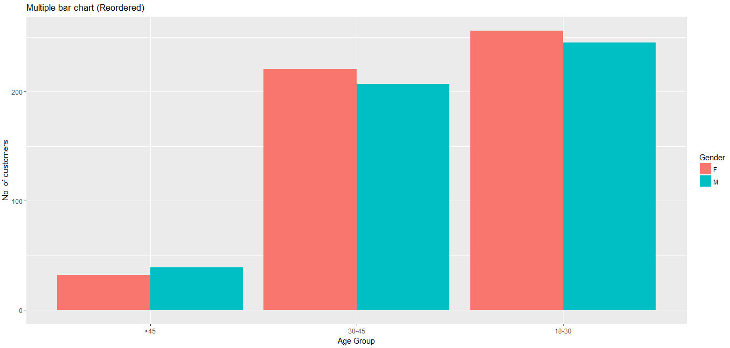
Multiple Bar Chart Reordering Bars R Output
#Multiple bars, age_group reordered

Slide 37
Multiple Bar Chart Horizontal View
#Try with total calls on y-axis and flipped coordinate
ggplot(working, aes(x=age_group,y=Calls))+ geom_bar(stat="identity",aes(fill=Gender), position="dodge")+
labs(x="Age Group", y="Total calls", title="Multiple bar chart")+
coord_flip()

Slide 38
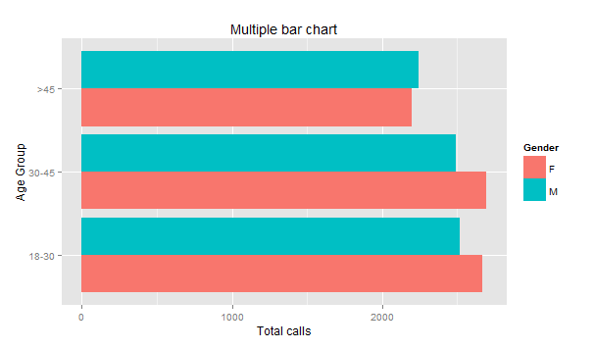
Multiple Bar Chart Horizontal View R Output
Try with total calls on y-axis and flipped coordinate(R code next slide)

Slide 39
Multiple Bar Chart
Changing ‘fill=‘ position
Another variation: 'fill=' is with ggplot() instead of geom_bar()
ggplot(working, aes(x=age_group,fill=Gender))+
geom_bar(position="dodge")+
labs(x="Age Group", y="No. of customers", title="Multiple bar chart")

Slide 40

Multiple Bar Chart
Changing ‘fill=‘ position
#Another variation: 'fill=' is with ggplot() instead of geom_bar()

Slide 41
Caution with ‘fill’
Caution: fill="blue" in geom_bar() overrides the fill=Gender in ggplot()
ggplot(working, aes(x=age_group,fill=Gender))+
geom_bar(position="dodge", fill="blue")+
labs(x="Age Group", y="No. of customers", title="Bar chart")

Slide 42
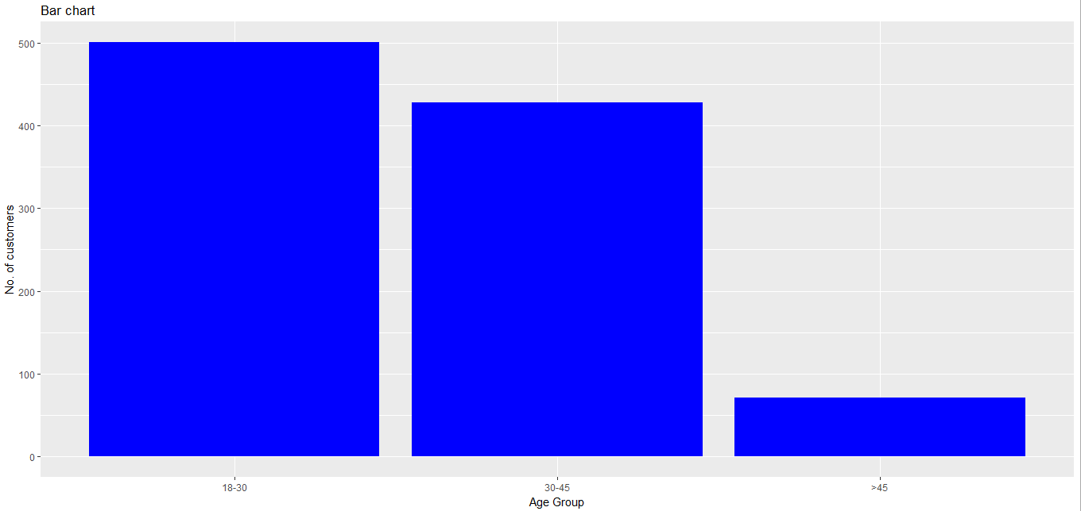
Caution with ‘fill’…
R Output
Caution: fill="blue" in geom_bar() overrides the fill=Gender in ggplot()

Slide 43
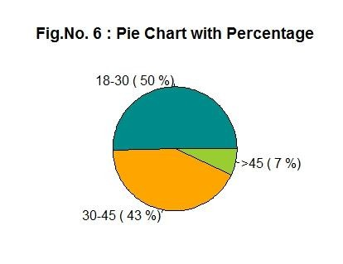
Pie Chart
Pie charts are generally used to show percentage or proportional data.
In this graph the entire circle (pie) is sliced proportional to the values of each category.

Slide 44
Pie Chart
#Pie Chart showing distribution of Age Group
ggplot(working, aes(x="", fill=age_group))+ geom_bar(width=1)+ coord_polar(theta="y", start=pi/3)+ labs(title="Pie chart", fill="Age Group")

Slide 45
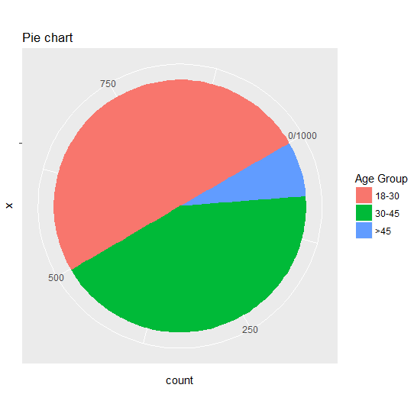
Pie Chart R Output
#Pie Chart for Age Group

Slide 46
Pie Chart Gender Distribution
#Pie Chart showing gender distribution
ggplot(working, aes(x=""))+ geom_bar(width=1,aes(fill=Gender))+ coord_polar(theta="y", start=pi/3)+ labs(title="Pie chart")

Slide 47
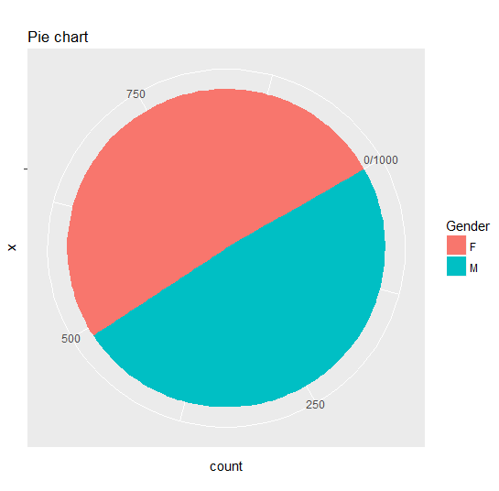
Pie Chart
Gender Distribution R Output
#Pie Chart showing gender distribution

Slide 48
Box Plot
Box and Whisker plot summarizes data graphically using 5 measures:
Minimum
The Three Quartiles : Q1, Q2 (i.e. Median) and Q3
Maximum.
Advantages of a Box Plot :
A boxplot is particularly effective when comparing two sets of data
It shows us the shape of the data

Slide 49
Box Plot
Describing a Box-Plot :
The rectangle (box) in the middle represents the middle 50% of the data (between the values that are ¼ and ¾ of the way through the data).
The lines (whiskers) extend from the box to the smallest and largest values.
The diagram also shows the middle value (i.e. The Median).
The outliers which are plotted outside the plot (The observations which are outside 1.5 times the interquartile range above the upper quartile and below the lower quartile)

Slide 50
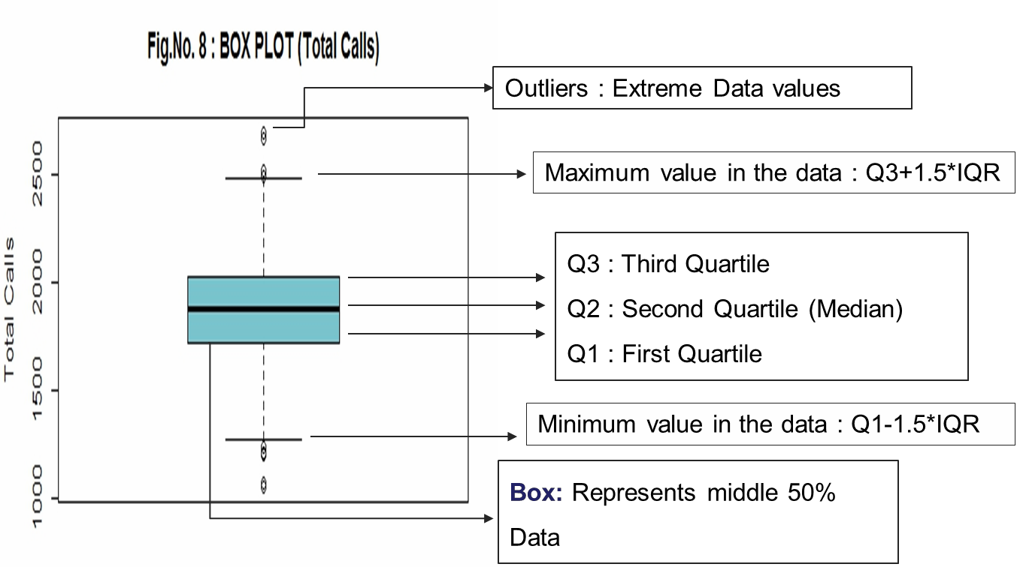
Box Plot
This plot shows that the distribution of total call is very much
symmetric
51

Slide 51
Box Plot
# Box plot for variable ‘Calls’
ggplot(working, aes(x="", y=Calls))+
geom_boxplot()+
labs( y="Total Calls", title="Boxplot")

Slide 52
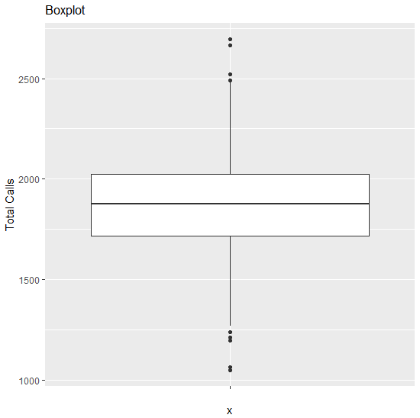
Box Plot R Output
# Box plot for variable ‘Calls’

Slide 53
Box Plot By Age Group
# Box plot by Age group
ggplot(working, aes(x=age_group, y=Calls))+
geom_boxplot()+
labs(x="Age Group", y="Total Calls", title="Boxplot")

Slide 54
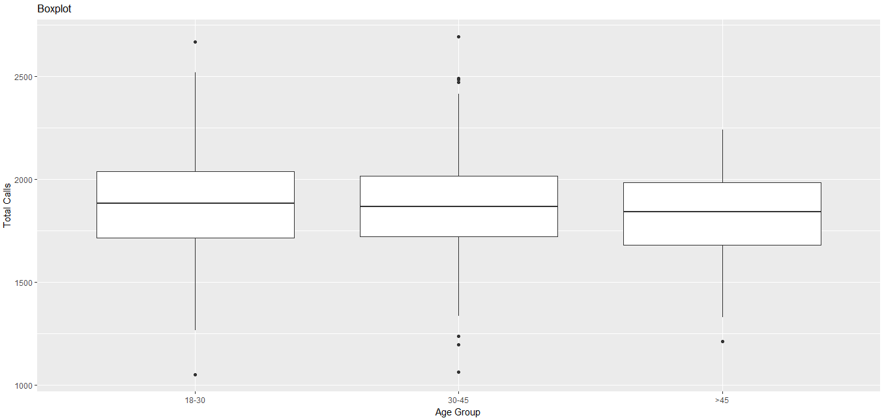
Box Plot
By Age Group R Output
# Box plot by Age group

Slide 55
Box Plot By Age Group Enhance the plot
#Box plot by Age group; colour the boxes & outlier
ggplot(working, aes(x=age_group, y=Calls))+ geom_boxplot(fill=5, outlier.colour="blue", outlier.size=2.5)+
labs(x="Age Group", y="Total Calls", title="Boxplot")

Slide 56
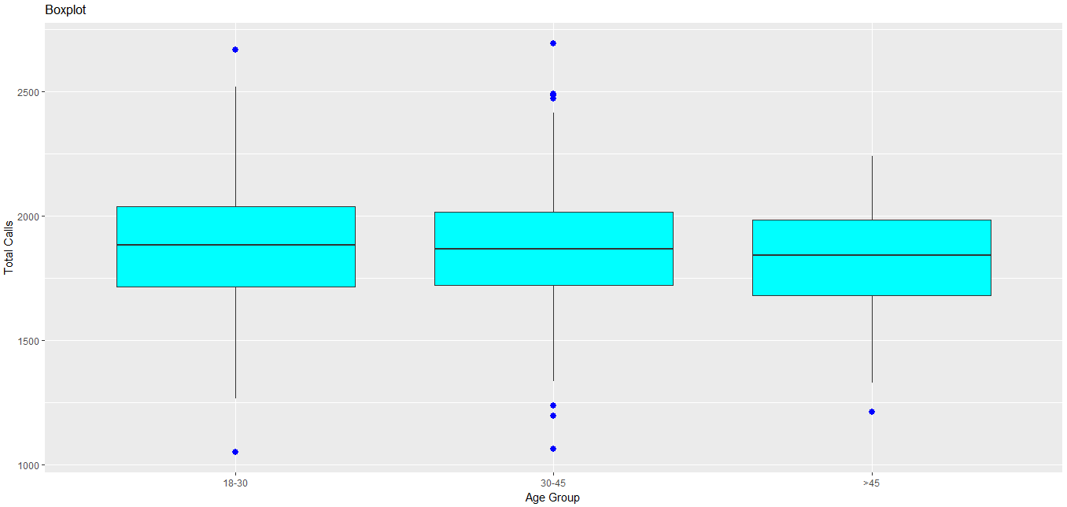
Box Plot By Age Group Enhance the plot R Output
#By Age group; colour the boxes & outlier

Slide 57
Box Plot Adding Gender Facet
#Adding Gender Facet
ggplot(working, aes(x=age_group, y=Calls))+
geom_boxplot(aes(fill=Gender))+
labs(x="Age Group", y="Total Calls", title="Boxplot")

Slide 58
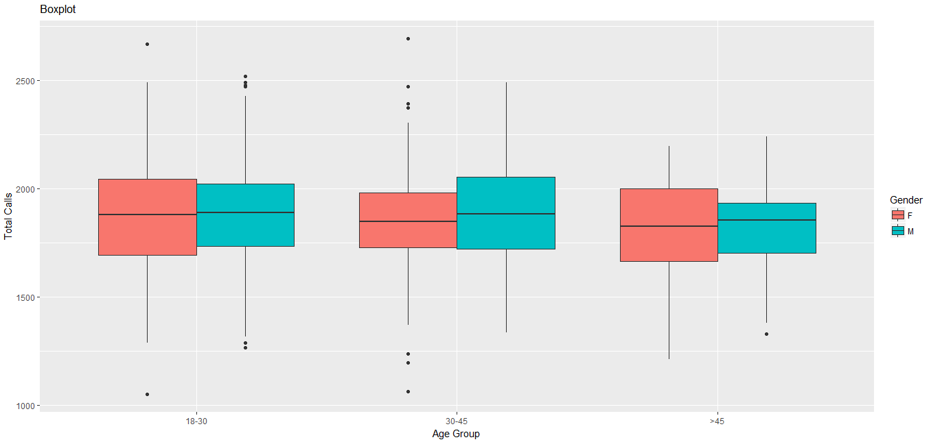
Box Plot
Adding Gender Facet R Output
#Adding Gender Facet

Slide 59
Box Plot Horizontal View
# Box plot:Horizontal View
ggplot(working, aes(x=age_group, y=Calls))+ geom_boxplot(aes(fill=Gender))+ coord_flip()+
labs( y="Total Calls", x="Age Group", title="Boxplot")

Slide 60
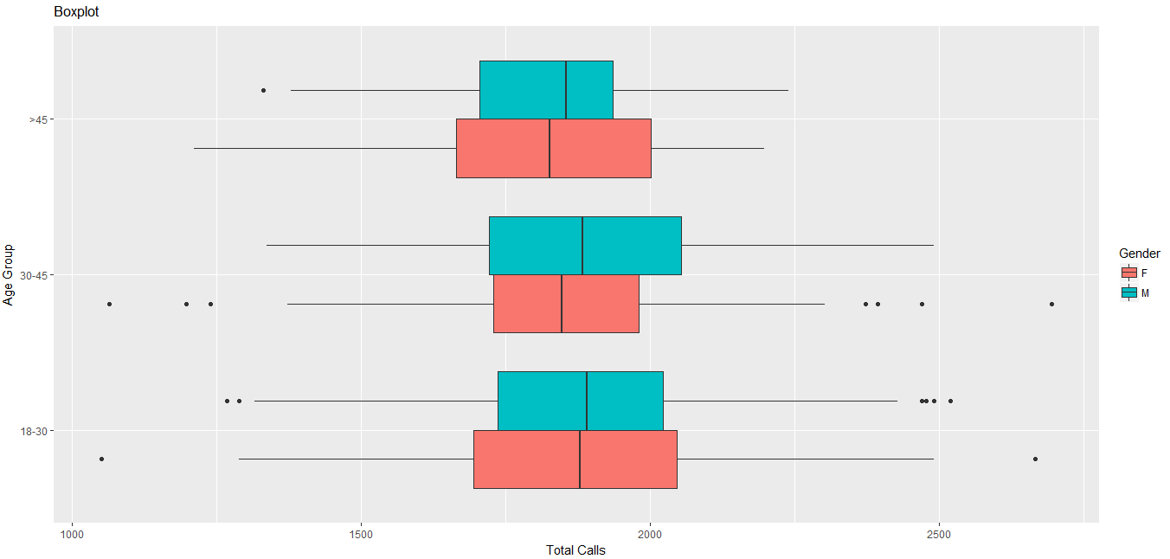
Box Plot Horizontal View: R Output
# Box plot: Horizontal View

Slide 61
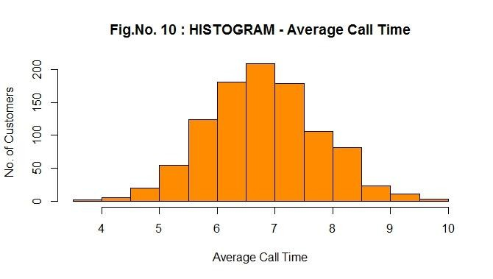
Histogram
A Histogram is similar to a bar chart but is used to display continuous data. Therefore we will use a continuous scale with no ‘gaps’ between the bars.
It is generally used to check the Normality of the data.
This plot shows that the distribution of Average Call Time is very much symmetric

Slide 62
Histogram
#Histogram for variable ‘Calls’
ggplot(working, aes(x=Calls))+
geom_histogram(binwidth=40, fill="maroon")+
labs(x="Total Calls", y="No. of customers", title="Customer usage")

Slide 63
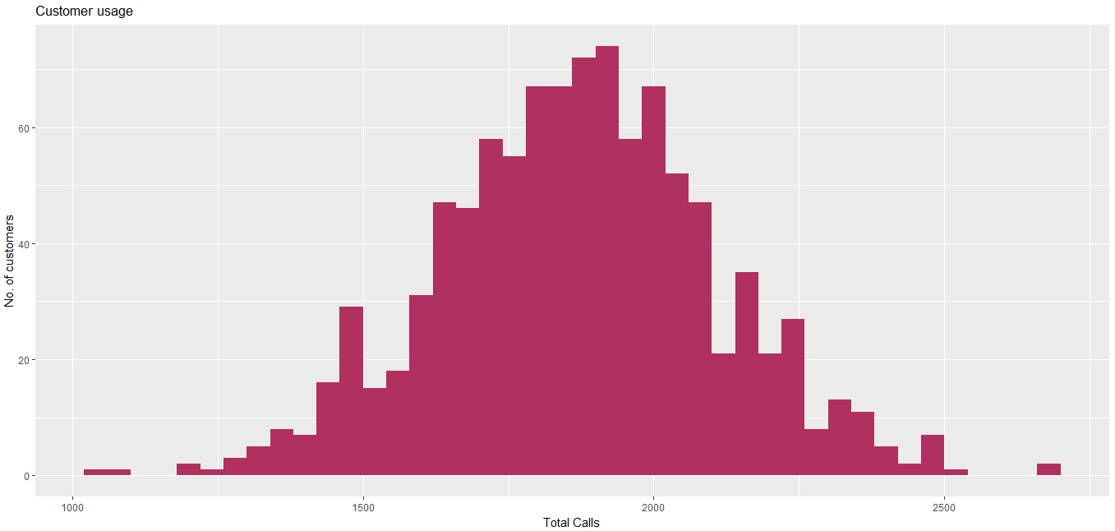
Histogram R Output
#Histogram for variable ‘Calls’

Slide 64
Histogram Fill with Gender
#Showing histogram for ‘Calls’ by ‘Gender’
ggplot(working, aes(x=Calls))+
geom_histogram(binwidth=40, aes(fill=Gender))+
labs(x="Total Calls", y="No. of customers", title="Customer usage based on gender")

Slide 65
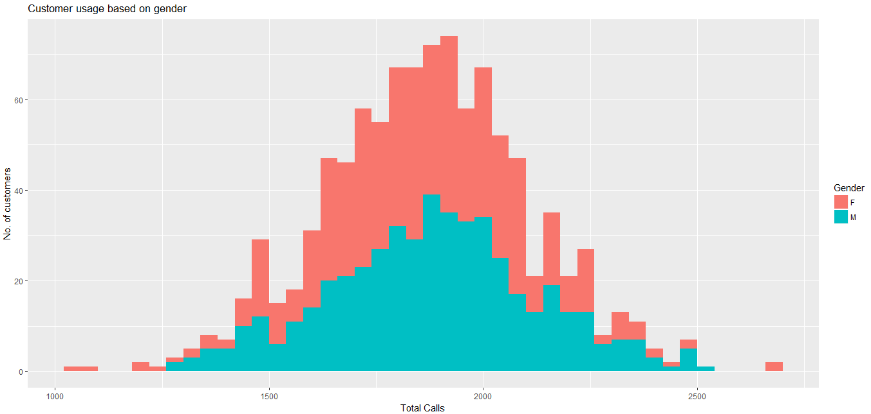
Histogram
Fill with Gender: R Output
#Showing histogram for ‘Calls’ by ‘Gender’

Slide 66
Histogram
Fill with Age Groups
#Try with Age Group
ggplot(working, aes(x=Calls))+
geom_histogram(aes(fill=age_group), binwidth=40)+
labs(x="Total Calls", y="No. of customers", title="Customer usage based on age", colour="Age Group")

Slide 67
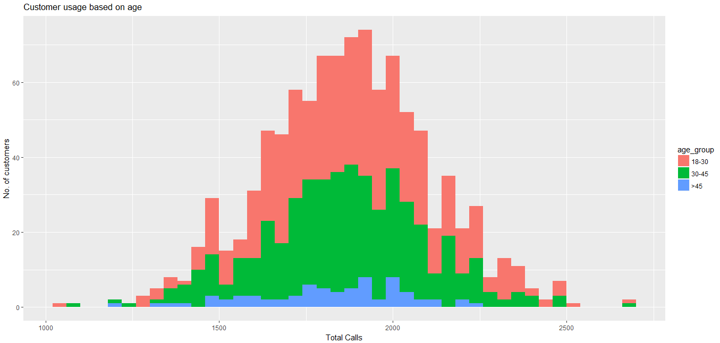
Histogram
Fill with Age Groups: R Output
#Try with Age Group

Slide 68
Make Plots Interactive
install.packages("plotly")
library(plotly)
#Save ggplot as an object
interactive <- ggplot(working, aes(x=age_group,fill=Gender))+
geom_bar(position="dodge")+
labs(x="Age Group", y="No. of customers", title="Multiple bar chart")
ggplotly(interactive)

Slide 69
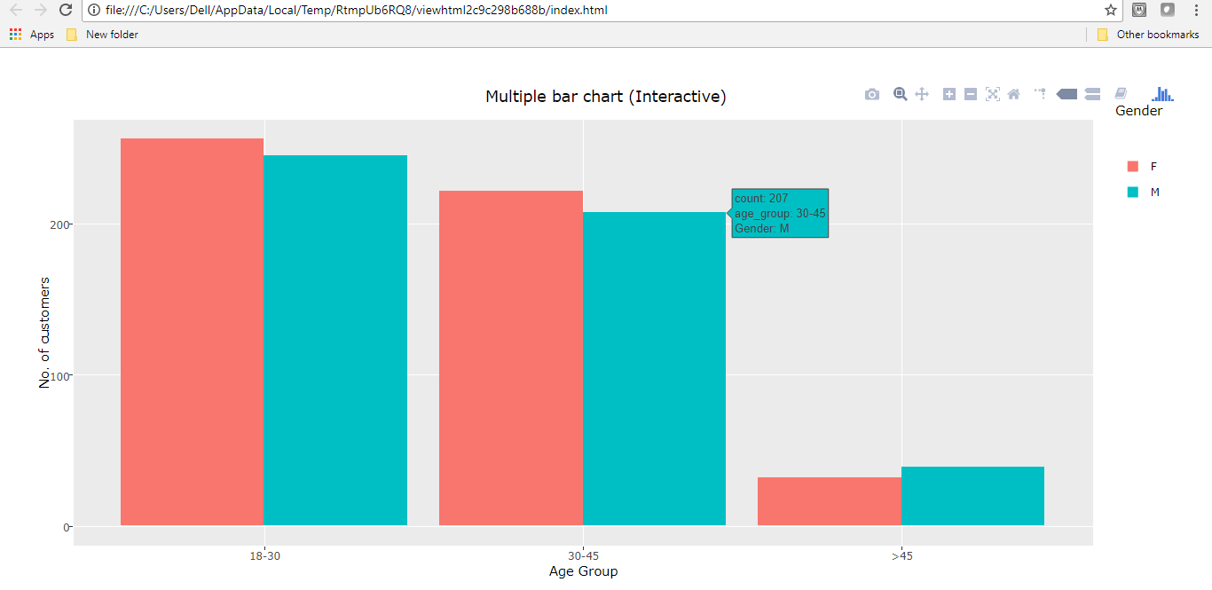
Make Plots Interactive

