Slide 1
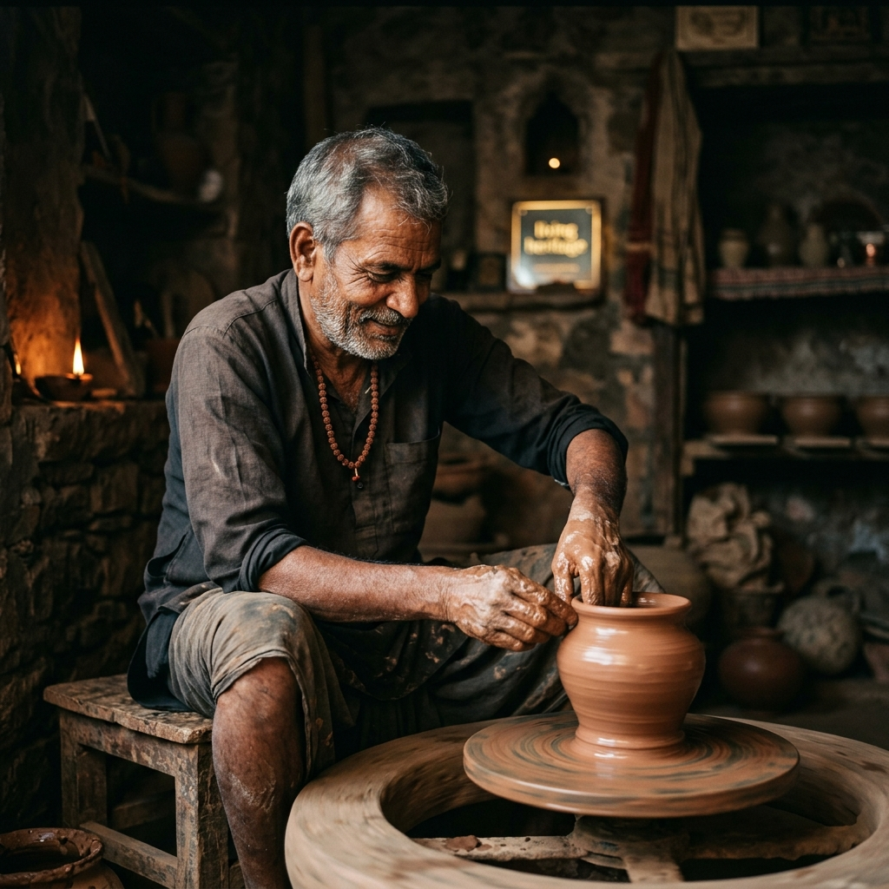
Parampara Heritage
"Direct-to-consumer luxury platform connecting global buyers with certified Indian master artisans."
✓ 10-WORD PLAIN ENGLISH DESCRIPTION
Empowering rural craft lineage through provenance, AI storytelling, and direct fair-trade commerce.
420+
Master Artisans
$48.5B
Heritage TAM
85%
Artisan Share
+18% MoM
GMV Growth

Slide 2
SLIDE 2 — THE ACUTE PAIN POINT
An Acute Heritage Crisis Demands Immediate Urgency
Global craft ecosystems suffer from severe exploitation, counterfeits, and loss of ancestral lineage.
800% Middleman Markups
Middlemen capture up to 90% of retail profit margins, leaving artisans under $3/day. 10,000+ artisans abandon crafts annually.
$15B Counterfeit Market
Cheap machine-made replicas swamping global markets impersonate authentic Geographical Indication (GI) heritage crafts.
Zero Digital Provenance
High-Net-Worth global collectors cannot verify authenticity or artisan lineage, creating deep mistrust in international markets.
CRITICAL URGENCY: Without direct digital fair-trade infrastructure, 40% of India's indigenous craft traditions will vanish within this decade.

Slide 3
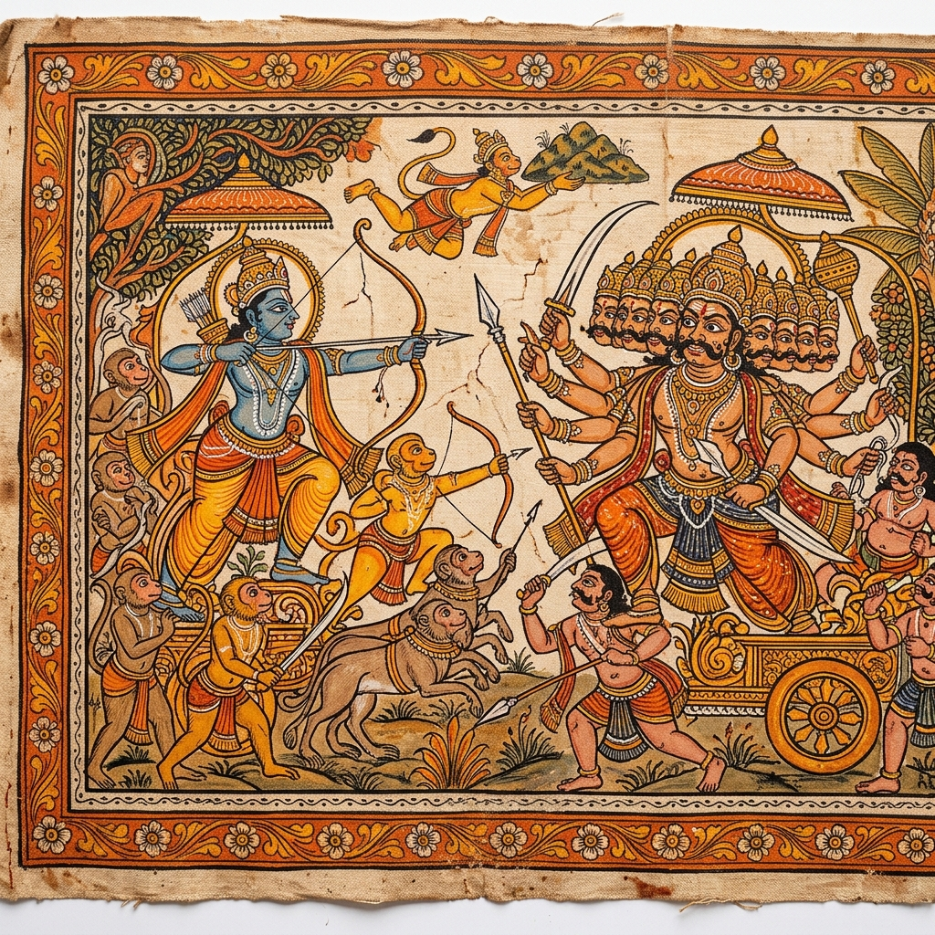
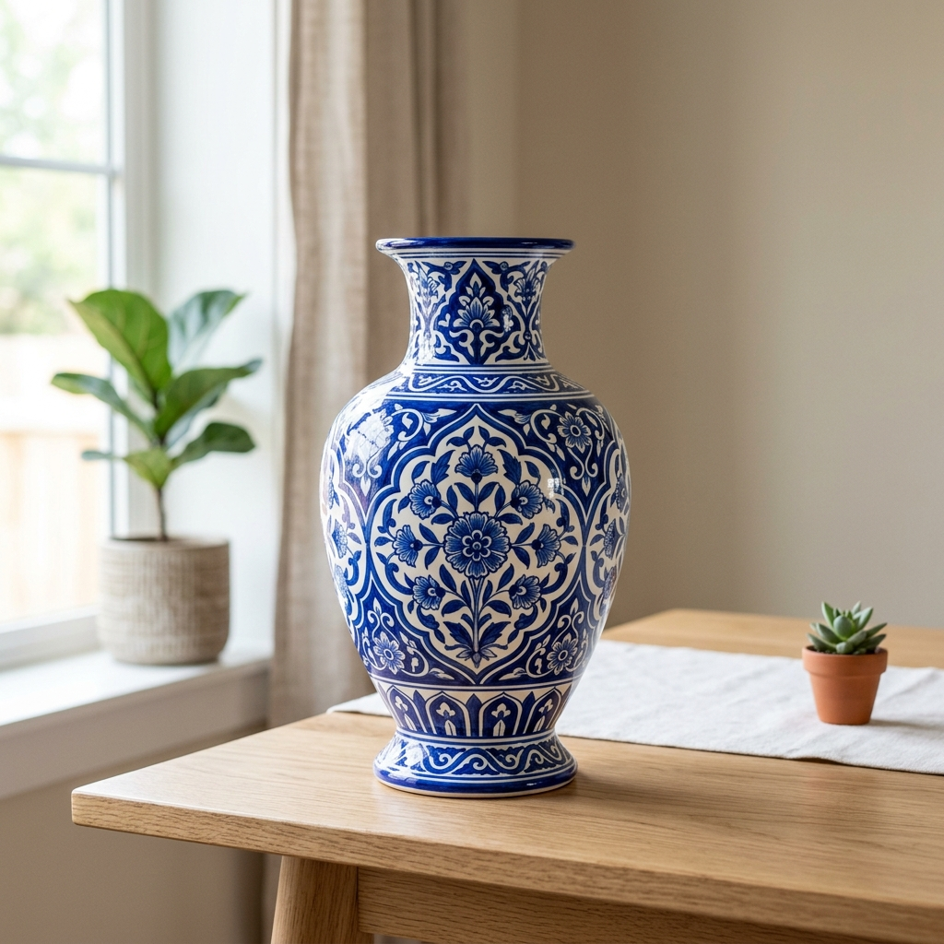
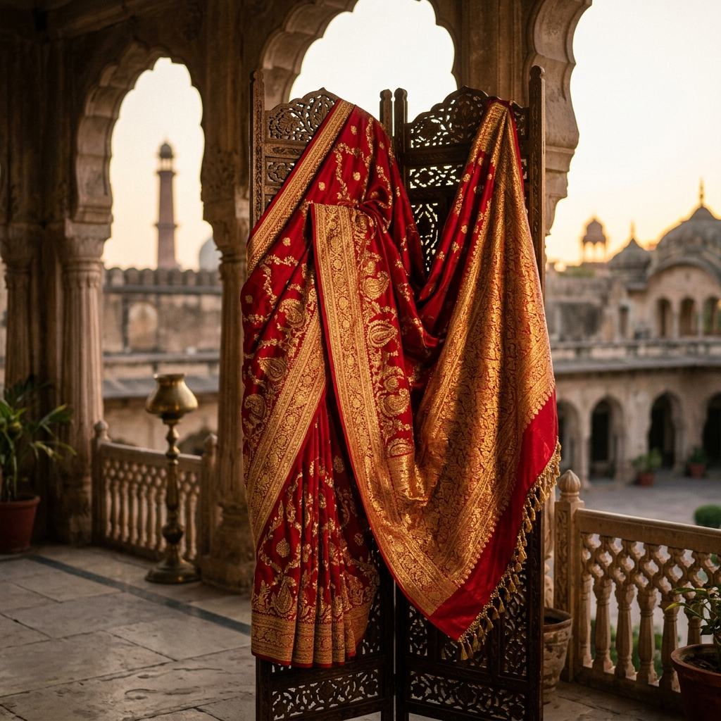
SLIDE 3 — PRODUCT SOLUTION & DEMO
The Parampara Platform & Provenance Engine
Direct artisan commerce paired with digital GI authenticity certificates and Gemini AI cultural storytelling.
✓ Direct-to-Artisan Payouts
Routes 85% of revenue straight to rural artisan bank accounts and co-ops.
✓ GI Certificate Generator
Cryptographically verifiable QR certificates shipped with every physical masterpiece.
✓ Gemini AI RAG Concierge
Interactive RAG vector assistant querying 5,000+ GI heritage records.
GEMINI RAG AI CONCIERGE
"RAG pipeline indexing 5,000+ GI records for instant craft lineage & authenticity checks."
✓ Interactive State Map Engine
Real-time exploration of 28 Indian States & district craft density.

Slide 4
SLIDE 4 — BOTTOM-UP MARKET SIZE
$48.5 Billion Global Heritage Luxury Opportunity
Calculated bottom-up from target high-net-worth diaspora & global art collectors.
TAM (Total Addressable)
$48.5B
Global Handmade Heritage & Luxury Home Decor Market
SAM (Serviceable Addressable)
$3.0B
2.5M Global Diaspora & Collectors × $1,200 Annual Spend
SOM (Target Year 3)
$120M
150,000 Active Luxury Buyers × $800 Annual Contract Value
BOTTOM-UP SOM FORMULA:
SOM = 150,000 Target Luxury Collectors × $800 Annual Contract Value (ACV) = $120,000,000 (Target Year 3)

Slide 5
SLIDE 5 — BUSINESS MODEL & MONETIZATION
Multi-Stream Revenue Engine with High Unit Economics
Diversified monetization spanning direct D2C commissions, B2B SaaS co-op fees, and corporate gifting.
Marketplace Stream
15% Take-Rate
Direct platform commission on consumer transactions across luxury heritage crafts and certified masterpieces.
Co-Op SaaS Tier
$299 – $999 / mo
Subscription inventory OS & digital storefronts for GI Cooperatives and Export Guilds.
Corporate Gifting
25% - 35% Margin
B2B bespoke artisan commissions for luxury hotel chains, diplomatic events, and corporate gifts.
Customer Acquisition Cost (CAC): $65 – $80
Unit profitable on first $240 order (eliminates first-order cash burn).
Customer Lifetime Value (LTV): $960
12x–15x LTV/CAC Ratio (based on 4x repeat purchases over 24 months).

Slide 6
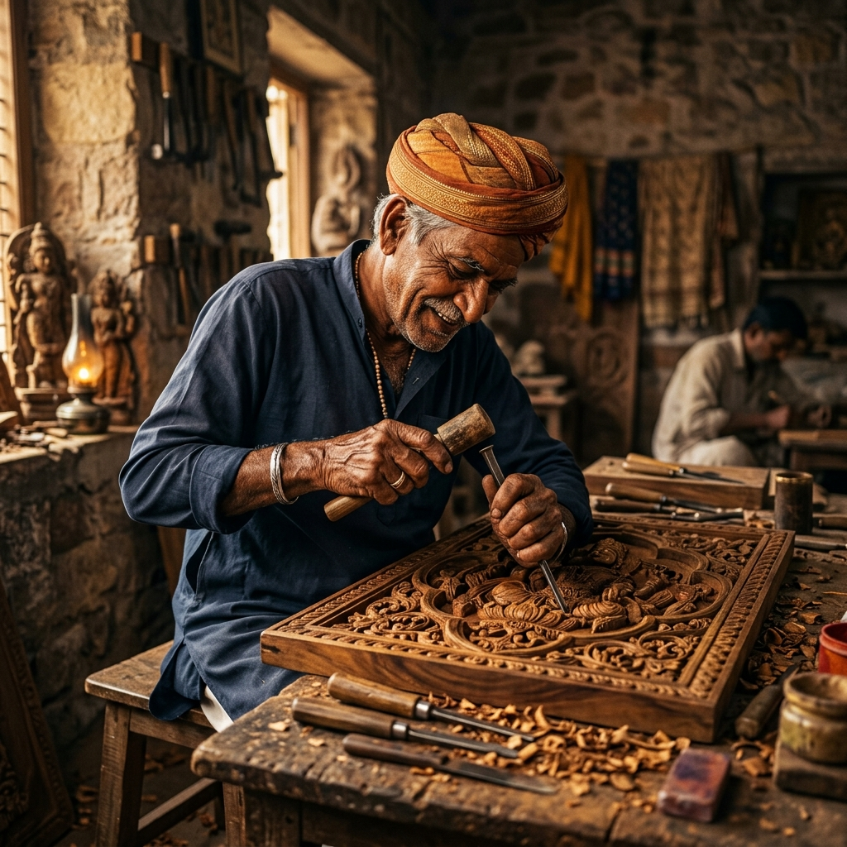
SLIDE 6 — TRACTION & KEY GROWTH METRICS
Month-over-Month Growth Driven by Authentic Provenance
Demonstrated demand avoiding vanity metrics in favor of organic GMV and artisan retention.
GROWTH TRACTION HIGHLIGHTS
• Quarterly GMV: $185,000 GMV in Q3 2026 (+18% Month-over-Month Growth)
• Weekly Buyer Traction: +4.2% Week-over-Week (WoW) Active Buyer Growth
• Active Master Artisans: 420+ Certified Artisans across 22 Indian States
• Average Order Value: $240 AOV across luxury crafts & masterpieces
• Retention & Churn: 44% 90-day repeat purchase rate | 0% Artisan Churn

Slide 7
SLIDE 7 — TECH STACK & EDGE ARCHITECTURE
High-Efficiency Architecture & AI Storytelling Engine
Microservices architecture delivering sub-100ms API responses and RAG-powered cultural AI context.
EDGE & CLIENT LAYER
HTML5 & SVG Engine
Zero-dependency client architecture, responsive SVG state maps, glassmorphism UI.
BACKEND API LAYER
Node.js + Express 5
RESTful API services, JWT security, webhooks for Razorpay & Stripe payments.
DATA & MEDIA ENGINE
MongoDB Atlas & Cloudinary
Cloud MongoDB cluster with WebP image optimization and video delivery CDN.
AI INTELLIGENCE
Gemini 3.6 RAG Engine
RAG / Vector Indexing Pipeline querying 5,000+ GI documents via Gemini API.
⚡ INFRASTRUCTURE ADVANTAGE: 99.99% Uptime | Sub-100ms Response Times | Encrypted On-Chain/Database Provenance Records

Slide 8
SLIDE 8 — COMPETITIVE QUADRANT & MOAT
Why Parampara Outperforms Mass Retailers & Legacy Galleries
Combining high digital scalability with verified digital craft provenance.
COMPETITIVE POSITIONING QUADRANT
• PARAMPARA (Winner Top-Right): High Digital Scale + Direct Verified GI Provenance.
• Mass E-Commerce (Etsy/Amazon): High Scale, but Low Provenance (Fake crafts, exploited sellers).
• Legacy Art Galleries: High Provenance, but Low Scale (500% markup, zero digital reach).
• Local Craft Fairs: Low Scale, Low Reach (Seasonal, local only).
OUR DEFENSIBLE MOATS
1. Exclusive Co-Op Contracts:
Multi-year binding contracts with 30+ official Indian Geographical Indication (GI) guilds.
2. Digital GI Verification Engine:
Proprietary serial code & QR cryptographic certificate linked directly to artisan IDs.
3. RAG / Vector AI Heritage Engine:
RAG / Vector Indexing Pipeline querying 5,000+ GI documents via Gemini API.

Slide 9
SLIDE 9 — LEADERSHIP & TEAM
Built by Engineering & Heritage Preservation Leaders
Combining deep technical execution with authentic artisan guild leadership.
Pruthviraj Ganiharkar
Founder & CEO / Lead Architect
Hands-on execution: Full-Stack Architecture, RAG Pipeline Development, Node.js REST API & Glassmorphism UI.
Dr. Devendra Sharma
Head of Craft Authentication
30+ years in Indian Heritage Preservation. Former advisor to GI Certification Boards.
Aria Chen
VP of Global D2C Growth
Ex-Luxury Retail Director. Scaled high-end art & artisanal brands to $50M+ annual revenue.
Vikramaditya Rao
Lead AI & Cloud Architect
Ex-Senior AI Engineer. Specialized in Gemini API integration, cloud scaling, and microservices.

Slide 10
SLIDE 10 — 5-YEAR VISION & FUNDING ASK
Scaling Heritage Luxury Globally — Pre-Seed / Seed Round
Transforming Parampara into the global operating system for indigenous luxury heritage.
5-YEAR GROWTH ROADMAP
Year 1 (India Scale):
5,000+ Master Artisans across all 28 States ($5M GMV).
Year 3 (Global Flagships):
Launch NYC, London, & Dubai physical experience hubs ($35M GMV).
Year 5 (Global Expansion):
Scale model to Southeast Asia & Latin America heritage crafts ($150M GMV).
TARGET FUNDING REQUEST
$500K – $1.5M
Pre-Seed / Seed Incubator Target
USE OF FUNDS BREAKDOWN:
• 45% ($225k–$675k): Engineering & Guild Onboarding
• 35% ($175k–$525k): Customer Acquisition & DTC Growth
• 20% ($100k–$300k): Operations & GI Logistics Hubs

