Slide 1
Crop Production Analysis of Asia Continent
Team members:
Ganesh L kalkote PES1201902354
Vivek M PES1201902363
Sharath S PES1201902576

Slide 2
Data Cleaning

Slide 3
Data cleaning is the process of identifying and removing (or correcting) inaccurate records from a dataset, table, or database and refers to recognising unfinished, unreliable, inaccurate or non-relevant parts of the data and then restoring, remodelling, or removing the dirty or crude data.

Slide 4
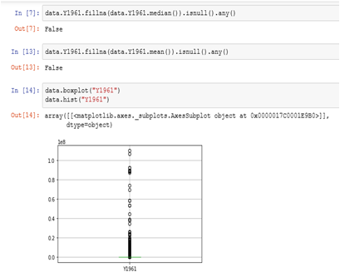
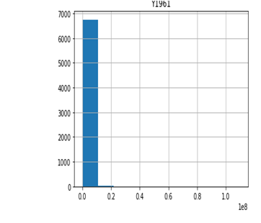
Removing outlier

Slide 5
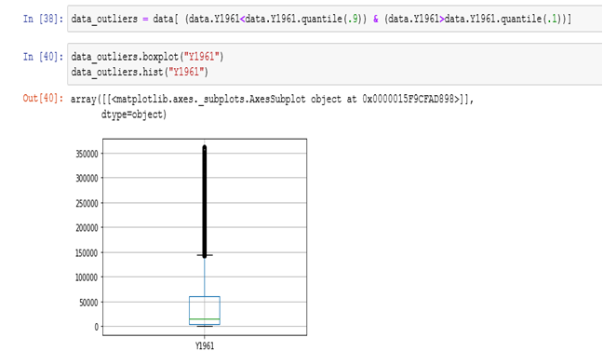
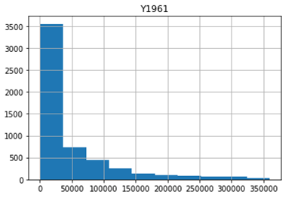
Cont...

Slide 6
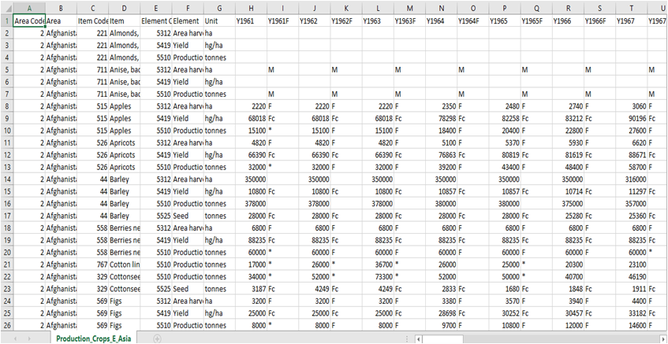
Before

Slide 7
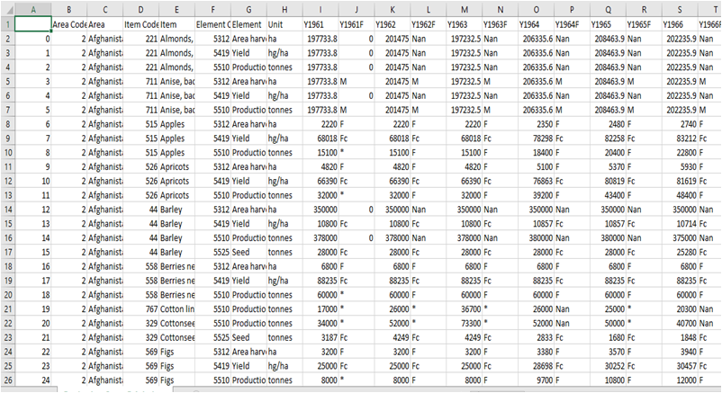
After

Slide 8
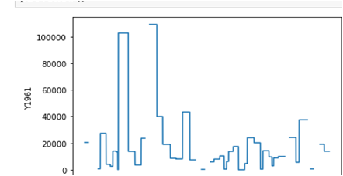
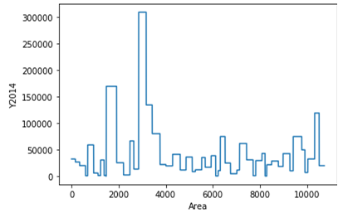
Histogram after transforming mean value
before cleaning
Cleaned data

Slide 9
Normalizing

Slide 10
Normalization is to change the values of numeric columns in the dataset to a common scale, without distorting differences in the ranges of values. For machine learning, every dataset does not require normalization.

Slide 11
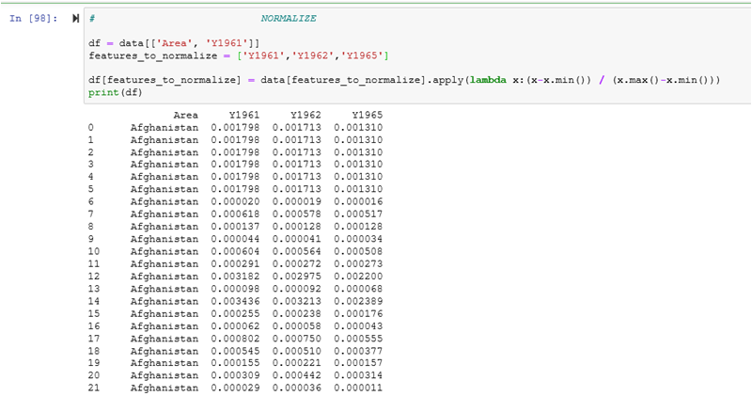

Slide 12
Hypothesis Testing

Slide 13
Hypothesis testing is to draw inferences or some conclusion about the overall population or data by conducting some statistical tests on a sample

Slide 14
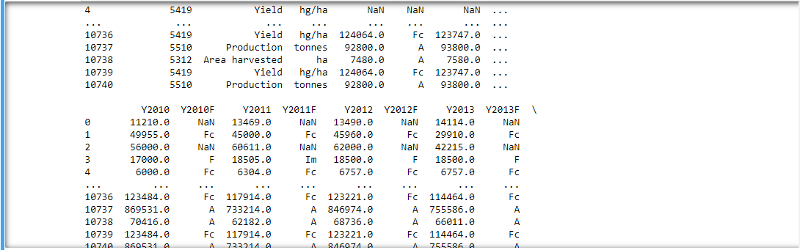
T Test

Slide 15
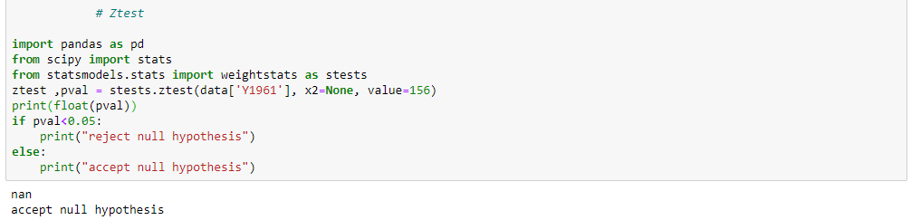
Z Test

Slide 16
Correlation

Slide 17
Correlation is a statistical measure. Correlation explains how one or more variables are related to each other.

Slide 18
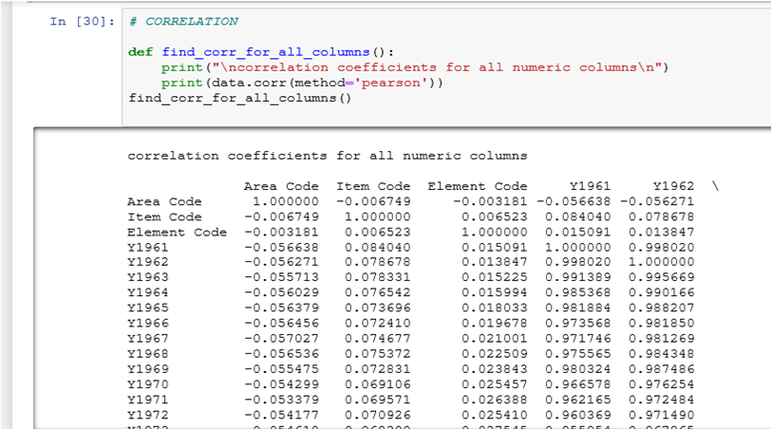

Slide 19
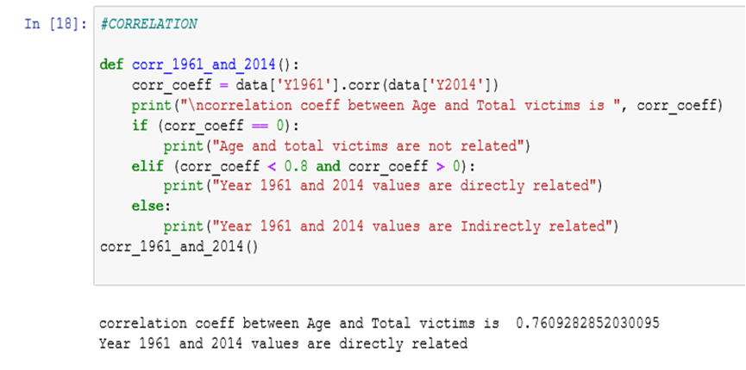

Slide 20
Data Visualization

Slide 21
Data visualization refers to the techniques used to communicate data or information by encoding it as visual objects (e.g., points, lines or bars) contained in graphics.

Slide 22
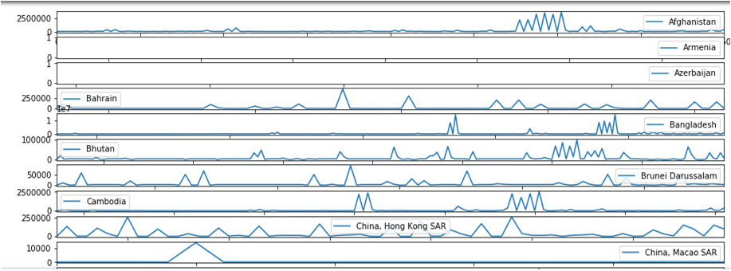
According to the area Line chart

Slide 23
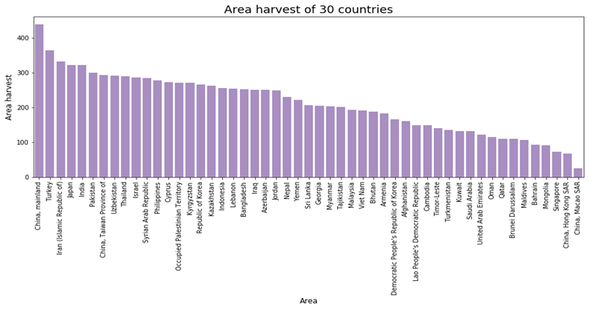

Slide 24
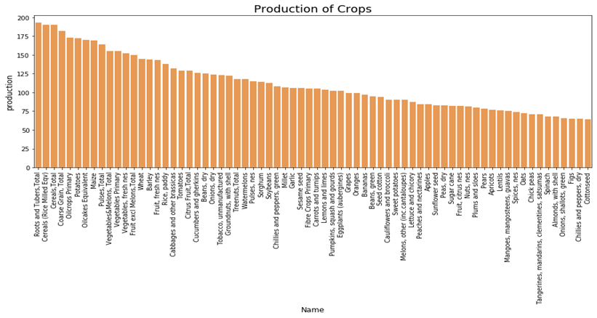

Slide 25
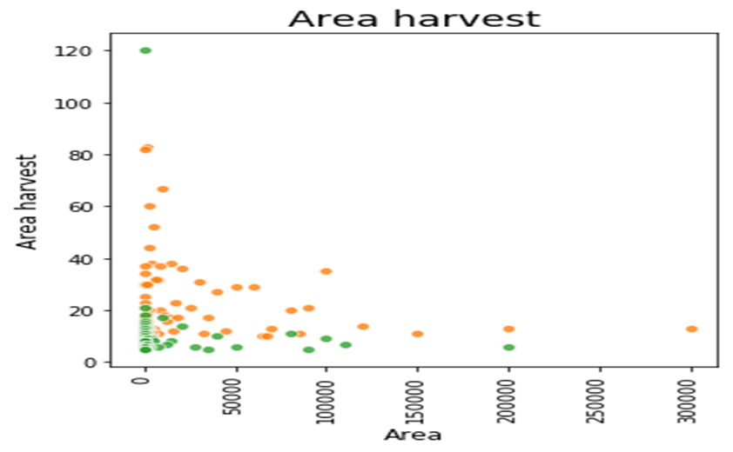

Slide 26
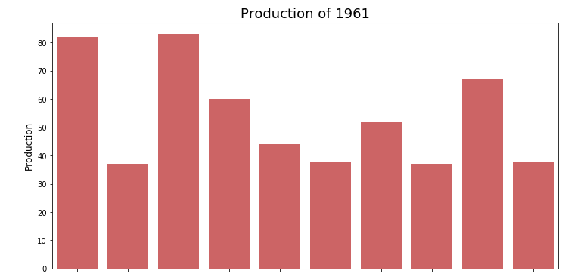
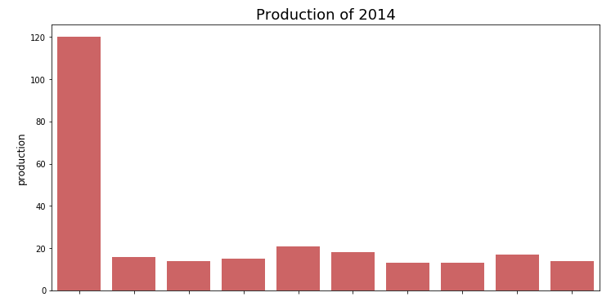
Comparison of 1961 and 2014

Slide 27
THANK YOU

