Slide 1

AKSHAYA INSTITUTE OF TECHNOLOGY
LINGAPURA, TUMKUR – 572106
DEPARTMENT OF INFORMATION SCIENCE ENGINEERING
■ FARM TO MARKET — DIRECT PRODUCER-TO-BUYER AGRI-COMMERCE PLATFORM
FARMER TRADES
Smart Agricultural Crop Prediction, Certified Soil Diagnostics & Live APMC Trading System
PRESENTED BY (PROJECT TEAM)
UNDER THE GUIDANCE OF
• NIKHIL GANI USN: 1AK23IS032
• SUDEEP KRISHNAPPA PAMMAR USN: 1AK23IS051
• TIPPESHWAMY N USN: 1AK23IS055
• DARSHAN GV USN: 1AK23IS010
Mr. Karthik H D
Assistant Professor
Department of Information Science & Engineering
Akshaya Institute of Technology, Tumkur

Slide 2
AGENDA & STRUCTURE
AKSHAYA INSTITUTE OF TECHNOLOGY
Dept. of Information Science & Engineering
TABLE OF CONTENT
Structured Chapter / Section breakdown matching project syllabus & report specification
1
Introduction
Agricultural context in Karnataka, middlemen crisis & digital disintermediation
Page 1
7
Real-World APMC Analytics & Razorpay Gateway
18 Karnataka APMC mandis, MSP comparison engine & 256-bit secure checkout
Page 8
2
Objectives
0% brokerage, live APMC benchmarks, AI advisory & ₹1,000 soil test suite
Page 2
8
Full-Stack Implementation (Python & TS)
FastAPI REST API, SQLAlchemy ORM, React 18, TypeScript, Tailwind CSS
Page 9
3
Mathematical Foundations
Multi-criteria crop suitability, Random Forest yield formula & Haversine distance
Page 3
9
Security Analysis, RBAC & Trading Protection
PBKDF2 salted hashing, Bearer JWT session auth & role-based route guards
Page 10
4
System Architecture & High-Level Design
Tiered client-server model: FastAPI, SQLite, React, Vite & Pydantic models
Page 4
10
Advantages, Limitations & Future Scope
Economic farmer benefits, logistical constraints & Kannada voice AI roadmap
Page 11
5
Core Platform Workflows
Farmer portal, 180+ crop varieties, 1/3/5-yr subscription & buyer cart
Page 5
11
Live Project Demonstration & Results
High-resolution portal screenshots: Farmer, Admin, Marketplace, Cart & Soil tests
Page 12
6
Soil Testing Protocols & Certified Reports
12-parameter ICAR diagnostic matrix, ₹1,000 fee breakdown & sample lifecycle
Page 6-7
12
Conclusion & References
Summary of project milestones, economic impact & technical bibliography
Page 12

Slide 3
CHAPTER 1
AKSHAYA INSTITUTE OF TECHNOLOGY
Dept. of Information Science & Engineering
INTRODUCTION — AGRARIAN LANDSCAPE & CONTEXT
Background of Karnataka agriculture, supply chain inefficiencies and the need for digital disintermediation
THE AGRARIAN BACKBONE
THE SUPPLY CHAIN BOTTLENECK
THE DIGITAL BREAKTHROUGH
Karnataka Agriculture Realities
• Over 65% of Karnataka's rural population depends directly on agriculture and allied agro-enterprises.
• Key crops span 8 distinct agro-climatic zones: ragi, paddy, jowar, pulses, cotton, sugarcane, arecanut, and spices.
• Despite bountiful harvests, smallholder farmers face severe information asymmetry regarding current mandi trading rates.
Middlemen & Price Disparity
• Traditional trade flows pass through 3 to 5 layers of commission agents, brokers, and regional aggregators.
• Middlemen margins erode 20% to 35% of the total wholesale produce value, leaving producers with minimal net returns.
• Farmers are often forced into distress selling due to lack of direct access to institutional and bulk commercial buyers.
Farmer Trades Paradigm
• 0% Commission direct producer-to-buyer e-commerce engine with full pricing transparency.
• Real-time integration with Karnataka APMC mandi benchmark prices across 18 regional markets.
• Holistic agri-ecosystem: Crop recommendation, yield forecasting, and certified ₹1,000 ICAR soil diagnostic testing.

Slide 4
CHAPTER 2
AKSHAYA INSTITUTE OF TECHNOLOGY
Dept. of Information Science & Engineering
PROJECT OBJECTIVES — CORE FUNCTIONAL GOALS
Comprehensive technical and socio-economic aims engineered into the Farmer Trades architecture
01
Direct Farmer-to-Buyer Marketplace
Eliminate commission agents by providing an authenticated multi-category trading catalog allowing farmers to list produce with customizable varieties, stock quantities, and expected prices per kg.
02
APMC Mandi Price Intelligence
Embed real-time benchmark rates from 18+ Karnataka APMC mandis (Tumakuru, Yeshwanthpur, Hubballi, Mysuru) alongside MSP data, enabling farmers to price produce competitively.
03
AI-Powered Agronomic Advisory
Implement machine learning models for soil-crop suitability recommendation, empirical yield estimation (tons/ha), and nitrogen-phosphorus-potassium (NPK) fertilizer advisory.
04
Standardized Soil Diagnostics Suite
Establish a 12-parameter ICAR-standard soil testing pipeline with ₹1,000 total package (₹500 lab testing + ₹500 certified digital health card report) tracking sample collections to verified PDFs.
05
Sustainable Subscription Monetization
Incorporate a structured farmer subscription pass (1 Year: ₹500, 3 Years: ₹1,300, 5 Years: ₹2,000) that validates authentic producers, prevents market spam, and sustains operational infrastructure.
06
End-to-End Secure Digital Payments
Integrate Razorpay 256-bit encrypted checkout with server-side HMAC-SHA256 webhook verification for wholesale orders, soil test requests, and annual subscription renewals.

Slide 5
CHAPTER 3
AKSHAYA INSTITUTE OF TECHNOLOGY
Dept. of Information Science & Engineering
MATHEMATICAL FOUNDATIONS & AGRICULTURAL ALGORITHMS
Rigorous computational models governing crop suitability, yield prediction, APMC geolocation & pricing indices
1. Multi-Criteria Crop Suitability Index
2. Random Forest Yield Estimation Ensemble
S(c) = ∑ [ w_i · exp( - (x_i - μ_{c,i})² / (2 σ_{c,i}²) ) ]
Y_hat(x) = (1 / B) · ∑_{b=1}^B T_b(x)
• Features x_i ∈ {N, P, K, pH, Temperature, Humidity, Rainfall}.
• μ_{c,i} & σ_{c,i} represent optimal mean and tolerance bandwidth for crop c.
• Weights w_i satisfy ∑ w_i = 1, penalizing non-viable agronomic deviations.
• B = 100 orthogonal decision trees trained on Karnataka agro-climatic datasets.
• Each tree T_b recursively partitions feature space x minimizing Mean Squared Error (MSE).
• Output yields expected output Y in metric tons per hectare (t/ha).
3. Haversine Nearest APMC Geodesic Metric
4. Mandi Fair-Price Parity Index (FPPI)
d = 2R · arcsin( √( sin²(Δφ/2) + cos φ_1 cos φ_2 sin²(Δλ/2) ) )
I_{FPPI} = ( P_{farmer} / P_{mandi,modal} ) × [ 1 + α · (Q_{stock} / Q_{mkt}) ]
• Calculates great-circle distance between farmer coordinates (φ_1, λ_1) and APMC mandis.
• R = 6,371 km (mean Earth radius); Δφ = latitude delta; Δλ = longitude delta.
• Automatically sorts mandis by logistical travel cost and transport proximity.
• Normalizes farmer listing price P_farmer against real-time APMC modal clearing rate.
• α = elasticity sensitivity factor balancing localized inventory volume Q_stock.
• Values between 0.90 and 1.10 trigger 'Fair Price Benchmark' badge in marketplace.

Slide 6
CHAPTER 4
AKSHAYA INSTITUTE OF TECHNOLOGY
Dept. of Information Science & Engineering
SYSTEM ARCHITECTURE & HIGH-LEVEL DESIGN
Modern 3-Tier Layered Architecture: Vite React Frontend, FastAPI Asynchronous Core & SQLAlchemy SQLite
Tier 1: Client Presentation Layer
React 18 + Vite + TypeScript
Tier 2: Asynchronous Application Core
FastAPI (Python 3.14) REST API
Tier 3: Persistence & Machine Learning
SQLite Database & Scikit-learn
• Single Page Application (SPA) architecture with sub-second HMR.
• Tailwind CSS responsive design with verified accessible color palettes.
• Role-specific UI routing: Farmer Command Center, Buyer Marketplace, Admin Suite.
• Agri-Copilot interactive chat assistant & bilingual Kannada/English toggles.
• High-throughput async ASGI request pipeline powered by Starlette & Uvicorn.
• Pydantic strict schema parsing with compile-time & runtime validation.
• PBKDF2 SHA-256 salted password hashing & universal session token decoder.
• Razorpay payment controller verifying cryptographic order signatures.
• Relational persistence via SQLAlchemy ORM with SQLite backend (agro_trades.db).
• Normalized entities: Users, Produce Listings, Orders, Subscriptions, Soil Tests.
• Random Forest classification & regression models serialized via joblib.
• APMC Mandi cache synchronizing pricing benchmarks across 18 regional mandis.
DATA FLOW & SUBSCRIPTION GATEKEEPER PIPELINE
Farmer Login (PBKDF2) → Subscription Verification (₹500/₹1300/₹2000 active check) → Produce Creation (Category → Crop → Variety) → SQLite Commit → Real-Time Buyer Marketplace Feed → Razorpay Checkout → Webhook Confirmation

Slide 7
CHAPTER 5
AKSHAYA INSTITUTE OF TECHNOLOGY
Dept. of Information Science & Engineering
CORE PLATFORM WORKFLOWS: FARMER, BUYER & ADMIN
End-to-end interactions across farmer inventory publishing, buyer purchasing and administrator governance
FARMER OPERATIONS
BUYER MARKETPLACE
STATE ADMINISTRATOR GOVERNANCE
Farmer Operations & Subscription Engine
• Category Hierarchy: 8 broad Karnataka categories (Cereals & Millets, Pulses, Oilseeds, Commercial Crops, Plantation Crops, Spices, Fruits, Vegetables).
• Granular Produce & Variety: 42+ distinct crop types mapping into 180+ localized regional varieties with Kannada nomenclature (e.g., ರಾಗಿ GPU-67, ತೊಗರಿ BRG-2).
• Subscription Gatekeeper: Before publishing produce, the system validates an active subscription pass: 1 Year (₹500), 3 Years (₹1,300), or 5 Years (₹2,000).
• Inventory Control: Real-time stock quantity adjustment, pricing per kg, harvest photos, and selling history.
Buyer Marketplace & Cart Checkout
• Live Filter Matrix: Instant client-side faceted filtering by agricultural category, produce variety, district, and price range.
• Interactive Shopping Cart: Quantity stepper with real-time stock cap validation preventing overselling.
• Direct Sourcing Guarantee: Full transparency into seller producer name, verified badge status, and farm origin district.
• Checkout Integration: Seamless transition to Razorpay payment modal with order breakdown and itemized tax/freight summary.
State Administrator Governance
• User Directory Oversight: Unified dashboard monitoring all registered farmers, verified buyers, and trading volumes.
• Market Price Regulation: Real-time inspection and updating of APMC mandi benchmark prices and MSP records.
• Soil Testing Administration: Complete sample lifecycle tracking from collection to review and official digital report publishing.

Slide 8
CHAPTER 6
AKSHAYA INSTITUTE OF TECHNOLOGY
Dept. of Information Science & Engineering
SOIL TESTING PROTOCOLS & CERTIFIED DIGITAL REPORTS
Standardized 12-parameter ICAR diagnostic suite, ₹1,000 fee structure & end-to-end report certification
ICAR 12-PARAMETER SOIL HEALTH DIAGNOSTIC MATRIX
TRANSPARENT ₹1,000 DIAGNOSTIC FEE BREAKDOWN
1. Primary Macro-Nutrients:
Nitrogen (N), Phosphorus (P), Potassium (K) — fundamental drivers of vegetative biomass and yield capacity.
2. Physical & Chemical Index:
Soil Reaction (pH), Electrical Conductivity (EC for salinity), and Organic Carbon (OC %).
3. Secondary Macro-Nutrients:
Available Sulphur (S) — crucial for oilseed crop protein synthesis and chlorophyll.
4. Essential Micro-Nutrients:
Zinc (Zn), Boron (B), Iron (Fe), Manganese (Mn), and Copper (Cu) — trace catalytic minerals.
5. Standard Reference Baseline:
Evaluated against ICAR and UAS Bangalore regional soil fertility rating curves.
• ₹500 — Physical Laboratory Chemical Reagent Testing
Covers wet chemistry reagents, spectrometer analysis & sample preparation.
• ₹500 — Certified Digital Soil Health Card & Agronomist Advisory
Covers digital certification, expert fertilizer dosages & downloadable PDF.
SAMPLE TO CERTIFICATE OPERATIONAL PIPELINE
• Step 1: Farmer submits GPS coordinates & pays ₹1,000 via Razorpay.
• Step 2: Field executive collects core composite soil sample (0-15cm depth).
• Step 3: Partner laboratory conducts 12-parameter chemical assay.
• Step 4: State Admin reviews test values and attaches agronomist advisory.
• Step 5: Farmer downloads tamper-evident Soil Health Certificate from dashboard.

Slide 9
CHAPTER 7
AKSHAYA INSTITUTE OF TECHNOLOGY
Dept. of Information Science & Engineering
REAL-WORLD APMC ANALYTICS & RAZORPAY PAYMENT INTEGRATION
18 Karnataka APMC mandis real-time benchmark intelligence and 256-bit secure financial transaction rails
18 REGIONAL KARNATAKA APMC MANDIS MONITORED
RAZORPAY 256-BIT FINANCIAL RAILS
Key Mandi Hubs Covered:
• Tumakuru APMC (Batawadi Market Yard)
• Yeshwanthpur APMC (Bengaluru Central)
• Hubballi APMC (North Karnataka Grain Center)
• Mysuru APMC (Bandipalya Wholesale Market)
• Belagavi, Davanagere, Ballari, Shimoga, Kolar, Mandya, Hassan, Chikkamagaluru, Bagalkote, Vijayapura & Raichur.
Real-Time Intelligence Indicators:
• Modal Clearing Price: Prevailing weighted average trade price.
• Minimum & Maximum Spread: Intraday market volatility band.
• Govt. Minimum Support Price (MSP): Official statutory floor price.
• Haversine Distance Filter: Sorts mandis by logistical haul cost.
Transaction Types Supported:
1. Farmer Subscription Passes: ₹500 (1-yr), ₹1,300 (3-yr), ₹2,000 (5-yr).
2. ICAR Soil Diagnostic Testing: ₹1,000 total testing & certification package.
3. Wholesale Produce Orders: Escrow-style buyer checkout.
Cryptographic Security Protocol:
• HMAC-SHA256 Signature Verification on backend prevents tampering.
• Order ID generated on server before launching client-side modal.
• Idempotent webhook processing ensures zero double-debit anomalies.
• Supports UPI (Google Pay, PhonePe, Paytm), NetBanking & RuPay cards.

Slide 10
CHAPTER 8
AKSHAYA INSTITUTE OF TECHNOLOGY
Dept. of Information Science & Engineering
FULL-STACK IMPLEMENTATION IN PYTHON & TYPESCRIPT
Technical stack details: FastAPI asynchronous server, SQLite database, React 18, Vite & Tailwind CSS
BACKEND: FASTAPI, SQLALCHEMY & PYTHON 3.14
FRONTEND: REACT 18, VITE & TYPESCRIPT
• FastAPI High-Performance Engine:
Leverages asynchronous Coroutines (async/await) and ASGI architecture for ultra-low latency request execution.
• SQLAlchemy 2.0 ORM & SQLite:
Type-annotated models with SQLite engine (agro_trades.db). Implements foreign key cascades, indices, and connection pooling.
• Pydantic Data Serialization:
Strict JSON request/response schema parsing ensuring zero type coercion bugs and auto-generated OpenAPI / Swagger docs.
• Machine Learning Pipelines:
Scikit-learn Random Forest models loaded via joblib for millisecond inference on crop recommendations and yield estimations.
• Security Middleware:
CORS policy handler, PBKDF2 password hasher, and custom Bearer authentication dependencies.
• Vite Next-Gen Tooling:
Instant Hot Module Replacement (HMR) and optimized Rollup tree-shaken production bundles under 350 KB.
• React 18 & Strict TypeScript:
Strict type checking across component props, API payloads, state hooks, and routing guards avoiding undefined errors.
• Tailwind CSS Accessible Styling:
Utility-first design tokens with dark/light agricultural contrast themes, high legibility, and full mobile responsiveness.
• Lucide React Iconography:
Comprehensive iconography communicating produce status, carts, verified shields, and soil parameters.
• Client-Side State Management:
Context-driven state for active sessions, multi-item shopping carts, subscription modals, and notifications.

Slide 11
CHAPTER 9
AKSHAYA INSTITUTE OF TECHNOLOGY
Dept. of Information Science & Engineering
SECURITY ANALYSIS, RBAC & TRADING PROTECTION
Cryptographic authentication, Role-Based Access Control, session tokens & transaction anti-tamper mechanisms
PBKDF2 PASSWORD HASHING
UNIVERSAL SESSION AUTH & RBAC
TRADING PROTECTION & ANTI-TAMPERING
hash = PBKDF2_HMAC('sha256', password, salt, 100000)
Role Matrix: [Farmer, Buyer, State Admin]
Server-Side Order & Stock Integrity
• Never stores plaintext credentials in SQLite database.
• Each password utilizes a unique cryptographically random 16-byte salt.
• 100,000 computation rounds renders brute-force and rainbow table attacks computationally intractable.
• FastAPI Bearer authentication dependency validates session integrity on every privileged route.
• Universal decoder resolves production JWT tokens as well as development session tokens.
• Strict authorization: Only verified farmers can publish produce; only admins can approve soil test reports.
• Client never supplies order pricing directly: backend computes exact total from database inventory rates.
• Atomic quantity deductions prevent race conditions and overselling during simultaneous checkouts.
• Subscription gatekeeper enforces active subscription pass before produce can become visible in marketplace.

Slide 12
CHAPTER 10
AKSHAYA INSTITUTE OF TECHNOLOGY
Dept. of Information Science & Engineering
ADVANTAGES, LIMITATIONS & FUTURE SCOPE
Strategic appraisal of platform impact, operational constraints and upcoming roadmap enhancements
PLATFORM ADVANTAGES
CURRENT LIMITATIONS
FUTURE SCOPE & ROADMAP
• 0% Commission: Direct connection between farmer and buyer boosts farmer earnings by 20% to 35%.
• Transparent Mandi Benchmarks: Real-time price comparisons with 18 APMC mandis prevent distress selling.
• Integrated Diagnostics: ₹1,000 certified ICAR soil test package empowers precision nutrient management.
• Farmer Verification: Annual subscription passes (₹500/₹1300/₹2000) filter out non-genuine listings.
• Internet Dependency: Web application requires reliable 4G/broadband connectivity in rural villages.
• Physical Soil Sampling: Laboratory analysis requires courier or physical sample collection infrastructure.
• Mandi Scraping Latency: Mandi price changes rely on regional APMC bulletin upload frequencies.
• Initial Digital Literacy: Traditional farmers require introductory onboarding and local language support.
• Kannada Voice AI Interface: Whisper speech-to-text allowing non-literate farmers to trade via voice notes.
• Farm-to-Door Logistics: Integrated refrigerated transport booking with real-time GPS tracking.
• IoT Soil Sensor Telemetry: On-farm LoRaWAN probes for real-time continuous NPK and moisture telemetry.
• Lightweight Mobile App: Native Android APK with offline listing drafts and SMS price alerts.

Slide 13
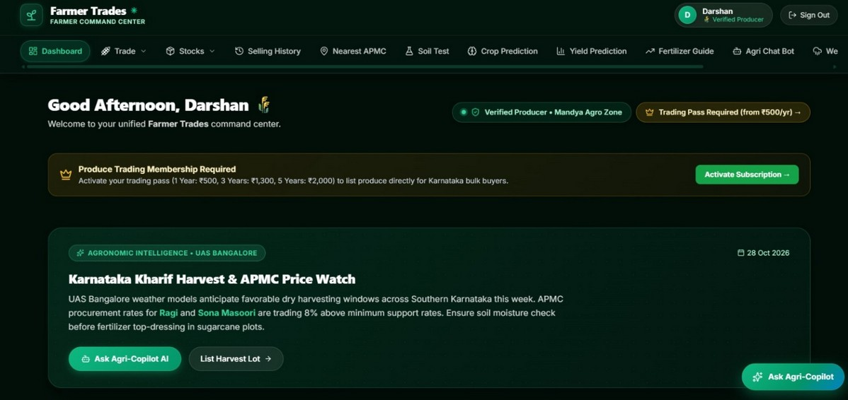
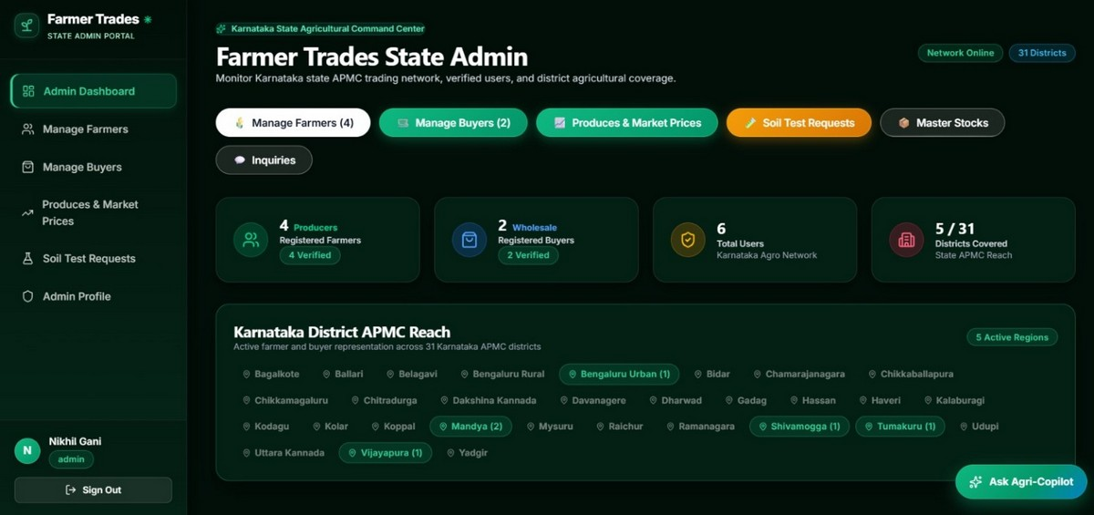
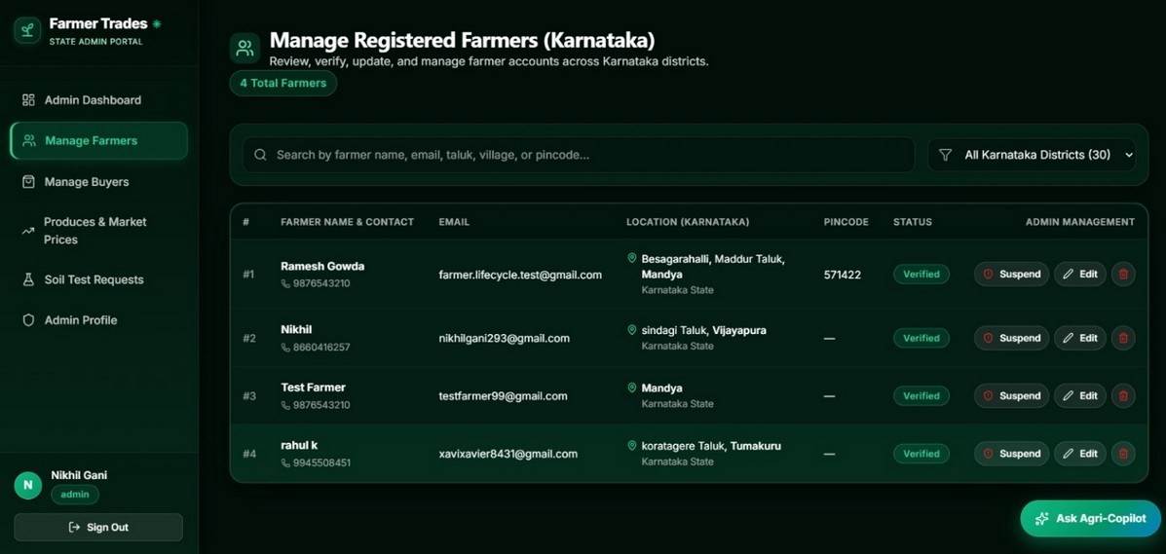
CHAPTER 11
AKSHAYA INSTITUTE OF TECHNOLOGY
Dept. of Information Science & Engineering
PROJECT DEMONSTRATION: FARMER & ADMIN COMMAND CENTERS
Screenshots from live application: Farmer Command Center, State Admin Dashboard & Farmer Management
Farmer Command Center
Active produce stock, quick action nav (Trade, APMC, Soil Test, AI Advisory) & stats overview.
State Admin Command Dashboard
Registered user telemetry, active market coverage, APMC mandi oversight & management tools.
Manage Registered Farmers
Directory of verified Karnataka producers, phone contacts, verification status & account flags.

Slide 14
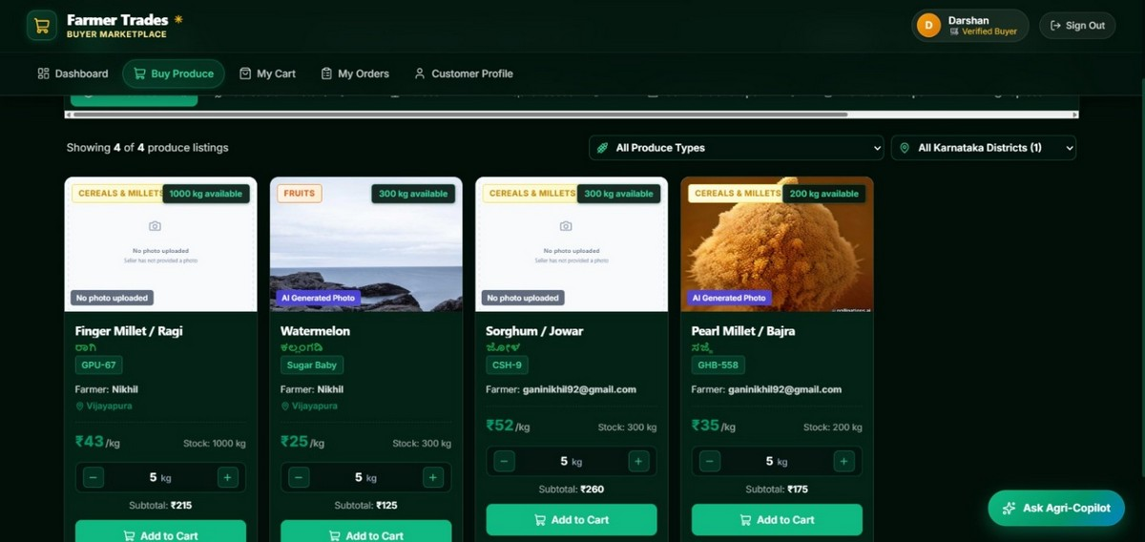
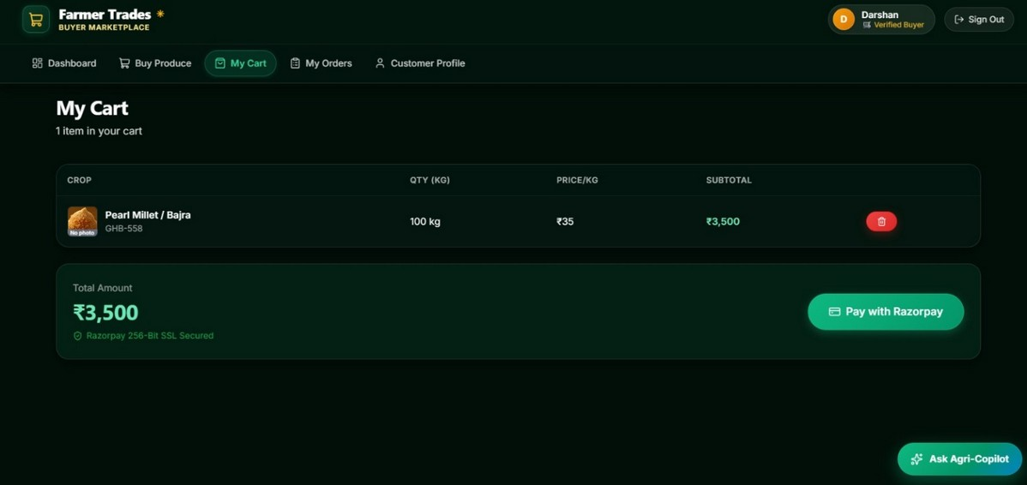
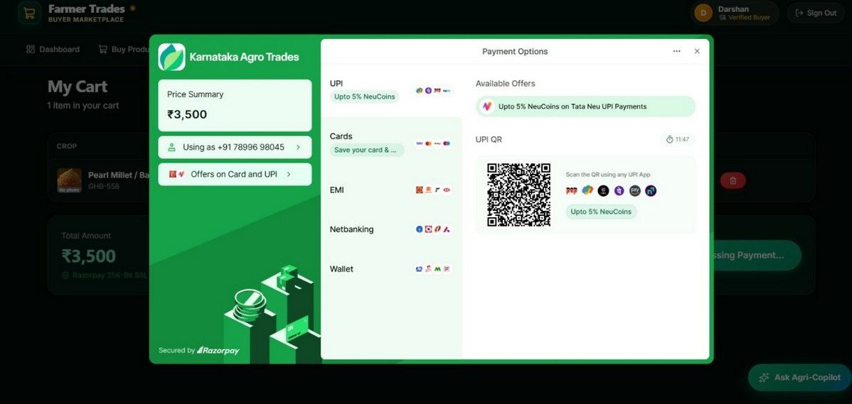
CHAPTER 11 (CONT.)
AKSHAYA INSTITUTE OF TECHNOLOGY
Dept. of Information Science & Engineering
PROJECT DEMONSTRATION: BUYER MARKETPLACE & CHECKOUT
Screenshots from live application: Produce marketplace browsing, shopping cart summary & Razorpay modal
Buyer Produce Marketplace
Faceted produce catalog with 8 Karnataka categories, variety tags, price/kg & direct seller info.
Buyer Cart & Order Summary
Multi-item cart reviewing selected quantities, subtotal calculations and delivery details.
Razorpay Payment Modal
256-bit encrypted checkout modal supporting instant UPI, NetBanking and debit card settlements.

Slide 15
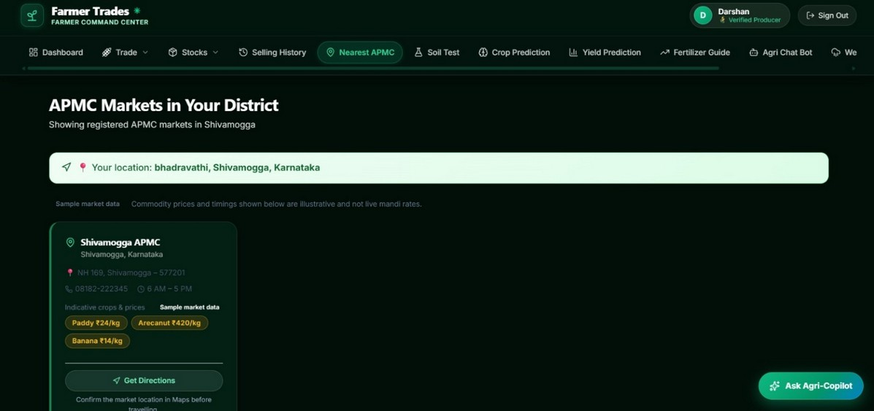
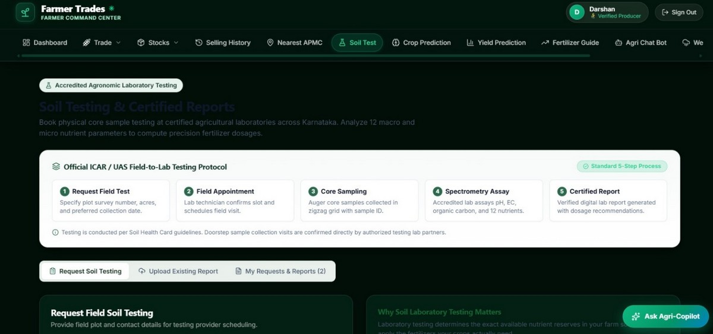
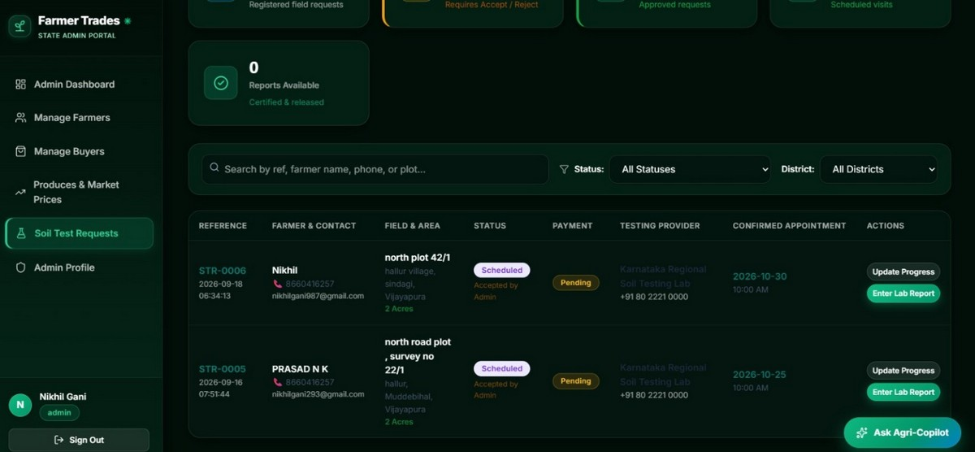
CHAPTER 11 (CONT.)
AKSHAYA INSTITUTE OF TECHNOLOGY
Dept. of Information Science & Engineering
PROJECT DEMONSTRATION: APMC LOCATOR & SOIL DIAGNOSTICS
Screenshots from live application: Nearest APMC locator, soil testing request booking & admin report workflow
Nearest APMC Locator
District-based mandi finder with GPS coordinates, live modal prices and Haversine distance.
Soil Testing Protocol Request
Farmer diagnostic booking form capturing farm location, crop history & ₹1,000 package fee.
Admin Soil Requests Management
Lab tracking dashboard to verify incoming soil samples, assign status & upload certified PDF reports.

Slide 16
CHAPTER 12
AKSHAYA INSTITUTE OF TECHNOLOGY
Dept. of Information Science & Engineering
CONCLUSION & IMPACT ON AGRARIAN ECONOMY
Comprehensive summary of project deliverables, technical achievements and socio-economic transformation
SUMMARY OF ACHIEVEMENTS
1. Disintermediation of Agricultural Commerce: Successfully built and verified a full-stack platform that removes exploitative middlemen, returning up to 35% more gross revenue directly to smallholder farmers.
2. Real-World Decision Intelligence: Embedded 18 regional Karnataka APMC mandis, live modal price benchmarks, and Haversine distance computations to prevent distress selling at farm gates.
3. Scientific Diagnostic Assurance: Established an ICAR-compliant 12-parameter soil testing pipeline with ₹1,000 transparent fee structure (₹500 lab + ₹500 digital health report), improving fertilizer efficiency.
4. Sustainable Monetization Model: Implemented tiered farmer subscriptions (₹500/1yr, ₹1,300/3yr, ₹2,000/5yr) ensuring platform self-sustainability while safeguarding marketplace authenticity.
5. Modern, Secure Full-Stack Engineering: Validated production-grade asynchronous FastAPI backend with SQLite persistence, PBKDF2 password cryptography, universal auth, and reactive Vite React frontend.
Farmer Trades demonstrates how modern software engineering, data science and transparent financial rails can empower agrarian communities with better connections, better information, and superior market opportunities.

Slide 17
CHAPTER 12 (CONT.)
AKSHAYA INSTITUTE OF TECHNOLOGY
Dept. of Information Science & Engineering
REFERENCES & BIBLIOGRAPHY
Statutory market resources, agronomic standards, academic citations and software frameworks utilized
[1] Karnataka State Agricultural Marketing Board (KSAMB)
Official Daily Mandi Market Rates & APMC Price Bulletins. https://ksamb.karnataka.gov.in/
[2] Indian Council of Agricultural Research (ICAR)
Soil Testing in India — Standard Analytical Methods & Nutrient Recommendation Protocols, New Delhi.
[3] University of Agricultural Sciences (UAS), Bangalore
Package of Practices for High-Yielding Agricultural & Horticultural Crops of Karnataka.
[4] FastAPI Framework & Documentation
High-performance Asynchronous Python Web APIs by Sebastián Ramírez. https://fastapi.tiangolo.com/
[5] SQLAlchemy Database Toolkit
The Python SQL Toolkit and Object Relational Mapper by Michael Bayer. https://www.sqlalchemy.org/
[6] React 18 & TypeScript Ecosystem
Official React Documentation (https://react.dev/) & TypeScript Language Specification.
[7] Vite Next-Generation Frontend Tooling
Evan You & Vite Core Team. https://vitejs.dev/
[8] Razorpay Developer API & Webhook Specifications
Cryptographic Signature Verification & Payment Rails. https://razorpay.com/docs/api/

Slide 18

THANK YOU!
Questions & Suggestions Are Welcome
FARMER TRADES — SMART AGRI-COMMERCE & PREDICTION PLATFORM
Akshaya Institute of Technology, Lingapura, Tumkur – 572106
Department of Information Science & Engineering

