Slide 1
DG INTERNS HUB
WEEK 8
ADVANCED WEB APPLICATION INTERNSHIP
REST API Development & Advanced Backend Engineering
Prepared by: [Nishanth G A] | Submission: 14 October 2026

Slide 2
Project Introduction
• DG Interns Hub is a job and internship portal developed across Week 7 and Week 8.
• Week 8 strengthens the backend behind user accounts, job discovery, and applications.
• Focus: maintainable architecture, secure APIs, database quality, and reliable integration.
DG INTERNS HUB • WEEK 8 02

Slide 3
Week 8 Objectives
• Build professional REST APIs and separate backend responsibilities.
• Implement CRUD, validation, middleware, and centralized errors.
• Add search, combined filters, pagination, and sorting.
• Secure endpoints and document/test them using Postman.
DG INTERNS HUB • WEEK 8 03

Slide 4
Backend Architecture
• Config: environment settings and MongoDB connection.
• Models: User, Job, and Application schemas, references, and indexes.
• Controllers: business logic; Routes: HTTP endpoint mapping.
• Middleware: authentication, roles, validation, and error handling.
• Keep server.js focused on setup and route mounting.
DG INTERNS HUB • WEEK 8 04

Slide 5
REST APIs
• Auth: register, login, current user, logout.
• Users: read, update, and delete own profile.
• Jobs: list, search, filter, read one, create, update, delete.
• Applications: apply, view own, read one, update status, delete.
• Use consistent JSON responses and suitable HTTP status codes.
DG INTERNS HUB • WEEK 8 05

Slide 6
Authentication & Authorization
• Hash passwords with bcrypt; never store plaintext passwords.
• Issue signed JWTs and verify them on protected routes.
• Use Bearer tokens in Authorization headers.
• Apply role-based permissions to privileged job/status operations.
• Candidates should only access their own profile and applications.
DG INTERNS HUB • WEEK 8 06

Slide 7
Security
• Required controls: JWT, password hashing, validation, protected routes, roles, environment variables.
• Additional controls: rate limiting, Helmet, CORS, request-size limits.
• Protect MongoDB queries and return safe error messages.
• Never commit .env, passwords, database URIs, or live tokens.
DG INTERNS HUB • WEEK 8 07

Slide 8
Database & Optimization
• Use Mongoose schemas, references, required fields, and unique constraints.
• Index normalized email and commonly queried fields where appropriate.
• Perform search/filter/sort/pagination in MongoDB.
• Prevent duplicate applications and avoid unnecessary queries.
• Verify actual collections and indexes before documenting results.
DG INTERNS HUB • WEEK 8 08

Slide 9
Postman Testing
• Test authentication, jobs, applications, and user endpoints.
• Cover invalid login, duplicate registration, invalid input, and missing/invalid tokens.
• Test wrong roles, search, combined filters, pagination, and sorting.
• Capture real success/error responses and retain the Postman collection.
• Postman testing has been reported completed; attach genuine evidence.
DG INTERNS HUB • WEEK 8 09

Slide 10
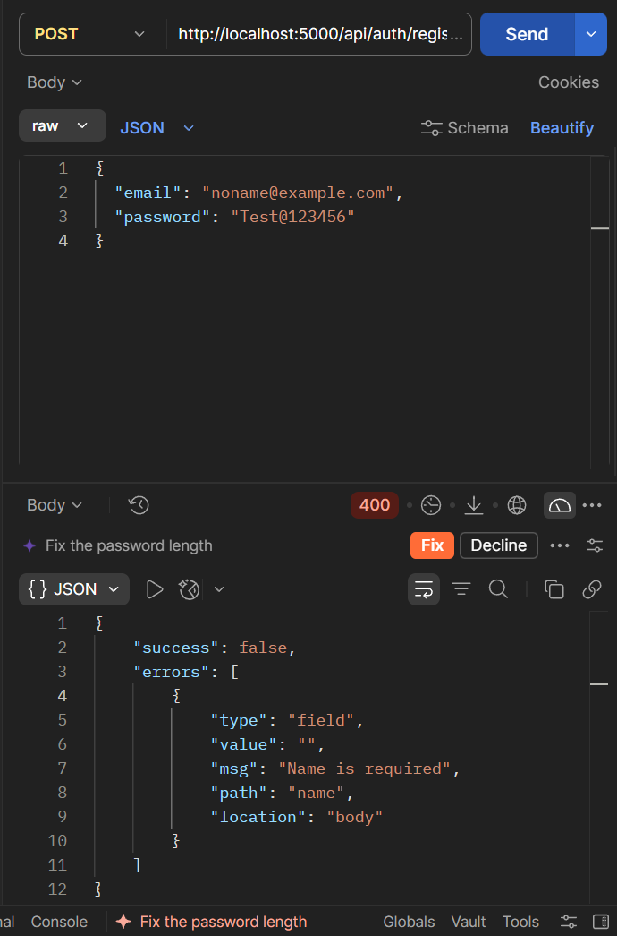
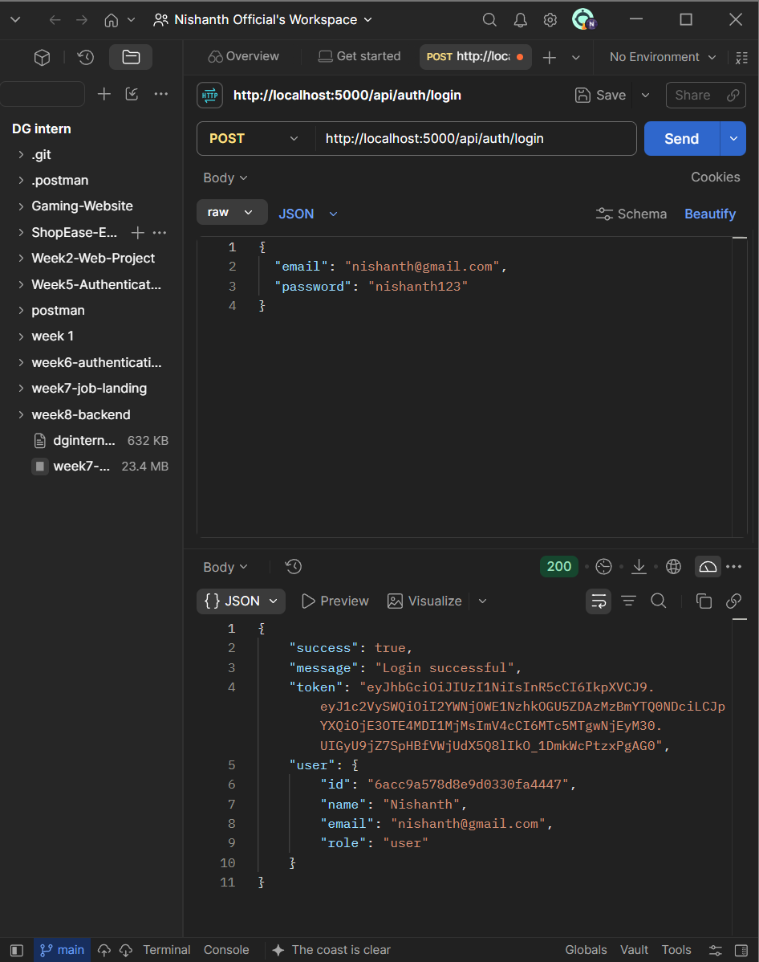
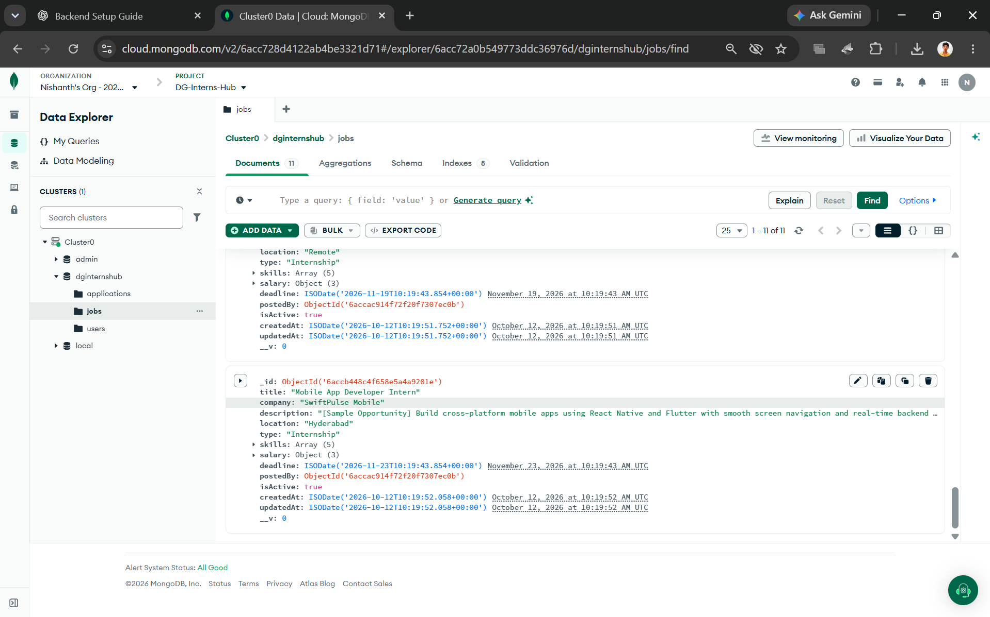
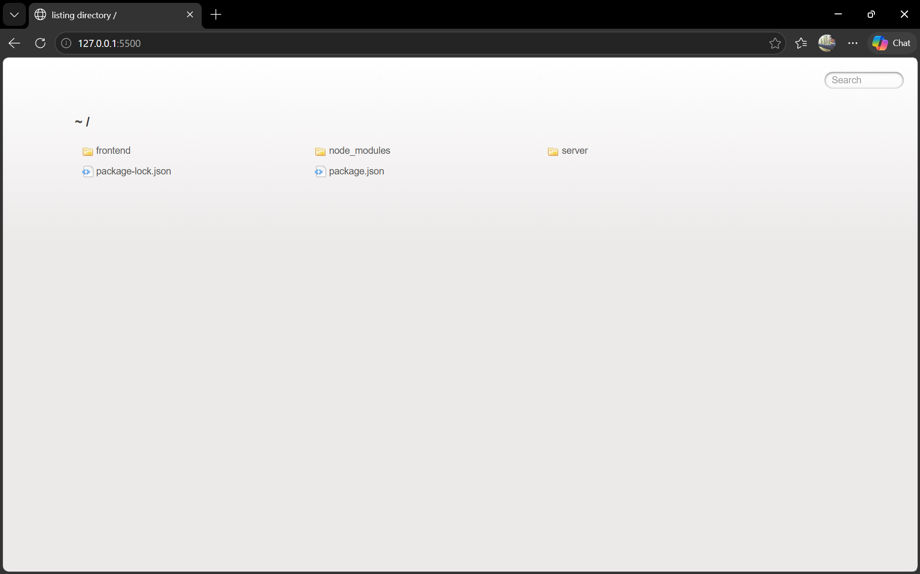
Screenshots & Conclusion
• Include folder structure, routes, authentication, search/filter, pagination, and Postman.
• Include success/error responses, MongoDB records, and GitHub repository.
• Complete API-DOCUMENTATION.md and README.md.
• Submit the 8–10 page report and this 9-slide presentation after replacing placeholders.
• Verify every claim against the running project; do not present unverified features as complete.
DG INTERNS HUB • WEEK 8 10

