Slide 1

THE BATTLE OF NEIGHBORHOODS: ISTANBUL CASE
GANI YAMAN

Slide 2
Table of Contents
Introduction: Business Problem
Description of the Data
Methodology
Analysis of the Data
Results
Discussion
Conclusion

Slide 3
Introduction: Business Problem
Istanbul is the most populated city in Turkey with an increasing migration constantly. In order to meet the needs of the growing population, new amnesties establishes continuously, thus, arises new opportunities for enterpreneurs
The aim of this project is the get insight for business purposes to find the best location to start a business like restaurants, cafe, arcade centers, and to get the best possible profitability out of the investment
The tool that will be utilized in this project is the Foursquare API. The geographical data acquired from Foursquare API will be used to access the venues information and so to compare the neighborhoods by applying clustering algorithms and finally to choose best option among boroughs.

Slide 4
2. Description of the Data
Istanbul has 39 districts in total. The coordinates of the boroughs of Istanbul attained from the Second-level Administrative Divisions of the Turkey from Spatial Data Repository of NYU
Also, the venues information of the boroughs is attained from Foursquare API
the center coordinates of each Borough are determined by using Google Map, 'Search Nearby' option
I will be using K-Means clustering model to analyze different clusters of boroughs and evaluate the venue information to establish a model which will determine the best location to start a business in Istanbul
Latitude and longtitude values attained by using geopy library and by using Latitude and Longtitude values, the map of Istanbul is created by Folium library

Slide 5
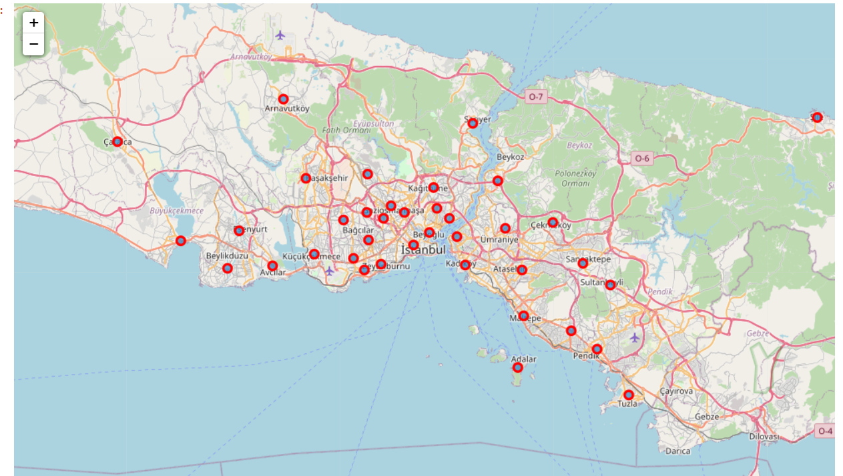
2. Description of the Data

Slide 6
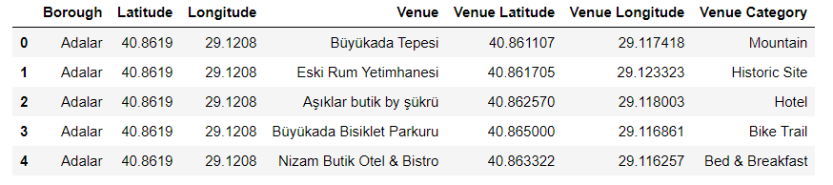
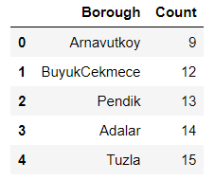
2. Description of the Data
We can explore the boroughs of Istanbul by using Foursquare API
1812 venues were found, and we can count venues per borough

Slide 7
3. Methodology
Now, we have the neighborhoods data of Istanbul (i.e total 39 neighborhoods). We also have the most popular venues in each neighborhood obtained using Foursquare API
A total of 1812 venues have been obtained in the whole city and 254 UNIQUE CATEGORIES. The least venue number is 9 which is in Arnavutkoy
We can perform one hot encoding on the obtained data set and use it find the 9 most common venue category in each neighborhood
Then clustering can be performed on the dataset. K - Nearest Neighbor clustering method have been used and to find the optimal number of clusters silhouette score metric technique is used
The clusters obtained can be analyzed to find the major type of venue categories in each cluster. The outcome then can be used to suggest business people, potential locations based on the category

Slide 8
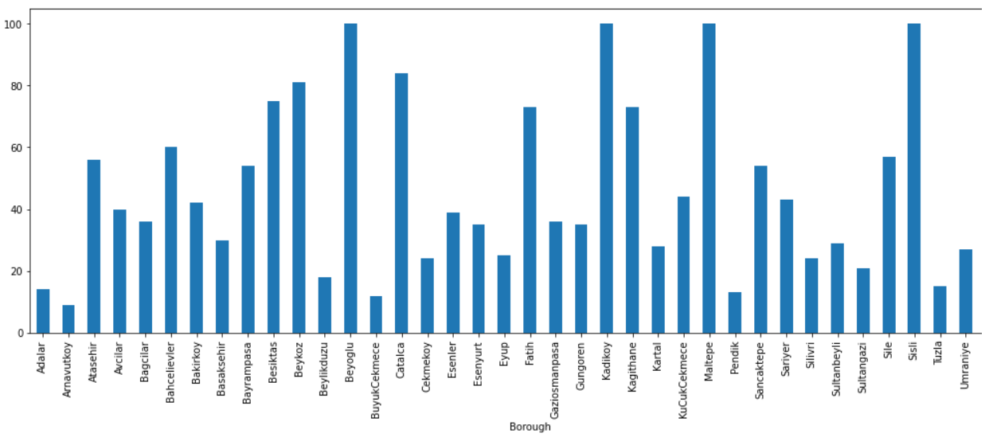
4. Analysis of the Data

Slide 9
4. Analysis of the Data
Some boroughs have not sufficient venues while others such as Beyoglu, Kadıkoy, Sisli have significantly higher number of venues
So, we have to cluster neighborhoods here by using k-Nearest Neighborhoods clustering technique. I will use the silhouette score to obtain the best value for the number of clusters
, the best number of clusters having the highest silhouette score is 3. So, we could consider the number of clusters as 3

Slide 10
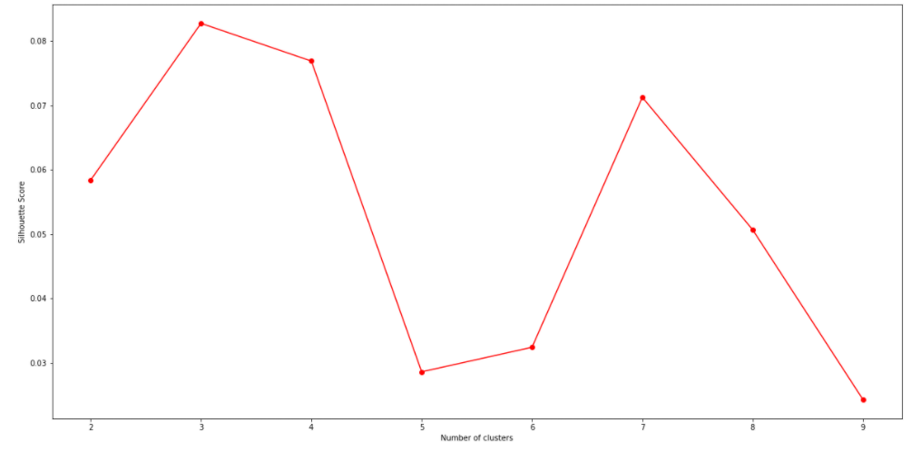
4. Analysis of the Data

Slide 11
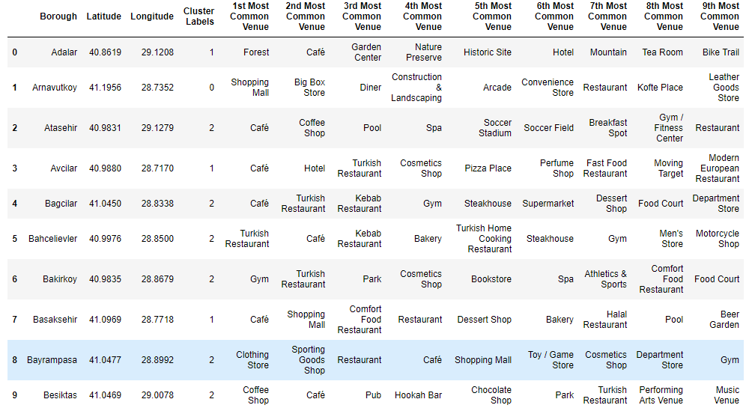
4. Analysis of the Data

Slide 12
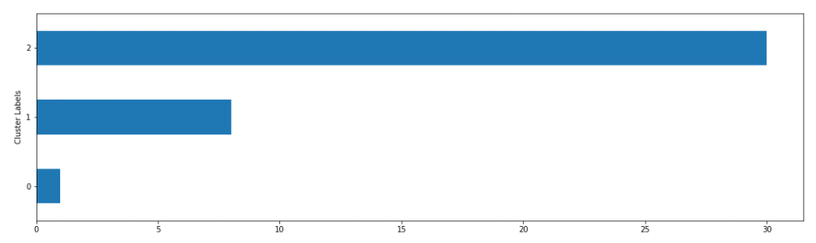
4. Analysis of the Data

Slide 13
4. Analysis of the Data
Cluster2 contains the highest cluster density. We need to find the geographic centroid for this cluster. This is the most suitable location for a new business set-up
With the help of reverse lookup, we can find the best suitable Neighborhood to locate a new business is in Fatih while we know the geographical coordinate of Fatih are (41.0252.221, 28.9491824) which is located around Balat

Slide 14
5. Results
We need to dig more to find out complimentary business set-ups in each cluster in order to suggest a most suitable cluster for new business set-up
So, let’s examine the clusters and find the discriminating venue categories that distinguish each cluster.
For this purpose, we should also print the nine most common venue category in each cluster
plots can be used to suggest valuable information to Business persons. Let's discuss a few examples considering they would like to start the following category of business

Slide 15
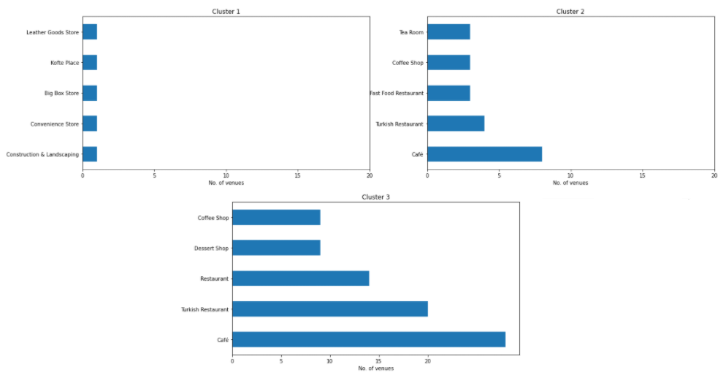
5. Results

Slide 16
6. Discussion
Let us discuss about appropriate business opportunity by Venue Category for certain targeted business set ups
A.Cafe
Cluster 3 has the highest number of cafes. To start a successful business we should find a place which has least number of the amnesty. Thus, Cluster 1 which is Arnavutkoy could be the best option for opening a cafe. Also, Cluster 2 could be the other option
B. Fast Food Restaurant
Cluster 3 seems to be best attraction for people as most of amnesties established in that region. This could be a good sign of locating a place to start-up a business. Also, our best place Fatih that we found before is also located in that cluster. However, there is not much Fast Food Restaurant in that region. So, it could be a good option to run a business in cluster 3

Slide 17
6. Discussion
C. Tea Room
Another popular amnesty is the room that is on the list in Cluster 2. However, we could not see much tea room in cluster 3. So, it could be good option for cluster 3.
D. Dessert Shop
We can see the high similarity between cluster 2 and cluster 3 in terms of amnesties. Therefore, we could suggest the Dessert Shop for cluster 2
This map can be used to find a suitable location to start a new business based on the Venue category. I have added a most suitable location on Istanbul map based on above analytics for a new business set-up
This map can also be used to select a vast suggestion area for a particular type of business based on the category

Slide 18
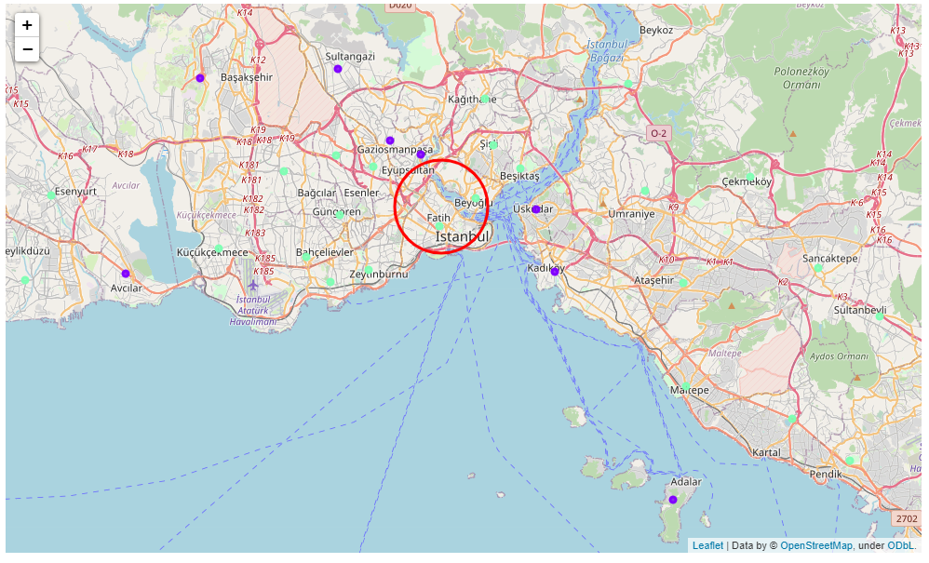
6. Discussion

Slide 19
Conclusion
The objective of this project was to analyze the boroughs of Istanbul and create a clustering model to suggest potential places to start a new business based on the category
The neighborhoods data was obtained from the Second-level Administrative Divisions of the Turkey from Spatial Data Repository of NYU and the Foursquare API was used to find the major venues in each neighborhood
Locations were used to create a clustering model. The best number of clusters i.e. 3 was obtained using the silhouette score. Each cluster was examined to find the most venue categories present, that defines the characteristics for that particular cluster
A few examples for the applications that the clusters can be used for have also been discussed. A map showing the clusters have been provided
Both these can be used by stakeholders to decide the location for the particular type of business
A major drawback of this project was that the Foursquare API returned only few venues in each neighborhood
As a future improvement, better data sources can be used to obtain more venues in each neighborhood
This way the neighborhoods that were filtered out can be included in the clustering analysis to create a better decision model

