Slide 1

Using computer vision for time series model identification with CNN
Data science-project (2024-hs)
ganjireb, goernjos, gallomor

Slide 2

Agenda
INTRODUCTION
GENERATE TIME SERIES DATA
CNN MODEL TRAINING
TESTING WITH REAL LIFE DATA
INTERACTIVE DASHBOARD
SUMMARY

Slide 3

INTRODUCTION
TIME SERIES MODELS
Autoregressive (AR)
Moving Average (MA)
Autoregressive Moving Average (ARMA)

Slide 4

Generating artificial data

Slide 5
Generating artificial data
72,000 time series plots generated
18 classes (e.g., AR_1_with_trend, MA_2_without_trend)
4,000 images per class
>50,000 data points to ensure a solid foundation
8 x 4 inches plot dimensions (width x height)
Orders 1, 2 and 3 for AR, MA and ARMA models
Randomized parameters for each generated plot
Seasonal patterns and trends added for realism

Slide 6
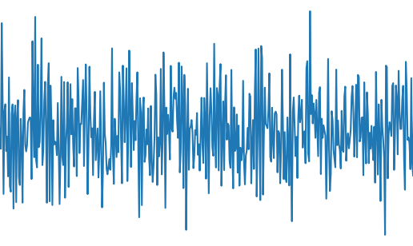
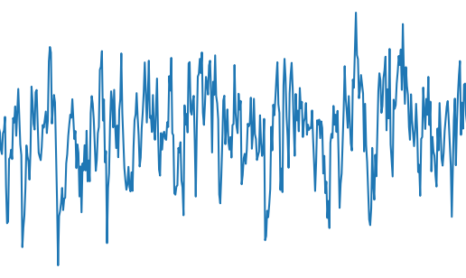
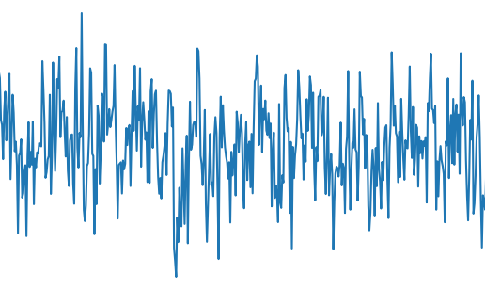
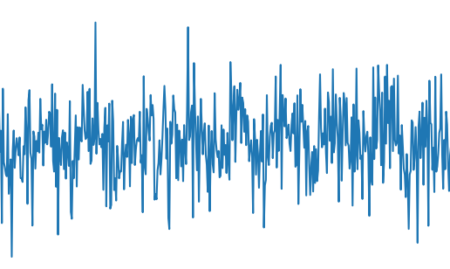
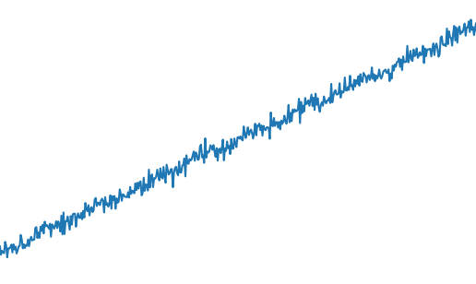
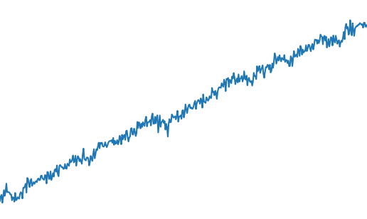
Time series plots
ARMA(2,2) without trend | ARMA(3,3) without trend
AR order 1 without trend | MA order 1 without trend
AR order 1 with trend | AR order 3 with trend

Slide 7
Model Exploration and challenges

Slide 8
Model exploration
25% training accuracy for the custom CNN (overfitting issue)
51% training accuracy after Hilbert curve transformation
36% validation accuracy after Hilbert transformation (generalization issue)
9 balanced classes selected for testing pretrained models
42% training accuracy for non-fine-tuned MobileNetV2
38% validation accuracy for non-fine-tuned MobileNetV2
50% training accuracy for fine-tuned MobileNetV2
35% validation accuracy for fine-tuned MobileNetV2 (overfitting risk)
<40% validation accuracy for EfficientNet, ResNet and SVM classifiers
6-class subset tested with Vision Transformer (ViT), but failed to outperform CNNs

Slide 9
Challenges & limitations
64x64 → 224x224 double image resizing issue degraded model performance
5-class limit per training batch due to memory constraints
Incremental training approach with ResNet-50 to manage memory
3 classes added at a time in incremental training
Kernel crashes forced manual reloading and retraining
Data Generator used to split and load data in batches
Catastrophic forgetting occurred in incremental training
Final model: 58% accuracy, but imbalanced across time series types
Time constraints forced proceeding despite shortcomings

Slide 10
Testing with real life data

Slide 11

Used data for testing
Real-world time series data tested from Kaggle weather datasets
2 Kaggle datasets in CSV format used for evaluation
Seasonal patterns and trends present in datasets for classification testing
Dataset 1: Python Project on Weather Dataset (hourly weather data from 2012)
Dataset 2: Hourly Weather Data in Gallipoli (2008–2021, multiple attributes)
Pre-generated time series plots of AR, MA and ARMA models used for further testing

Slide 12
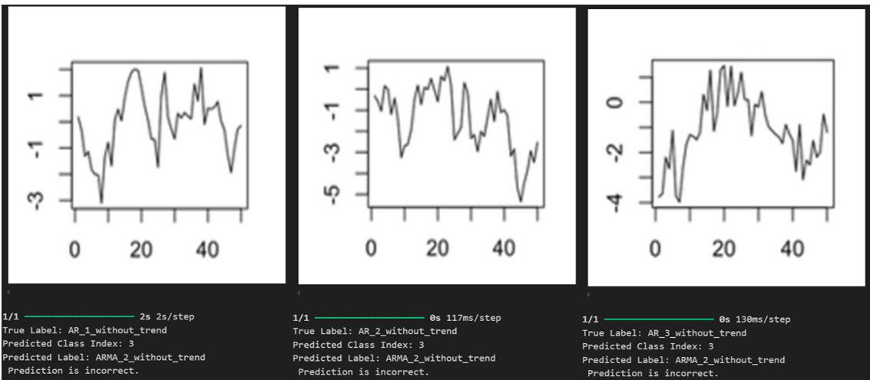
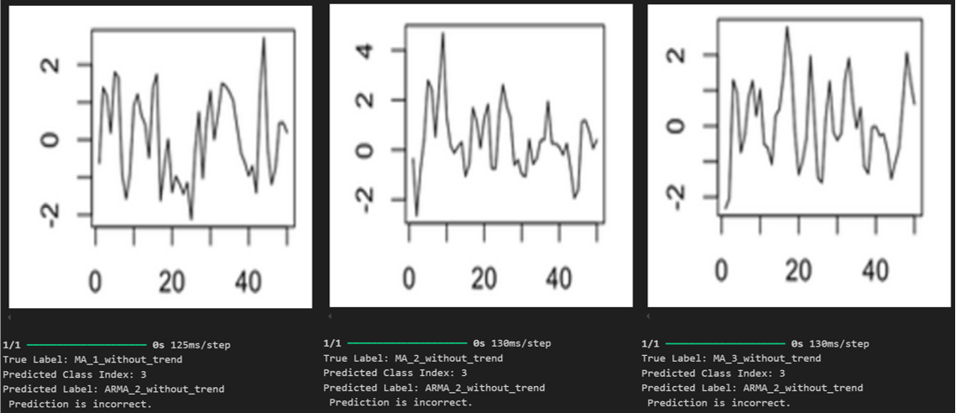
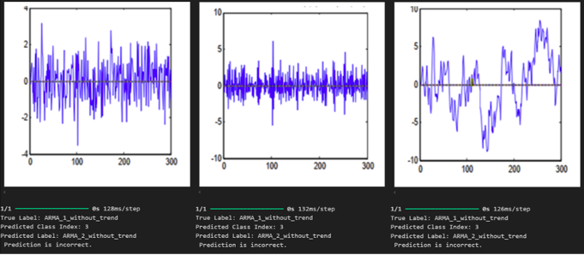
Testing results
Model bias: Consistently classified time series as ARMA_2_without_trend
Kaggle datasets contained raw, non-stationary data, making classification difficult
Lack of preprocessing (ACF and PACF analysis) impacted model performance
ARMA(1,1) images were also misclassified as ARMA_2_without_trend
Bias: Last trained dataset contained predominantly ARMA_2_without_trend examples
Future improvements: Feature extraction and a more balanced dataset needed for accuracy

Slide 13
Dashboard

Slide 14

SUMMARY
Explored ML Methods: Tested CNN-based models, Hilbert curves, SVM classifiers, and Vision Transformers for time series classification
Challenges Faced: Encountered catastrophic forgetting, model bias toward ARMA, misclassification issues and preprocessing difficulties
Key Findings: Poor generalization affected accuracy, but solutions like knowledge distillation and alternative representations helped
Learning Experience: Gained hands-on experience in model selection, hyperparameter tuning and computational efficiency.
Critical Thinking in ML: Learned to analyse patterns, question assumptions and refine approaches through data-driven insights.

Slide 15
THANK YOU
Rebecca Ganjineh, Josephine Görner, Moreno Gallo

