Slide 1


AOI Quick Tutorial
AOI01-AOI Basics
Hsueh-Ting Chu

Slide 2
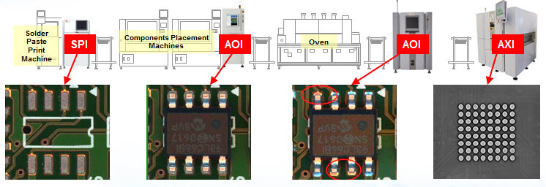
Automated Optical Inspection
SPI (Solder Paste Inspection)
AOI (Auto Optical Inspection)
AXI (Automatic X-ray Inspection)

Slide 3
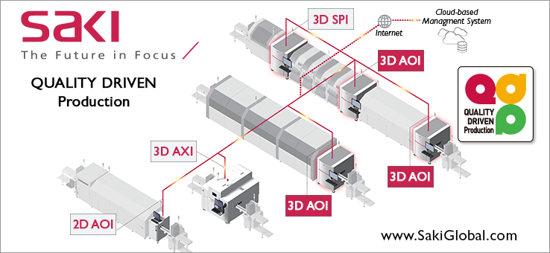
SPI, AOI, AXI
SPI (Solder Paste Inspection)
AOI (Auto Optical Inspection)
AXI (Automatic X-ray Inspection)

Slide 4
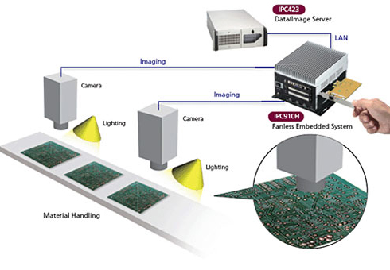
AOI system architecture

Slide 5
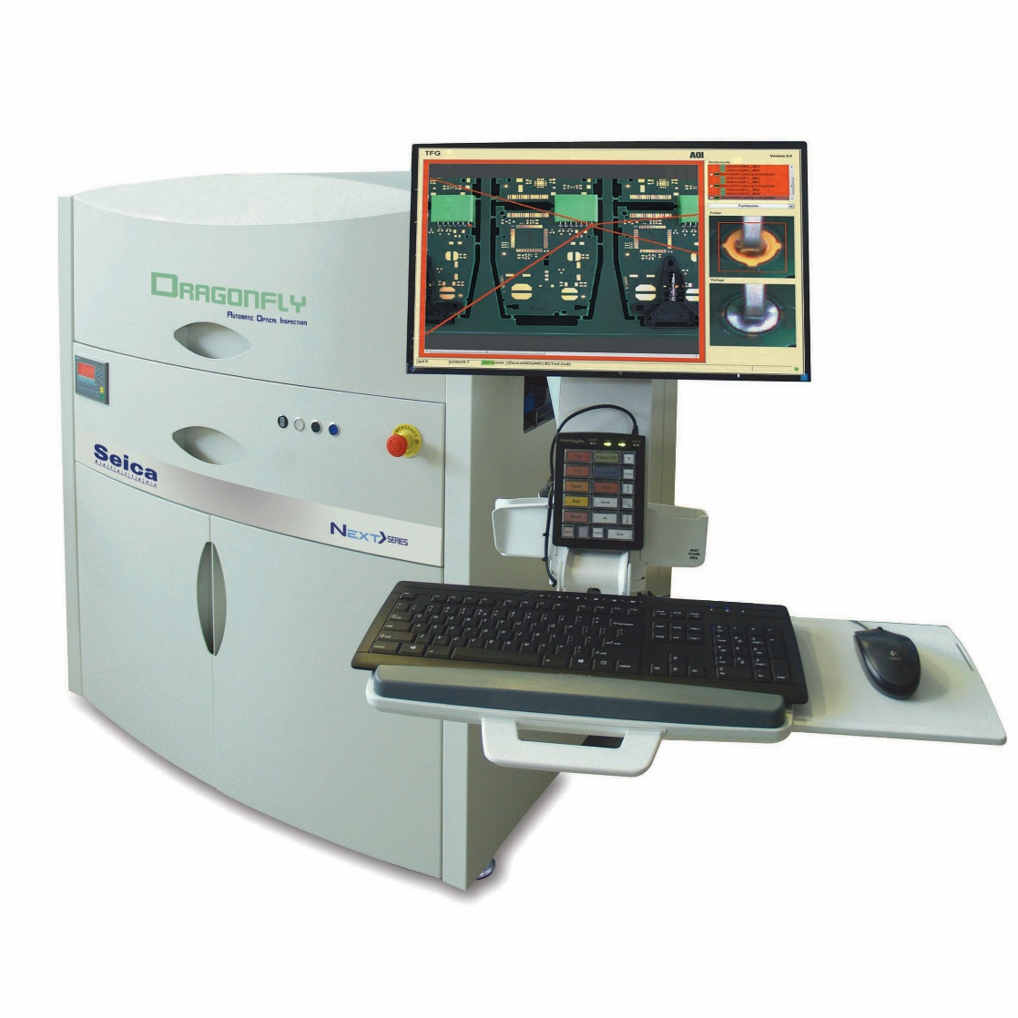
AOI Machine

Slide 6
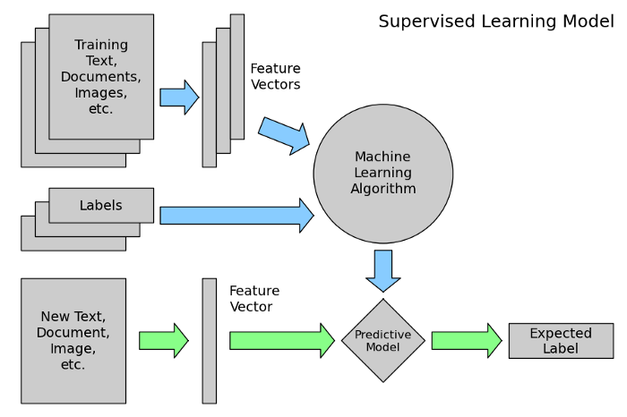
Machine Learning model

Slide 7
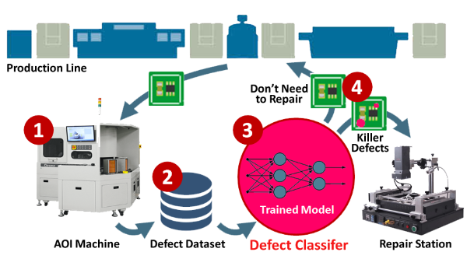
AOI with Deep Learning models

Slide 8
Q&A
T
hanks!

