Slide 1


AOI Quick Tutorial
AOI02-Aidea AOI Project
Hsueh-Ting Chu

Slide 2

Aidea platform
Artificial Intelligence Collaboration Platform by ITRI(Industrial Technology Research Institute)
Solving real AI industrial issues in Taiwan
Building AI industrial datasets in Taiwan

Slide 3
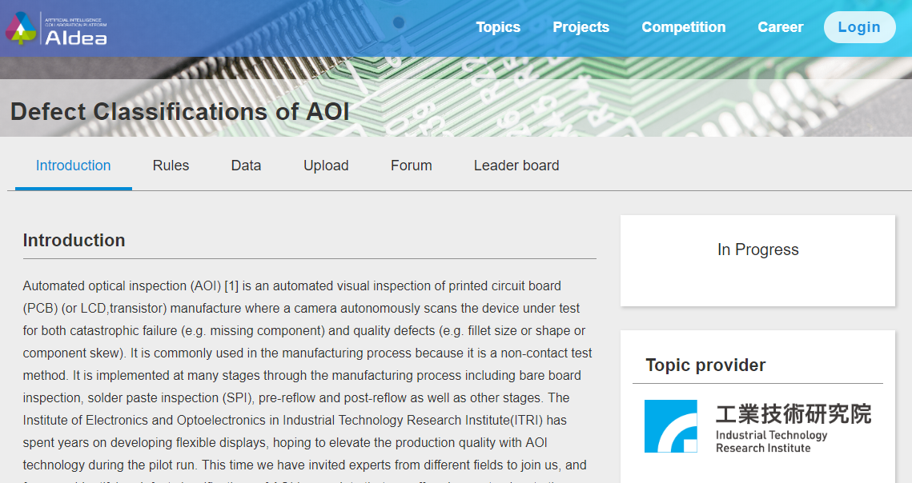
Open Topic: Defect Classifications of AOI
https://aidea-web.tw/topic/a49e3f76-69c9-4a4a-bcfc-c882840b3f27
The top three exceeding Baseline score (0.998521) on Private Leaderboard would be awarded

Slide 4
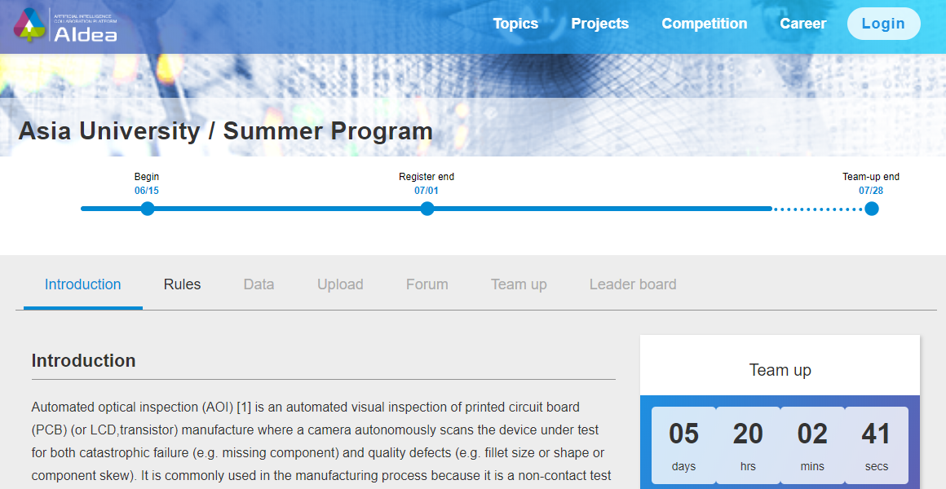
Closed Project: Defect Classifications of AOI

Slide 5
AOI Study for AU AI summer program
Same dataset:
Open Topic: Defect Classifications of AOI
Closed Project: Defect Classifications of AOI
Dataset is available from the Open Topic.
Closed Project is for ranking.

Slide 6
AOI data discription
There are six categories included in image data that the issue offers (1 normal category + 5 defect categories)
The download data file (aoi_data.zip) includes:
train_images.zip: image data for training (PNG format), 2,528 images in total.
train.csv: includes 2 columns, ID and Label.
ID: the image filename
Label: defect classification category (0: normal, 1: void, 2: horizontal defect, 3: vertical defect, 4: edge defect, 5: particle)
test_images.zip: image data for testing (PNG format), 10,142 images in total.
test.csv: includes 2 columns, ID and Label.
ID: the image filename
Label: defect classification category (the value can be only one of the following numbers: 0, 1, 2, 3, 4, 5)

Slide 7
Q&A
T
hanks!

