Slide 1
AU AI Summer Program AOI Project
Hsueh-Ting Chu

Slide 2
Content
Introduction to AOI defect classification
Program flow
TensorFlow implementation and program explanation

Slide 3

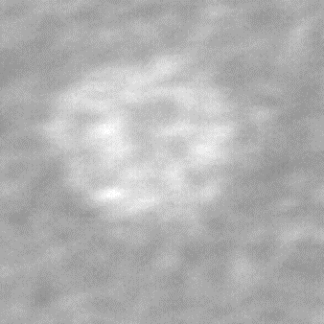
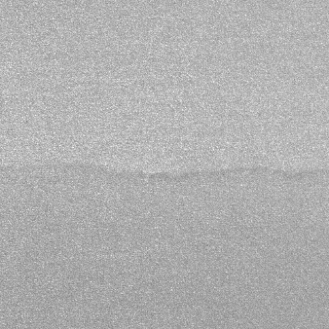
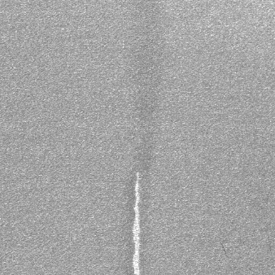
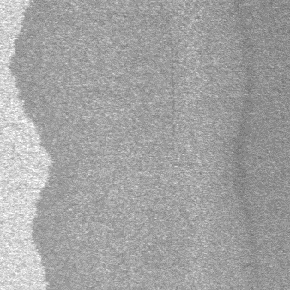
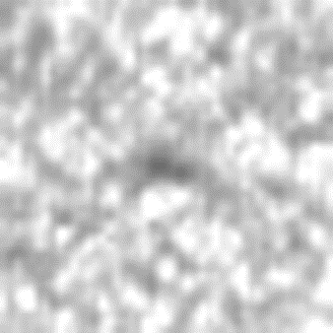
Automated Optical Inspection (AOI) defect classification project
Six class of AOI images:
normal、void、horizontal defect、vertical defect、edge defect、particle

Slide 4
Training Set
test_images.zip：
For the testing of Deep Learning models.
The number of images (PNG format) is 2,528. 。
train.csv：the labels of images contains two fields: ID and Label。
Size of training images is 512*512.
ID | Label
train_00000.PNG | 0
train_00001.PNG | 1
train_00002.PNG | 1
…. | …
train_02527.PNG | 5

Slide 5
Test Set
train_images.zip：
For the training of Deep Learning models.
The number of images (PNG format) is 10,142.
test.csv：ID without labels.
Size of test images is 512*512.
ID | Label
test_00000.PNG
test_00001.PNG
test_00002.PNG
….
test_10141.PNG

Slide 6
Target
Fill in the lables in test.csv and upload the file test.csv。
ID | Label
test_00000.PNG | 1
test_00001.PNG | 3
test_00002.PNG | 5
….
test_10141.PNG | 0

Slide 7
The workflow of AOI with Deep Learning models
Definition of problem
Collecting and cleaning up data
Select and build DL models
Evaluate results and adjust model parameters
Submit results

Slide 8
AOI Program with a VGG model
Read dataset
Setup parameters of VGG16 model
Train and Evaluate result

Slide 9

Keras implementation and program explanation
Upload data using google drive

Slide 10


Setting data path
Set folder path
Read the file names in the folder directory

Slide 11

Read images under the folders

Slide 12

Read the image Convert the image to array Add the dimension to the front of the array Save the array to the list

Slide 13
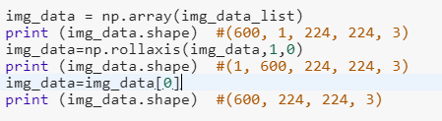
Using np.array to convert the list into Network input check the shape of input data

Slide 14
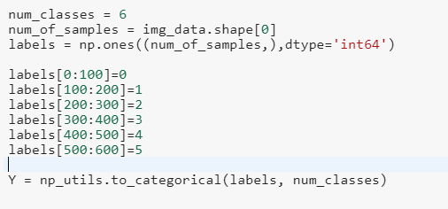
Labeling the images One-hot encoding Labels

Slide 15

Split images into training set and test set

Slide 16
Use the VGG16 model include_top to retain the top three layers of the fully connected layer include_top = ture default input is (224, 224, 3) must be adjusted to False printed model layer for overview

Slide 17

Take the last layer of the model just printed out the category and activation function of the Dense data. Create a model and put it in the top input and the bottom output and print it out.

Slide 18
Set the model's loss function optimizer And list the accuracy rate

Slide 19
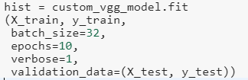
Training parameters required for training models Batch_size number of samples per batch of training Epochs training times Verbose process display mode Validation test data set

Slide 20

Evaluate the accuracy of the trained data
Predict test data
Print out the predicted Label value

Slide 21
Predict the labels of images in the AOIdata_test folder
Data_path = PATH + '/AOIdata_100‘
Data_path = PATH + '/AOIdata_test'
#############Predict 60 copies
Prediction = custom_vgg_model.predict(img_data)
Predict = np.argmax(prediction, axis=1)
Print(predict)

