Slide 1


Implementation of Chat bot
using NLP
19WJ1A0594 G Padma Priya

Slide 2

Learning Objectives
Python Basics
Python is a widely used programming language for AI and ML applications.
Installed libraries like nltk, sklearn, and streamlit for NLP tasks.
Logistic Regression statistical model used for classification tasks.
Vectorization
Converts text data into numerical format so that ML models can process it.
TF-IDF (Term Frequency - Inverse Document Frequency) is used for feature extraction.
Helps assign importance to words based on their frequency in a document vs. the entire dataset.
GOAL
Source :
www.freepik.com/

Slide 3
Tools and Technology used
Jupyter Notebook and Visual Studio Code – Used for initial model training and testing in an interactive environment.
Python File for Local Deployment – Allows chatbot execution outside Jupyter, ensuring flexibility.
Streamlit for Frontend & Logistic Regression
Streamlit is used to create a web-based chatbot UI.
Allows easy interaction with the model via a simple, user-friendly interface.

Slide 4
Methodology
Libraries Installe:
nltk for Natural Language Processing (NLP), sklearn for vectorization (TF-IDF) and classification (Logistic Regression).streamlit for UI.
HTTPS & HTTP Permissions
Disabled SSL certificate verification for proper access (ssl._create_unverified_context).
NLTK Installation & Punkt Tokenizer
nltk.download('punkt') ensures sentence tokenization works correctly.
Tokenization breaks down sentences into meaningful words (tokens) for NLP processing.
Vectorization using TF-IDF
Converts text into numerical format for ML models.Ensures important words get higher weights and common words get lower weights.
Classification - Logistic Regression
Trains the model to identify the most probable intent from user input.
Uses predefined intents dataset to map inputs to responses.
Trained Model & Custom Functions
Created a custom function that Vectorizes input text.Uses the trained Logistic Regression model to predict the intent.
Returns the best-matching response.
Frontend with Streamlit
Interactive UI for users to chat with the bot.Supports emoji reactions, chat history, and quick replies.

Slide 5
Problem Statement:
With the increasing use of chatbots in various industries, a major challenge remains: understanding human language accurately. Many existing chatbots fail to interpret user queries correctly, leading to irrelevant or repetitive responses. To address this, our chatbot leverages NLP techniques such as tokenization and vectorization (TF-IDF) to preprocess user input and extract meaningful information. It then uses Logistic Regression for classification, allowing it to predict user intent with high accuracy. This approach ensures a more intelligent and adaptable chatbot that can better understand human language, provide relevant responses, and improve overall user interaction.

Slide 6
Solution:
Our solution integrates tokenization, vectorization (TF-IDF), and machine learning (Logistic Regression) to accurately classify user intent and provide meaningful responses.
NLTK's Punkt tokenizer, breaks down sentences into words (tokens), enabling better analysis.
TF-IDF vectorizer converts text into numerical format, assigning higher importance to meaningful words while filtering out common words.
The trained model predicts the user’s intent based on learned patterns and selects the most relevant response.
Users can easily chat with the bot, and the conversation history is logged for future reference.
Enhances user engagement by making interactions more intuitive and expressive.

Slide 7
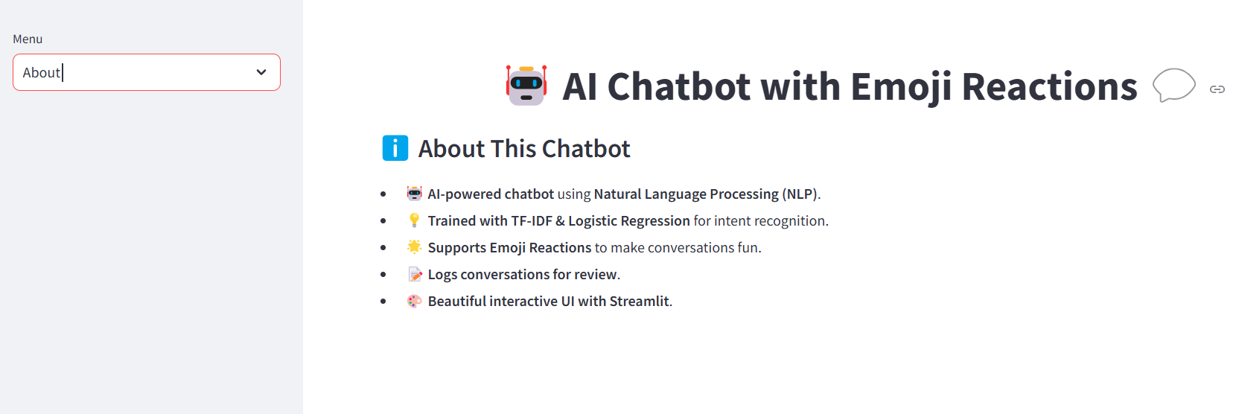
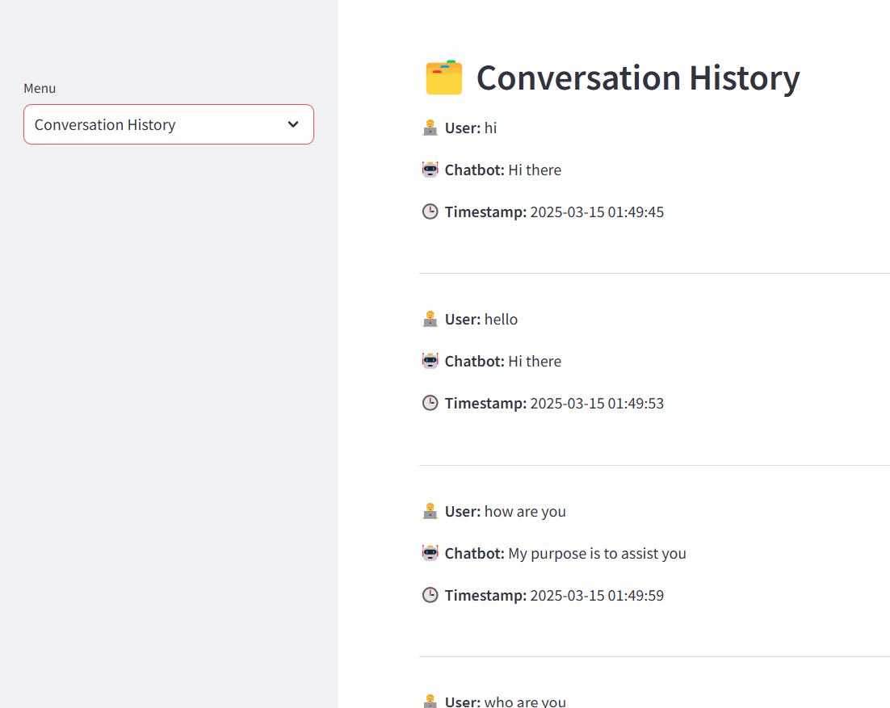
Screenshot of Output:

Slide 8
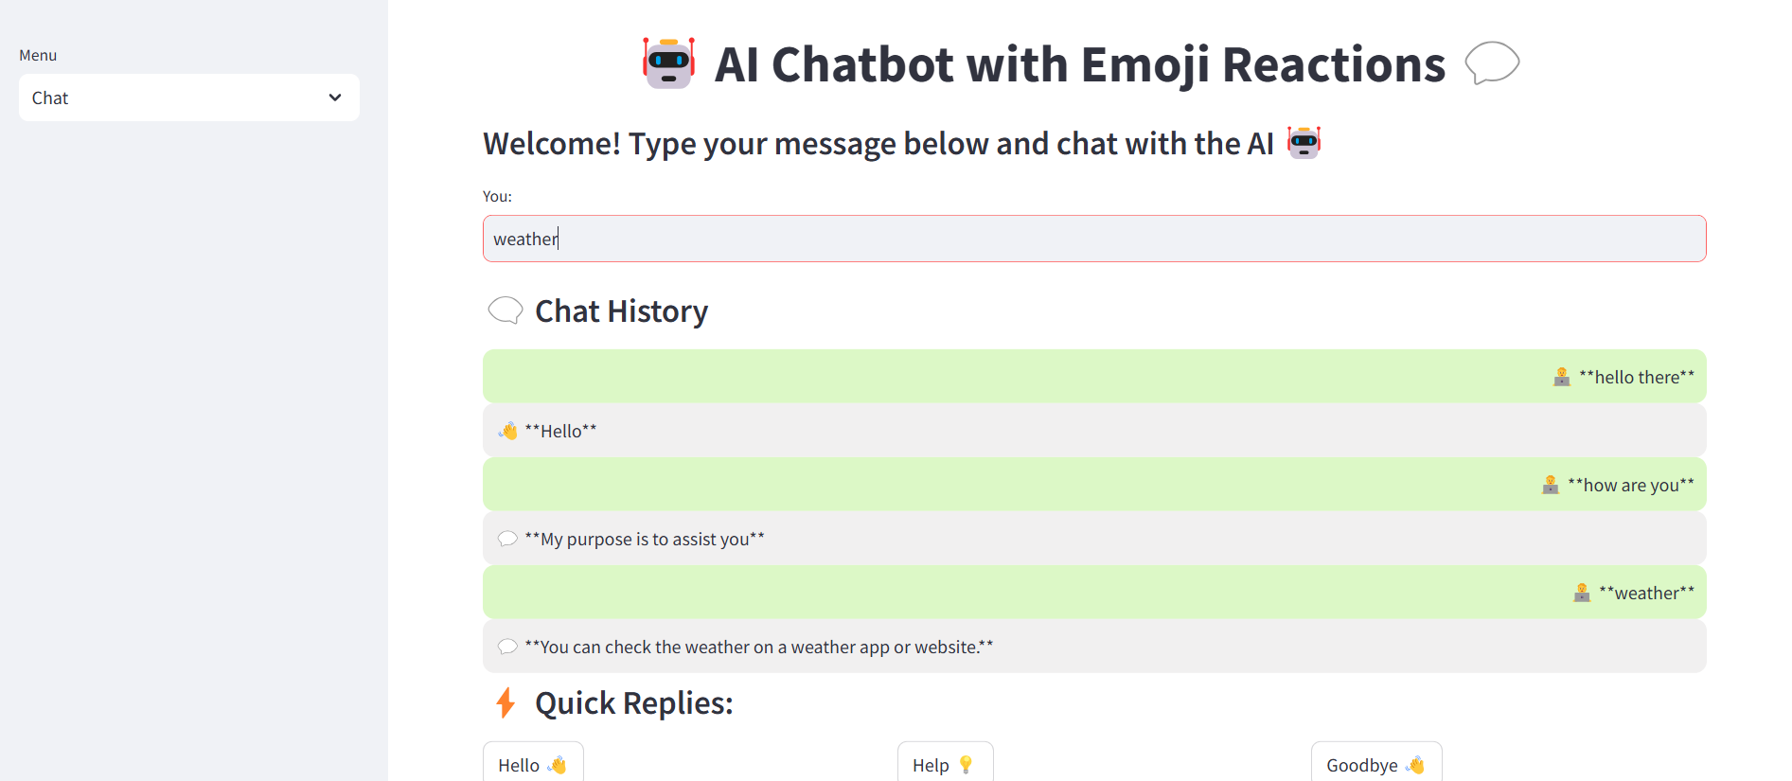
Screenshot of Output:

Slide 9
Conclusion:
Developed an AI chatbot using NLP & Logistic Regression in python.
Successfully understands user intents and provides appropriate responses.
Created a web-based chatbot UI with emoji reactions & conversation history log for future considerations.

