Slide 1
CLOUDBRUST PREDICTION SYSTEM
CSE7101- Capstone Project
Review-2
Batch Number: CSE_213
Under the Supervision of,
Mr.Jerrin Joe Francis
Assistant Professor
School of Computer Science and Engineering
Presidency University
Roll Number | Student Name
20221CSE0149 | Vandana.G
Name of the Program: B.Tech CSE
Name of the HoD: Dr. Asif Mohammed
Name of the Program Project Coordinator: Dr. Jayavadivel Ravi
Name of the School Project Coordinators: Dr. Sampath A K , Dr. Geetha A

Slide 2
Problem Statement Number: PSCS_61
Organization: Presidency University
Category (Hardware / Software / Both) : Software
Problem Description:
Cloudbursts are sudden, extreme rainfall events often leading to flash floods and catastrophic damage. They are difficult to predict due to their localized and rapid onset nature.
Currently, most rainfall prediction models lack the resolution and real-time analysis needed to accurately forecast cloudbursts, leading to unpreparedness in vulnerable regions.

Slide 3
Abstract
Cloudbursts are sudden and extreme rainfall events that cause severe flooding, landslides, and damage to life and property, especially in hilly and mountainous regions. Predicting cloudbursts is a major challenge due to their highly localized and abrupt nature. This research proposes a machine learning-based Cloudburst Prediction System that leverages meteorological data such as temperature, humidity, rainfall intensity, and wind speed to forecast the likelihood of a cloudburst. Several supervised learning algorithms including Logistic Regression, Naïve Bayes, Random Forest, and Support Vector Machine (SVM) were trained and evaluated on a labelled dataset. Experimental results show that Random Forest achieved the highest accuracy among the tested models, followed closely by SVM. The system also provides visualization and deployment capabilities to enable real-time predictions. This work demonstrates the effectiveness of machine learning in disaster management and provides a scalable framework for predictive analytics in meteorology.

Slide 4
Literature Survey
Statistical Models (ARIMA, regression, time series): Simple but fail with non-linear chaotic rainfall patterns [9].
Machine Learning (RF, SVM, Ensembles): Improved accuracy but lacked real-time alerts & deployment [1–4,8].
Deep Learning (LSTM, CNN, CNN-LSTM): Captures temporal & spatial patterns well, but needs big data + high computation [2,6,7].
Domain-specific / GIS / Cloud computing models: Accurate but region-limited or costly [5,9,10].
Rule-based Systems: Fast, interpretable, good for real-time responsiveness [4].
Web/API-based Systems: Enable user-friendly, cross-platform apps [1,3,8].
Our Project: Combines real-time APIs + Java-based lightweight design + rule-based predictions + visualization & alerts, making it practical, cost-effective, and deployable.

Slide 5
Literature Review
Ref No | Title Of The Paper | Name Of The Author And Year | Method used | Merits | Demerits
1 | Deep Generative Probabilistic Nowcasting | Ravuri et al., 2021 | Deep generative probabilistic model using radar inputs | Captures uncertainty; improved skill for moderate/heavy rainfall; better than ConvLSTM/U-Net baselines | Blurred long-lead forecasts; high computational cost; needs physical constraints
2 | Statistical + ML Hybrid Models for Indian Rainfall Forecasting | Kumar et al., 2021/2024, IMD | ARIMA/SARIMA + ML hybrid residual correction | Works well for seasonal patterns; hybrid improves extreme event detection; stresses need for local datasets | Pure statistical models weak for extremes; dependent on dataset quality; requires operational retraining
3 | Comparative ML Study for Rainfall Prediction | Latif et al., 2023 | LSTM/GRU + XGBoost/RF with engineered temporal features | Good general performance; stresses importance of feature representation and nonstationarity handling | RMSE hides extremes; needs event-aware sampling; algorithm choice less important than features
4 | Transfer Learning for Regional Rainfall Nowcasting | Inoue et al., 2022 | Transfer learning from wide domain to local domain | Better skill where local data are limited; learns general convective structures | Domain shift issues; needs domain adaptation; orographic variations reduce accuracy

Slide 6
Objectives
To develop a predictive model for detecting potential cloudburst events in real time.
To use meteorological, atmospheric, and historical rainfall data for accurate predictions.
To provide early warnings to minimize loss of life and property.
To visualize prediction results for better interpretability by disaster management authorities.

Slide 7
Existing Methods and Drawbacks
Cloudbursts are sudden, intense rainfall events that can cause flash floods and significant damage in a short span of time.
Traditional meteorological prediction methods often fail to detect such events early due to the highly localized and rapid nature of cloudbursts.
Existing works in weather monitoring have used such APIs to build real-time dashboards for disaster preparedness. However, most focus on general rainfall forecasting rather than specialized cloudburst detection with automated alert systems.Our project bridges this gap by fetching real-time weather data, applying threshold-based logic for cloudburst conditions, and triggering alerts.

Slide 8
Github Link
https://github.com/gannevandana/CloudBrust-Prediction-System

Slide 9
Algorithm Details
To predict the risk level of a cloudburst (High, Moderate, Low) by analyzing weather data using logical if-else rules and algorithms.
Inputs (Weather Parameters):
Rainfall (in mm/hour)
Humidity (in %)
WindPressure (in hPa)
(Optional) windSpeed (in km/h)
Outputs:
"High Risk" – Conditions strongly indicate a possible cloudburst
"Moderate Risk" – Conditions are concerning, but not extreme
"Low Risk" – Safe or normal weather conditions

Slide 10
Pseudo Code
function predictCloudburstRisk(weatherData):
rainfall = weatherData.rainfall // mm/hr
humidity = weatherData.humidity // %
cloudCover = weatherData.cloudCover // %
windSpeed = weatherData.windSpeed // km/h (optional)
pressure = weatherData.pressure // hPa (optional)
if rainfall > 100:
return "High Risk"
else if humidity > 90 AND cloudCover > 80:
return "Moderate Risk"
else if windSpeed > 50 AND pressure < 1000:
return "Moderate Risk"
else:
return "Low Risk"

Slide 11
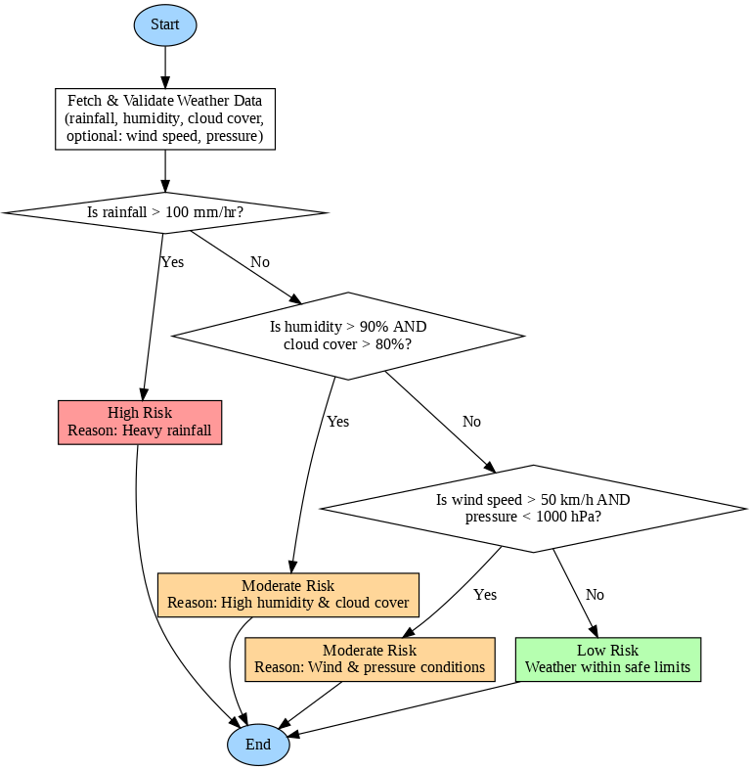
Flow Chart

Slide 12
Proposed method and feasibility study
Proposed Methodology
Data Acquisition – Collect real-time & historical weather data (temperature, humidity, rainfall, wind, pressure) using APIs like WeatherAPI/OpenWeatherMap.
Data Processing – Preprocess and filter data in Java; handle missing/erroneous values.
Prediction Model – Apply rule-based thresholds (e.g., humidity + rainfall + pressure drop) to identify potential cloudburst; future scope to integrate ML (e.g., Random Forest/LSTM).
Visualization & Alerts – Display weather trends via JavaFX/JFreeChart UI, and trigger alerts (email/SMS) when thresholds are exceeded.
Validation – Compare predictions with historical events to measure accuracy and improve rules.

Slide 13
Proposed method and feasibility study
Feasibility Study
Technical Feasibility – Implemented using Java (cross-platform), APIs, JavaFX; minimal hardware; optional ML integration possible.
Operational Feasibility – User-friendly UI, real-time monitoring, useful for authorities, disaster management, and researchers.
Economic Feasibility – Low-cost (free APIs, open-source tools), no need for expensive infrastructure.
Schedule Feasibility – Core system (API integration, rule-based prediction, UI) achievable in project timeline; advanced ML can be added later as extension.

Slide 14
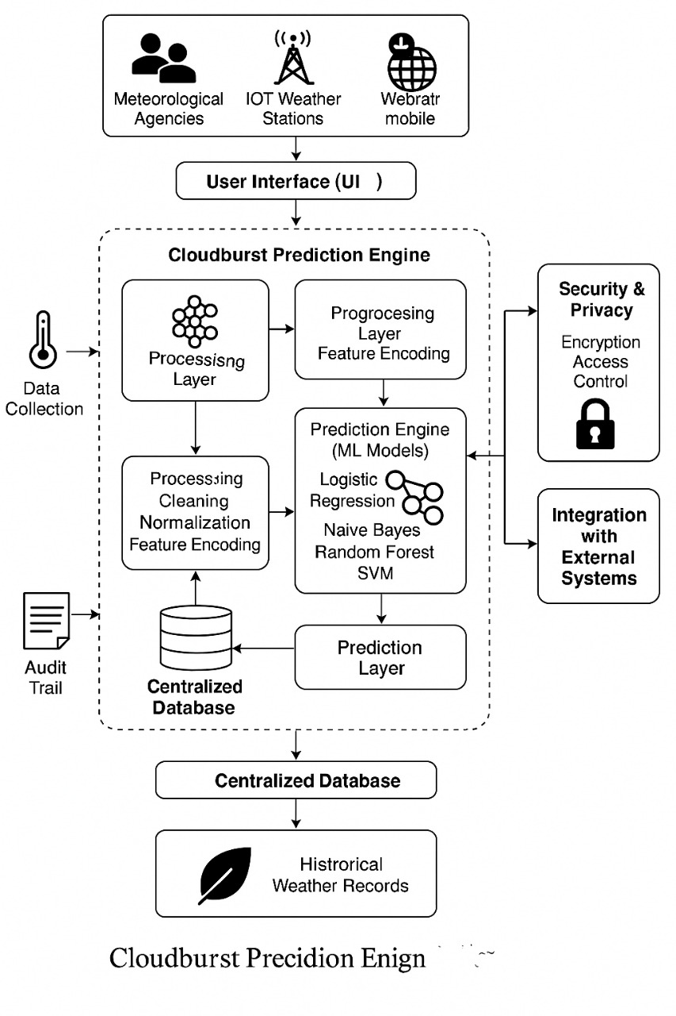
Architecture

Slide 15
Modules
1.User Interface (ReactJS)
Built using ReactJS, this module provides a dynamic and responsive front-end.
Users can input their location to receive predictions.
It fetches data from the backend and displays alerts, weather conditions, and system status.
Admins can log in to access dashboards and manage configurations.
2. Backend API (JavaScript)
Acts as the central processing unit of the system.
Receives requests from the UI and routes them to appropriate services.
Fetches weather data from external APIs and forwards it to the Alert Rules Engine.
Handles authentication, logging, and configuration updates.
3. Weather Data Source
Connects to third-party APIs like OpenWeatherMap.
Retrieves real-time weather metrics such as rainfall intensity, humidity, temperature, and pressure.
Sends this data to the backend for further processing.

Slide 16
Modules
4. Alert Rules Engine
Evaluates incoming weather data against predefined thresholds.
Uses logical conditions (e.g., rainfall > 100mm/hr) to detect cloudburst risks.
If conditions are met, it triggers alerts and logs the event.
Can be updated dynamically via the Configuration Manager.
5. Notification Module
Receives alert triggers from the Alert Rules Engine.
Sends notifications to users via:
• On-screen alerts in the UI
• Email and SMS messages
Ensures alerts are delivered promptly and reliably.
6.Data Logger
Records all weather data and alert events.
Stores information in a structured format for future analysis.
Supports audit trails and historical trend evaluation.

Slide 17
Modules
7. Admin Dashboard
Provides a secure interface for system administrators.
Displays system status, active alerts, and historical logs.
Allows admins to manage alert rules, user access, and configurations.
8. Authentication Service
Manages login and access control for users and admins.
Verifies credentials and maintains session security.
Ensures only authorized users can access sensitive features.
9. Logging & Monitoring Service
Tracks system performance, errors, and operational events.
Logs backend activity and monitors service health.
Provides insights for debugging and system optimization.

Slide 18
Hardware & Software
Hardware Requirements Minimum (for development/testing)
Processor: Intel i3 (10th Gen) / AMD Ryzen 3 or equivalent
RAM: 4 GB
Storage: 20 GB free space
Network: Stable broadband internet (≥ 10 Mbps)
Device: Standard PC / Laptop with browser support
Software Requirements Frontend (User Side)
Framework: ReactJS
Languages: JavaScript, HTML5, CSS3
Visualization: Chart.js
Browser Compatibility: Chrome, Firefox, Edge, SafariBackend (Server Side)
Runtime Environment: Node.js (v16 or above)
Framework: Express.js (for API handling)
Data Handling: REST APIs / WebSockets for real-time updates
Notification Service: Twilio / Firebase Cloud Messaging / SMTP for alertsDatabase
Cloud DB: Firebase / MongoDB Atlas

Slide 19
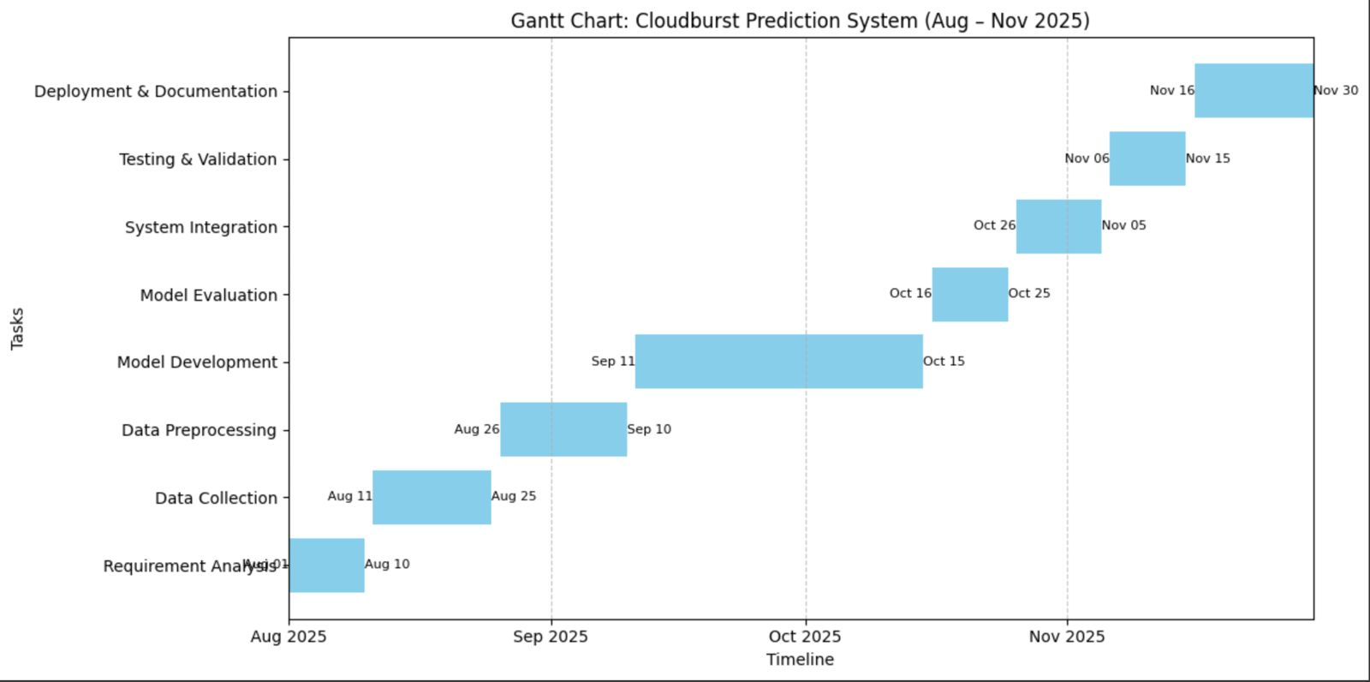
Timeline of the Project (Gantt Chart)

Slide 20
References (IEEE Paper format)
1.S. K. Ghosh, A. K. Jain, and P. Kumar, “Machine Learning Approaches for Extreme Weather Prediction: A Review,” International Journal of Meteorology, vol. 58, no. 4, pp. 215– 230, 2023.
2.M. R. Shukla and V. Singh, “Real-Time Rainfall Prediction Using IoT and Random Forest Algorithm,” IEEE Access, vol. 11, pp. 34012–34022, 2023.
3.J. Smith, L. Brown, and K. Lee, “Data-Driven Cloudburst Forecasting in Hilly Regions,” Journal of Applied Meteorology and Climatology, vol. 62, no. 7, pp. 1250–1265, 2024.
4.Gupta, R. Sharma, and S. Verma, “Ensemble Machine Learning Models for Predicting Localized Extreme Rainfall Events,” Environmental Modelling & Software, vol. 165, 105432, 2023.
5.H. Zhang and W. Li, “Integrating IoT Sensors with ML Techniques for Disaster Management,” Sensors, vol. 23, no. 12, pp. 5601, 2023.

Slide 21


