Slide 1
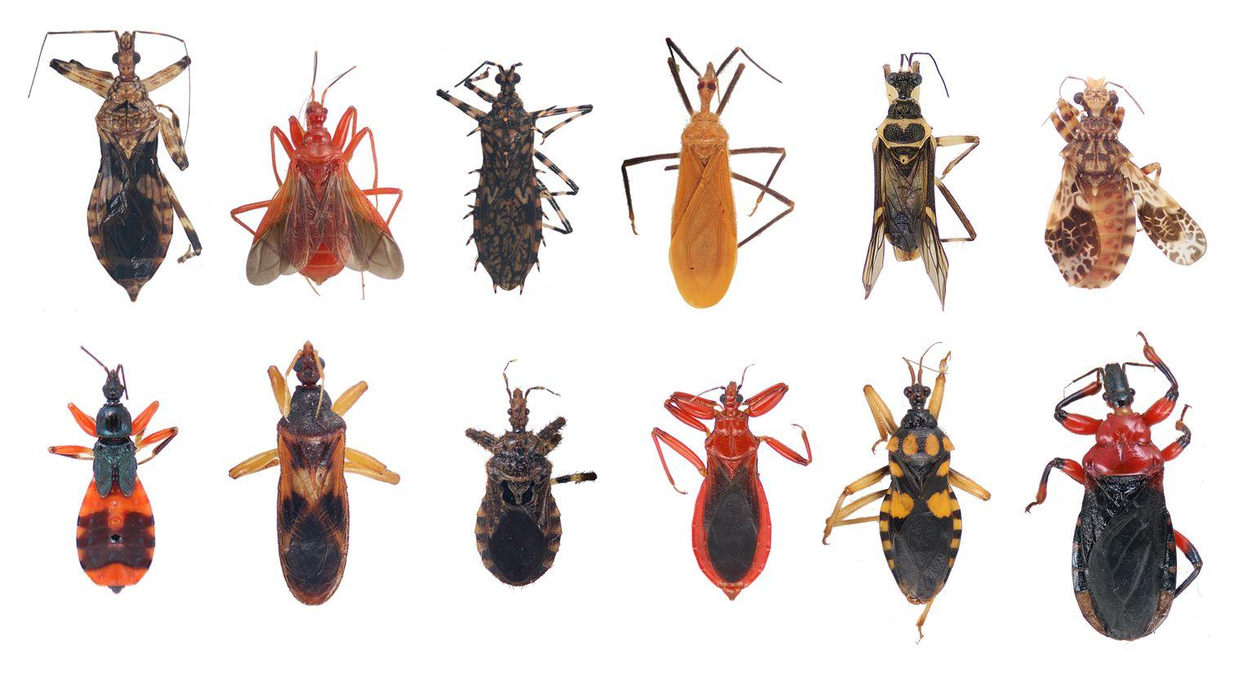
Embracing the new threat: towards automatically, self-diversifying malware
Mathias Payer <mathias.payer@nebelwelt.net>
UC Berkeley and (soon) Purdue University
Image (c) http://ucrtoday.ucr.edu/9768/assassin-bugs
Notes:
Joschean talked about attacking AV software, I talk about attacking AV best practices
Joint work with Stefan Brunthaler, Per Larsen, Stephen Crane, Michael Franz, Richard Wartell
How similar are those bugs?
Are they from the same family?
Assassin bugs, different lineage
Exactly what's happening with malware: few families, manual diversification to evade detection.
Common solutions for MW detection still rely on signatures and similarity metrics. In this talk we will see that they are no longer effective

Slide 2
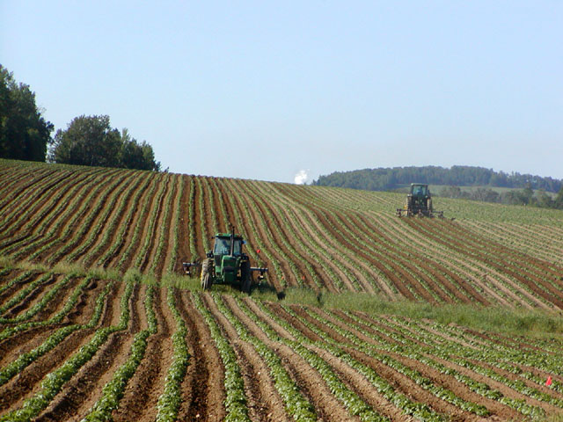

Malware landscape is changing
Image (c) Wikimedia
Notes:
What kind of malware famlilies do you know?
Only few malware families alive: monoculture
But thousands of variants (AV companies overrun by lots of samples)
Packers hide actual code
Packers or crypters (use exchangeable)
It's all about the money: attackers generate new samples, defenders classify those samples
Resources better spent somewhere else; e.g., research that actually solves the problem

Slide 3
The ongoing malware arms race
Generate new
malware
instance
Signatures
updated
Attack a bunch
of targets
Malware
analysis
AV vendor
gets first sample
Notes:
Manually rediversify when too many scanners detect sample, use time lag to your advantage

Slide 4
Defense limitations
Newly diversified samples are not detected
  Basically a “new” attack
New malware spreads fast
  Time lag between analysis and updated signatures
Can we automate this process?
Notes:
Automate?
Drive point home that signatures are not effective
Compiler is at the core of efficient automation

Slide 5
Fully automatic diversity
?
*.cpp
Compiler
Malware
Malware
Malware
Notes:
Attack: similarity-based matching is not the solution, it's time to move along!
A call for less work, more automation!
Compiler-based diversification
Lot's of information available
Use flexibility in code generator to produce unique binaries
Low similarity to other samples is key

Slide 6
Outline
State of the art:
Malware detection
A new threat:
Malware diversification
Possible mitigation:
Better security practices

Slide 7
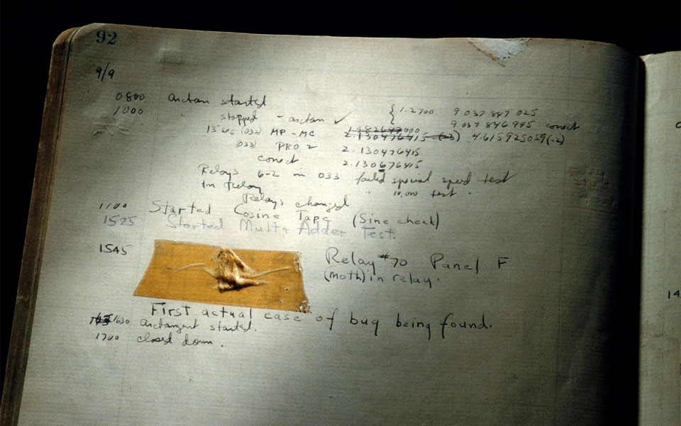
State of the art: Malware detection
Image (c) Wikimedia

Slide 8
Malware detection is limited
Performance
  Don't slow down a user's machine (too much)
Precision
  Behavioral, generic matching
Latency
  Time lag between spread and protection
Notes:
Detection always executes in a constraint space.
Limited in 3 ways

Slide 9

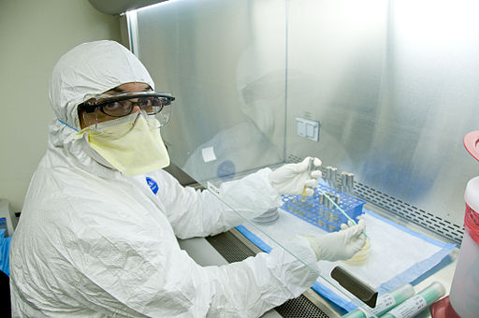
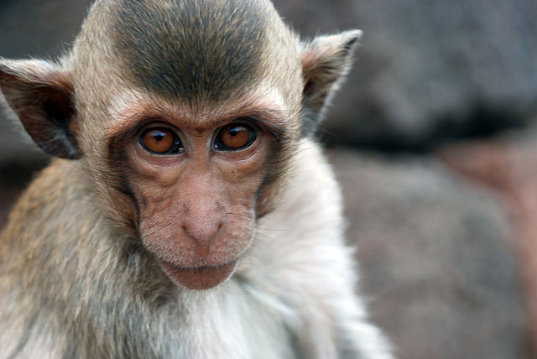
Detection mechanisms
Image (c) Wikimedia
Notes:
Signature: George W. Bush
Static Analysis
Behavioral-based Analysis

Slide 10
Signature-based detection
Compare against database of known-bad
  Extract pattern
  Match sequence of bytes or regular expression
Advantages
  Fast
  Low false positive rate
Disadvantages
  Precision limited to known-bad samples
Notes:
Bread and butter technique for AV

Slide 11
Static analysis-based detection
Search potentially bad patterns
  API calls
  System calls
Advantages
  Low overhead
Disadvantages
  False positives
  Based on well-known heuristics

Slide 12
Behavioral-based detection
Execute “file” in a virtual machine
  Detect modifications
Advantages
  Most precise
Disadvantages
  High overhead
  Precision limited due to emulation detection

Slide 13
Summary: Malware protection
Arms race due to manual diversification
  Signature-based techniques loose effectiveness
Cope with limited resources
  On the target machine, for the analysis, and to push new signatures/heuristics
No perfect solution
  Either false positives and/or negatives or huge performance impact
Notes:
Large attack surface, hard to protect, push AV onto higher levels
Software bugs used to drop files
Low performance, limited precision, latency

Slide 14
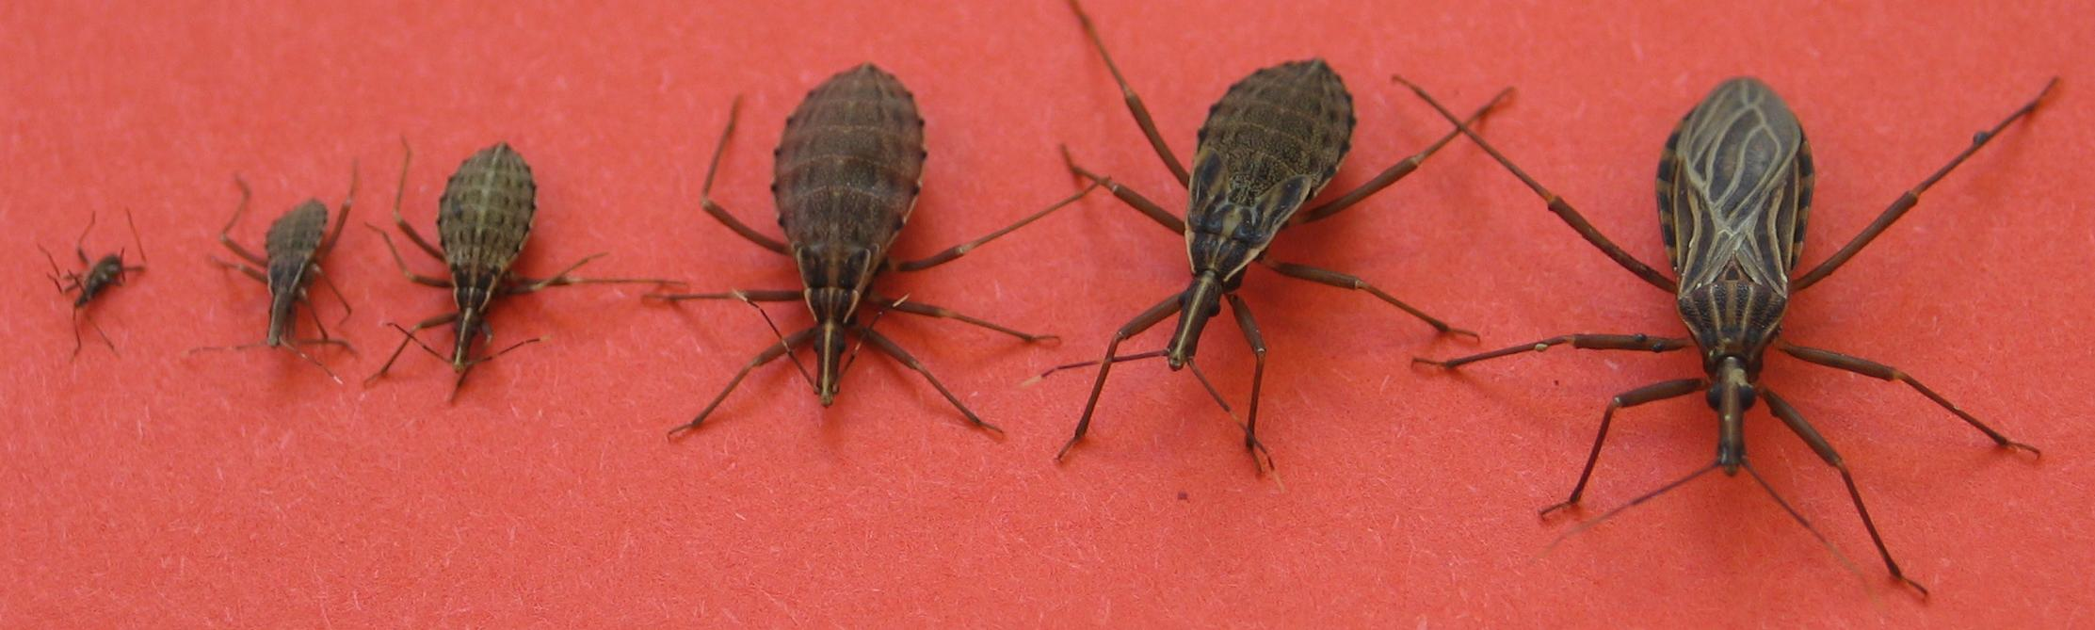
New threat: Malware diversification
Image (c) Wikimedia
Notes:
Move from packers on the binary level to the source level and to the compiler.
Use automation to generate millions of malware binaries that are no longer similar to each other

Slide 15
Software diversification
?
*.cpp
Compiler
Program
Program
Program
Notes:
Usually from high-level language to low-level language
A compiler translates between two formats
Language specification defines transformation
Undefined or unspecified aspects can be used for optimization
Good compiler makes deterministic best guess

Slide 16
C/C++ liberties
Data layout changes
  Data structure layout on stack
  Layout for heap objects (limited for structs)
Code changes
  Register allocation (shuffle or starve)
  Instruction selection
  Basic block splitting, merging, shuffling

Slide 17
Malware diversification
Generate unique binaries
  Minimize common substrings (code or data)
  Performance overhead not an issue
Diversify code and data layout
Diversify static data as well
Notes:
Currently: any software diversifying compiler will suffice.
But let's move further and look into diversifying compilers geared for malware

Slide 18
Implementation
Prototype built on LLVM 3.4
  Small changes in code generator, code layouter, register allocator, stack frame layouter, some data obfuscation passes
Input: LLVM bitcode
Output: diversified binary
Source: http://github.com/gannimo/MalDiv
Notes:
This is a research project and code is very messy so I cannot release the source code.
Just kidding, this is not like many other research projects. Fork the code from github and I urge you to play around.
We'll also update and add more diversification techniques as we go along!

Slide 19
Similarity limitations

Slide 20
Demo
Simple hello world
  Let's see how far we can push this!
#include <stdio.h, string.h>
const char foo[] = "foobar";
char bar[7];
int main(int argc, char* argv[]) {
strcpy(bar, "barfoo");
printf("Hello World %s %s\n", foo, bar);
printf("Arguments: %d, executable: %s\n",
argc, argv[0]);
return 0;
}

Slide 21
Scenario 1: malware generator
?
*.cpp
Compiler
Malware
Malware
Malware
Notes:
Compiler generates newly diversified binary every time.
Instead of cpp use bc.
Compile bots that spit out large set of binaries, use newly diversified binary for every attack

Slide 22
Scenario 2: self-diversifying MW
Malware
Malware*
Malware*
Malware*
LLVM Opt
LLVM Opt*
LLVM Opt*
LLVM Opt*
Malware bc
Malware bc*
Malware bc*
Malware bc*
LLVM bc
LLVM bc*
LLVM bc*
LLVM bc*
Notes:
Pack LLVM opt frameworkand (packed LLVM and MW bitcode) alongside malware
Automatically diversify on the same system and when generating an attack binary

Slide 23
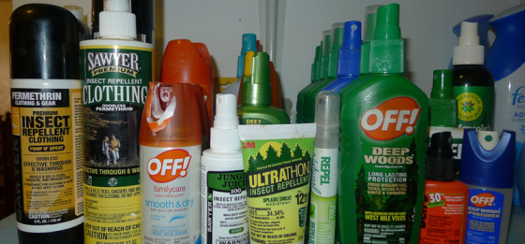
Possible mitigation:
Better security practices
Image (c) Wikimedia

Slide 24

Mitigation
Recover high-level semantics from code
  Hard (and results in an arms race)
Full behavioral analysis
  Harder
Prohibit initial intrusion
  Fix broken software & educate users
  Hardest
Notes:
Graph based similarity matching: works for now
Behavioral matching always uses some heuristics

Slide 25
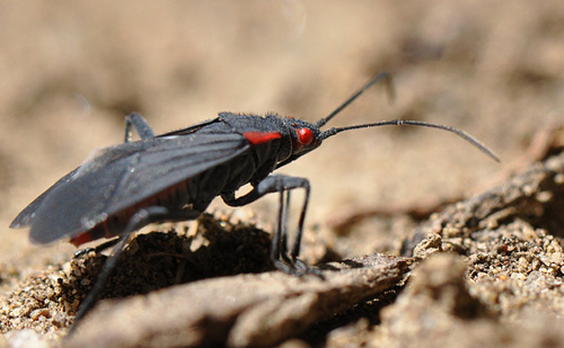
Conclusion
Image (c) Wikimedia

Slide 26
Conclusion
Diversity evades malware detection
  Fully automatic, built into compiler
  No need for packers anymore
Adopts to new similarity metrics
New arms race between defenders and compiler writers
Don't rely on simple, static similarity!
Notes:
Generate new instances of diversified binaries faster than malware analysts can generate signatures

Slide 27
Questions?
Mathias Payer <mathias.payer@nebelwelt.net>
Project: https://github.com/gannimo/MalDiv
Homepage: https://nebelwelt.net

