Slide 1
Verizon Digital Branding Project
Gannon Radenberg

Slide 2
Goal of the Site and Target Audience
The goal of the website is to attract new customers to Verizon and their mobile and wireless plans and is also easily accessible to current users that need to use Verizon’s services.
The goal of the app is to make Verizon’s services easily accessible to existing customers.
The target audience for the site is potential new customers and existing customers.

Slide 3
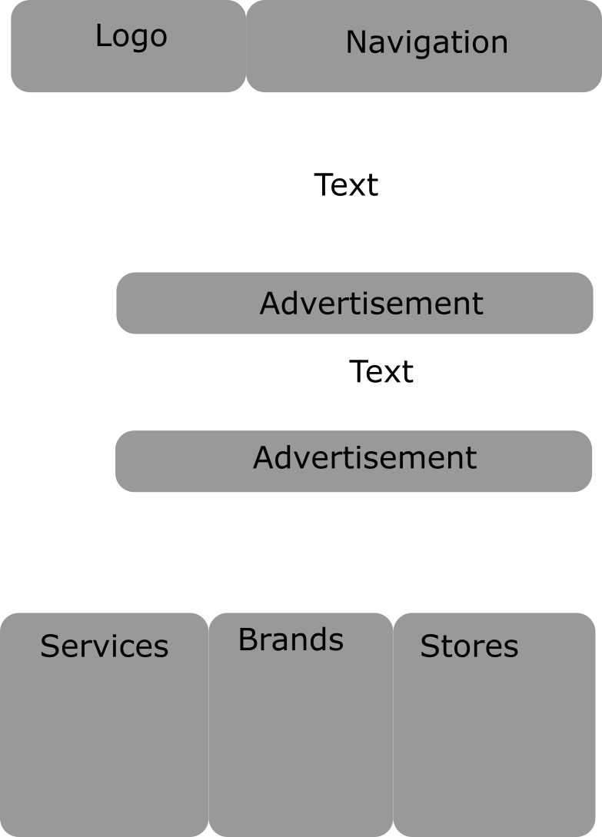

Slide 4
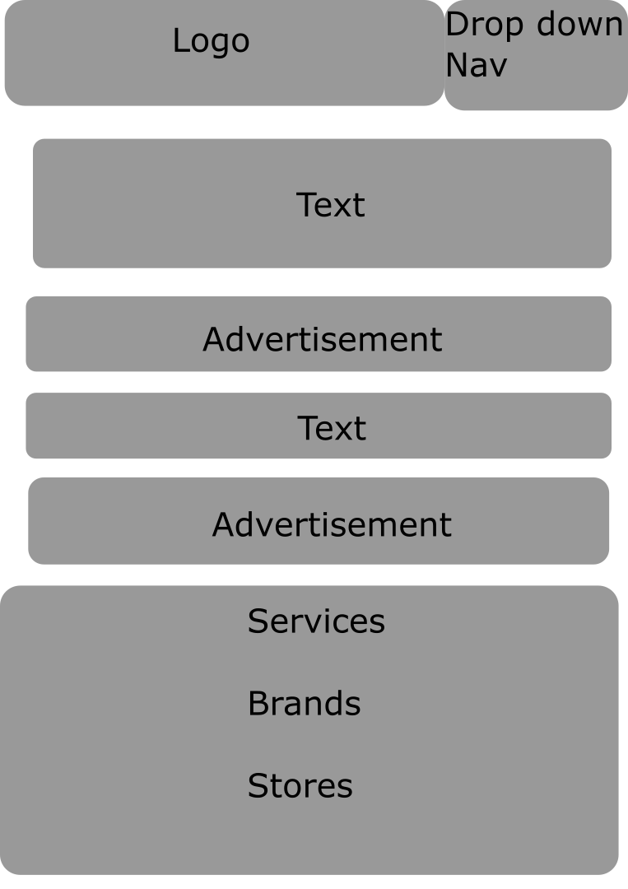

Slide 5
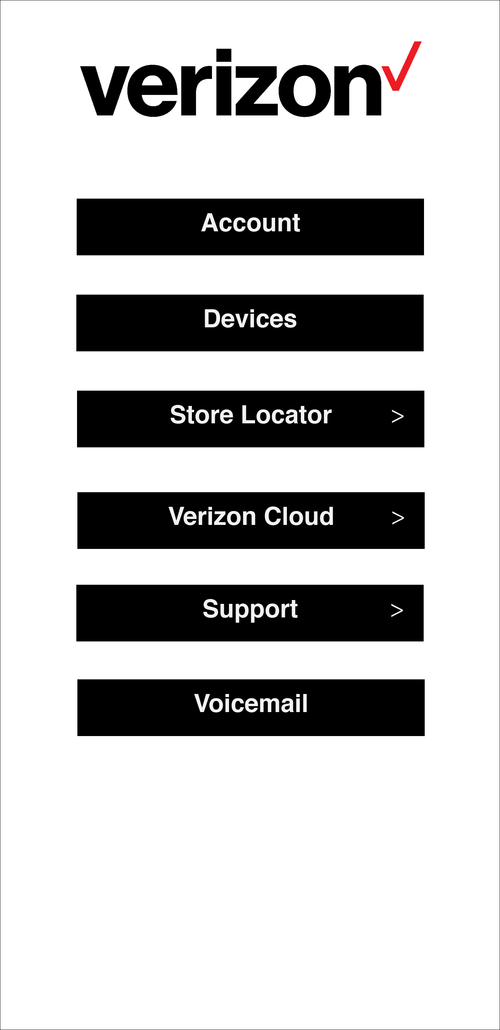

Slide 6


Slide 7


Slide 8


Slide 9
