Slide 1
CS 820 Project Presentation on HealthBotAssist
Suby Singh (200414214) and Vineel Gannu (200439673)
Department of Computer Science
Professor : Malek Mouhoub
DATE 12 April, 2021

Slide 2
Outline
Introduction
Background
Implementation
  Symptom Assessment
  Appointment Booking
Tools
Demo
Conclusion
2 of 21

Slide 3
Introduction
Chatbot - a computer software that carries out conversations without any human intervention
Chatbot in healthcare sector
  Provides support for preliminary symptoms assessment
  Minimizes the cost of services by diagnosing diseases, booking appointments
In this project
  Designed an AI chatbot called HealthBotAssist
  Does preliminary assessment of the symptoms
  Guide users in learning their medical conditions by solving CSP and CP-nets
3 of 21

Slide 4
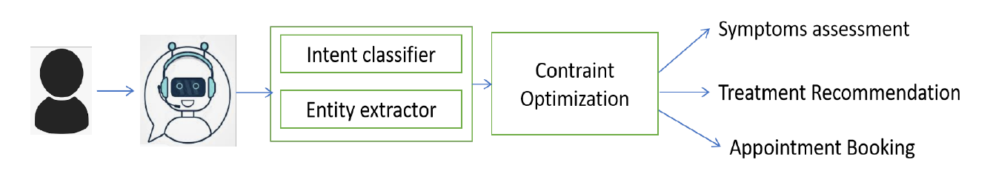
Introduction…
Fig.1. Prototype of HealthBotAssist
4 of 21

Slide 5
Background
History of chatbots
Eliza
  Developed by Joseph Weizenbaum in 1966
  Identifies the keywords from input and triggers the output based on the defined set of rules
Parry
  Written by psychiatrist Kenneth Colby in 1972
  Developed to simulate a person with paranoid schizophrenia
  It passed the Turing test
5 of 21

Slide 6
Background…
History of chatbots
Alice
  Developed by Richard Wallace in 2195
  NLP Chatterbot
  Applies pattern matching rules to the user input
Siri by Apple
  First one to introduce the conversational assistants
Google Assistant, Microsoft Cortana
6 of 21

Slide 7
Background…
Constraint Optimization
With Acyclic CP-net & variable assignments (empty or partial), finding optimal solution would be simple
Hard Constraints may hinder in finding optimal solution
In that case, we need to find feasible solution that is consistent with the hard constraints
7 of 21

Slide 8
Implementation
CSP based Symptoms Assessment and Recommendation
  Headache
  Cancer
  Covid
CP-net based Appointment Booking using Graphical Representation
8 of 21

Slide 9
Implementation…
CSP based Symptoms Assessment and Recommendation
Variables - Set of questions
Domains - Possible answers for a given question
Constraints - User’s answers (symptoms)
CSP solution represents the standard of medical care recommended to the user
9 of 21

Slide 10
Implementation…
Cancer
Different set of questions are asked to the user
  Symptoms
    Bleeding, changes in toe and finger nails, chronic fatigue and weakness
  Body monitoring
    Questions related to the body parts examination
The bot identifies whether the symptoms are primary or mild and recommends the medical treatment
10 of 21

Slide 11
Implementation…
Headache
User-defined constraints
Various constraints such as injury, duration of the headache, vomiting or nausea sensation, sensitive to light, duration for feeling sensitive to light
Based on the users input, the bot identifies one of the following causes for a given user and recommends the medical treatment accordingly.
  Headache due to dehydration
  Minor migraine issue
  Migraine
11 of 21

Slide 12
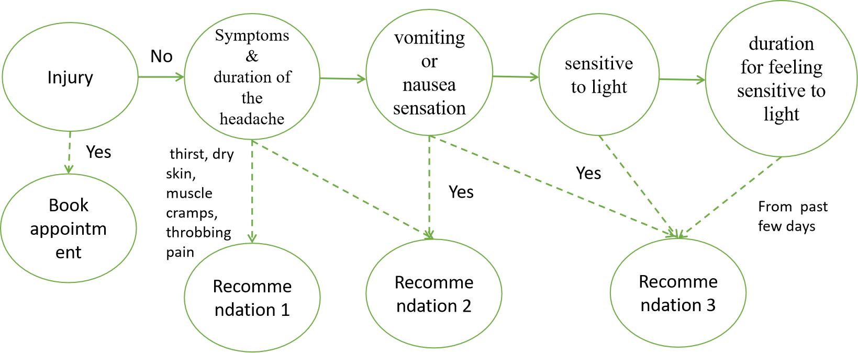
Implementation…
massage, stay hy_x0002_drated drink, take aspirin
stay in a dark or quiet Room,
perform breathing exercises, yoga
sumatriptan, stay in a quiet and dark room, practice relaxation
12 of 21

Slide 13
Implementation…
Covid
Priority is given to few symptoms/constraints such as difficulty in breathing, pain in chest, feeling confused, losing consciousness
  Response 1: If user satisfies the above constraint, the user is asked to get tested for covid and Bot tries to book an appointment
symptoms such as fever, cold, headache, sore throat, covid contact
  Response 2: Stay home, monitor health, face coverings and masks, take pre-liminary medicines for the symptoms
  Response 3: get tested and inform people
13 of 21

Slide 14
Implementation…
Appointment Booking
Best suitable booking is determined among the available appoinment slots that satisfy CP-net N
Forward Sweep Procedure
  Sweep from top-node variables (time and date) to bottom-node variable (clinic)
  Each variable is set to most preferred value
14 of 21

Slide 15
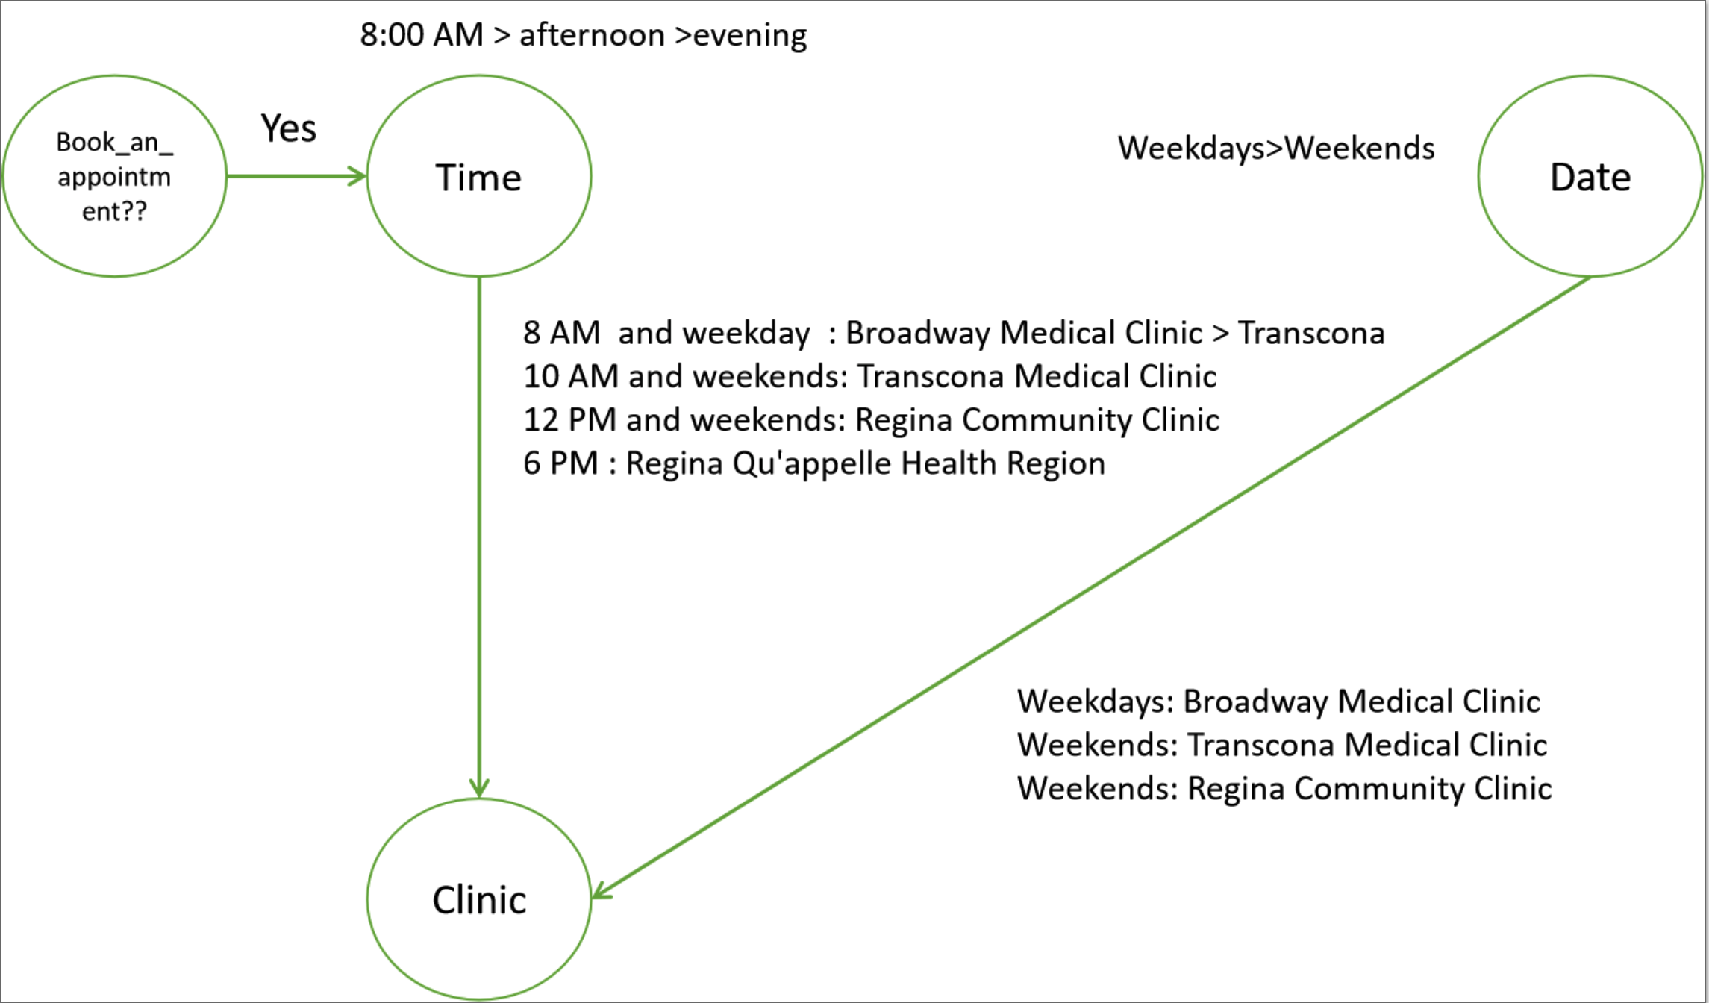
Implementation…
Fig. 3 CP-net N for appointment booking (Headache)
15 of 21

Slide 16
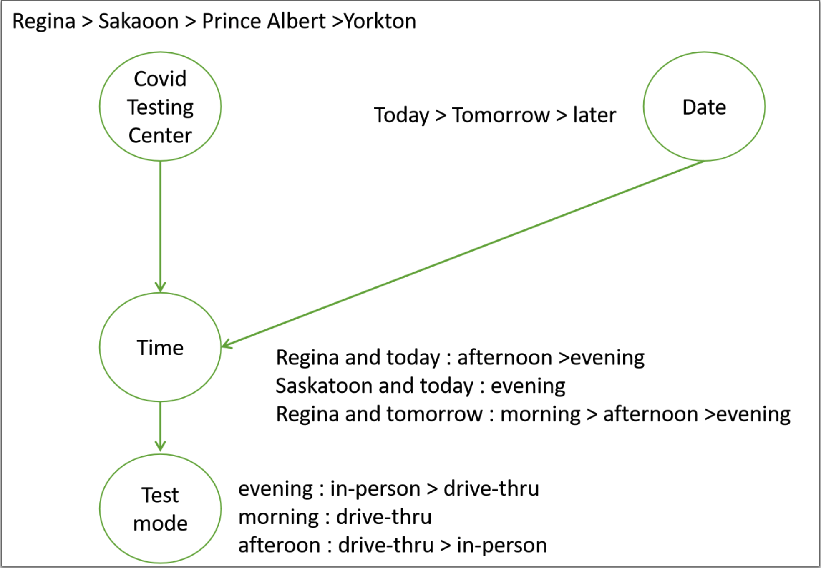
Implementation…
Fig. 3 CP-net P for appointment booking (Covid)
16 of 21

Slide 17
Tools
  Botpress Open-source conversational AI platform
  Natural Language Understanding (NLU)
  Java script to code CSP
17 of 21

Slide 18
Demo
Demo1 (CP-net outcome for booking appointment due to Covid) :
https://drive.google.com/file/d/12Jt2WQvkLvLeMf6qHfRCMIr-aPOBr7nW/view?usp=sharing
Demo2 (CSP for covid) : https://drive.google.com/file/d/1txMnpVHoKey9Dxjs8HwbGzJmqATiTuR2/view?usp=sharing
Demo3 (CP-net outcome for booking appointment due to headache) : https://drive.google.com/file/d/1-HSa1G3v9AFHhzTTappiAjJCFBjoF4ji/view?usp=sharing
18 of 21

Slide 19
Conclusion
We implemented a chatbot, HealthBotAssist
Performs preliminary assessment about the users' health conditions
Questions are posed based on the user's initial symptoms and the bot attempts to gather more details by conversing with them
Derives the contextual information from the conversations by identifying the intent
Uses CSP to suggest a medical treatment and CP-net to book an appointment
forward sweeping procedure for findind an optimal solution
19 of 21

Slide 20
References
Boutilier, C., Brafman, R.I., Domshlak, C., Hoos, H.H. and Poole, D. (2004), Preference-Based Constrained Optimization with CP-Nets. Computational Intelligence, 20: 137-157.https://doi.org/10.1111/j.0824-7935.2004.00234.x
https://www.spottingcancer.org/
https://github.com/botpress/botpress
20 of 21

Slide 21
Thank you

