Slide 1
MindMate
An AI-Powered Mental Health Assistant for Students
M.Sc. (Data Science), Final Project Report
Submitted by: Ganesh L | Enrolment No: O24MSD110165
Guide: Mr. Prashant Stephens | In association with Plag Pro, Noida
Chandigarh University · 2026

Slide 2
The Problem
Why MindMate?
▸ Student mental-health needs are rising, but counselling capacity is limited (WHO, 2022; Auerbach et al., 2018).
▸ Stigma, cost and waiting times stop many students from seeking help early.
▸ Generic apps rarely personalise support or handle crises transparently.
▸ There is a need for accessible, stigma-free, personalised first-line support, clearly distinct from clinical care.
MindMate, An AI-Powered Mental Health Assistant for Students

Slide 3
Project Objectives
Three core objectives
▸ Design and develop an AI mental-health assistant for students.
▸ Personalise its support using machine-learning algorithms.
▸ Evaluate its effectiveness on mental-health and academic outcomes.
MindMate, An AI-Powered Mental Health Assistant for Students

Slide 4
MindMate, Solution Overview
What we built
▸ A privacy-respecting Streamlit web app with six pages: Home, Chat, Mood Tracker, Self-Check, Insights, Resources.
▸ Empathetic conversational assistant (OpenAI API with a robust offline fallback engine).
▸ ML personalisation: sentiment analysis, student segmentation, stress prediction, transparent recommendations.
▸ Safety-first: every message screened for crisis signals before any reply.
▸ PHQ-9 and GAD-7 self-checks with validated severity bands.
MindMate, An AI-Powered Mental Health Assistant for Students

Slide 5
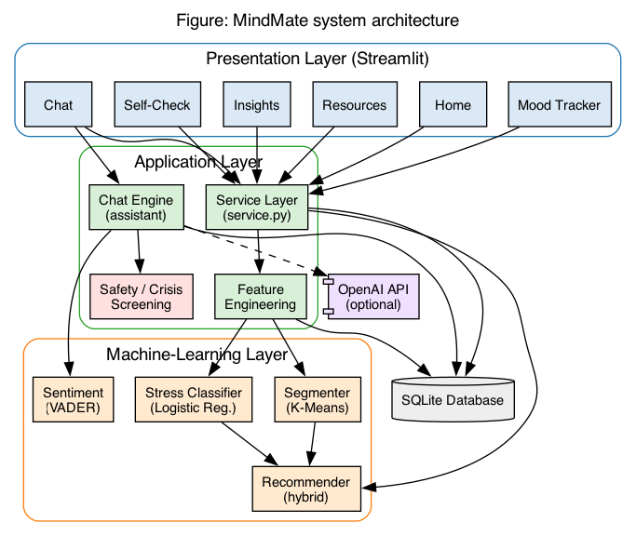
System Architecture
▸ Presentation layer (Streamlit)
▸ Service layer orchestrates logic
▸ Assistant + ML domain layer
▸ Local SQLite persistence
▸ OpenAI API is optional
MindMate, An AI-Powered Mental Health Assistant for Students

Slide 6
Technology Stack
Open-source and reproducible
▸ Language & UI: Python 3.12, Streamlit (multipage).
▸ Machine learning: scikit-learn (K-Means, Logistic Regression, PCA), VADER for sentiment.
▸ LLM: OpenAI Chat Completions API, with an offline rule-based engine for zero-dependency demos.
▸ Data & analysis: pandas, numpy, scipy; visualisation with plotly and matplotlib.
▸ Persistence: SQLite; models serialised with joblib; tested with pytest (34 tests).
MindMate, An AI-Powered Mental Health Assistant for Students

Slide 7
01
Machine-Learning Personalisation

Slide 8
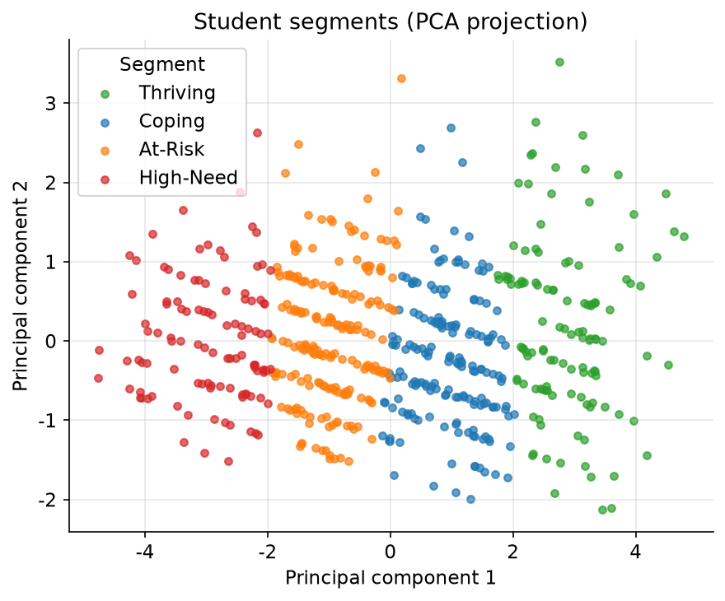
Student Segmentation (K-Means)
▸ Four support segments: Thriving, Coping, At-Risk, High-Need
▸ Six wellbeing features
▸ Silhouette score 0.209
▸ Labels ranked by a wellbeing index
▸ Each segment maps to a tailored plan
MindMate, An AI-Powered Mental Health Assistant for Students

Slide 9
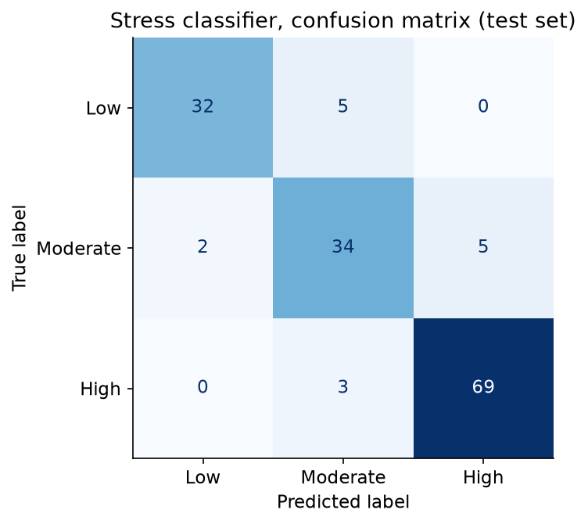
Stress Classification
▸ Logistic Regression (Low/Moderate/High)
▸ Test accuracy: 90.0%
▸ Macro-F1: 0.889
▸ Feeds the dashboard + recommender
▸ Transparent probability output
MindMate, An AI-Powered Mental Health Assistant for Students

Slide 10
Safety-First Design
Ethics and user safety
▸ Every user message is screened for crisis signals BEFORE a reply is generated.
▸ Three risk levels: none, elevated, crisis.
▸ Crisis triggers a calm, validating message + 24x7 helplines (Tele-MANAS, Vandrevala, AASRA, iCall).
▸ Conservative by design: a false positive is far less costly than a missed crisis.
▸ MindMate never diagnoses and always defers clinical concerns to professionals.
MindMate, An AI-Powered Mental Health Assistant for Students

Slide 11
02
Evaluation of Effectiveness

Slide 12
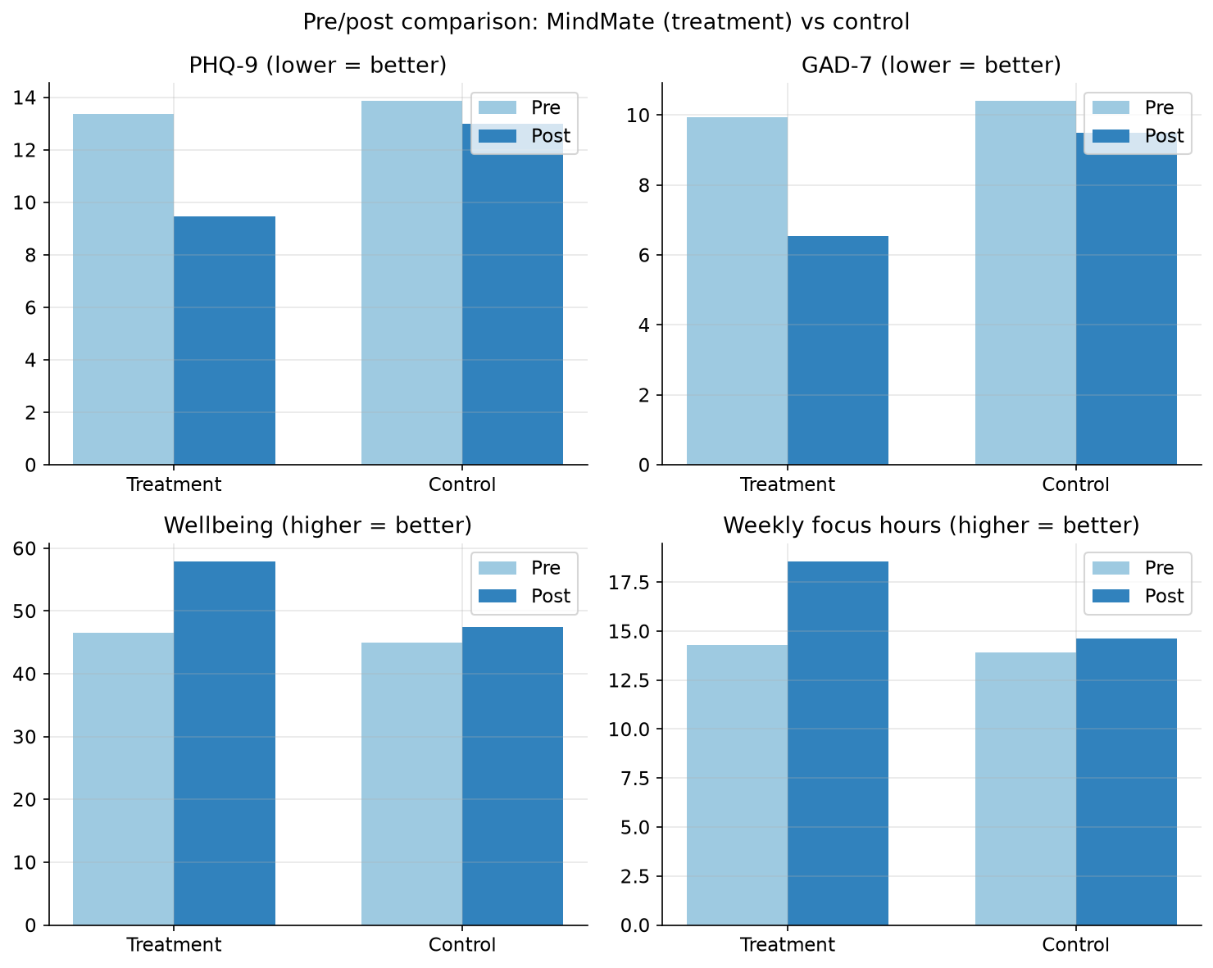
Pilot Evaluation Results
Simulated 4-week pilot (120 treatment vs 120 control). Synthetic data, demonstrates the evaluation methodology.
MindMate, An AI-Powered Mental Health Assistant for Students

Slide 13
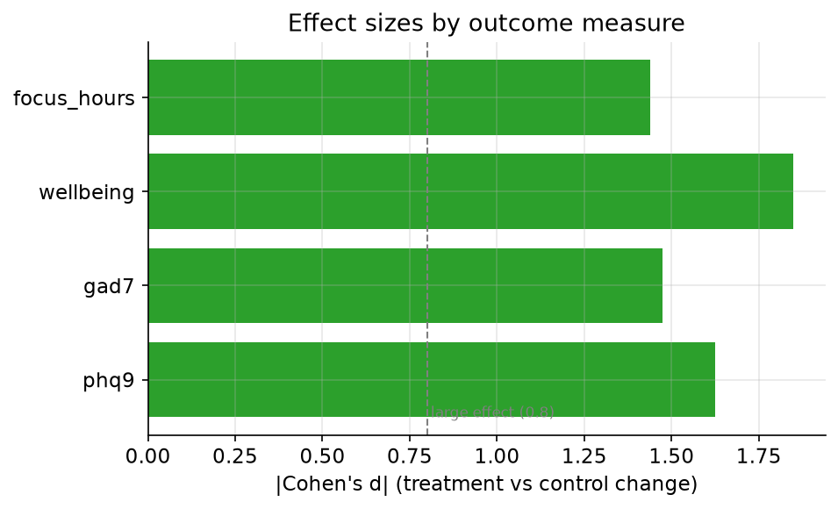
Effect Sizes
▸ PHQ-9: d = 1.62 (large)
▸ GAD-7: d = 1.47 (large)
▸ Wellbeing: d = 1.85 (large)
▸ Focus hours: d = 1.44 (large)
▸ All p < 0.001 (synthetic data)
MindMate, An AI-Powered Mental Health Assistant for Students

Slide 14
Testing & Validation
Quality assurance
▸ 34 automated pytest tests, unit, integration and system levels, all passing.
▸ Dedicated safety-critical tests (crisis detection, no over-flagging of phrases like 'killing it in exams').
▸ Models validated on a stratified hold-out: accuracy 0.900, macro-F1 0.889; clustering silhouette 0.209.
▸ Reproducible end-to-end via a fixed random seed.
MindMate, An AI-Powered Mental Health Assistant for Students

Slide 15
Conclusion & Future Scope
Outcomes and next steps
▸ All three objectives met: a working assistant, ML personalisation, and a reproducible evaluation.
▸ Contributions: transparent ML personalisation, safety-first + offline-capable design, reproducible evaluation pipeline.
▸ Future: IRB-approved real user study; multilingual support (Hindi & regional languages); mobile app.
▸ Future: transformer-based emotion models; campus-counselling referral integration; secure cloud deployment.
MindMate, An AI-Powered Mental Health Assistant for Students

Slide 16
Thank You
Questions & Discussion
Project repository: github.com/gannyprodigy/mindmate-mental-health-assistant

