Slide 1
Unix structure, history, and properties.
Shell and command-line parsing.
Department of Computer Systems FIT, Czech Technical University in Prague
©Jan Trdlička, 2017

Slide 2
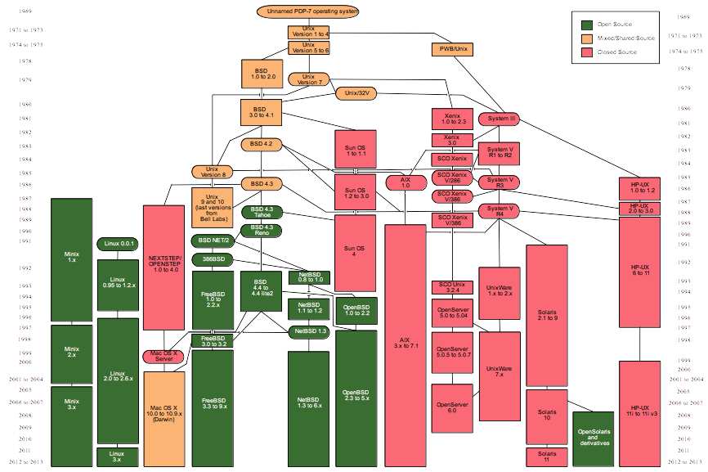
UNIX - history
Source: http://en.wikipedia.org/wiki/Unix

Slide 3
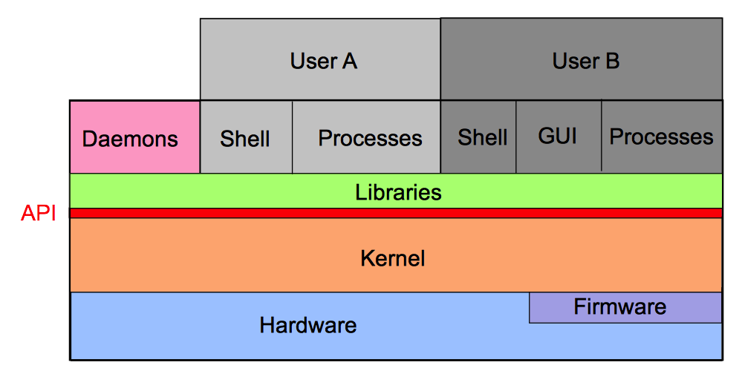
Unix - structure

Slide 4
UNIX - properties
Portable
  90% of kernel is written in C.
Multi-user
Multitasking, time-sharing
Multithreading
Symmetric Multi Processing (SMP)
CLI
IO redirection
Hierarchical FS
TCP/IP networking, NFS,…
GUI
  X-Windows
  Window managers - CDE, GNOME, KDE,…

Slide 5
Shell – command interpreter
Interface between user and kernel.
Environment setting
  Shell variables can define application behavior.
CLI
  Command-line parsing (e.g. find and replace special symbols)
  Command execution.
Shell scripts
  Shell executes commands from file (scripts).
  Script = Unix commands + control structures (e.g. loops, if/else…)

Slide 6
Bourne shells
Name | File | Properties
Bourne shell | /bin/sh | basic
Korn shell | /bin/ksh | command history, job control, aliases,…
Bourne again shell | /bin/bash | like ksh but more user friendly

Slide 7
C shells
More information about shell we can find in Unix manual (e.g. man bash).
In this modules we concentrate to Bourne shells.
Name | File | Properties
C shell | /bin /csh | like ksh
Toronto C shell | /bin/tcsh | like csh, but more user friendly

Slide 8
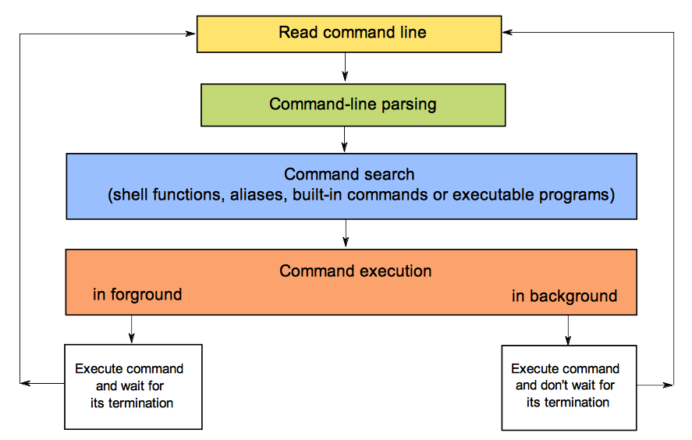
Command-line parsing

Slide 9
Command line syntax
Variables
    <prompt> <variable_name>=<value>
<prompt>
  Prompt is printed by shell.
  Value of prompt is defined by the shell variable PS1.
<variable_name>
  Variable name is identifier.
  No spaces around symbol =.
  Shell assigns the value to the variable.
<value>
  By default it is string.

Slide 10
Command line syntax
Simple commands
    <prompt> <command_name> <options> <arguments>
  <command_name>
    It defines which program will be executed (which).
    It can be only name or path to the file (relative/absolute).
  <options>
    They can modify the behavior of command (how).
  <arguments>
    They specify the input date (what).
Command name, options and arguments are available
  in script by variables $#, $0, $1, $2, …
  in C program by variables argc , argv[0], arg[1], …

Slide 11
Examples
ls
ls /etc
ls –la /etc
B=`ypcat passwd | cut -d: -f1`
echo $B
echo "$B"
export LC_TIME=cs_CZ ; /usr/bin/echo "Today is \c" ; date '+%A %d.%m.%Y‘
ypcat passwd | grep "student" | grep -v "docasne konto" | \
sort -t':' -k3,3n| tail -1 | cut -d: -f 5 | cut -d' ' -f1,2
Is it clear??? Too simple???

Slide 12
Examples
Little bit more complicated?
echo PID FD EXEC FILENAME; PID=$(pgrep ''); pfiles $PID | awk 'BEGIN { fd=-1; } /^[0-9]/ { if (fd>=0) { print pid, fd, exec; fd=-1; }; pid=substr($1,0,length($1)-1); exec=$2; } /^ *[0-9]*: / { if (fd>=0) { print pid, fd, exec; fd=-1; }; if ($2=="S_IFREG") { fd=substr($1,0,length($1)-1); } } /^ *\// { fd=-1; }' | while read pid fd exec; do echo $pid $fd $exec $(echo 0t$pid ::pid2proc \| ::fd $fd \| ::print file_t f_vnode \| ::vnode2path | mdb -k 2>/dev/null); done

