Slide 1

Code Generation
NI(E)-GEN, Spring 2021
https://courses.fit.cvut.cz/NI-GEN

Slide 2
Trivia
Petr Maj, majpetr@fit.cvut.cz
Lectures, MON, on teams
Tutorials, TUE, on teams
Course information on teams and coursepages
Grades in grades (and KOS)

Slide 3

Cover art for the book Oh, the Places You'll Go! written by Blais, Jacqueline; et al.

Slide 4
What to expect?
some theory and science
a lot of practice and engineering

Slide 5
What to expect?
you will learn in reasonable detail what & how compiler does
you will write your own compiler for a non-trivial (but still rather simple) programming language
all the way down to machine code (simplified)
you will have to work a lot on your own (but we are here to help)

Slide 6
What to expect?
“irrelevant” details, since in compilers history repeats itself
some overlap with programming languages design

Slide 7
Grades
course project:
compiler for a small C-like language
reasonably large piece of work
due at the last tutorial, extensions possible upon previous request
60 points max
exam
on paper, covered theory and algorithms
40 points max
grade: > 90: A, 80..90 : B, 70..80: C, 60..70: D, 50..60: E, <50: F

Slide 8
Course Project
compiler (middle & back end) implementation for a small c-like language
target a tiny86 VM, which is a simplified model of a PC architecture based on x86
code generation for higher level language constructs (condition, functions, etc.)
optimizations (inlining, constant propagation, peepholer, etc.)
register allocation

Slide 9
int main() {
// allocate
int numbers[100];
// initialize
for (int i =0; i < 100; ++i) {
numbers[i] = i + 2;
}
// iterate
for (int i = 0; i < 100; ++i) {
if (numbers[i] == 0)
continue;
// we have a prime
print(numbers[i]);
// remove all that are divisible
for (int j = i + 1; j < 100; ++j) {
if (numbers[j] == 0)
continue;
if (numbers[j] % numbers[i] == 0)
numbers[j] = 0;
}
}
}
Notes:
Your compiler will have to be able to work with code such as this (in terms of language and program complexity)

Slide 10
And will you succeed? Yes! You will, indeed! (98 and 3/4 percent guaranteed.) KID, YOU'LL MOVE MOUNTAINS! So... Be your name Buxbaum or Bixby or Bray Or Mordecai Ali Van Allen O'Shea, You're off to Great Places! Today is your day! Your mountain is waiting. So...get on your way!
by Dr Seuss, from Oh The Places You’ll Go

Slide 11

Notes:
Help wanted with the course, and needed

Slide 12
The Anatomy of a Compiler
NI(E)-GEN
https://courses.fit.cvut.cz/NI-GEN

Slide 13
In the beginning…
there were very few very big computers
there were no programming languages
there were no compilers

Slide 14
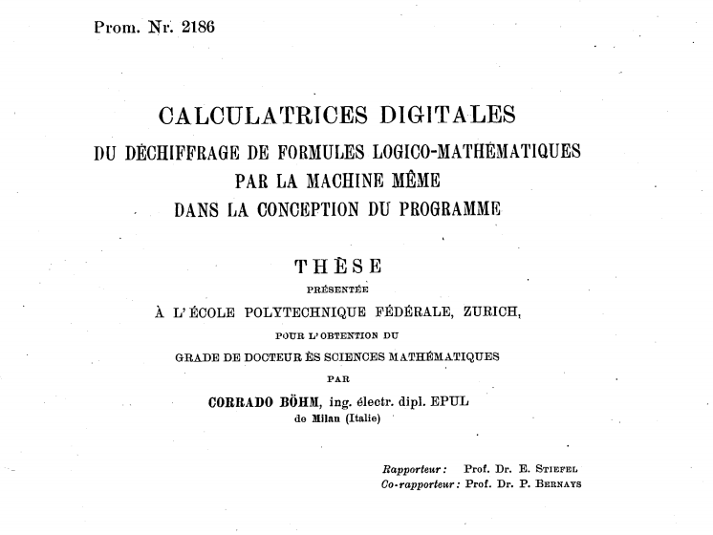
Notes:
The first compiler was designed by Corrado Bohm in 1951. This being the very early days of computer science, he did not actually program it, but just designed it. And with its design, he had to design a programming language it would compile and a computer that would execute it.
Not only did he create the first compiler, but he also described the compiler in the language it was supposed to compile, the so called self-hosting compiler. The language itself was also interesting as it consisted solely of assignments. He probably felt guilty about this and later become involved with functional languages and is the author of structured program theorem.

Slide 15
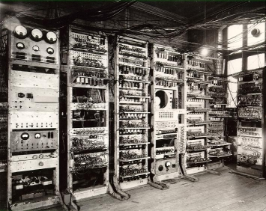
By Source, Fair use, https://en.wikipedia.org/w/index.php?curid=9975689
Notes:
Manchester Mark I

Slide 16


Slide 17
IBM, We Have a Problem

Slide 18
Bigger Computers Run Bigger Software
early computers were super expensive
but soon developing the software they executed was even costlier
all of it written in assembly
enter speedcoding
Actual “high-level” programming language
Notes:
Created by John Backus

Slide 19
Speedcoding
when an arithmetic operation was found in the source code, corresponding routine was called
designed to ease the burden on programmers
not for speed (up to 20x slower than assembly)
occupied about 300 bytes in RAM
a primitive interpreter!
Notes:
The 300 bytes was roughly 30% of total RAM available at the time

Slide 20
Code
Interpreter
Output
Input
Notes:
Happens in real time

Slide 21
High Level Languages Are Great!
but…

Slide 22
Efficiency Matters
the cost of an interpreter is prohibitive
John Backus observed that in speedcoding lot of time is spent in the mathematical formulas being translated over and over again every time they are executed

Slide 23
Efficiency Matters
the cost of an interpreter is prohibitive
John Backus observed that in speedcoding lot of time is spent in the mathematical FORmulas being TRANslated over and over again every time they are executed

Slide 24
FORTRAN
what if the operations are translated first once and for all?
doing this ahead of time also means the compiler can:
is not resource constrained
can do lots of things (can be slow, as long as generated executable is fast)
the very first compiler and highly influential compiler

Slide 25
Compiler
Code
Executable
Output
Input
Notes:
Happens in real time

Slide 26
Compiler
Code
Exe
Notes:
Happens in real time

Slide 27
Compiler
Syntax
Analysis
Semantic Analysis
Optimization
Code Generation
Code
Exe
Notes:
Happens in real time

Slide 28
Compiler
Lexical Analysis
Parsing
Semantic Analysis
Optimization
Code Generation
Code
Exe
BI-AAG
BI-PJP
Notes:
Happens in real time

Slide 29
// a simple function
int min(int a, int b) {
if (a < b)
return a;
else
return b;
}

Slide 30
// a simple function
int min(int a, int b) {
if (a < b)
return a;
else
return b;
}

Slide 31
// a simple function
int min(int a, int b) {
if (a < b)
return ☺;
else
return b;
}
Invalid character

Slide 32
// a simple function
int min(int a, int b) {
if (a < b)
return if;
else
return b;
}
valid…

Slide 33
int min(int a, int b) {
if (a < b)
return a;
else
return b;
}
Notes:
Comments are removed

Slide 34
int min ( int a , int b ) { if ( a < b ) return a ; else return b ; }
Notes:
So is whitespace

Slide 35
Function
int min(int a, int b) {
if (a < b)
return a;
else
return b;
}
min
int
args
body
if
arg
arg
<
return
return
a
int
b
int
a
b
a
b
Notes:
Comments are removed

Slide 36
Function
int min(int a, int b) {
if (a < b)
return if;
else
return b;
}
min
int
args
body
if
arg
arg
<
return
return
a
int
b
int
a
b
a
if
Notes:
Comments are removed

Slide 37
Function
int min(int a, int b) {
if (a < b)
return c;
else
return b;
}
min
int
args
body
if
arg
arg
valid…
<
return
return
a
int
b
int
a
b
c
b
Notes:
Comments are removed

Slide 38
Function
valid…
int min(int a, double b) {
if (a < b)
return a;
else
return b;
}
min
int
args
body
if
arg
arg
<
return
return
a
int
b
double
a
b
a
b
Notes:
Comments are removed

Slide 39
Compiler
Frontend
Lexical Analysis
Parsing
Semantic Analysis
Optimization
Code Generation
Code
Exe
BI-AAG
BI-PJP
Notes:
Happens in real time

Slide 40
int min(int a, int b) {
if (a < b)
return a;
else
return b;
}
Notes:
Comments are removed

Slide 41
int min(int a, int b) {
if (a < b)
return a;
else
return c;
}
Notes:
Comments are removed

Slide 42
int min(int a, int b) : int {
if (a : int < b : int) : bool
return a : int;
else
return b : int;
}
Notes:
Comments are removed

Slide 43
int min(int a, double b) : int {
if (a : int < b : double) : bool
return a : int;
else
return b : double;
}
Notes:
Comments are removed

Slide 44
Compiler
Frontend
Lexical Analysis
Parsing
Semantic Analysis
Optimization
Code Generation
Code
Exe
BI-AAG
BI-PJP
Notes:
Happens in real time

Slide 45
Compiler
Frontend
Analysis
Optimization
Code Generation
Code
Exe
Lexical Analysis
Parsing
Semantic Analysis
NI-APR
Pass Scheduler
Notes:
Happens in real time

Slide 46
Compiler
Middleend
Frontend
Analysis
Optimization
Code Generation
Code
Exe
Lexical Analysis
Parsing
Semantic Analysis
NI-APR
Pass Scheduler
Notes:
Happens in real time

Slide 47
int min2(int a, int b) {
if (a * 2 * 1 < b * 2)
return a * 2;
else
return a * 2;
}
Notes:
Comments are removed

Slide 48
int min2(int a, int b) {
if (a * 2 < b * 2)
return a * 2;
else
return a * 2;
}
Notes:
Constant propagation

Slide 49
int min2(int a, int b) {
if (a << 1 < b << 1)
return a << 1;
else
return a << 1;
}
Notes:
Strength reduction

Slide 50
int min2(int a, int b) {
int tmp = a << 1;
if (tmp < b << 1)
return tmp;
else
return tmp;
}
Notes:
Common subexpression elimination

Slide 51
int min2(int a, int b) {
int tmp = a << 1;
return tmp;
}
Notes:
Common subexpression elimination

Slide 52
int min2(int a, int b) {
return a << 1;
}
Notes:
Dead code elimination

Slide 53
Compiler
Middleend
Backend
Frontend
Analysis
Optimization
Target
Optimization
Code Generation
Code
Exe
Lexical Analysis
Parsing
Semantic Analysis
Pass Scheduler
BI-PJP*
Notes:
Happens in real time

Slide 54
bool lessThanZero(int a, int b) {
return a + b < 0;
}
Notes:
Dead code elimination

Slide 55
lessThanZero:
mov cx, 0
add ax, bx ; a + b
cmp ax, cx ; <
jl less
mov ax, 0 ; return false
ret
less:
mov ax, 1 ; return true
ret
Notes:
Dead code elimination

Slide 56
lessThanZero:
mov cx, 0
add ax, bx ; a + b
cmp ax, cx ; <
jl less
and ax, cx ; (smaller and faster)
ret
less:
xor ax, ax ; (smaller and faster)
ret
Notes:
Dead code elimination

Slide 57
Compiler
Middleend
Frontend
Analysis
Optimization
Backend
Code
Exe
Lexical Analysis
Parsing
Semantic Analysis
Target
Optimization
Code Generation
UTF
Pass Scheduler
tokens
derivation tree
Backend IR
machine code
Intermediate
representation
abstract syntax tree
Notes:
Happens in real time

Slide 58
This is a lot of work
for the programmer…

Slide 59
Compiler
Middleend
Frontend
Analysis
Optimization
Backend
Code
Exe
Lexical Analysis
Parsing
Semantic Analysis
Target
Optimization
Code Generation
Pass Scheduler
Target aware
Source aware
Notes:
Happens in real time

Slide 60
Compiler
Frontend
C
Lexical Analysis
Parsing
Semantic Analysis
Middleend
Frontend
C++
Lexical Analysis
Parsing
Semantic Analysis
Analysis
Optimization
Backend
Exe
Target
Optimization
Code Generation
Frontend
Pass Scheduler
FORTRAN
Lexical Analysis
Parsing
Semantic Analysis
Frontend
…
Lexical Analysis
Parsing
Semantic Analysis
Notes:
Happens in real time

Slide 61
Compiler
Frontend
Backend
C
x86
Lexical Analysis
Parsing
Semantic Analysis
Target
Optimization
Code Generation
Middleend
Frontend
Backend
C++
Lexical Analysis
Parsing
Semantic Analysis
ARM
Target
Optimization
Code Generation
Analysis
Optimization
Frontend
Backend
Pass Scheduler
RV
FORTRAN
Lexical Analysis
Parsing
Semantic Analysis
Target
Optimization
Code Generation
Frontend
…
Backend
Lexical Analysis
Parsing
Semantic Analysis
AVR
Target
Optimization
Code Generation
Notes:
Happens in real time

Slide 62
This is a lot of work
for the machine…
Notes:
Talk about linker

Slide 63
Compiler Efficiency
not really that important, you compile once and then can run as many times as you want
except when you don’t compile just once
we all make mistakes…
Notes:
Introduce Linker

Slide 64
Compiler
Middleend
Frontend
Analysis
Optimization
Backend
Code
Exe
Lexical Analysis
Parsing
Semantic Analysis
Target
Optimization
Code Generation
Pass Scheduler
Notes:
Happens in real time

Slide 65
Compiler
Frontend
Code
Lexical Analysis
Parsing
Semantic Analysis
Middleend
Analysis
Optimization
Backend
Exe
Frontend
Target
Optimization
Code Generation
Code
Lexical Analysis
Parsing
Semantic Analysis
Pass Scheduler
Code
Frontend
Lexical Analysis
Parsing
Semantic Analysis
In parallel /when needed
Notes:
Happens in real time

Slide 66
Compiler
Middleend
Frontend
Code
Lexical Analysis
Parsing
Semantic Analysis
Analysis
Optimization
Pass Scheduler
Backend
Middleend
Exe
Frontend
Target
Optimization
Code Generation
Code
Lexical Analysis
Parsing
Semantic Analysis
Analysis
Optimization
Pass Scheduler
Middleend
Code
Frontend
Lexical Analysis
Parsing
Semantic Analysis
Analysis
Optimization
Pass Scheduler
In parallel /when needed
Notes:
Happens in real time

Slide 67
Compiler
Middleend
Frontend
Backend
Code
Obj
Lexical Analysis
Parsing
Semantic Analysis
Analysis
Optimization
Target
Optimization
Code Generation
Pass Scheduler
Middleend
Frontend
Backend
Obj
Code
Lexical Analysis
Parsing
Semantic Analysis
Analysis
Optimization
Target
Optimization
Code Generation
Pass Scheduler
Middleend
Backend
Code
Frontend
Target
Optimization
Code Generation
Obj
Lexical Analysis
Parsing
Semantic Analysis
Analysis
Optimization
Pass Scheduler
In parallel /when needed
Notes:
Happens in real time

Slide 68
// file A
int min(int a, int b) {
return a < b ? a : b;
}
int max(int a, int b) {
return a > b ? a : b;
}
// file B
int min(int a, int b);
int foo(int a) {
return a + 3; }
int main() {
return min(foo(4), 10);
}
Notes:
Max can’t be removed
Min can’t be inlined

Slide 69
// file A
int min(int a, int b) {
return a < b ? a : b;
}
int max(int a, int b) {
return a > b ? a : b;
}
// file B
int min(int a, int b);
int foo(int a) {
return a + 3; }
int main() {
return min(4 + 3, 10);
}
Notes:
Max can’t be removed
Min can’t be inlined

Slide 70
// file A
int min(int a, int b) {
return a < b ? a : b;
}
int max(int a, int b) {
return a > b ? a : b;
}
// file B
int min(int a, int b);
int main() {
return min(7, 10);
}
Notes:
Max can’t be removed
Min can’t be inlined

Slide 71
// obj A
int min(int a, int b) {
return a < b ? a : b;
}
int max(int a, int b) {
return a > b ? a : b;
}
// obj B
int min(int a, int b);
int main() {
return min(7, 10);
}
Notes:
Max can’t be removed
Min can’t be inlined

Slide 72
// obj A
int min(int a, int b) {
return a < b ? a : b;
}
int max(int a, int b) {
return a > b ? a : b;
}
// obj B
int min(int a, int b);
int main() {
return min(7, 10);
}
Notes:
Max can’t be removed
Min can’t be inlined

Slide 73
// obj A
int min(int a, int b) {
return a < b ? a : b;
}
int max(int a, int b) {
return a > b ? a : b;
}
// obj B
int min(int a, int b);
int main() {
return 7 < 10 ? 7 : 10;
}
Notes:
Max can’t be removed
Min can’t be inlined

Slide 74
// obj A
int min(int a, int b) {
return a < b ? a : b;
}
int max(int a, int b) {
return a > b ? a : b;
}
// obj B
int min(int a, int b);
int main() {
return 7;
}
Notes:
Max can’t be removed
Min can’t be inlined

Slide 75
// executable
int main() {
return 7;
}
Notes:
Max can’t be removed
Min can’t be inlined

Slide 76
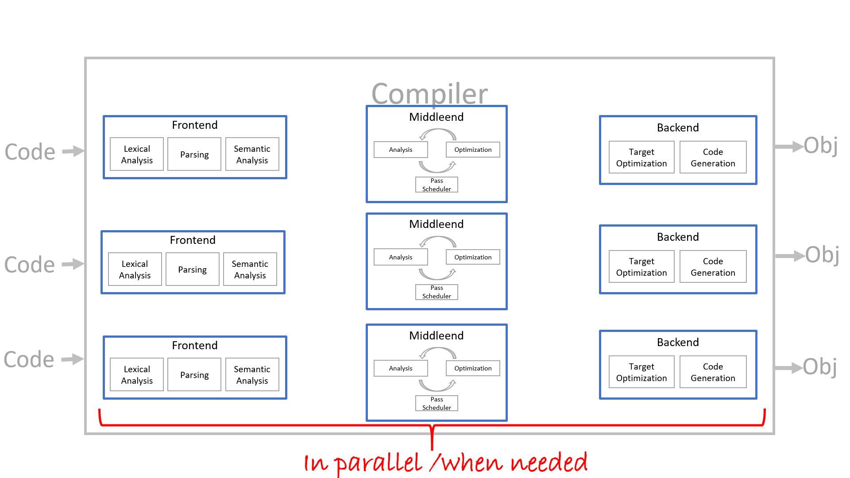
Linker
Linker
Optimization
Relocation
Exe

Slide 77
Assembler
Linker
Assembler
Linker
Optimization
Relocation
Exe
Assembler

Slide 78
Further Reading
https://www.cs.rit.edu/~ats/books/ooc.pdf - C with Objects on 226 pages
http://www.stroustrup.com/hopl2.pdf - Stroustrup’s account of the beginnings of C++

