Slide 1

Code Generation
NI(E)-GEN, Spring 2021
https://courses.fit.cvut.cz/NI-GEN

Slide 2

Cover art for the book Oh, the Places You'll Go! written by Blais, Jacqueline; et al.

Slide 3
What to expect?
some theory and science
a lot of practice and engineering

Slide 4
What to expect?
you will learn in reasonable detail what & how compiler does
you will write your own compiler for a non-trivial (but still rather simple) programming language
all the way down to machine code (simplified)
you will have to work a lot on your own (but we are here to help)

Slide 5
And will you succeed? Yes! You will, indeed! (98 and 3/4 percent guaranteed.) KID, YOU'LL MOVE MOUNTAINS! So... Be your name Buxbaum or Bixby or Bray Or Mordecai Ali Van Allen O'Shea, You're off to Great Places! Today is your day! Your mountain is waiting. So...get on your way!
by Dr Seuss, from Oh The Places You’ll Go

Slide 6
Trivia
Petr Maj, majpetr@fit.cvut.cz
Lectures, MON, on teams
Tutorials, TUE, on teams
Course information on teams and coursepages
Grades in grades (and KOS)

Slide 7
Grades
course project:
compiler for a small C-like language
reasonably large piece of work
due at the last tutorial, extensions possible upon previous request
60 points max
exam
on paper, covered theory and algorithms
40 points max
grade: > 90: A, 80..90 : B, 70..80: C, 60..70: D, 50..60: E, <50: F

Slide 8
Course Project
compiler (middle & back end) implementation for a small c-like language
target a tiny86 VM, which is a simplified model of a PC architecture based on x86
code generation for higher level language constructs (condition, functions, etc.)
optimizations (inlining, constant propagation, peepholer, etc.)
register allocation

Slide 9
int main() {
// allocate
int numbers[100];
// initialize
for (int i =0; i < 100; ++i) {
numbers[i] = i + 2;
}
// iterate
for (int i = 0; i < 100; ++i) {
if (numbers[i] == 0)
continue;
// we have a prime
print(numbers[i]);
// remove all that are divisible
for (int j = i + 1; j < 100; ++j) {
if (numbers[j] == 0)
continue;
if (numbers[j] % numbers[i] == 0)
numbers[j] = 0;
}
}
}
Notes:
Your compiler will have to be able to work with code such as this (in terms of language and program complexity)

Slide 10

Notes:
Help wanted with the course, and needed

Slide 11
The Anatomy of a Compiler
NI(E)-GEN
https://courses.fit.cvut.cz/NI-GEN

Slide 12
In the beginning…
there were very few very big computers
there were no programming languages
there were no compilers

Slide 13
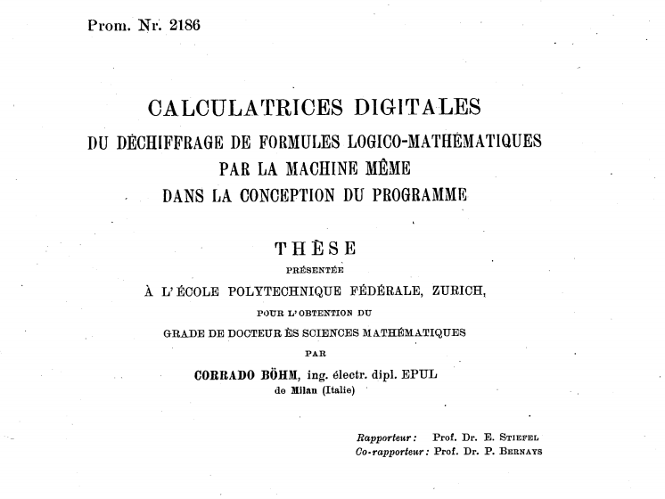
Notes:
The first compiler was designed by Corrado Bohm in 1951. This being the very early days of computer science, he did not actually program it, but just designed it. And with its design, he had to design a programming language it would compile and a computer that would execute it.
Not only did he create the first compiler, but he also described the compiler in the language it was supposed to compile, the so called self-hosting compiler. The language itself was also interesting as it consisted solely of assignments. He probably felt guilty about this and later become involved with functional languages and is the author of structured program theorem.

Slide 14
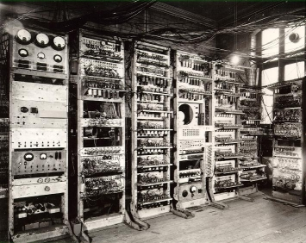
By Source, Fair use, https://en.wikipedia.org/w/index.php?curid=9975689
Notes:
Manchester Mark I

Slide 15


Slide 16
IBM, We Have a Problem

Slide 17
Bigger Computers Run Bigger Software
early computers were super expensive
but soon developing the software they executed was even costlier
all of it written in assembly
enter speedcoding
Actual “high-level” programming language
Notes:
Created by John Backus

Slide 18
Speedcoding
when an arithmetic operation was found in the source code, corresponding routine was called
designed to ease the burden on programmers
not for speed (up to 20x slower than assembly)
occupied about 300 bytes in RAM
a primitive interpreter!
Notes:
The 300 bytes was roughly 30% of total RAM available at the time

Slide 19
Code
Interpreter
Output
Input
Notes:
Happens in real time

Slide 20
High Level Languages Are Great!
but…

Slide 21
Efficiency Matters
the cost of an interpreter is prohibitive
John Backus observed that in speedcoding lot of time is spent in the mathematical formulas being translated over and over again every time they are executed

Slide 22
Efficiency Matters
the cost of an interpreter is prohibitive
John Backus observed that in speedcoding lot of time is spent in the mathematical FORmulas being TRANslated over and over again every time they are executed

Slide 23
FORTRAN
what if the operations are translated first once and for all?
doing this ahead of time also means the compiler can:
is not resource constrained
can do lots of things (can be slow, as long as generated executable is fast)
the very first compiler and highly influential compiler

Slide 24
Compiler
Code
Executable
Output
Input
Notes:
Happens in real time

Slide 25
Compiler
Code
Executable
Notes:
Happens in real time

Slide 26
Compiler
Syntax
Analysis
Semantic Analysis
Optimization
Code Generation
Code
Executable

Slide 27
Compiler
Lexical Analysis
Parsing
Semantic Analysis
Optimization
Code Generation
Code
Executable

Slide 28
Notes:
TODO show how the stuff propagates through the compiler

Slide 29
Notes:
TODO show the courses that deal with parts of the compiler taught at fit (AAG, PJP, AP, etc.)

Slide 30
The Big Picture
Talk bout linker,

Slide 31
Further Reading
https://www.cs.rit.edu/~ats/books/ooc.pdf - C with Objects on 226 pages
http://www.stroustrup.com/hopl2.pdf - Stroustrup’s account of the beginnings of C++

Slide 32
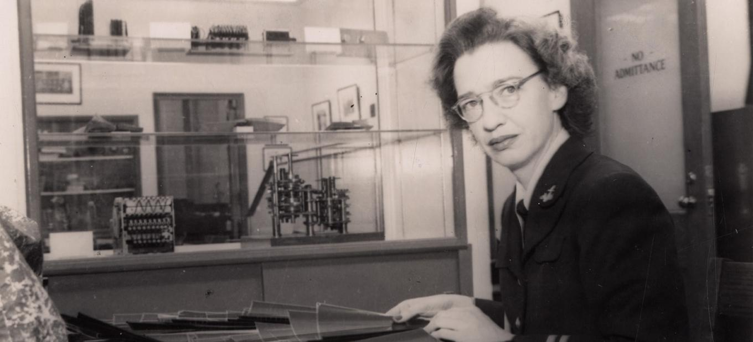

Slide 33
