Slide 1

Code Generation
NI(E)-GEN, Fall 2019
https://courses.fit.cvut.cz/NI-GEN

Slide 2
Overview
What to expect from the course
Requirements

Slide 3
Overview
there is a project

Slide 4
The Anatomy of a Compiler
Notes:
Corrado Bohm and his PhD thesis – a self-compiling compiler for an interesting language where every statement was assignment operator
He probably felt guilty about this so later become an important figure in functional programming

Slide 5
In the beginning…
there were very few very big computers
there were no programming languages
there were no compilers

Slide 6
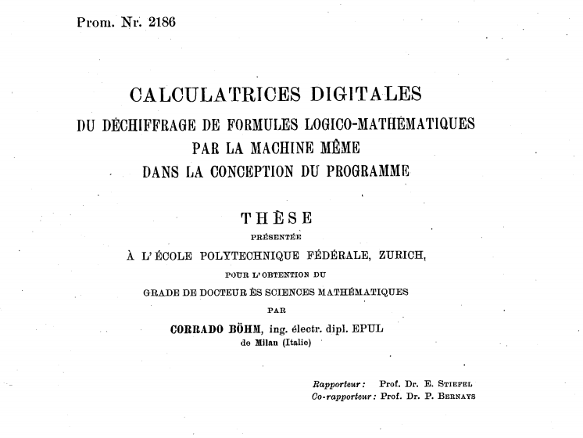
Notes:
The first compiler was designed by Corrado Bohm in 1951. This being the very early days of computer science, he did not actually program it, but just designed it. And with its design, he had to design a programming language it would compile and a computer that would execute it.
Not only did he create the first compiler, but he also described the compiler in the language it was supposed to compile, the so called self-hosting compiler. The language itself was also interesting as it consisted solely of assignments. He probably felt guilty about this and later become involved with functional languages and is the author of structured program theorem.

Slide 7
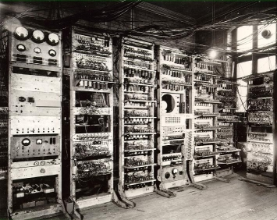
By Source, Fair use, https://en.wikipedia.org/w/index.php?curid=9975689
Notes:
Manchester Mark I

Slide 8


Slide 9
IBM, We Have a Problem

Slide 10
Bigger Computers Run Bigger Software
early computers were super expensive
but soon developing the software they executed was even costlier
all of it written in assembly
enter speedcoding
Actual “high-level” programming language

Slide 11
Speedcoding
when an arithmetic operation was found in the source code, corresponding routine was called
designed to ease the burden on programmers
not for speed (up to 20x slower than assembly)
occupied about 30% of available memory
Interpreter

Slide 12
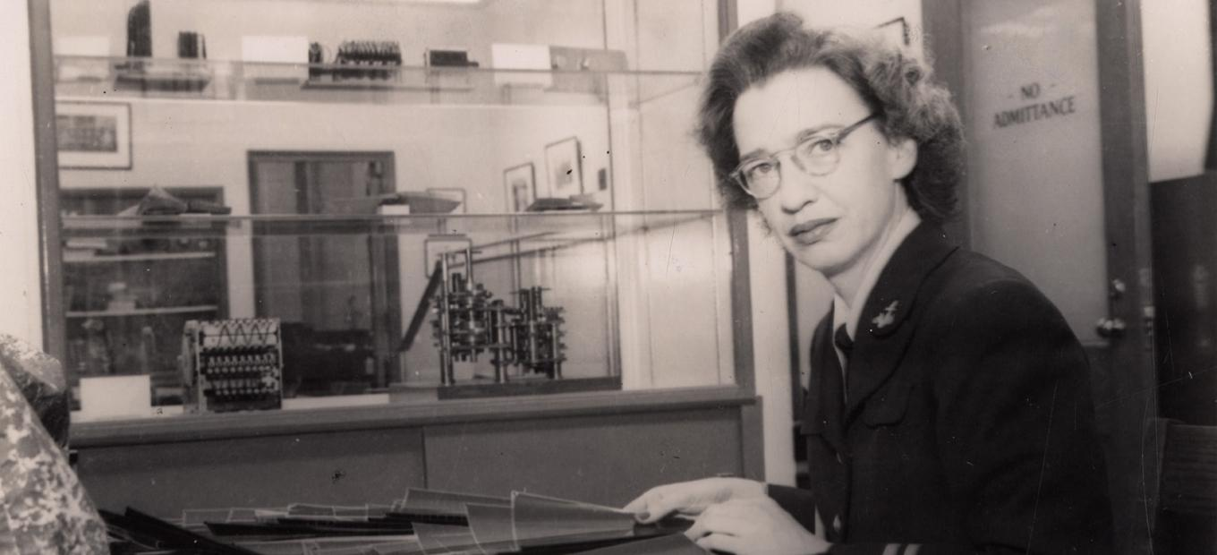

Slide 13
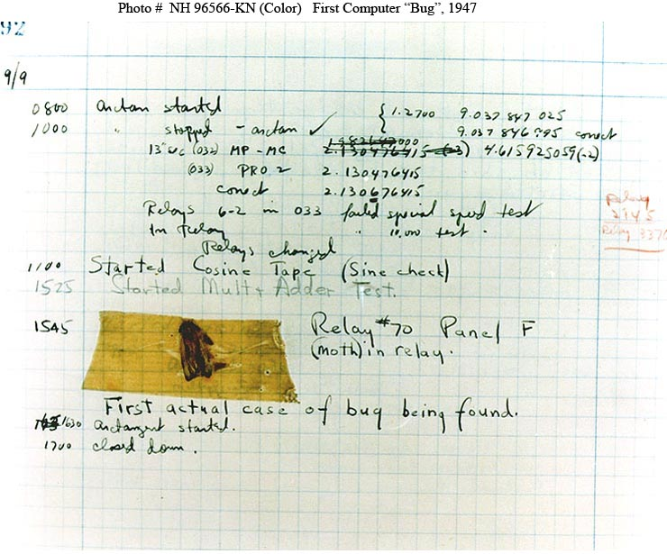

Slide 14
Compiler
a program that translates source code in human readable language to machine code
often, improves on the performance in the process

Slide 15
Compiler Architecture

Slide 16
Course Project
Notes:
Corrado Bohm and his PhD thesis – a self-compiling compiler for an interesting language where every statement was assignment operator
He probably felt guilty about this so later become an important figure in functional programming

Slide 17
tinyC
simple c-like language
pointers, integers, doubles, characters
loops, conditions
structs
functions
pointer arithmetics

Slide 19
Further Reading
https://www.cs.rit.edu/~ats/books/ooc.pdf - C with Objects on 226 pages
http://www.stroustrup.com/hopl2.pdf - Stroustrup’s account of the beginnings of C++

