Slide 1
Trying to outsmart a compiler defeats much of the purpose of using one.
Brian Kernighan

Slide 2

Principles of Compiled Code
NI(E)-GEN, Spring 2023
https://courses.fit.cvut.cz/NI-GEN
Notes:
Details about how compiled code actually works. Information about calling conventions, stack frames, variables, symbols and visibility. Memory areas (heap, stack, globals), alignment. Compilation units (modules, functions, basic blocks). Object files, static vs dynamic linkage, etc.

Slide 3
So we have a compiler…

Slide 4
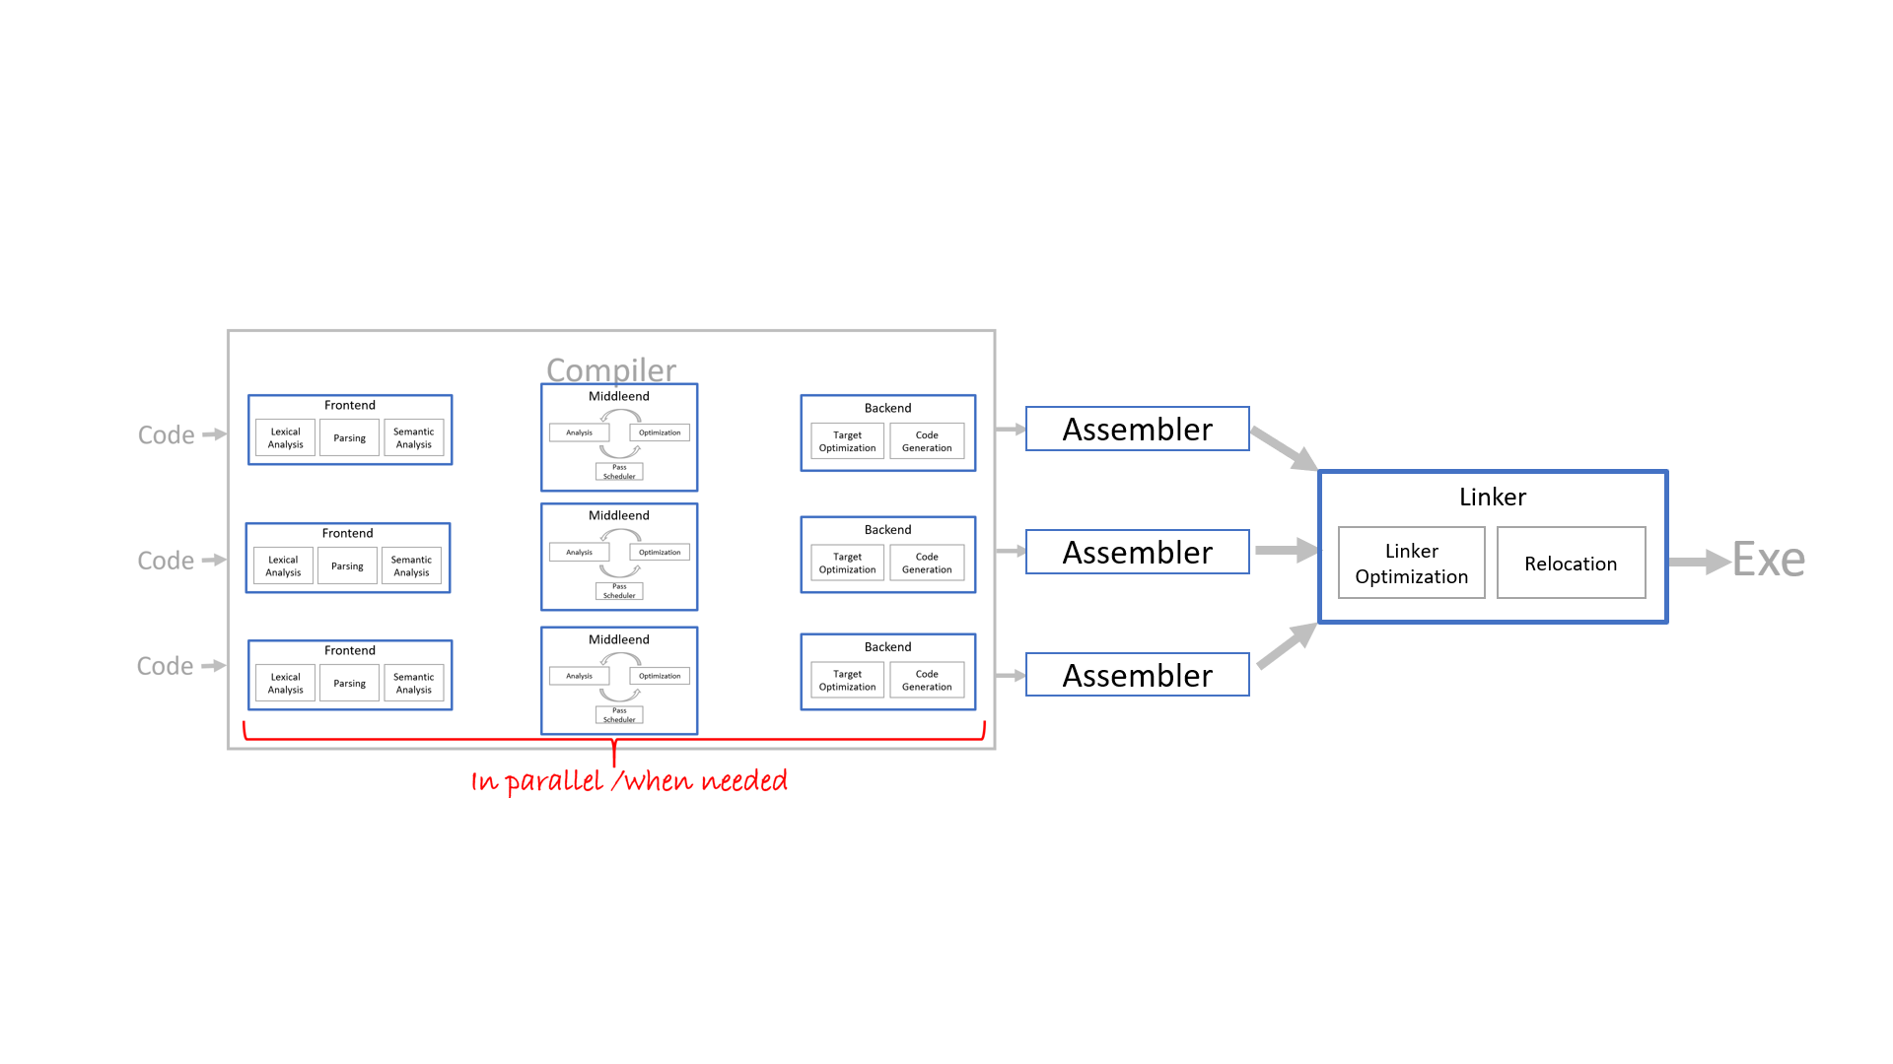
Notes:
So we know how to compile and what are all the aspects in the overview.

Slide 5
???
???
???
???
???
Notes:
So we know how to compile and what are all the aspects in the overview.

Slide 6
Executables

Slide 7
Executable
contains binary data of various kinds partitioned in sections (.text, .data, .rodata, etc.)

Slide 8
.text:
mov eax, hello_world
…
.rodata
hello_world:
“hello all, this is a text”, 0
.data
global-var:
0x67

Slide 9
Executable
contains binary data of various kinds partitioned in sections (.text, .data, .rodata, etc.)
when executed, the section contents are copied to memory

Slide 10
.data
.rodata
.text
System

Slide 11
.data
.rodata
.text
System

Slide 12
.data’
.rodata’
.text’
.data
.rodata
.text
System

Slide 13
Relocation
absolute addresses of symbols cannot be known statically
executable contains a relocation table
address to be patched
target symbol
patch type
the loader then updates the section contents based on the relocation table once the section starts are known

Slide 14
Executable
contains binary data of various kinds partitioned in sections (.text, .data, .rodata, etc.)
when executed, the section contents are copied to memory
and relocated

Slide 15
.data
.rodata
.data’
.text
.rodata’
.text’
System

Slide 16
Executable
contains binary data of various kinds partitioned in sections (.text, .data, .rodata, etc.)
when executed, the section contents are copied to memory
and relocated (if necessary, such as libraries)

Slide 17
.data
.rodata
.data’
.text
.rodata’
.text’
System

Slide 18
.text
.data’
.rodata’
.rodata
.text’
.data
System

Slide 19
Executable
contains binary data of various kinds partitioned in sections (.text, .data, .rodata, etc.)
when executed, the section contents are copied to memory
and relocated (if necessary, such as libraries, or ASLR)
Notes:
Address Space Layout Randomization

Slide 20
???
???
OK
OK
???
Notes:
So we know how to compile and what are all the aspects in the overview.

Slide 21
Object Files

Slide 22
Object Files
like executable
+ more sections, - loader
a lot more relocations
more information so that link-time optimization can be performed

Slide 23
???
OK
OK
OK
???
Notes:
So we know how to compile and what are all the aspects in the overview.

Slide 24
Source Granularity

Slide 25
Source Granularity
project
executable & libraries
files
functions
basic blocks
statements

Slide 26
Basic Block
code sequence with single entry and single leave point (terminating instruction)
once first instruction in a basic block gets executed, all instructions in basic block will execute sequentially
no control flow

Slide 27
if (a < 0) {
a = a + 1;
} else {
b = b + 1;
}
c = a + b;

Slide 28
if (a < 0) {
a = a + 1;
} else {
b = b + 1;
}
c = a + b;
B0: cmp ax, 0 // a in ax
jge B2
B1: add ax, 1
jmp B3
B2: add bx, 1 // b in bx
B3: mov cx, ax // c in cx
add cx, bx

Slide 29
if (a < 0) {
a = a + 1;
} else {
b = b + 1;
}
c = a + b;
B0: cmp ax, 0 // a in ax
jge B2
B1: add ax, 1
jmp B3
B2: add bx, 1 // b in bx
jmp B3
B3: mov cx, ax // c in cx
add cx, bx

Slide 30
Code Generation
BI-PPA, BI-PJP

Slide 31
Code Generation
int min(int x, int y) {
return x < y ? x : y;
}
int a = 67;
int b = 89;
print(min(a, b));

Slide 32
Code Generation
f_min: # functions are labels
int min(int x, int y) {
return x < y ? x : y;
}
int a = 67;
int b = 89;
print(min(a, b));

Slide 33
Code Generation
f_min:
cmp ax, bx # arguments in
jl x_less # ax and bx regs
x_less:
int min(int x, int y) {
return x < y ? x : y;
}
int a = 67;
int b = 89;
print(min(a, b));

Slide 34
Code Generation
f_min:
cmp ax, bx
jl x_less
mov ax, bx # result
ret # passed in ax reg
x_less:
int min(int x, int y) {
return x < y ? x : y;
}
int a = 67;
int b = 89;
print(min(a, b));

Slide 35
Code Generation
f_min:
cmp ax, bx
jl x_less
mov ax, bx
ret
x_less:
ret # already in ax
int min(int x, int y) {
return x < y ? x : y;
}
int a = 67;
int b = 89;
print(min(a, b));

Slide 36
Code Generation
jmp start # start with start
f_min:
cmp ax, bx
jl x_less
mov ax, bx
ret
x_less:
ret
start: # start exec here
mov ax, 67 # vars in regs
int min(int x, int y) {
return x < y ? x : y;
}
int a = 67;
int b = 89;
print(min(a, b));

Slide 37
Code Generation
jmp start
f_min:
cmp ax, bx
jl x_less
mov ax, bx
ret
x_less:
ret
start:
mov ax, 67
mov bx, 89
int min(int x, int y) {
return x < y ? x : y;
}
int a = 67;
int b = 89;
print(min(a, b));

Slide 38
Code Generation
jmp start
f_min:
cmp ax, bx
jl x_less
mov ax, bx
ret
x_less:
ret
start:
mov ax, 67
mov bx, 89
call f_min # luck:) -> ax
int min(int x, int y) {
return x < y ? x : y;
}
int a = 67;
int b = 89;
print(min(a, b));

Slide 39
Code Generation
jmp start
f_min:
cmp ax, bx
jl x_less
mov ax, bx
ret
x_less:
ret
start:
mov ax, 67
mov bx, 89
call f_min
call print # ax -> ax
int min(int x, int y) {
return x < y ? x : y;
}
int a = 67;
int b = 89;
print(min(a, b));

Slide 40
Code Generation
jmp start
f_min:
cmp ax, bx
jl x_less
mov ax, bx
ret
x_less:
ret
start:
mov ax, 67
mov bx, 89
call f_min
call print

Slide 41
Code Generation
00: jmp start
f_min:
04: cmp ax, bx
08: jl x_less
0a: mov ax, bx
0c: ret
x_less:
0d: ret
start:
0e: mov ax, 67
12: mov bx, 89
16: call f_min
1a: call print

Slide 42
Code Generation
00: jmp 0e
04: cmp ax, bx
08: jl 0d
0a: mov ax, bx
0c: ret
0d: ret
0e: mov ax, 67
12: mov bx, 89
16: call 04
1a: call print
Linker, help!

Slide 43
Memory Layout

Slide 44
AX
BX
CX
int fib(int n) {
if (n == 0)
return 0
if (n == 1)
return 1
int tmp = fib(n – 2)
int tmp2 = fib(n – 1)
int tmp3 = tmp1 + tmp2
return tmp3
}
fib(3)
DX
PC

Slide 45
AX
BX
CX
int fib(int n) {
if (n == 0)
return 0
if (n == 1)
return 1
int tmp = fib(n – 2)
int tmp2 = fib(n – 1)
int tmp3 = tmp1 + tmp2
return tmp3
}
fib(3)
DX
PC
main()

Slide 46
AX
1 argument
BX
CX
int fib(int n) {
if (n == 0)
return 0
if (n == 1)
return 1
int tmp = fib(n – 2)
int tmp2 = fib(n – 1)
int tmp3 = tmp1 + tmp2
return tmp3
}
fib(3)
DX
PC
recursive
3 local variables
return value

Slide 47
Call Stack
Last In – First Out Structure
Holds local variables, arguments and return addresses
Each function’s data live in its own area called stack frame
When function exits, the frame is popped off the stack

Slide 48
Stack:
AX
BX
CX
int fib(int n) {
if (n == 0)
return 0
if (n == 1)
return 1
int tmp = fib(n – 2)
int tmp2 = fib(n – 1)
int tmp3 = tmp1 + tmp2
return tmp3
}
fib(3)
DX
PC
SP
BP

Slide 49
Stack:
AX
BX
BP
start of main()
local vars of main
main
CX
int fib(int n) {
if (n == 0)
return 0
if (n == 1)
return 1
int tmp = fib(n – 2)
int tmp2 = fib(n – 1)
int tmp3 = tmp1 + tmp2
return tmp3
}
fib(3)
SP
DX
PC

Slide 50
Stack:
AX
BX
BP
start of main()
local vars of main
3
old BP
ret address (PC)
main
CX
int fib(int n) {
if (n == 0)
return 0
if (n == 1)
return 1
int tmp = fib(n – 2)
int tmp2 = fib(n – 1)
int tmp3 = tmp1 + tmp2
return tmp3
}
fib(3)
SP
DX
fib(3)
PC

Slide 51
Stack:
AX
BX
start of main()
local vars of main
3
old BP
ret address (PC)
[BP – 1]
main
CX
PC
int fib(int n) {
if (n == 0)
return 0
if (n == 1)
return 1
int tmp = fib(n – 2)
int tmp2 = fib(n – 1)
int tmp3 = tmp1 + tmp2
return tmp3
}
fib(3)
DX
BP
fib(3)
SP

Slide 52
Stack:
AX
BX
start of main()
local vars of main
3
old BP
ret address (PC)
tmp
tmp2
tmp3
main
CX
PC
int fib(int n) {
if (n == 0)
return 0
if (n == 1)
return 1
int tmp = fib(n – 2)
int tmp2 = fib(n – 1)
int tmp3 = tmp1 + tmp2
return tmp3
}
fib(3)
DX
BP
fib(3)
SP

Slide 53
Stack:
AX
BX
start of main()
local vars of main
3
old BP
ret address (PC)
tmp
tmp2
tmp3
main
CX
PC
int fib(int n) {
if (n == 0)
return 0
if (n == 1)
return 1
int tmp = fib(n – 2)
int tmp2 = fib(n – 1)
int tmp3 = tmp1 + tmp2
return tmp3
}
fib(3)
DX
BP
fib(3)
[BP + 2]
[BP + 3]
[BP + 4]
SP

Slide 54
Stack:
AX
BX
start of main()
local vars of main
3
old BP
ret address (PC)
tmp
tmp2
tmp3
main
CX
int fib(int n) {
if (n == 0)
return 0
if (n == 1)
return 1
int tmp = fib(n – 2)
int tmp2 = fib(n – 1)
int tmp3 = tmp1 + tmp2
return tmp3
}
fib(3)
DX
PC
BP
fib(3)
SP

Slide 55
Stack:
AX
BX
start of main()
local vars of main
3
old BP
ret address (PC)
tmp
tmp2
tmp3
main
CX
int fib(int n) {
if (n == 0)
return 0
if (n == 1)
return 1
int tmp = fib(n – 2)
int tmp2 = fib(n – 1)
int tmp3 = tmp1 + tmp2
return tmp3
}
fib(3)
DX
BP
PC
fib(3)
SP

Slide 56
Stack:
AX
BX
start of main()
local vars of main
3
old BP
ret address (PC)
tmp
tmp2
tmp3
main
CX
int fib(int n) {
if (n == 0)
return 0
if (n == 1)
return 1
int tmp = fib(n – 2)
int tmp2 = fib(n – 1)
int tmp3 = tmp1 + tmp2
return tmp3
}
fib(3)
DX
BP
fib(3)
PC
SP

Slide 57
Stack:
AX
BX
start of main()
local vars of main
3
old BP
ret address (PC)
tmp
tmp2
tmp3
1
old BP
ret address
main
CX
int fib(int n) {
if (n == 0)
return 0
if (n == 1)
return 1
int tmp = fib(n – 2)
int tmp2 = fib(n – 1)
int tmp3 = tmp1 + tmp2
return tmp3
}
fib(3)
DX
BP
fib(3)
PC
SP

Slide 58
Stack:
AX
BX
start of main()
local vars of main
3
old BP
ret address (PC)
tmp
tmp2
tmp3
1
old BP
ret address
main
CX
PC
int fib(int n) {
if (n == 0)
return 0
if (n == 1)
return 1
int tmp = fib(n – 2)
int tmp2 = fib(n – 1)
int tmp3 = tmp1 + tmp2
return tmp3
}
fib(3)
DX
fib(3)
BP
fib(1)
SP

Slide 59
Stack:
AX
BX
start of main()
local vars of main
3
old BP
ret address (PC)
tmp
tmp2
tmp3
1
old BP
ret address
tmp
tmp2
tmp3
main
CX
PC
int fib(int n) {
if (n == 0)
return 0
if (n == 1)
return 1
int tmp = fib(n – 2)
int tmp2 = fib(n – 1)
int tmp3 = tmp1 + tmp2
return tmp3
}
fib(3)
DX
fib(3)
BP
fib(1)
SP

Slide 60
Stack:
AX
BX
start of main()
local vars of main
3
old BP
ret address (PC)
tmp
tmp2
tmp3
1
old BP
ret address
tmp
tmp2
tmp3
main
CX
PC
int fib(int n) {
if (n == 0)
return 0
if (n == 1)
return 1
int tmp = fib(n – 2)
int tmp2 = fib(n – 1)
int tmp3 = tmp1 + tmp2
return tmp3
}
fib(3)
DX
fib(3)
BP
fib(1)
SP

Slide 61
Stack:
AX
BX
start of main()
local vars of main
3
old BP
ret address (PC)
tmp
tmp2
tmp3
1
old BP
ret address
tmp
tmp2
tmp3
main
CX
int fib(int n) {
if (n == 0)
return 0
if (n == 1)
return 1
int tmp = fib(n – 2)
int tmp2 = fib(n – 1)
int tmp3 = tmp1 + tmp2
return tmp3
}
fib(3)
DX
PC
fib(3)
BP
fib(1)
SP

Slide 62
Stack:
AX
BX
start of main()
local vars of main
3
old BP
ret address (PC)
tmp
tmp2
tmp3
1
old BP
ret address
tmp
tmp2
tmp3
main
CX
int fib(int n) {
if (n == 0)
return 0
if (n == 1)
return 1
int tmp = fib(n – 2)
int tmp2 = fib(n – 1)
int tmp3 = tmp1 + tmp2
return tmp3
}
fib(3)
DX
PC
fib(3)
BP
fib(1)
SP

Slide 63
Stack:
AX
BX
start of main()
local vars of main
3
old BP
ret address (PC)
tmp
tmp2
tmp3
1
old BP
ret address
tmp
tmp2
tmp3
main
CX
int fib(int n) {
if (n == 0)
return 0
if (n == 1)
return 1
int tmp = fib(n – 2)
int tmp2 = fib(n – 1)
int tmp3 = tmp1 + tmp2
return tmp3
}
fib(3)
DX
fib(3)
PC
BP
fib(1)
SP

Slide 64
Stack:
AX
1
BX
start of main()
local vars of main
3
old BP
ret address (PC)
tmp
tmp2
tmp3
1
old BP
ret address
tmp
tmp2
tmp3
main
CX
int fib(int n) {
if (n == 0)
return 0
if (n == 1)
return 1
int tmp = fib(n – 2)
int tmp2 = fib(n – 1)
int tmp3 = tmp1 + tmp2
return tmp3
}
fib(3)
DX
fib(3)
PC
BP
fib(1)
SP

Slide 65
Stack:
AX
1
BX
start of main()
local vars of main
3
old BP
ret address (PC)
tmp
tmp2
tmp3
1
old BP
ret address
tmp
tmp2
tmp3
main
CX
int fib(int n) {
if (n == 0)
return 0
if (n == 1)
return 1
int tmp = fib(n – 2)
int tmp2 = fib(n – 1)
int tmp3 = tmp1 + tmp2
return tmp3
}
fib(3)
DX
fib(3)
PC
BP
fib(1)
SP

Slide 66
Stack:
AX
1
BX
start of main()
local vars of main
3
old BP
ret address (PC)
tmp
tmp2
tmp3
1
old BP
ret address
tmp
tmp2
tmp3
main
CX
int fib(int n) {
if (n == 0)
return 0
if (n == 1)
return 1
int tmp = fib(n – 2)
int tmp2 = fib(n – 1)
int tmp3 = tmp1 + tmp2
return tmp3
}
fib(3)
DX
BP
fib(3)
PC
SP

Slide 67
Stack:
AX
1
BX
start of main()
local vars of main
3
old BP
ret address (PC)
tmp
tmp2
tmp3
main
CX
int fib(int n) {
if (n == 0)
return 0
if (n == 1)
return 1
int tmp = fib(n – 2)
int tmp2 = fib(n – 1)
int tmp3 = tmp1 + tmp2
return tmp3
}
fib(3)
DX
BP
fib(3)
PC
SP

Slide 68
Stack:
AX
1
BX
start of main()
local vars of main
3
old BP
ret address (PC)
1
tmp2
tmp3
main
CX
int fib(int n) {
if (n == 0)
return 0
if (n == 1)
return 1
int tmp = fib(n – 2)
int tmp2 = fib(n – 1)
int tmp3 = tmp1 + tmp2
return tmp3
}
fib(3)
DX
BP
fib(3)
PC
SP

Slide 69
Stack:
AX
BX
start of main()
local vars of main
3
old BP
ret address (PC)
1
tmp2
tmp3
main
CX
int fib(int n) {
if (n == 0)
return 0
if (n == 1)
return 1
int tmp = fib(n – 2)
int tmp2 = fib(n – 1)
int tmp3 = tmp1 + tmp2
return tmp3
}
fib(3)
DX
BP
fib(3)
PC
SP

Slide 70
Stack:
AX
BX
start of main()
local vars of main
3
old BP
ret address (PC)
1
tmp2
tmp3
2
old BP
ret address (PC)
main
CX
int fib(int n) {
if (n == 0)
return 0
if (n == 1)
return 1
int tmp = fib(n – 2)
int tmp2 = fib(n – 1)
int tmp3 = tmp1 + tmp2
return tmp3
}
fib(3)
DX
BP
fib(3)
PC
SP

Slide 71
Stack:
AX
BX
start of main()
local vars of main
3
old BP
ret address (PC)
1
tmp2
tmp3
2
old BP
ret address (PC)
main
CX
PC
int fib(int n) {
if (n == 0)
return 0
if (n == 1)
return 1
int tmp = fib(n – 2)
int tmp2 = fib(n – 1)
int tmp3 = tmp1 + tmp2
return tmp3
}
fib(3)
DX
fib(3)
BP
fib(2)
SP

Slide 72
Stack:
AX
BX
start of main()
local vars of main
3
old BP
ret address (PC)
1
tmp2
tmp3
2
old BP
ret address (PC)
tmp
tmp2
tmp3
main
CX
PC
int fib(int n) {
if (n == 0)
return 0
if (n == 1)
return 1
int tmp = fib(n – 2)
int tmp2 = fib(n – 1)
int tmp3 = tmp1 + tmp2
return tmp3
}
fib(3)
DX
fib(3)
BP
SP
fib(2)

Slide 73
Stack:
AX
BX
start of main()
local vars of main
3
old BP
ret address (PC)
1
tmp2
tmp3
2
old BP
ret address (PC)
tmp
tmp2
tmp3
main
CX
PC
int fib(int n) {
if (n == 0)
return 0
if (n == 1)
return 1
int tmp = fib(n – 2)
int tmp2 = fib(n – 1)
int tmp3 = tmp1 + tmp2
return tmp3
}
fib(3)
DX
fib(3)
BP
fib(2)
SP

Slide 74
Stack:
AX
BX
start of main()
local vars of main
3
old BP
ret address (PC)
1
tmp2
tmp3
2
old BP
ret address (PC)
tmp
tmp2
tmp3
main
CX
int fib(int n) {
if (n == 0)
return 0
if (n == 1)
return 1
int tmp = fib(n – 2)
int tmp2 = fib(n – 1)
int tmp3 = tmp1 + tmp2
return tmp3
}
fib(3)
DX
fib(3)
PC
BP
fib(2)
SP

Slide 75
Stack:
AX
BX
start of main()
local vars of main
3
old BP
ret address (PC)
1
tmp2
tmp3
2
old BP
ret address (PC)
tmp
tmp2
tmp3
main
CX
int fib(int n) {
if (n == 0)
return 0
if (n == 1)
return 1
int tmp = fib(n – 2)
int tmp2 = fib(n – 1)
int tmp3 = tmp1 + tmp2
return tmp3
}
fib(3)
DX
fib(3)
PC
BP
Stack Overflow
fib(2)
SP

Slide 76
Stack:
AX
BX
start of main()
local vars of main
3
old BP
ret address (PC)
1
tmp2
tmp3
2
old BP
ret address (PC)
0
tmp2
tmp3
main
CX
int fib(int n) {
if (n == 0)
return 0
if (n == 1)
return 1
int tmp = fib(n – 2)
int tmp2 = fib(n – 1)
int tmp3 = tmp1 + tmp2
return tmp3
}
fib(3)
DX
fib(3)
PC
BP
fib(2)
SP

Slide 77
Stack:
AX
BX
start of main()
local vars of main
3
old BP
ret address (PC)
1
tmp2
tmp3
2
old BP
ret address (PC)
0
tmp2
tmp3
main
CX
int fib(int n) {
if (n == 0)
return 0
if (n == 1)
return 1
int tmp = fib(n – 2)
int tmp2 = fib(n – 1)
int tmp3 = tmp1 + tmp2
return tmp3
}
fib(3)
DX
fib(3)
PC
BP
fib(2)
SP

Slide 78
Stack:
AX
BX
start of main()
local vars of main
3
old BP
ret address (PC)
1
tmp2
tmp3
2
old BP
ret address (PC)
0
1
tmp3
main
CX
int fib(int n) {
if (n == 0)
return 0
if (n == 1)
return 1
int tmp = fib(n – 2)
int tmp2 = fib(n – 1)
int tmp3 = tmp1 + tmp2
return tmp3
}
fib(3)
DX
fib(3)
PC
BP
fib(2)
SP

Slide 79
Stack:
AX
BX
start of main()
local vars of main
3
old BP
ret address (PC)
1
tmp2
tmp3
2
old BP
ret address (PC)
0
1
tmp3
main
CX
int fib(int n) {
if (n == 0)
return 0
if (n == 1)
return 1
int tmp = fib(n – 2)
int tmp2 = fib(n – 1)
int tmp3 = tmp1 + tmp2
return tmp3
}
fib(3)
DX
fib(3)
PC
BP
fib(2)
SP

Slide 80
Stack:
AX
BX
start of main()
local vars of main
3
old BP
ret address (PC)
1
tmp2
tmp3
2
old BP
ret address (PC)
0
1
1
main
CX
int fib(int n) {
if (n == 0)
return 0
if (n == 1)
return 1
int tmp = fib(n – 2)
int tmp2 = fib(n – 1)
int tmp3 = tmp1 + tmp2
return tmp3
}
fib(3)
DX
fib(3)
PC
BP
fib(2)
SP

Slide 81
Stack:
AX
1
BX
start of main()
local vars of main
3
old BP
ret address (PC)
1
tmp2
tmp3
2
old BP
ret address (PC)
0
1
1
main
CX
int fib(int n) {
if (n == 0)
return 0
if (n == 1)
return 1
int tmp = fib(n – 2)
int tmp2 = fib(n – 1)
int tmp3 = tmp1 + tmp2
return tmp3
}
fib(3)
DX
fib(3)
BP
PC
fib(2)
SP

Slide 82
Stack:
AX
1
BX
start of main()
local vars of main
3
old BP
ret address (PC)
1
tmp2
tmp3
2
old BP
ret address (PC)
0
1
1
main
CX
int fib(int n) {
if (n == 0)
return 0
if (n == 1)
return 1
int tmp = fib(n – 2)
int tmp2 = fib(n – 1)
int tmp3 = tmp1 + tmp2
return tmp3
}
fib(3)
DX
BP
fib(3)
PC
SP

Slide 83
Stack:
AX
1
BX
start of main()
local vars of main
3
old BP
ret address (PC)
1
1
tmp3
main
CX
int fib(int n) {
if (n == 0)
return 0
if (n == 1)
return 1
int tmp = fib(n – 2)
int tmp2 = fib(n – 1)
int tmp3 = tmp1 + tmp2
return tmp3
}
fib(3)
DX
BP
fib(3)
PC
SP

Slide 84
Stack:
AX
BX
start of main()
local vars of main
3
old BP
ret address (PC)
1
1
tmp3
main
CX
int fib(int n) {
if (n == 0)
return 0
if (n == 1)
return 1
int tmp = fib(n – 2)
int tmp2 = fib(n – 1)
int tmp3 = tmp1 + tmp2
return tmp3
}
fib(3)
DX
BP
fib(3)
SP
PC

Slide 85
Stack:
AX
BX
start of main()
local vars of main
3
old BP
ret address (PC)
1
1
2
main
CX
int fib(int n) {
if (n == 0)
return 0
if (n == 1)
return 1
int tmp = fib(n – 2)
int tmp2 = fib(n – 1)
int tmp3 = tmp1 + tmp2
return tmp3
}
fib(3)
DX
BP
fib(3)
SP
PC

Slide 86
Stack:
AX
BX
start of main()
local vars of main
3
old BP
ret address (PC)
1
1
2
main
CX
int fib(int n) {
if (n == 0)
return 0
if (n == 1)
return 1
int tmp = fib(n – 2)
int tmp2 = fib(n – 1)
int tmp3 = tmp1 + tmp2
return tmp3
}
fib(3)
DX
BP
fib(3)
SP
PC

Slide 87
Stack:
AX
2
BX
start of main()
local vars of main
3
old BP
ret address (PC)
1
1
2
main
CX
int fib(int n) {
if (n == 0)
return 0
if (n == 1)
return 1
int tmp = fib(n – 2)
int tmp2 = fib(n – 1)
int tmp3 = tmp1 + tmp2
return tmp3
}
fib(3)
DX
BP
fib(3)
SP
PC

Slide 88
Stack:
AX
2
BX
BP
start of main()
local vars of main
3
old BP
ret address (PC)
1
1
2
main
CX
int fib(int n) {
if (n == 0)
return 0
if (n == 1)
return 1
int tmp = fib(n – 2)
int tmp2 = fib(n – 1)
int tmp3 = tmp1 + tmp2
return tmp3
}
fib(3)
SP
DX
PC

Slide 89
Stack:
AX
2
BX
BP
start of main()
local vars of main
main
CX
int fib(int n) {
if (n == 0)
return 0
if (n == 1)
return 1
int tmp = fib(n – 2)
int tmp2 = fib(n – 1)
int tmp3 = tmp1 + tmp2
return tmp3
}
fib(3)
SP
DX
PC

Slide 90
Call Stack
stack frames used also for nested blocks
elements on stack must have statically known sizes
slightly more complicated for languages that allow nested functions
stack frame saves the old BP as well as BP to the closest parent function
when function returns data on stack cease to exist
this is not ok for other than local variables
why?

Slide 91
Data Segment
stores global variables
has statically known size
data in DS are valid throughout the duration of the program
Is this always true?
Notes:
Not always true, they may need to be initialized first

Slide 92
Data Segment
stores global variables
has statically known size
data in DS are valid throughout the duration of the program
But so does stack!!
Where to put dynamically sized data?

Slide 93
Heap
memory area for dynamically allocated data
allows allocation & deallocation in arbitrary order
manual or automatic (garbage collector) management
dynamic size depending on the actual allocation at any given time (sort of)

Slide 94
Memory Layout
max mem
Stack
Heap
Data Segment
Code Segment
0

Slide 95
Calling Conventions

Slide 96
Calling Conventions
how to pass arguments?
stack, registers, both, argument order
how to return the result of the function?
stack, registers, type-dependent
which registers are free for caller, and which for callee
who is responsible for cleanup?
caller cleanup, callee cleanup
architecture, OS, and language dependent

Slide 97
cdecl (x86)
Microsoft’s C compiler, caller saved
arguments on stack, right to left
result in eax, st0, or stack
eax, ecx, edx caller saved, rest callee saved

Slide 98
cdecl (x86)
push ebp ; save caller’s frame and start new frame
mov ebp, esp
push 3 ; push the arguments left to right
push 2
push 1
call f ; call function f
add esp, 12 ; remove arguments from frame (caller saved)
add eax, 1 ; result returned in eax (if integer)
mov esp, ebp ; ebp is callee cleaned (call to itself!)
pop ebp
ret

Slide 99
cdecl (x86)
sometimes the bp is updated by callee (BP - addressing in callee, like our example)
larger results returned on stack (caller allocated)
results in more registers (eax:edx typically)
stack alignment considerations

Slide 100
Other x86 Calling Conventions
fastcall (arguments in registers, callee cleanup)
thiscall (this pushed on stack as first argument, some variants in ecx, caller cleanup)
stdcall (callee cleanup, right to left args, Win32API)
x86_64 calling conventions (Microsoft vs the world)

Slide 101
ARM (A32)
link register (LR) for return address
faster than stack for calls to leaf subroutines
not really that necessary with inlining
more registers
r0, r1, r2, r3 = arguments (callee saved)
r4 – r11 = local variables (callee saved)

Slide 102
ARM64
even more registers
r19-r29 callee saved
r9 – r15 caller saved
r0-r7 arguments and results

Slide 103
Target Architectures

Slide 104
Target Architectures
x86, x86-64, ARM, RISC-V, MIPS, Itanium, Sparc, AVR, …, …
RISC, CISC, EPIC
all have memory, registers, instructions
Notes:
Talk a bit about the target architectures (RISC, CISC, etc.). Registers and all the basic stuff we need to compile to.

Slide 105
CISC
1960
memory is fast(!), and pricey
clock speed is function of available technology only, cpu size & power is not an issue
since there are transistors to spare, complex CPU instructions are possible and they greatly speed up the program and lower the memory requirements

Slide 106
CISC
1960
reg-mem arithmetics
very complex addressing modes
special instructions to support calls, control flow and other higher level language features
variable instruction length

Slide 107
CISC
1980
memory is fast(!), and pricey
clock speed is function of available technology only, cpu size & power is not an issue
since there are transistors to spare, complex CPU instructions are possible and they greatly speed up the program and lower the memory requirements

Slide 108
CISC
1980
memory is slow and cheap
clock speed is largely function of cpu size & power
cpu features on die compete with caches, pipeline stages, super-scalar ALUs, etc., there are no transistors to spare, complex instructions make the whole CPU slower

Slide 109
RISC
1980
reg-reg arithmetics
simple addressing modes
fixed instruction length
highly regular decoding

Slide 110
SuperScalar Processors
as instruction is processed by the CPU, different parts are utilized
instead of idling the unused circuits, more instructions can be processed at the same time
instruction pipeline
Notes:
Talk about pipeline saturation and draw an image

Slide 111
Pipeline Stalls
pipeline only helps if it is full
branches, more complex ALU operations, data dependencies, memory accesses may cause holes (stalls) in the pipeline
the instructions must be scheduled to minimize these
Notes:
Talk about branch delay slot

Slide 112
RISC
1980
small, fast to execute instructions soon reached the limit of 1 IPC
clock rates limited by technology & power
can we go below 1 IPC?

Slide 113
VLIW
Very Large Instruction Words
large instructions encoding multiple smaller operations
that are executed in parallel
(the compiler schedules the operations into the VLIWs ahead of time)

Slide 114
EPIC
non-determinism of memory access is a problem for VLIW
Mitigated by EPIC (Explicitly Parallel Instruction Computing) where instructions and continuation logic is put by compiler into bundles
explicit prefetching, explicit speculative pre-loading, predicated execution all used to make the bundles into more deterministic sequence
Intel Itanium
Notes:
Talk a bit about itanium and how x86_64 eventually got the upper hand

Slide 115
The Awesome Compiler

Slide 116
The Awesome Compiler
Not so much…

Slide 117
Super-Super Processors
as superscalar or EPIC processors got more and more complex and powerful, the scheduling demands placed on the compiler were too great
multiple execution units per stage were added to lower the congestion
the super-super architecture

Slide 118
SMT
often computers do more than one thing anyways
SMT (Simultaneous Multithreading) makes multiple “cores” share parts of the execution units
better utilization of the resources
no thread context switching required
Hyperthreading

Slide 119
Out of Order Execution
CPU keeps a pool of fetched instructions
these are issued dynamically not according to their order in program, but availability of required execution units and inputs
requires complex bookkeeping to preserve sequential semantics
makes compiler scheduling much less important

Slide 120
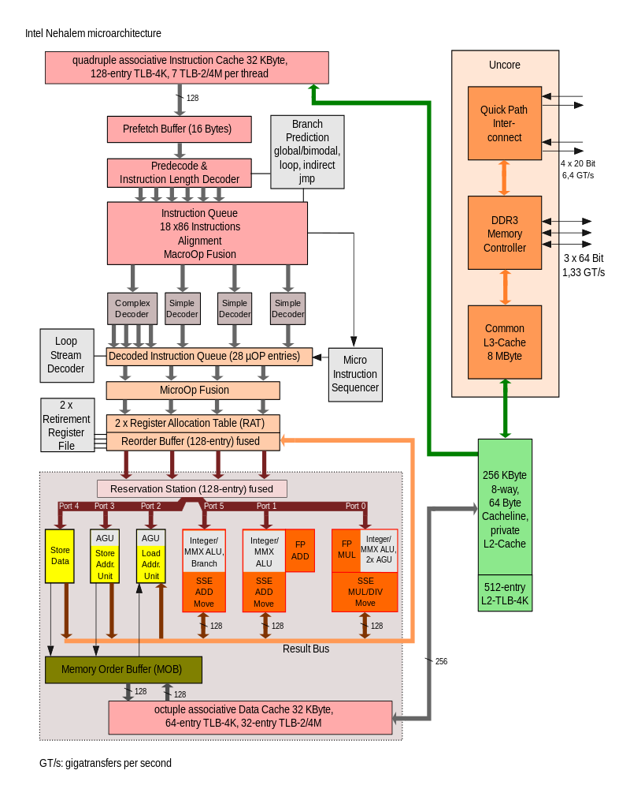
https://en.wikipedia.org/wiki/Nehalem_(microarchitecture)#/media/File:Intel_Nehalem_arch.svg

Slide 121
Practical ISA

Slide 122
struct pos {
int32_t x;
int32_t y;
};
pos items[128];
int32_t j = items[i].y;
// r1 contains & items
// r2 contains i
ldi r3, r2
shr r3, 3
add r3, r1
ldi r4, 4
add r3, r4
load r4, r3
* by 8 (sizeof pos)
load from memory

Slide 123
struct pos {
int32_t x;
int32_t y;
};
pos items[128];
int32_t j = items[i].y;
// edx contains & items
// eax contains i
mov eax, [edx + 8 * eax + 4]
j
items
i
sizeof pos
y’s offset

Slide 124
struct pos {
int32_t x;
int32_t y;
};
pos items[128];
int32_t * j = & items[i].y;
// r1 contains & items
// r2 contains i
ldi r3, r2
shr r3, 3
add r3, r1
ldi r4, 4
add r3, r4
r3 contains the address

Slide 125
struct pos {
int32_t x;
int32_t y;
};
pos items[128];
int32_t * j = & items[i].y;
lea eax, [edx + 8 * eax + 4]

Slide 126
Fun with CISC
complex instructions not created equal
some are deprecated (made slower), or made faster
often complex instructions can be used for surprising purposes
consider lea
Notes:
Talk about weirdly designed instruction sets
LEA used for add as it is more powerful & faster often

Slide 127
lea ecx, [edx + 8 * eax + 4]

Slide 128
lea ecx, [edx + 8 * eax + 4]
mov ecx, eax
shl ecx, 3
add ecx, 4
add ecx, edx

Slide 129
Code Size Matters
variable length encodings even on RISC ISAs
immediate argument sizes
relative branch distances
not all registers created equal

Slide 130
General Trends
out-of-order execution and more regular pipelines
RISC architecture is becoming increasingly complex
Notes:
Maybe just talk about this

Slide 131
Further Reading
https://medium.com/swlh/what-does-risc-and-cisc-mean-in-2020-7b4d42c9a9de

