Slide 1

Code Generation
Course Title:
NI(E)-GEN, Spring 2021
https://courses.fit.cvut.cz/NI-GEN

Slide 2
Code Generation
Lecture Title:
NI(E)-GEN, Spring 2021
https://courses.fit.cvut.cz/NI-GEN

Slide 3
Compiler
Middleend
Frontend
Analysis
Optimization
Backend
Code
Exe
Lexical Analysis
Parsing
Semantic Analysis
Target
Optimization
Code Generation
Pass Scheduler
Notes:
Happens in real time

Slide 4
Backend
IR
Target
Optimization
Code Generation
Exe
Notes:
Happens in real time

Slide 5
Backend
Target
Optimization
IR
Code Generation
Exe
Code Layout
Calling Conventions
Notes:
Happens in real time

Slide 6
Code Layout
determines the ordering of basic blocks in memory
taking a branch is usually more expensive
longer execution time
worse code cache locality
convert 2 target branches so that mostly taken branches don’t translate to jumps
not always possible
how to determine which target is more important?

Slide 7
Calling Conventions
calling convention for each function must be determined
callers may need rewrite to provide arguments and read results properly (i.e. stack)
callee must add prologue / epilogue code
stack & local variables bookkeeping
local variables management

Slide 8
Local Variables
on stack (addressable by statically known offsets from BP)
simple
slow (extra memory reads & writes)
in register
uses machine registers (not that many of them)
not always possible
usually determined by the optimizer and already reflected in some form in the IR
sometimes combination of both

Slide 9
Backend
Target
Optimization
IR
Code Generation
Exe
Code Layout
Calling Conventions
Notes:
Happens in real time

Slide 10
Backend
Target
Optimization
Code Generation
IR
Exe
Code Layout
Calling Conventions
Instruction Selection
Instruction Scheduling
Register Allocation
Notes:
Happens in real time

Slide 11
Code Generation
traditionally consists of three main phases
instruction selection (determine which instructions will be used to execute the program’s semantics)
instruction scheduling (reorder instructions to ease pressure on computer units)
register allocation (determine which machine registers will be used for what)
presented separately
a hairy, interleaved, mess of code in practical reality…

Slide 12
Registers
instruction selection almost never done in isolation
the register allocator is responsible for providing new free registers
i.e. instead of r0, call nextRegister() which returns new free registers
this may also insert extra code to keep old value if no new registers available
register spilling

Slide 13
Instruction Selection

Slide 14
Instruction Selection
if IR is simple enough (such as our case), direct translation is possible
for each instruction, generate its target counterpart (or counterparts)

Slide 15
a = b + 45;

Slide 16
a = b + 45;
r7 = load [b]
r8 = load_imm 45
r9 = add r7 r8
store [a] r9

Slide 17
a = b + 45;
r7 = load [b]
r8 = load_imm 45
r9 = add r7 r8
store [a] r9
mov r1, [b]
mov r2, 45
add r1, r2
mov [a], r1

Slide 18
a = b + c + d + e + f + g + h + i + j + 45;
Say we only have 8 registers…

Slide 19
a = b + c + d + e + f + g + h + i + j + 45;
r0 = load [b]
r1 = load [c]
r2 = load [d]
r3 = load [e]
r4 = load [f]
r5 = load [g]
r6 = load [h]
r7 = load [i]
r8 = load [j]
r9 = load_imm 45
r10 = add r8 r9
store [a] r10

Slide 20
a = b + c + d + e + f + g + h + i + j + 45;
mov r0, [b]
mov r1, [c]
mov r2, [d]
mov r3, [e]
mov r4, [f]
mov r5, [g]
mov r6, [h]
mov r7, [i]
mov ??, [j]
mov ??, 45
…

Slide 21
a = b + c + d + e + f + g + h + i + j + 45;
mov r0, [b]
mov r1, [c]
mov r2, [d]
mov r3, [e]
mov r4, [f]
mov r5, [g]
mov r6, [h]
mov r7, [i]
mov ??, [j]
mov ??, 45
…

Slide 22
Instruction Selection
if IR is simple enough (such as our case), direct translation is possible
for each instruction, generate its target counterpart (or counterparts)
keep local variables in memory
lowers register pressure
expensive

Slide 23
Naïve Instruction Selection
if IR is simple enough (such as our case), direct translation is possible
for each instruction, generate its target counterpart (or counterparts)
keep local variables in memory
lowers register pressure
expensive

Slide 24
a = b + 45;
r7 = load [b]
r8 = load_imm 45
r9 = add r7 r8
store [a] r9
mov r1, [b]
mov r2, [45]
add r1, r2
mov [a], r1

Slide 25
a = b + 45;
r7 = load [b]
r8 = load_imm 45
r9 = add r7 r8
store [a] r9
mov r1, [b]
mov r2, 45
add r1, r2
mov [a], r1
mov r1, [b]
add r1, 45
mov [a], r1

Slide 26
a = b + c + d + e + f + g + h + i + j + 45;
mov r0, [b]
mov r1, [c]
mov r2, [d]
mov r3, [e]
mov r4, [f]
mov r5, [g]
mov r6, [h]
mov r7, [i]
mov ??, [j]
mov ??, 45
…

Slide 27
a = b + c + d + e + f + g + h + i + j + 45;
mov r0, [b]
add r0, [c]
add r0, [d]
add r0, [e]
add r0, [f]
add r0, [g]
add r0, [h]
add r0, [i]
add r0, 45
mov [a], r0

Slide 28
Instruction Selection II
naïve implementation possible, but suboptimal
same operation can be expressed by many different instructions
much more so for CISC machines
or when changing archictecture (stack IR to register machine, etc.)
different instructions can be beneficial in different settings
speed vs size vs power consumption

Slide 29
Tree Walk
bottom-up walk of the IR tree
rewrite rules for each node

Slide 30
=
a
+
b
45

Slide 31
=
store [a]
add
load [b]
load_imm 45

Slide 32
store [a]
add
add r0, r1
load [b]
load_imm 45
mov r0, [b]
mov r1, 45
Notes:
In reality this goes top down really

Slide 33
store [a]
add
add r1, 45
Rule : if rhs or lhs is constant, rewrite as add immediate and do not use rhs
a hack, not really bottom up any more
load [b]
load_imm 45
mov r0, [b]
mov r1, 45

Slide 34
store [a]
mov [a], r1
add
add r1, 45
load [b]
load_imm 45
mov r0, [b]
mov r1, 45

Slide 35
The generated code:
store [a]
mov r0, [b]
add r1, 45
add
mov [a], r1
load [b]
load_imm 45
mov r1, 45

Slide 36
Tree Walk
bottom-up walk of the IR tree
rewrite rules for each node
quality depends on the complexity of the rules
only explores local optimizations
cf. optimizing AST-based IR
should be followed by target code optimizer to remove obvious inefficiencies
double loads / extra stores, etc.

Slide 37
Tree Walk
often extra nodes (dereferencing, etc.) are preserved in the AST
this allows better code matching opportunities
at the expense of costlier tree rewrite
and more complex rewrite rules
rewrite rules can be ambiguous and have associated cost with them
different costs can be used for different goals (speed, size, etc.)

Slide 38

ME LIKES SOME CODE REUSE!
Compiler
Middleend
Frontend
Backend
Code
Obj
Lexical Analysis
Parsing
Semantic Analysis
Analysis
Optimization
Target
Optimization
Code Generation
Pass Scheduler
Middleend
Frontend
Backend
Obj
Code
Lexical Analysis
Parsing
Semantic Analysis
Analysis
Optimization
Target
Optimization
Code Generation
Pass Scheduler
Middleend
Backend
Code
Frontend
Target
Optimization
Code Generation
Obj
Lexical Analysis
Parsing
Semantic Analysis
Analysis
Optimization
Pass Scheduler
Notes:
Happens in real time

Slide 39
Tree Tiling
generalization of the tree-walk method
can be expressed in pattern tables for each architecture and share the actual implementation code
tree must encode operations and inputs (register, memory, immediate)
immediate sizes, register constraints, etc.

Slide 40
Rewriting Rules
AST | Target
IMM | mov REGNEW, IMM
* REG1 | mov REGNEW, [REG1]
* IMM | mov REGNEW, [IMM]
* + (REG1, IMM) | mov REGNEW, [REG1 + IMM]
+ (REG1, REG2) | add REG1, REG2
+ (REG1, IMM) | add REG1, IMM
+ (REG1, * REG2) | add REG1, [REG2]
+ (REG1, * + (REG2, IMM)) | add REG1, [REG2 + IMM]
= ( * REG1, REG2) | mov [REG1], REG2
and many, many more…

Slide 41
Rewriting Rules are actually a grammar
AST | Target
REG := IMM | mov REGNEW, IMM
REG := * REG1 | mov REGNEW, [REG1]
REG := * IMM | mov REGNEW, [IMM]
REG := * + (REG1, IMM) | mov REGNEW, [REG1 + IMM]
REG := + (REG1, REG2) | add REG1, REG2
REG := + (REG1, IMM) | add REG1, IMM
REG := + (REG1, * REG2) | add REG1, [REG2]
REG := + (REG1, * + (REG2, IMM)) | add REG1, [REG2 + IMM]
ASSIGN := = ( * REG1, REG2) | mov [REG1], REG2
and many, many more…

Slide 42
AST | Target
IMM | mov REGNEW, IMM
* REG1 | mov REGNEW, [REG1]
* IMM | mov REGNEW, [IMM]
* + (REG1, IMM) | mov REGNEW, [REG1 + IMM]
+ (REG1, REG2) | add REG1, REG2
+ (REG1, IMM) | add REG1, IMM
+ (REG1, * REG2) | add REG1, [REG2]
+ (REG1, * + (REG2, IMM)) | add REG1, [REG2 + IMM]
= ( * REG1, REG2) | mov [REG1], REG2
=
a
+
b
45

Slide 43
AST | Target
IMM | mov REGNEW, IMM
* REG1 | mov REGNEW, [REG1]
* IMM | mov REGNEW, [IMM]
* + (REG1, IMM) | mov REGNEW, [REG1 + IMM]
+ (REG1, REG2) | add REG1, REG2
+ (REG1, IMM) | add REG1, IMM
+ (REG1, * REG2) | add REG1, [REG2]
+ (REG1, * + (REG2, IMM)) | add REG1, [REG2 + IMM]
= ( * REG1, REG2) | mov [REG1], REG2
=
*
+
a
*
45
b
Ambiguity

Slide 44
AST | Target | $
IMM | mov REGNEW, IMM | 1
* REG1 | mov REGNEW, [REG1] | 1
* IMM | mov REGNEW, [IMM] | 1
* + (REG1, IMM) | mov REGNEW, [REG1 + IMM] | 1
+ (REG1, REG2) | add REG1, REG2 | 1
+ (REG1, IMM) | add REG1, IMM | 1
+ (REG1, * REG2) | add REG1, [REG2] | 1
+ (REG1, * + (REG2, IMM)) | add REG1, [REG2 + IMM] | 1
= ( * REG1, REG2) | mov [REG1], REG2 | 1
=
*
+
a
*
45
b
Ambiguity

Slide 45
AST | Target | $
IMM | mov REGNEW, IMM | 1
* REG1 | mov REGNEW, [REG1] | 1
* IMM | mov REGNEW, [IMM] | 1
* + (REG1, IMM) | mov REGNEW, [REG1 + IMM] | 1
+ (REG1, REG2) | add REG1, REG2 | 1
+ (REG1, IMM) | add REG1, IMM | 1
+ (REG1, * REG2) | add REG1, [REG2] | 1
+ (REG1, * + (REG2, IMM)) | add REG1, [REG2 + IMM] | 1
= ( * REG1, REG2) | mov [REG1], REG2 | 1
=
*
+
a
mov r1, [b]
add r1, 45
mov [a], r1
*
45
b
Ambiguity

Slide 46
Finding All Tilings
to simplify, assume at most subtrees per node
assume that each rule contains at most one operation
Ouch:
REG := + (REG1, * + (REG2, IMM))
Now illegal:(

Slide 47
Finding All Tilings
to simplify, assume at most subtrees per node
assume that each rule contains at most one operation
simple rewrite, replace the extra operation with special symbol only appearing once, assign cost of 0 to it
REG := + (REG1, * + (REG2, IMM))
becomes:
REG := + (REG1, REG_TMP_1) [$1]
REG_TMP_1 := * REG_TMP_2 [$0]
REG_TMP_2 := + (REG, IMM) [$0]

Slide 48
Finding All Tilings
to simplify, assume at most subtrees per node
assume that each rule contains at most one operation
simple rewrite, replace the extra operation with special symbol only appearing once, assign cost of 0 to it
task is to find for each node a list of rules that can be used to tile it
the rule also tells us about its lhs and rhs subtrees, and thus are sufficient to reconstruct the tiling

Slide 49
For Each Binary Tile:
Start empty
labels(n) = empty set
tile(left(n))
tile(right(n))
for each rule r that matches n’s operation:
if left(r) ∈ labels(left(n)) and right(r) ∈ labels(right(n))
labels(n) += r
Calculate labels for subtrees
Check all possible own rules, see if the lhs and rhs nonterminals of the rule match labels for the lhs and rhs subtrees respectively. If they do add the rule to own labels.

Slide 50
For Each Unary Tile:
Start empty
labels(n) = empty set
tile(arg(n))
for each rule r that matches n’s operation
if arg(r) ∈ labels(arg(n))
labels(n) += r
calculate label for the operand subtree
Check all possible own rules, see if the operand nonterminals of the rule match labels for the operand subtree. If they do add the rule to own labels.

Slide 51
For Each Leaf Tile:
Start empty
labels(n) = empty set
for each rule r that matches n’s operation
labels(n) += r
There is nothing to check for leaves:)

Slide 52
Finding All Tilings
naïve implementations will be slow
repeated rule searches can be optimized in tables
these tend to get very large, but are really sparse
rules can be pruned
each node can only keep rules that provide the cheapest tiling

Slide 53
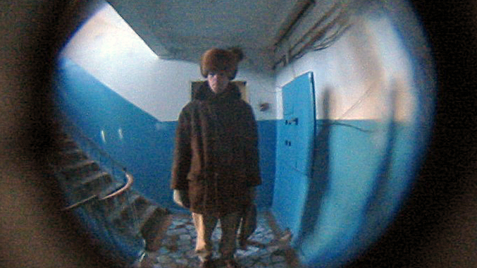

Slide 54
Peephole Optimizations
a simple, yet powerful concept for many backend optimizations
idea: by observing and modifying a relatively small sliding window of instructions (peephole), the compiler can discover local optimizations
used not just for instruction selection
expression simplification
dead store, extra load removal
…

Slide 55
a = b + 45;
(A) The trivial generator:
(B) The optimal code:
mov r1, [b]
mov r2, 45
add r1, r2
mov [a], r1
mov r1, [b]
add r1, 45
mov [a], r1
The usual problem: How to get from A to B?

Slide 56
a = b + 45;
mov r1, [b]
mov r2, 45
add r1, r2
mov [a], r1
mov r1, [b]
add r1, 45
mov [a], r1

Slide 57
a = b + 45;
mov r1, [b]
mov r2, 45
add r1, r2
mov [a], r1
mov r1, [b]
add r1, 45
mov [a], r1
Available rewrite:
mov R1, IMM
add R2, R1
-> add R2, IMM

Slide 58
a = b + 45;
mov r1, [b]
add r1, 45
mov [a], r1
mov r1, [b]
add r1, 45
mov [a], r1
Yeah!

Slide 59
The Devil Lies In The Detail
simple peepholers offer very limited optimization possibilities
can only match what it sees
context only as large as the peephole
modern implementations consist of three steps
expansion
simplification
matching

Slide 60
Expansion
takes each IR operation and expands it into a low-level set of operations
these capture every side-effect of the operation
setting values, flags, etc.
exposes “hidden” instructions
reading local variable via BP,
getting function arguments
reading values from memory (unless explicit in IR)

Slide 61
Simplification
looks at the contents of sliding window in the low level IR
at each step looks through a database to find simpler rewrites within
if found, rewrites and tries again on rewritten code
if none found, moves the window

Slide 62
Matching
rewrites the simplified low level IR to target assembly
usually simple matching of N operations

Slide 63
The Devil Lies In The Detail II
must know the liveness of variables and remove dead ones
removing dead variable declaration removes instruction and changes the contents of the peephole
the devil lies in the detail III
this is hard with control flow, code generation on single basic block basis wastes optimization opportunities
what should be the peephole size?
more is not always better
the window does not have to be sequential instructions, but can use DDG for more context as well

Slide 64
On The Other Side
well-made peepholer can be powerful
can be easily retargeted
can easily add new features (adding rewrite rules)
the simplifier provides distinct benefits compared to tree rewriting
and plays better with the other backend tasks

Slide 65
Improving Instruction Selection

Slide 66
Improving Instruction Selection
vital for compiler performance
new architecture versions often change instruction parameters
really complex for advanced instruction sets
even RISC can get really complex nowadays
vectorization, special modes, etc.
There are bugs too:(

Slide 67
Learning IS Patterns
both tree tiling and peepholer benefit from many useful rewrite patterns
getting these is lengthy and involved process, but can be precalculated
try to write these for the tiny86 backend
for small peephole sizes, even exhaustive search of all possible patterns is feasible
law of diminishing returns

Slide 68
Superoptimizers
a traditional compiler is unlikely to produce the optimal code for any given problem
a supercompiler attempts to find the true optimal solution

Slide 69
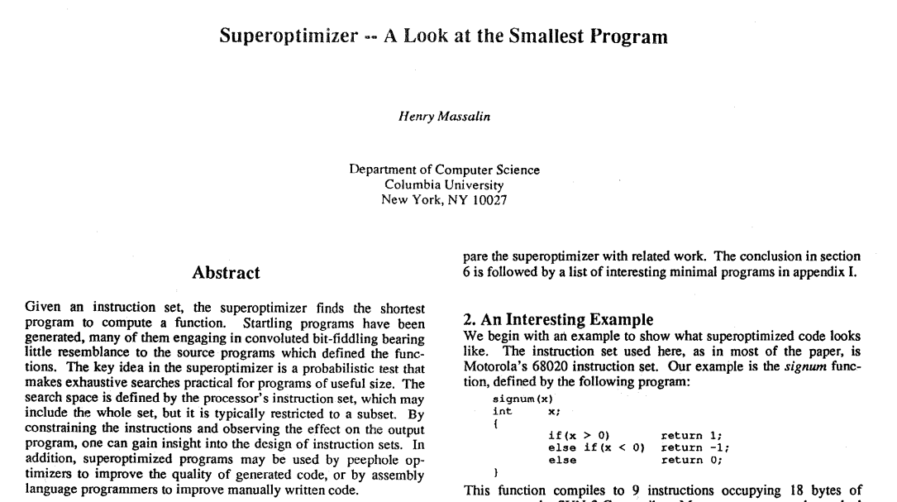

Slide 70
Superoptimizers
a traditional compiler is unlikely to produce the optimal code for any given problem
a supercompiler attempts to find the true optimal solution
does so by exhaustive brute force search of all possible programs of given sizes
scales not well
or SAT solvers
scales better, but programs are vast!

Slide 71
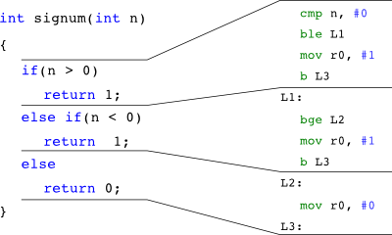
http://superoptimization.org/wiki/Superoptimizing_Compilers

Slide 72
http://superoptimization.org/wiki/Superoptimizing_Compilers

Slide 73
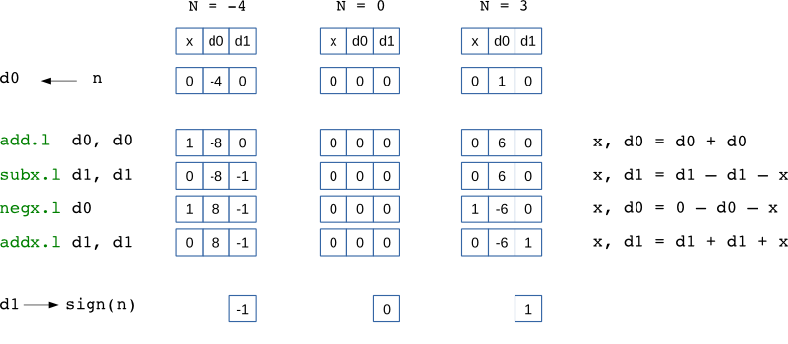
http://superoptimization.org/wiki/Superoptimizing_Compilers

Slide 74
Superoptimization
requires detailed knowledge of the target architecture, including all side-effects
takes a lot of time
unlike new patterns, this is actual, real compile time

Slide 75
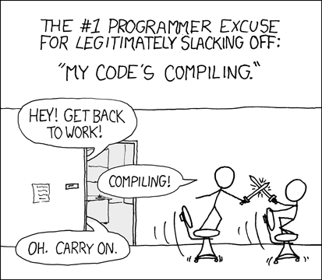
https://xkcd.com/303/

Slide 76
Superoptimization
requires detailed knowledge of the target architecture, including all side-effects
takes a lot of time
unlike new patterns, this is actual, real compile time
requires checking that generated sequences are semantically identical
used only for really small performance sensitive kernels
And for finding new peephole patterns…

Slide 77
Further Reading
https://eli.thegreenplace.net/2012/11/24/life-of-an-instruction-in-llvm/ - don’t be scared:)
https://www.hpl.hp.com/techreports/Compaq-DEC/SRC-RR-171.html - The DENALI superoptimizer

