Slide 1
INDEX
What is problem statement?
Objectives
Literature Review
What is our Idea and how it works?
Benefits of new System on Society
Challenges to new System
References

Slide 2
What is the problem statement?
Farmers are not able to sell their crops to anyone they have to visit sell it to agents in APMC markets.
Agents buy crop at less rate but increased rate the rate when selling to wholesalers.
Truck drivers are not getting enough transport deals due to lack advance infrastructure.

Slide 3
Objectives
Providing an Infrastructure to customer and driver to directly communicate regarding transportation requirements.
Providing opportunity to all truck drivers to make offers for all available shipments.
To give opportunity for farmers to decide the minimum price of shipment and also give equal opportunities to customers including APMCs, government agencies, etc. and truck drivers throughout the country.
Make easy payments and more secure transport service for both farmers and drivers.

Slide 4
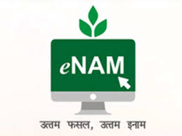


Present condition-
Current options available for same procedure -

Slide 5
Literature Review
Recently, there are some developments done in some parts of this field like transporting and tracking management systems with the help of greedy like algorithms, but till date there is no efficient effort has been made in this area to solve the problem. There is a strong requirement for a one-stop solution for this problem. [2]
The basic idea behind our application is that both Farmers and Consumers can search for their needs and get more benefits through our application. Our application helps farmers get different options to sell their products in their locations that reduce transportation costs. [1]
In our application, we will make use of Time Series data that converts to time series by using point process. Our model predicts the probability of a crop that has the highest price.[1]
Forecasting is a process of making predictions of the future based on past and present data. The common method of Prediction is the ARIMA model, which stands for Auto Regressive Integrated Moving Average. [1]

Slide 6
What is our idea?
We are providing a e-platform to Farmers where they can sell their crops to anyone on their desired rate and conditions.
They will not bounded to sell crop to APMC agents who usually rob them with low price to their crops.
On the other hand Wholesaler who buys from these APMC agents can directly buy from farmers. It will remove the cost added by APMC agents.
And, for transport Truck Drivers can see the successful deals on platform and can transport the crop from Farmers to Wholesaler

Slide 7



So who and all are stakeholder?
Farmers
Customers
Drivers

Slide 8

So what is solution?
Farmers
Drivers
Customers

Slide 9
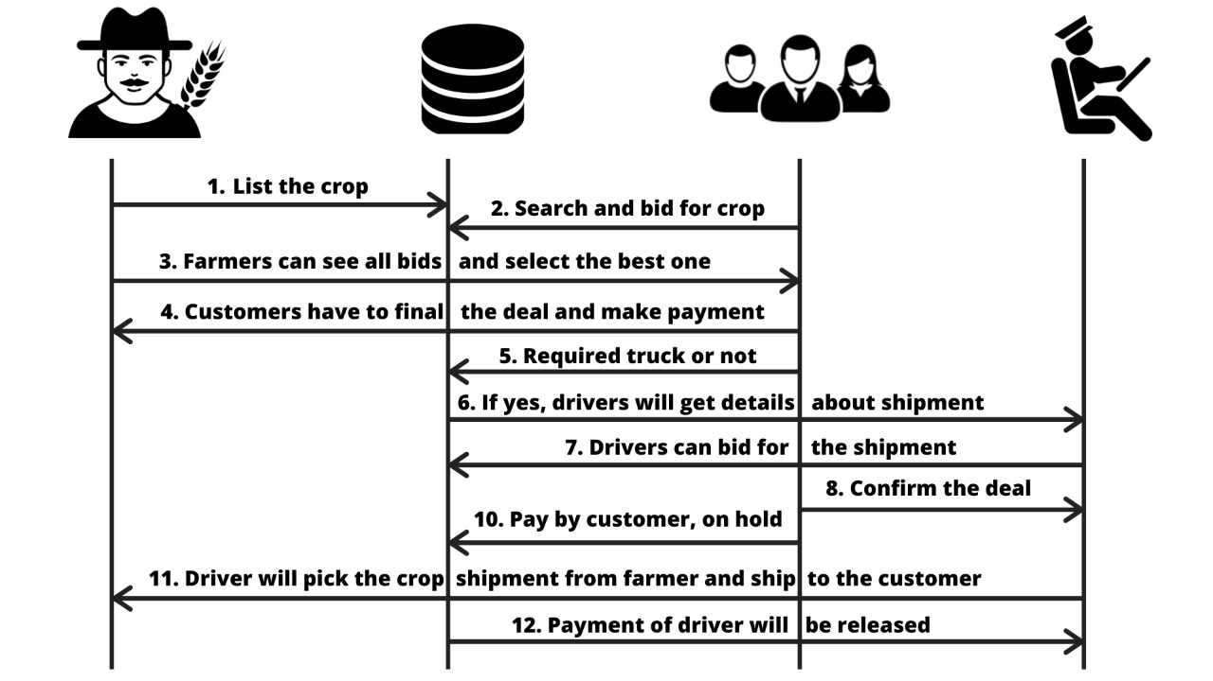
How it works?

Slide 10
Why we need new system?
APMC: 1.Cess tax,
2.Broker fee,
3.Visit mandi,
4.Low price,
5.High retail Price
eNAM: 1.Visit mandi,
2.No control on price,
3.Waiting
Kisan Rath: Not integrated with other system

Slide 11
Benefit of new system on Society:
It will remove Cess tax applied by APMC which is around 1% to 8%
Farmers will be the only person who can decide price of their crops.
Agents can't rob farmers by selling crop to lower price simply.
Farmers are not bounded to a fix trade area they can trade anywhere.
Farmers will get payment on same day of deal.
Wholesaler can get crop on less price compare to existing system.
Truck drivers can get transport work easily.
Agri-Transport will be lot cheaper compare to now-a-days.

Slide 12
Challenges to new system?
Challenge 1: Quality assurance
How can a customer trust on farmer that he or she will provide the same quality which is expecting by the customer.
How can a farmer get rid by customer's fraud about crop quality after delivery.
Challenge 2: Lack of Awareness and Literacy
How to deal with challenge of Awareness and Literacy among farmers?
Challenge 3: Lack of Availability of Resources
How to deal with unavailability of resources like modern gadgets and network connectivity.

Slide 13
Then what will happen to APMC?
APMC can still work.
They can use platform as Customers. (We will have option as type of customers)
APMC will be more transparent as they need compete with all other customers.
APMC can be used by a fixed trade area with some kind of extra benifts to farmers.

Slide 14
REFERENCES
Krishna S, Midhul M S, Rahul R Pillai - An efficient agricultural marketing system for optimizing the benefits of farmers : 2019 2nd International Conference on Intelligent Computing, Instrumentation and Control Technologies (ICICICT)
Baala Kalyanasundaram, Kirk R. Pruhs - The Online Transportation Problem: 2000 Society for Industrial and Applied Mathematics
Manisha Bhende, Mohini S. Avatade, Suvarna Patil, Pooja Mishra, Pooja Prasad, Shubham Shewalkar - Digital Market : E-Commerce Application for Farmers : 2018 Fourth International Conference on Computing Communication Control and Automation (ICCUBEA)

Slide 15
Thank You So Much

