Slide 1


IBM Project Presentation On “Emotion Detection from Facial Expressions”
By
Group ID: G03
Patel Sarjan Shashikant - 20162171019
Patel Dhyan Jagdishkumar - 20162101009
Patel Ujjval Kiranbhai - 20162121021
Under the guidance of
Dr. Rohit Patel / Mr. Anoj Dixit
Institute of Computer Technology, Ganpat University
Date: 10-02-2024

Slide 2
Table of Contents
Introduction
Problem Statement & Scope
Expected Outcome
Tools & Technologies
Methodology (Modules)
Flowchart & Algorithms
Screenshots
Conclusion
References

Slide 3
Introduction
Our project aims to create an Emotion Detection System using Facial Expression Recognition powered by AI and ML. By accurately identifying emotions like joy, sadness, and anger in real-time, we seek to enhance human-computer interactions across industries such as customer service, healthcare, education, and entertainment. Our goal is to develop empathetic and responsive artificial systems for improved user experiences.

Slide 4
Problem Statement & Scope
Focus: Developing a system for real-time emotion detection from facial expressions in live video.
Target Emotions: Seven basic emotions (happiness, sadness, anger, fear, surprise, disgust, neutral).
Challenge: Facial expressions are complex, subjective, and context-dependent, requiring robust algorithms for accurate and efficient real-time recognition.
Impact: Revolutionize human-machine interaction, enhance communication, and provide valuable insights into human emotions.
Applications: Human-computer interaction, customer experience analysis, mental health, education, security.

Slide 5
Expected Outcome
The expected outcome for a facial expression emotion detection project would be an accurate system capable of analyzing facial features to identify and classify emotions such as happiness, sadness, anger, etc.
It could be used in various applications, like human-computer interaction, mental health monitoring, or market research. Success would be measured by the model's precision and recall rates in correctly identifying emotions.

Slide 6
Tools & Technologies
Programming Languages: Python, Django, React.js
Libraries: Python 3, OpenCV, TensorFlow
Datasets: Kaggle, Github
Cloud-based Solutions: Vercel. Render, Neon.Tech

Slide 7
Methodology (Modules)
Signup
Login
Live face detection interface
Admin page
User profile page
Report

Slide 8
Flowchart & Algorithm
Flowchart:
https://drive.google.com/file/d/1-fDIxJ-4U1Hq01tg-rIFwSiaU0cmQknd/view?usp=sharing
Algorithm:
https://drive.google.com/file/d/1JpyTPmZCl_u8u1jFDWjP8yVN4dxjFC2A/view?usp=sharing

Slide 9
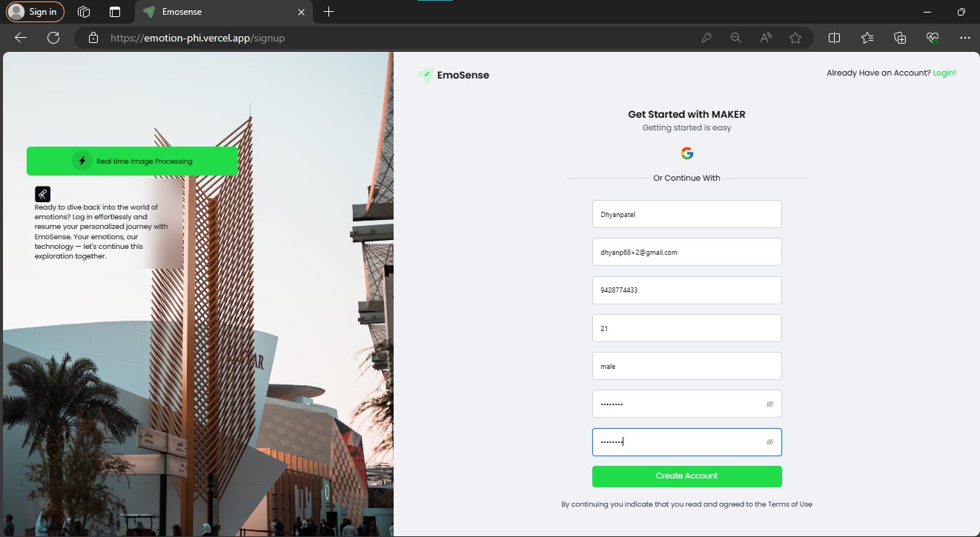
Signup

Slide 10
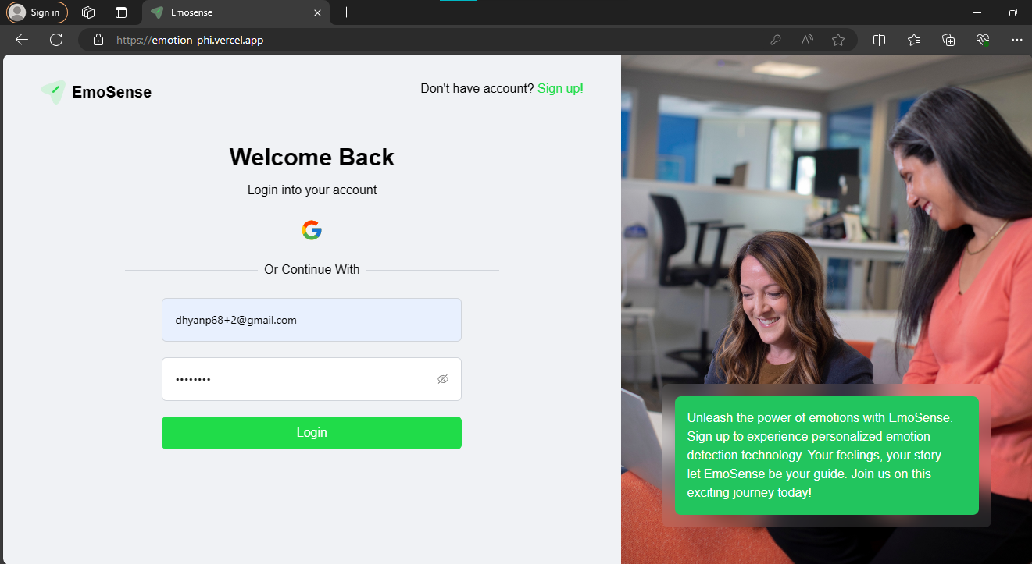
Login

Slide 11
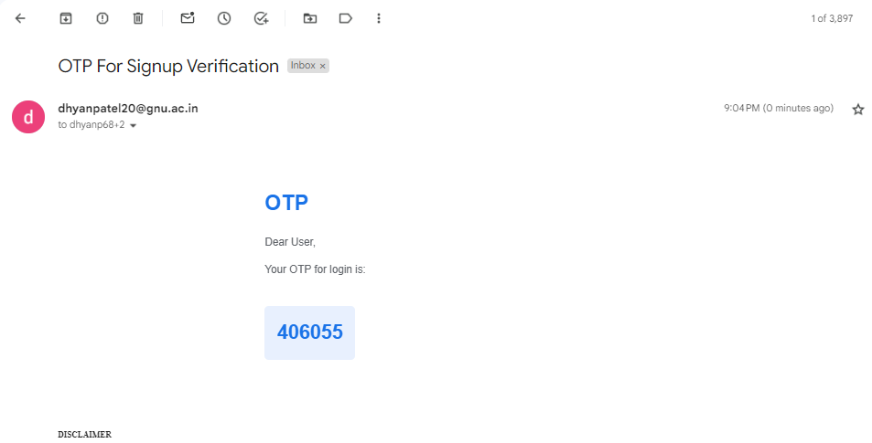
OTP Verification - Email

Slide 12
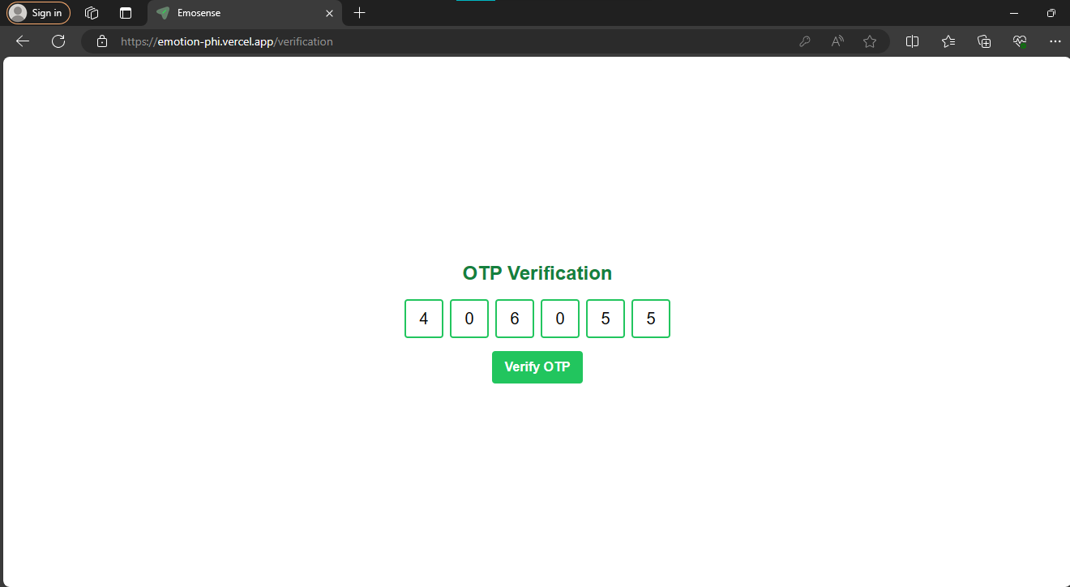
Verification

Slide 13
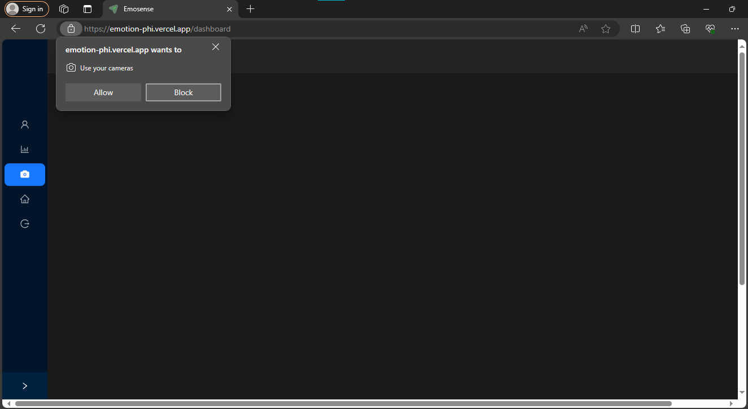
Dashboard

Slide 14
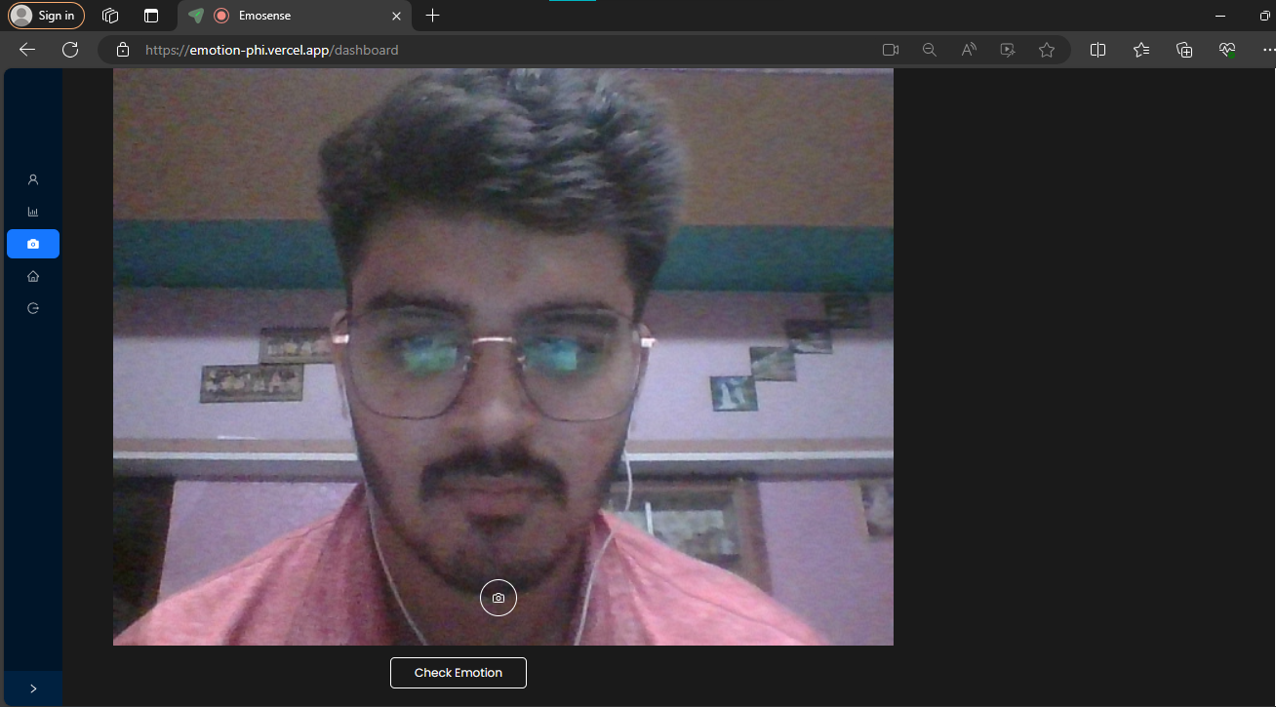
Real-time Emotion Detection

Slide 15
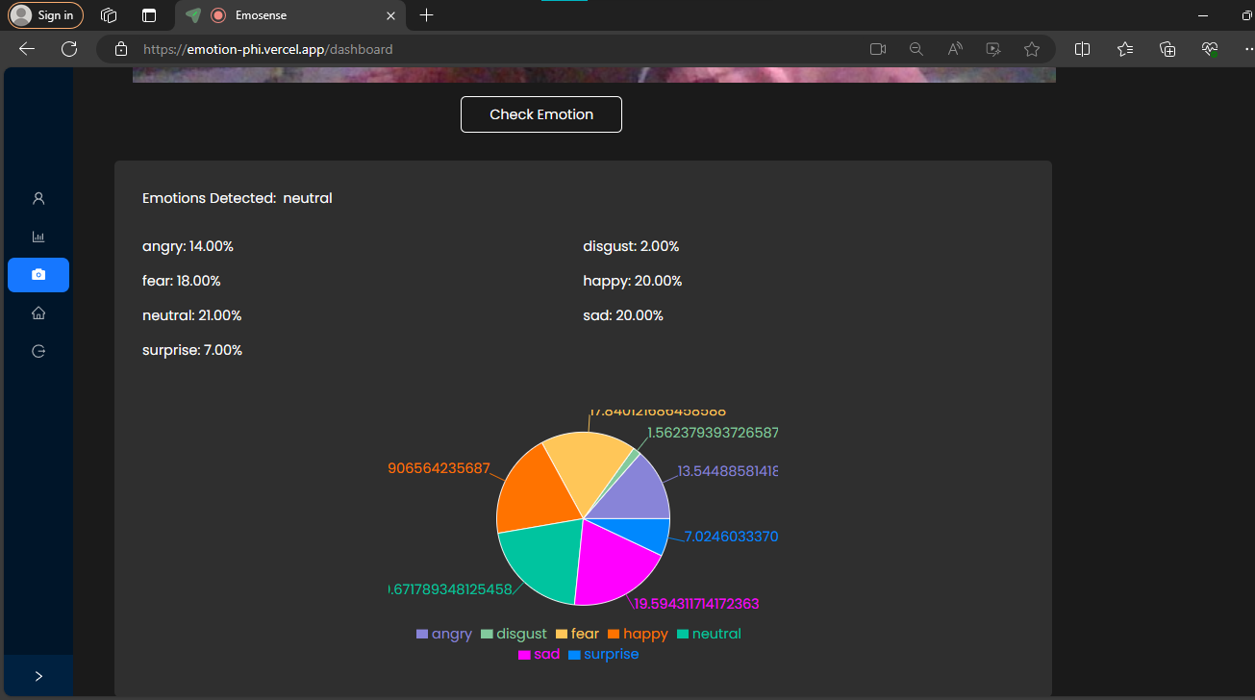
Emotion prediction

Slide 16
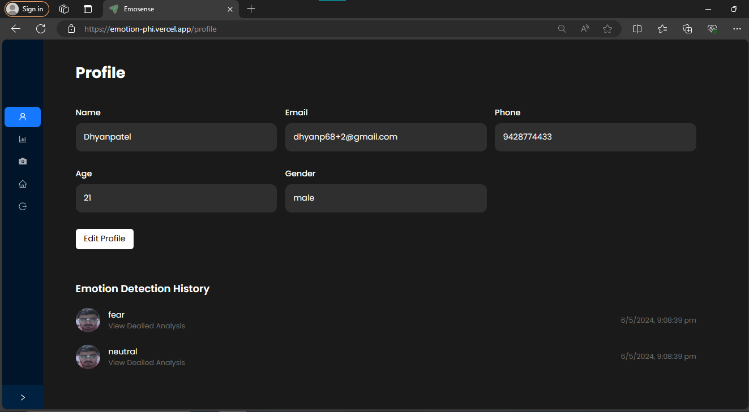
Profile/Edit Profile

Slide 17
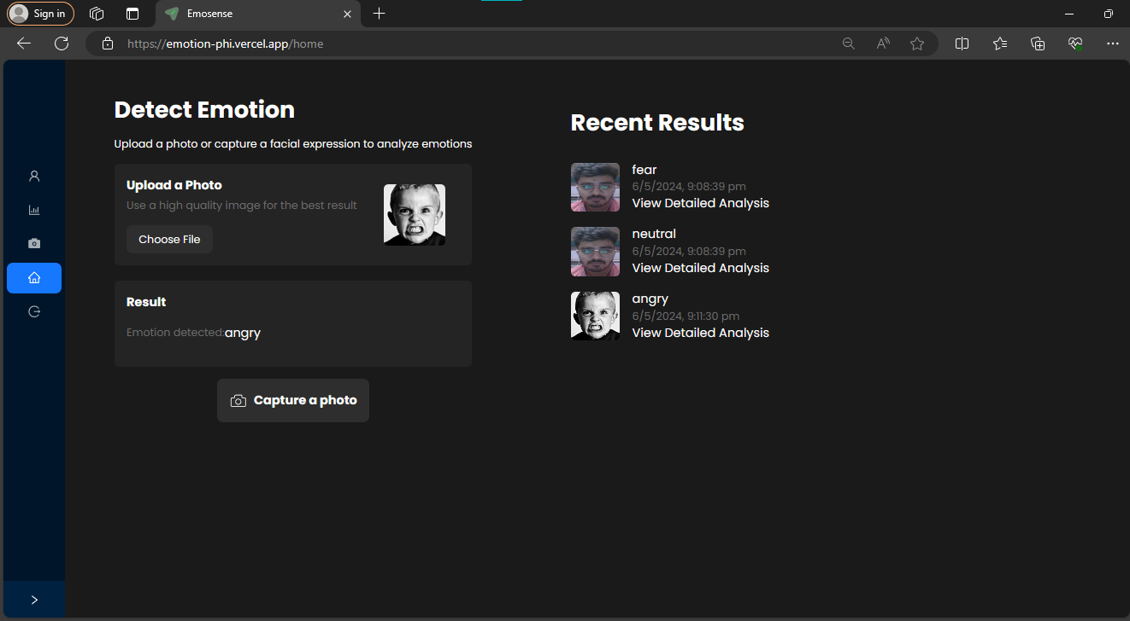
Home Page

Slide 18
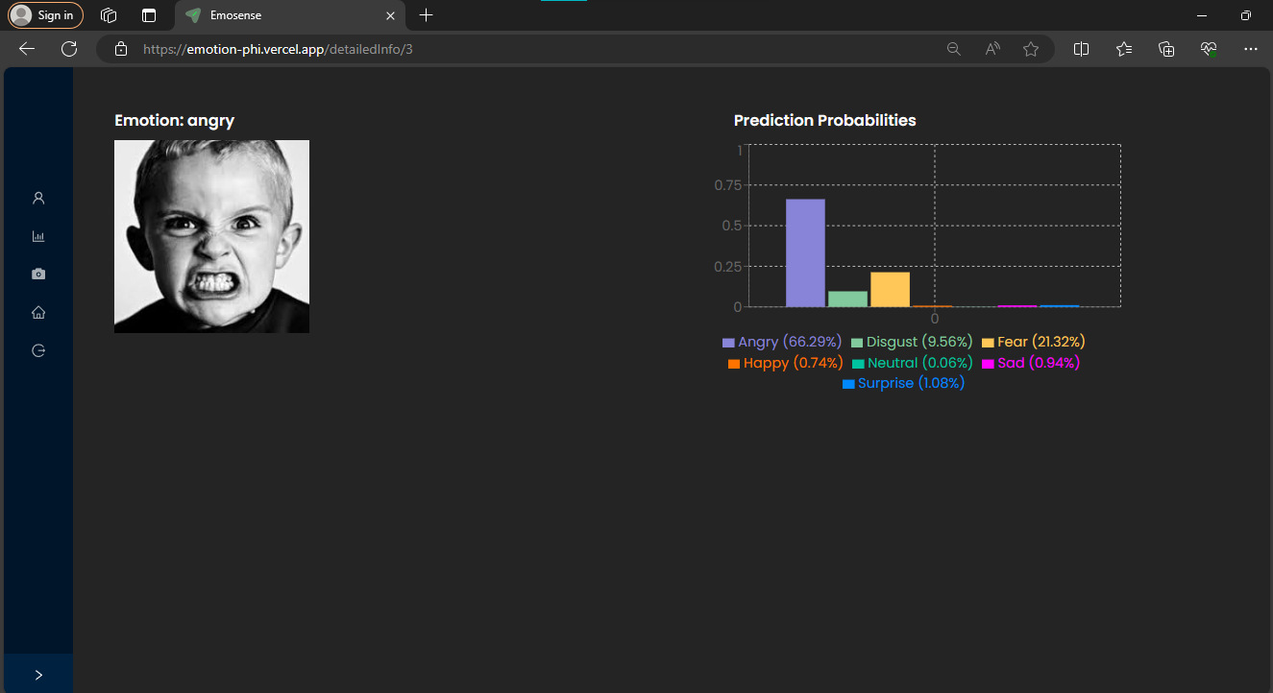
Predicted Probabilities

Slide 19
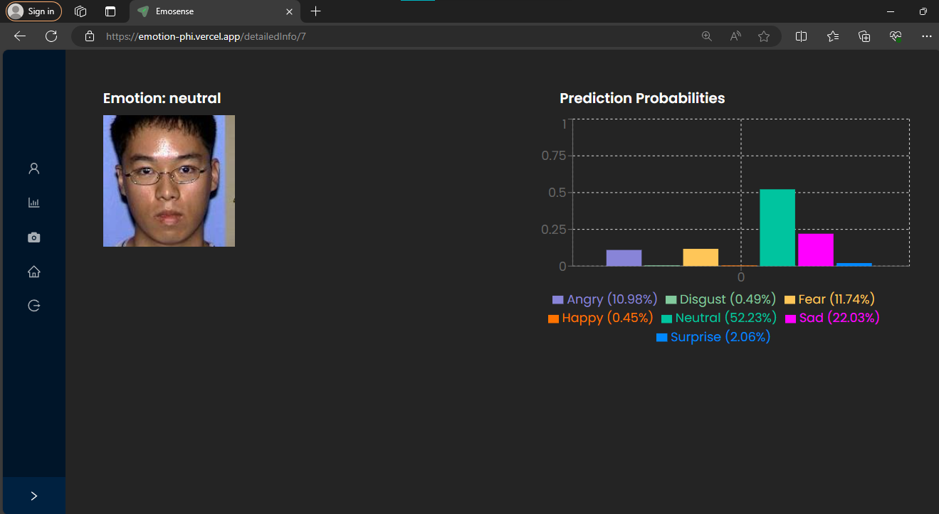
Predicted Probabilities

Slide 20
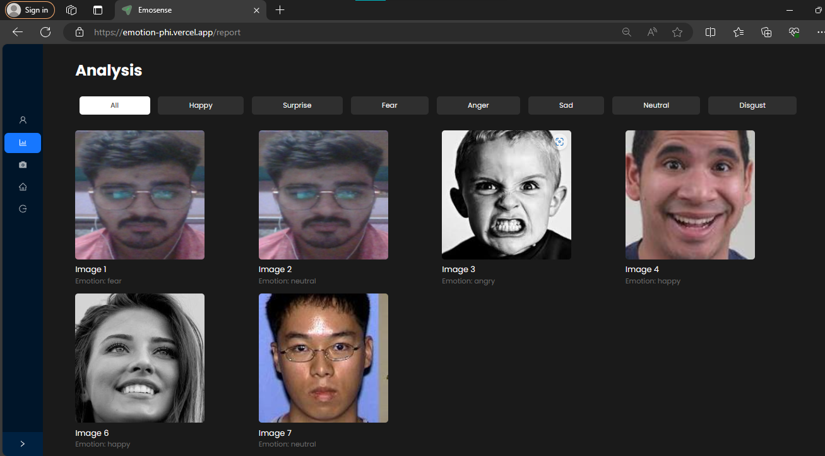
Report Page

Slide 21
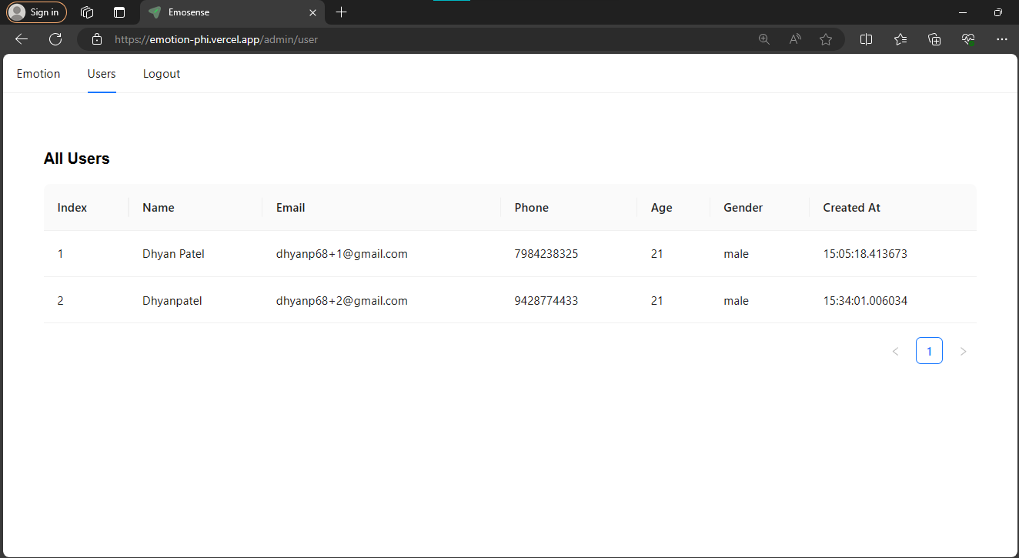
Admin Page

Slide 22
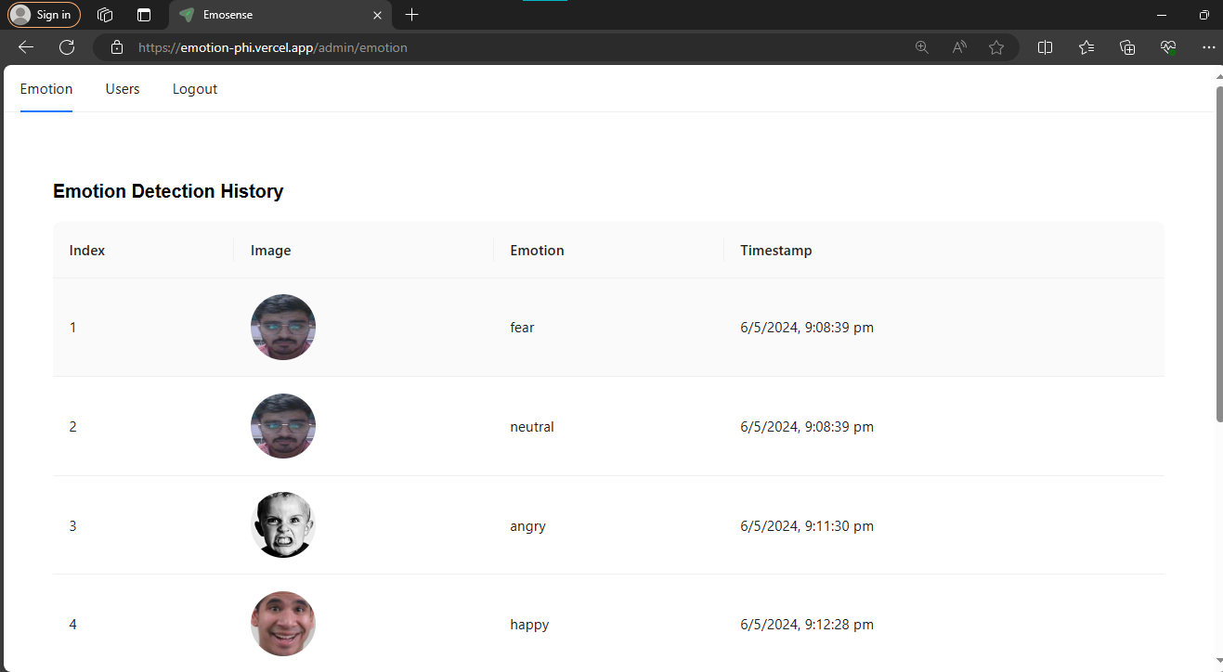
Admin Page

Slide 23
Conclusion
In Conclusion, the project concludes that utilizing machine learning for facial expression emotion detection is viable, with applications in human-computer interaction and mental health. Ongoing improvements are crucial for enhancing accuracy and real-world usability.

Slide 24
References
Kaggle
AI Applications
GitHub
stack overflow

Slide 25
Thank You !!

