Slide 1
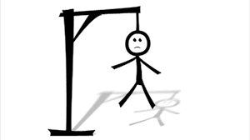
Hangman (AD Project)
Group ID BDA-432
Enrollment Number:
17162121010-Dixit Kasodariya
17162121003 Chandan Kamal
17162121006- Dhrutika Dahiya
17162121009- Jessica Mangaraj

Slide 2
Contents
Introduction
Problem Statements
Solution
Rules of the game
Advantage
Flowchart
Database Structure
Trello Activities

Slide 3
Introduction
The purpose of this project is to provide user some entertainment. Basically the concept of this game is same as Guessing game we use to play as kids. But, the animation and challenges make it more interesting. There will be different categories like movies, sports, countries, etc. from which one word will be selected randomly and the user have to guess it right within 7 attempts. The game will end on guessing right or when the user attempts it.
This game will provide relaxation and fun for some minutes and would help in enriching some vocabulary, and some brain skills without diverting into complete mindlessness.

Slide 4
Hangman game system requirements
Software requirements:
Windows XP,7,8,10
XAMPP
Github(for code Sharing)
Trello(for communication)

Slide 5
Modules
Fetching random word from random categories : It returns a random word that is going to be used in the game from the specified text file.
Hiding characters of the word : It hides certain characters of the word that has been generated.
Checking and placing the right character: This function checks if the character entered by the user is one of the missing characters of the hidden word. If the character is found in the word, it is placed into its exact location.
Checking if Game is Over: This function checks if the game is over. Games ends when user exceeds maximum allowed attempts or if the user guesses the word right.

Slide 6
Problem Statements
Nowadays children play those games which divert their minds.

Slide 7
Solution
This game will reduce the mind divertlessness from other games and would increase their vocabulary.

Slide 8
What languages we used?
We used html, JavaScript, css, PHP.

Slide 9
Rules of the game
A random word is chosen and presented to the player as a string of underscores
Ex. Chosen word is Cat, presented string is “ _ _ _ “
A correct guess yields a filled in blank on the target string corresponding to the location or locations of the correctly guessed letter.
Ex. A is guessed, player is presented with “ _ A _ “
An incorrect guess does not fill in any of the target string.
Limit to amount of guesses.

Slide 10
Advantages
It can be played anytime and anywhere without having internet connection.
Primes him/ her to recognize patterns and spelling quirks that cannot be taught before they come up in context
Can help in learn more and more words
Provides exercise to the brain, increase thinking power
Improves the working of the brain and response time
Spelling improvement

Slide 11
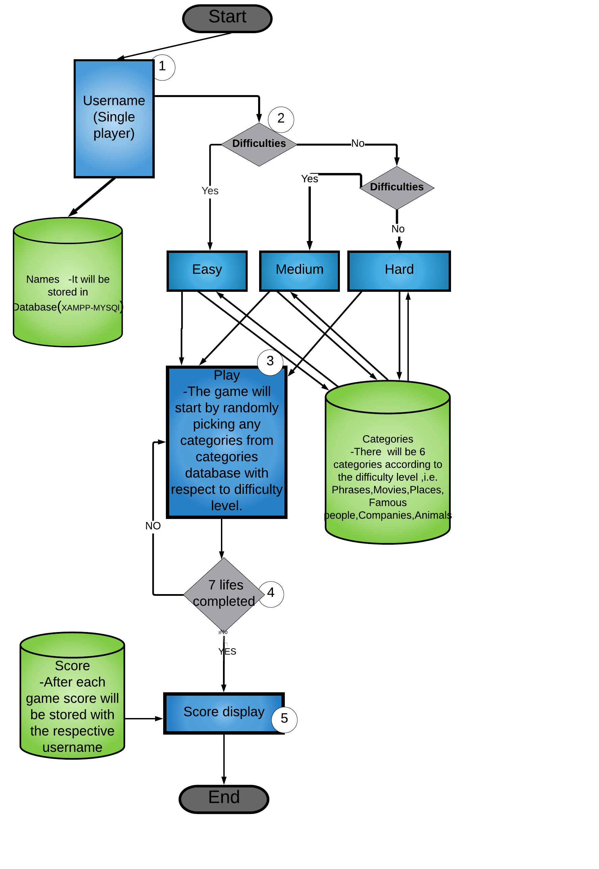
Flowchart

Slide 12
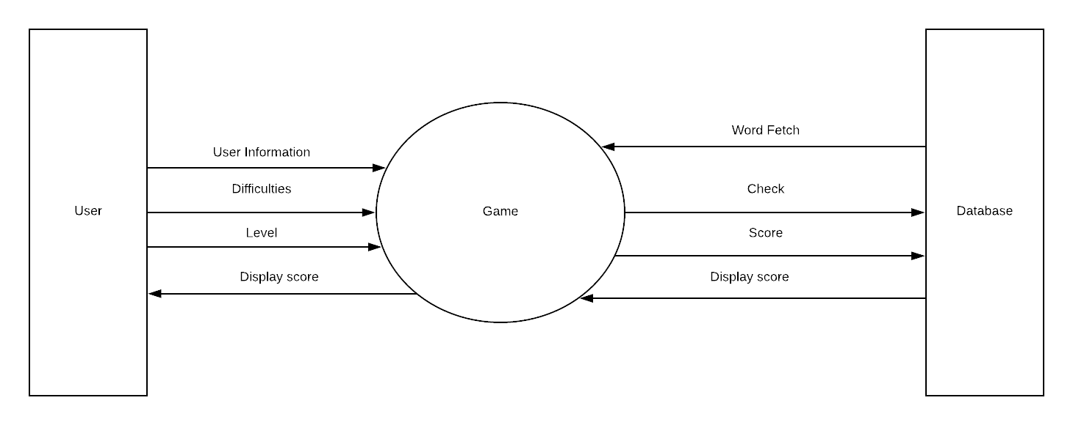
DFD- Level 0

Slide 13
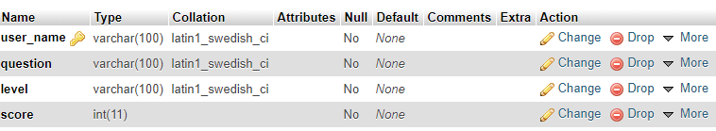
Database Structure

Slide 14
Database Name- Hangman
Table - Display
Column Name | Data Type | Size | Constraints
user_name | Varchar | 100 | Primary key
question | Varchar | 100 | Not null
level | Varchar | 100 | Not null
score | Int | 11 | Not null

Slide 15
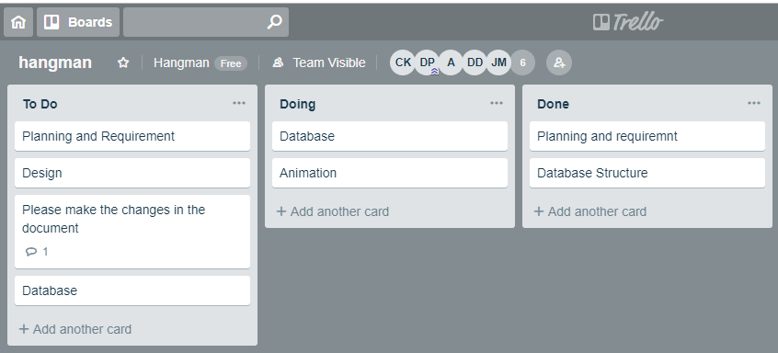
Trello Activities

