Slide 1
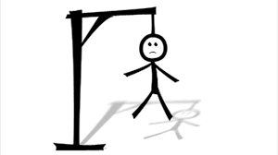
Hangman (AD Project)
Group ID BDA-432
Enrollment Number:
17162121010-Dixit Kasodariya
17162121003 Chandan Kamal
17162121006- Dhrutika Dahiya
17162121009- Jessica Mangaraj

Slide 2
Contents
Introduction
System Requirements
Modules
Problem Statements
Solution
Languages used
Rules of the game
Advantage
Testing
Flowchart
DFD level-0
Database Structure
Sample Code
Sample output
Github Activity
Trello Activities
Future Scope
References

Slide 3
Introduction
Hangman is a popular word guessing game where the player attempts to build a missing word by guessing one letter at a time. The purpose of this project is to provide user some entertainment. Basically the concept of this game is same as Guessing game we use to play as kids. But, the animation and challenges make it more interesting. There will be the whole bunch of words contained in a dictionary from which one word will be selected randomly and the user have to guess it right within the attempts given at each level . After a certain number of correct guesses, the game ends and the player wins. The game also ends if the player incorrectly identifies all the letters of the missing word and looses. And the player can play this game as many times the player want to play and there is no time limit to complete this game.
This game will provide relaxation and fun for some minutes and would help in enriching some vocabulary, and some brain skills without diverting into complete mindlessness and is a 1 player game.

Slide 4
Hangman game system requirements
Software requirements:
Windows XP,7,8,10
XAMPP(for database )
Github(for code Sharing)
Trello(for communication)

Slide 5
Modules
Fetching random word : It returns a random word that is going to be used in the game from the specified text file.
Hiding characters of the word : It hides every characters of the word that has been generated in the game.
Checking and placing the right character: This function checks if the character entered by the user is one of the missing characters of the hidden word. If the character is found in the word, it is placed into its exact location and it goes on loop until the word has been correctly guessed within the right amount of no. of attempts.

Slide 6
Modules(Continued)
Checking if Game is Over: This function checks if the game is over. Games ends when user exceeds maximum allowed attempts or if the user guesses the word right.
Checking if Letter has been already used: To check if the letters are already selected to guess, if already selected then it will not show on the virtual keyboard.
Play Again: If the game is completed and the player wants to play game again then user would select play again option and the game would restart again.

Slide 7
Problem Statements
Animate: Animating the character
Select word: Selecting random words from Database
Letter Guessed: To let the user know that the character has been selected
Real Life problem: Nowadays children play those games which divert their minds.

Slide 8
Solution
Animate: First we made a simple game and the if the selected character was incorrect we added a new image at each step.
Select word: It was difficult to select random words from database , therefore we created a text file and selected random words from there which consists of every word that is in a dictionary.
Letter Guessed: We removed each letter as soon it has been selected and compared that letter with the hidden characters letter, if there it gets displayed on the right position , if not the attempts gets reduced.
Real Life problem: This game will reduce the mind divertlessness from other games and would increase their vocabulary.

Slide 9
What languages we used?
We used HTML, JavaScript, css, PHP, MySQL.

Slide 10
Rules of the game
A random word is chosen and presented to the player as a string of underscores
Ex. Chosen word is Cat, presented string is “ _ _ _ “
A correct guess yields a filled in blank on the target string corresponding to the location or locations of the correctly guessed letter.
Ex. A is guessed, player is presented with “ _ A _ “
An incorrect guess does not fill in any of the target string and the number of attempts reduces.
Limit to amount of guesses.

Slide 11
Advantages
It can be played anytime and anywhere without having internet connection
Primes him/ her to recognize patterns and spelling quirks that cannot be taught before they come up in context
Can help in learn more and more words
Provides exercise to the brain, increase thinking power
Improves the working of the brain and response time
Spelling improvement

Slide 12
Testing
We tested the game in different phases:
Entering name and levels into database and then starting the game
Displaying “_” same as the length of the word which is taken randomly from a text file
Selecting a character from virtual keyboard and the selected word to be omitted out from the virtual keyboard
The replacing the selected letter with “_” if the letter present in the word , else it would take it as a count and would decrement the count of attempts
With each decrement of attempt it shows an image and images goes on loop to show it as a part of animation until the attempts reaches its maximum capacity
Play again option to go to the beginning of game

Slide 13
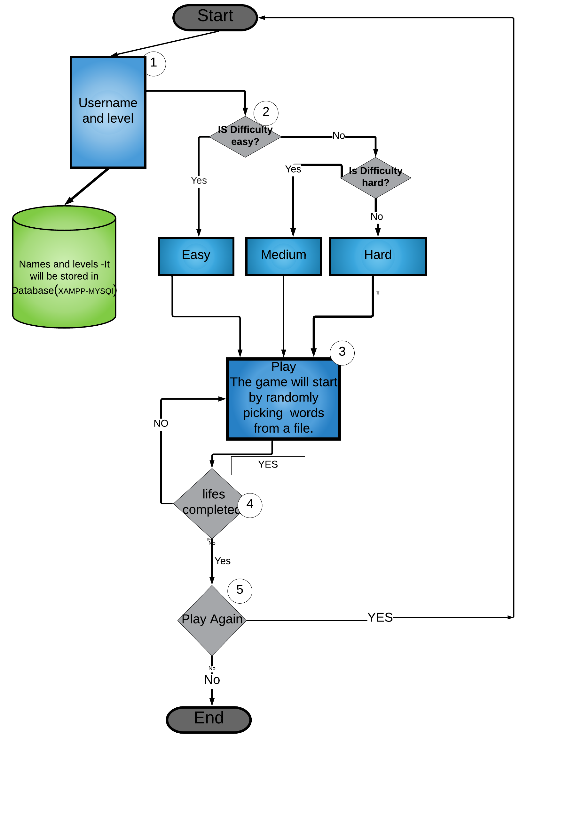
Flowchart

Slide 14
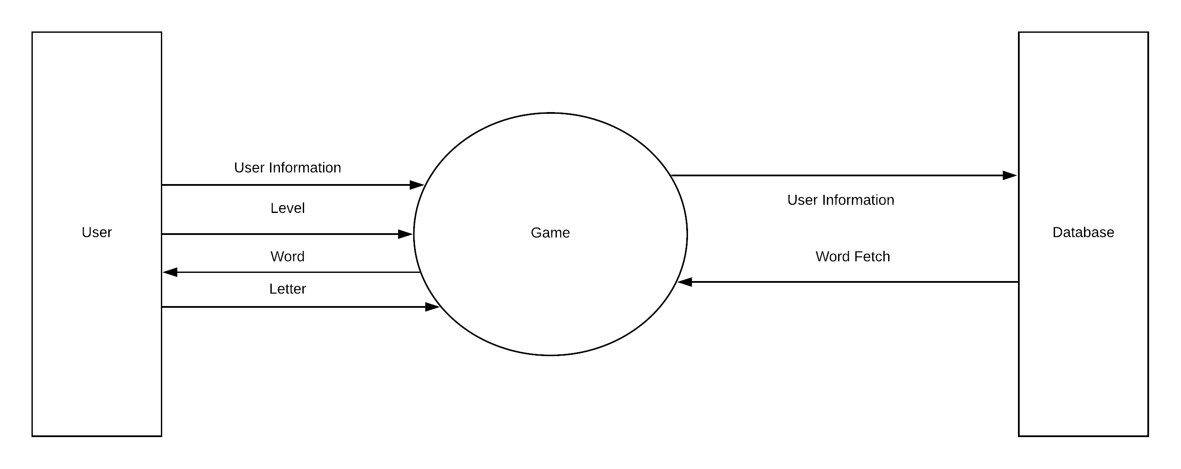
DFD- Level 0

Slide 15
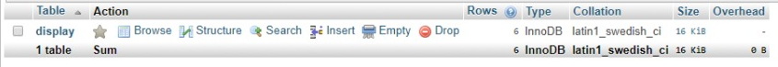
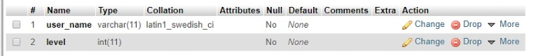
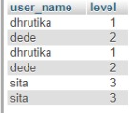
Database Structure
TABLE
COLUMNS
Sample output of stored database

Slide 16
Database Name- AD_PRO
Table - Display
Column Name | Data Type | Size | Constraints
user_name | Varchar | 11 | Not Null
level | Integer | 11 | Not null

Slide 17
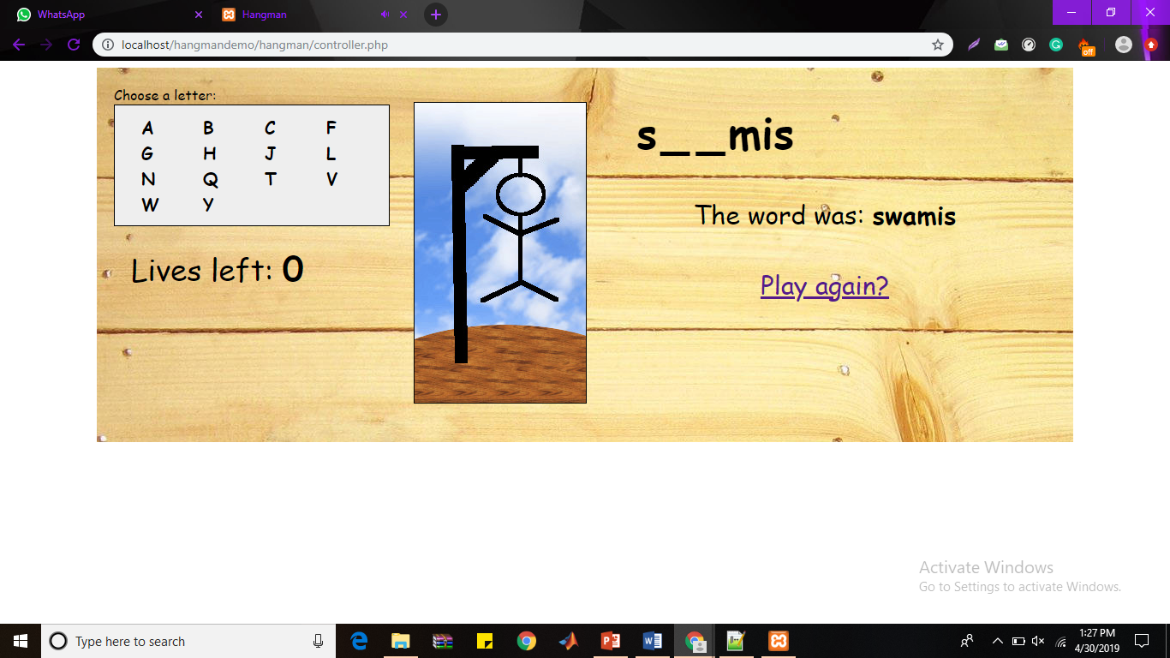
Sample Output
Here “_” are representing the length of characters and correct guess are displayed at there respective places and wrong guess shows the character being hanged in the picture. And a option to play again , if user wants to play the game again. Lives represent the number of lives left.

Slide 18
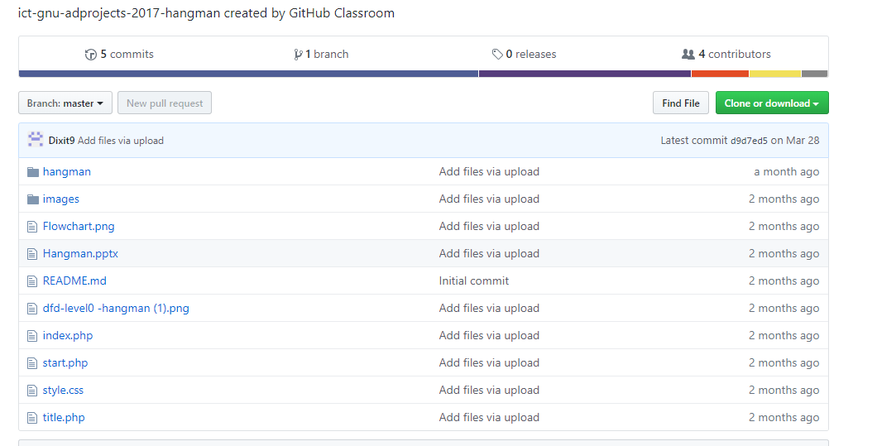
Github Activity

Slide 19
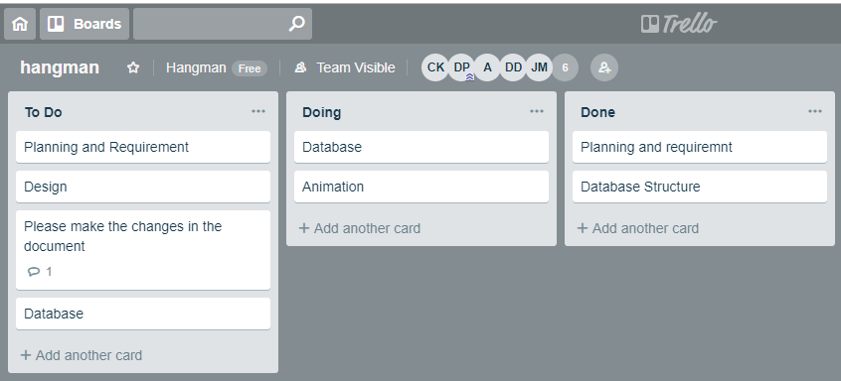
Trello Activities

Slide 20
Future Scopes
This game can have varied applications in the context of word formations and puzzles. Its knowledge can be valuable to many other games like CROSSWORD PUZZLES, WHEEL OF FORTUNE,SCRABBLE. We can also have an investigation of very popular and commonly used letters in most of the words. Make a frequency distribution in graph out of it. The underlying mathematical concepts are Data Collection and Analysis, Presentation and Interpretation which can have lot of implications in language processing and study of graphs and testing conjectures. Also, we can find out that the most popular letter in the English language is "e". The letter frequency of all letters in the English language is: e t a o i n s r h l d c u m f p g w y b v k x j q z.

Slide 21
References
Tutorials Point
w3school
Geeks for Geeks

