Slide 1
ESFP-2 PROJECT Book Inventory
Presented By:
Saiyam Sanghavi-18162121032
Jinesh Shah-18162121034
Jainam Shah-18162121033

Slide 2
CONTENTS
Program Overview
Libraries
Algorithm
Flowcharts

Slide 3
Program Overview
We have designed a book inventory which stores and displays required books for a customer based on his/her preference.
We have also designed a system which maintains the stock position of each and every book accordingly.
Allows user to find his/her required book based on different available tasks.

Slide 4
LIBRARIES
The libraries which are used in this project of GOODS MANAGEMENT SYSTEM are as follows :
1. #include<iostream>
2. #include<fstream>
3.#include<cstring>
4.#include<cstdio>
5.#include<ctype.h>
6.#include<cstdlib>

Slide 5
Algorithm
Following are the steps of the algorithm :
STEP 1: Take all the information of the books regarding author , title, publisher, price and stock position of the book
STEP 2 : Create a class and declare all variables regarding the given data .
STEP 3: Ask The user for input and output using set() and get()
STEP 4 : Create main function and declare char variables needed for data

Slide 6
STEP 5:Provide Validations for author, title, publisher, price and stock position of book.
STEP 6: Perform conditions for the respective task according to allocated tasks.
STEP 7: End of program

Slide 7
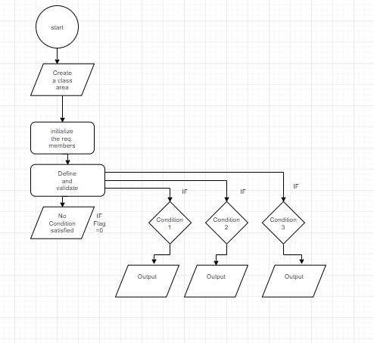
Flowchart : Task 1

Slide 8
Flowchart: Task 2

Slide 9
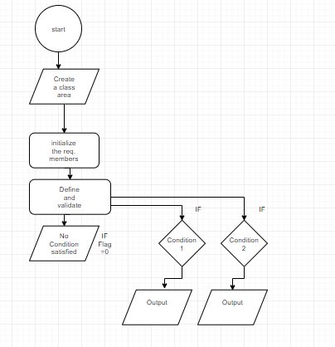
Flowchart : Task 3

