Slide 1

Industry Project Presentation on “IOT DATA ANALYTICS”
By
Group ID: G29
Team Member Name & Enrollment No:
Archan Vyas – 21162122007
Institute of Computer Technology, Ganpat University
Date:12/05/2024

Slide 2
Table of Contents
Introduction
Objectives
Related Background
Expected Outcome
Tools & Technology
Methodology (Modules)
Design / Diagrams & TimeLine Charts with Milestones
Flowchart & Algorithms
Implementation Details
Conclusion
References
(Extra Can be Added/removed as per your Project Requirement)

Slide 3
INTRODUCTION
In the era of the Internet of Things (IoT), the ability to collect, analyze, and derive insights from sensor data has become increasingly crucial across various industries. Our project addresses this demand by establishing a seamless pipeline for transmitting sensor data from a DHT11 sensor connected to a Raspberry Pi to an AWS S3 bucket.
The power of MQTT (Message Queuing Telemetry Transport) protocol and AWS cloud services, we ensure secure and efficient transmission of data, laying the foundation for scalable and reliable IoT solutions. This presentation will delve into the implementation details of our project, highlighting the integration of hardware, software, and cloud technologies to enable secure and intelligent IoT data collection and storage.

Slide 4
OBJECTIVES
1. Establish a secure and reliable pipeline for transmitting sensor data from a DHT11 sensor connected to a Raspberry Pi to an AWS S3 bucket.
2. Implement MQTT (Message Queuing Telemetry Transport) protocol for efficient and lightweight communication between the Raspberry Pi and AWS IoT Core.
3. Ensure data integrity and confidentiality through the use of TLS/SSL encryption and IAM (Identity and Access Management) user authentication.
4. Enable seamless integration with AWS services, such as S3 bucket storage and IAM user management, for scalable and flexible IoT solutions.
5. The foundation for future enhancements, including real-time monitoring, data analytics, and predictive maintenance, to unlock the full potential of IoT data.

Slide 5
RELATED BACKGROUND
1. Internet of Things (IoT) Revolution: IoT devices has transformed various industries, enabling the collection of vast amounts of sensor data for analysis and decision-making.
2. Raspberry Pi as IoT Gateway:Raspberry Pi, a low-cost, single-board computer, serves as a powerful IoT gateway capable of interfacing with sensors and transmitting data to cloud platforms.
3. AWS Cloud Services: Amazon Web Services (AWS) offers a comprehensive suite of cloud services, providing scalable infrastructure and data management solutions for IoT applications.
4. MQTT Protocol: MQTT, a lightweight messaging protocol, is widely adopted for IoT communication due to its efficiency, low bandwidth usage, and support for reliable messaging.
5. Security and Compliance: Security is paramount in IoT deployments, with considerations for data encryption, access control, and many other.
6. Data Storage and Analytics: AWS S3 bucket serves as a reliable and scalable storage solution for IoT data, while AWS analytics services enable insights extraction and actionable intelligence from raw sensor data.

Slide 6
EXPECTED OUTCOME
1. Secure and Reliable Data Transmission: A robust pipeline will be established for transmitting sensor data securely from the Raspberry Pi to the AWS S3 bucket, ensuring data integrity and confidentiality.
2. Efficient IoT Communication: Implementation of the MQTT protocol will enable efficient and lightweight communication between the Raspberry Pi and AWS IoT Core, facilitating seamless data exchange.
3. Scalable and Flexible Architecture: Integration with AWS cloud services will provide scalability and flexibility, allowing for the IoT deployments and adaptation to changing requirements.
4. Enhanced Data Insights: By leveraging AWS analytics services, actionable insights will be extracted from the collected sensor data, enabling informed decision-making and predictive maintenance.
5. Foundation for Future Innovation: The project will serve as a foundational step towards building intelligent IoT solutions, paving the way for future enhancements such as real-time monitoring, machine learning integration, and edge computing capabilities.

Slide 7
TOOLS & TECHNOLOGY
1. Raspberry Pi.
2. DHT11 Sensor.
3. AWS IoT Core
4. AWS S3 Bucket
5. MQTT Protocol
6. Python Programming Language
7. AWS IAM (Identity and Access Management)
8. AWS SDK (Boto3)
9. Mosquitto MQTT Broker

Slide 8
METHODOLOGY
Hardware Setup
AWS Setup
Raspberry Pi Configuration
Generate Certificates and Configure AWS IoT Core
Implement MQTT Communication
Python Scripting
Upload Data to AWS S3
Testing and Validation
Monitoring and Maintenance
Documentation and Reporting

Slide 9
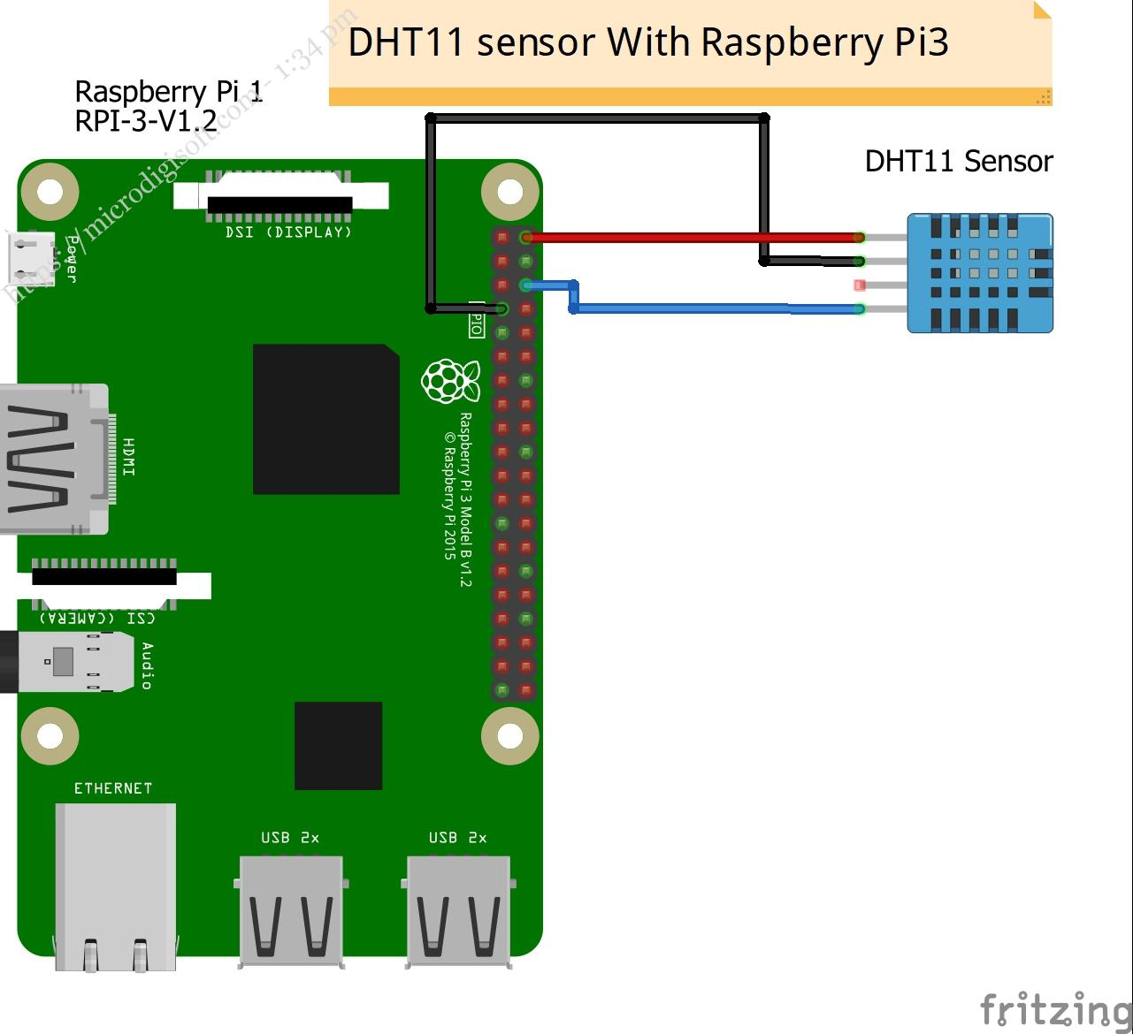
DIAGRAM

Slide 10
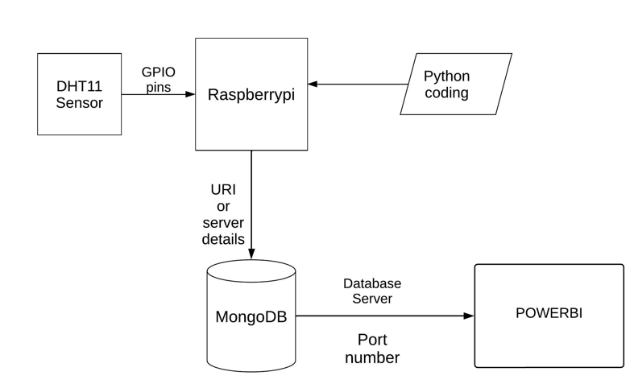
FLOWCHART(IOT FRAMEWORK WITHOUT CLOUD)

Slide 11
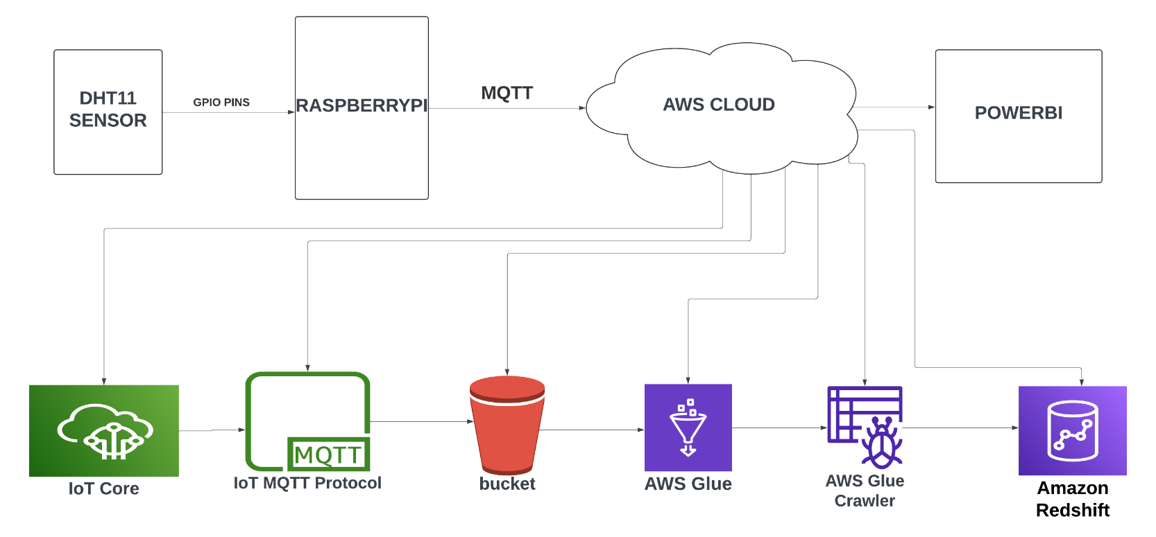
FLOWCHART(IOT FRAMEWORK WITH CLOUD)

Slide 12
ALGORITHMS
Read Sensor Data
Format Data into JSON
Connect to AWS IoT Core
Publish Sensor Data
Subscribe to MQTT Topics
Upload Data to AWS S3
Data Storage and Analysis
End-to-End Encryption
Error Handling and Retry Mechanism
Continuous Monitoring and Optimization

Slide 13
IMPLEMENTATION DETAILS(WITH CLOUD)
Hardware Setup
AWS Setup
Raspberry Pi Configuration
Generate Certificates and Configure AWS IoT Core
Implement MQTT Communication
Python Scripting
Upload Data to AWS S3
Testing and ValiMonitoring and Maintenancedation

Slide 14
IMPLEMENTATION DETAILS(WITHOUT CLOUD)
Wiring DHT11 Sensor to Raspberry Pi
Setting up MongoDB on Raspberry Pi
Python Script for Data Collection
Power BI Setup
Data Visualization in Power BI

Slide 15
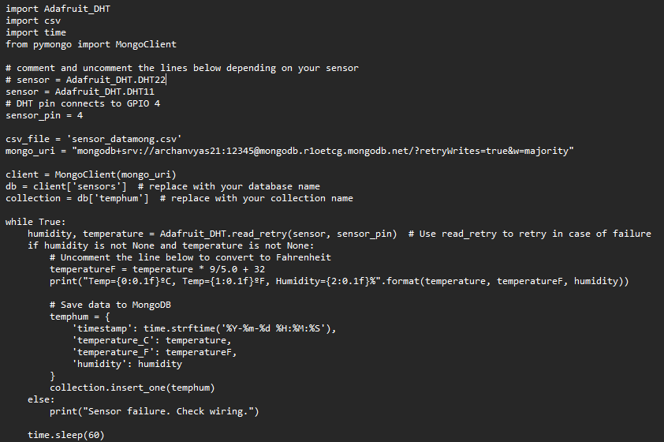
SNIPPET CODE(WITHOUT CLOUD)

Slide 16
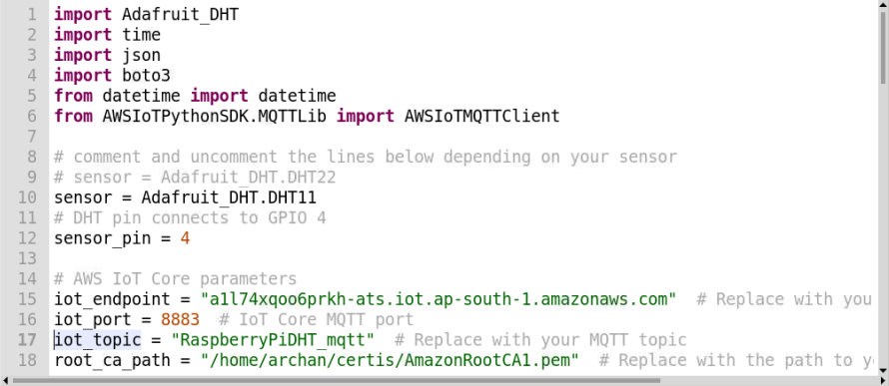
SNIPPET CODE(WITH CLOUD)

Slide 17
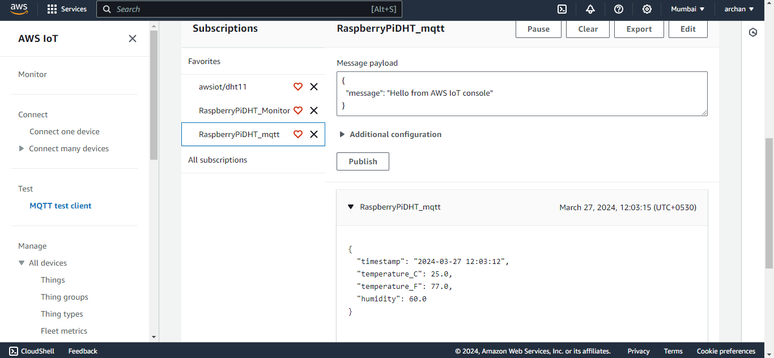
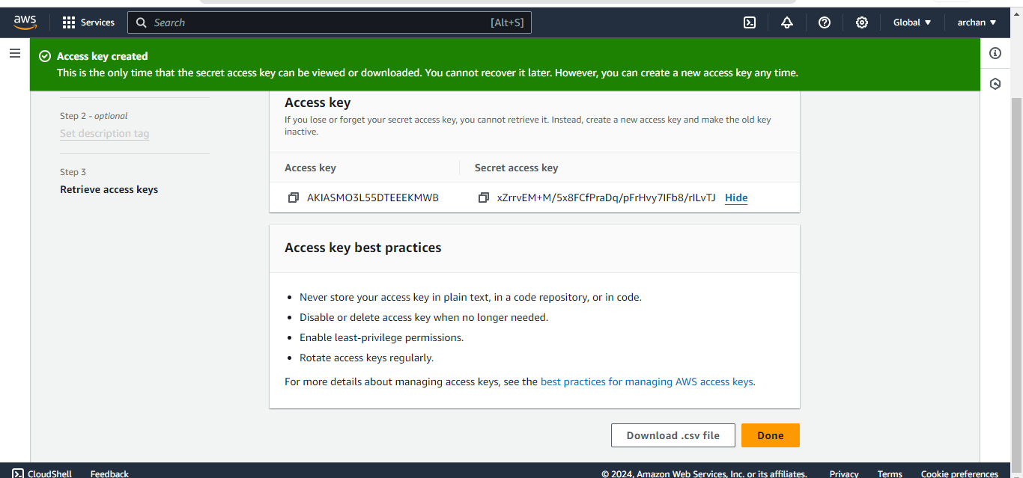
IAM & MQTT

Slide 18
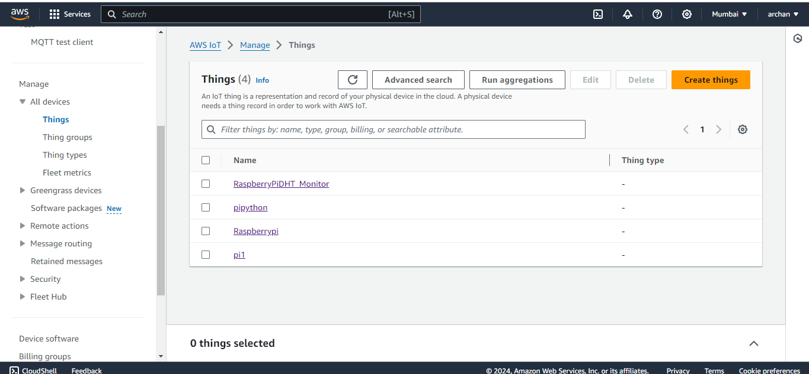
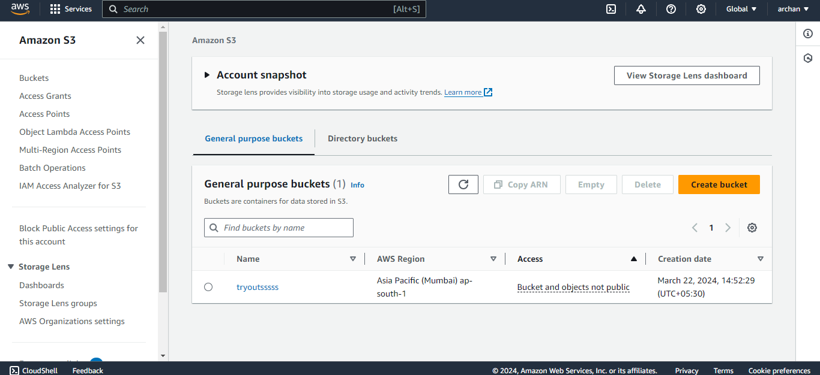
IOT CORE(THING) & S3 BUCKET

Slide 19
CONCLUSION
Our project successfully establishes a secure and efficient pipeline for transmitting sensor data from a DHT11 sensor connected to a Raspberry Pi to an AWS S3 bucket. By leveraging MQTT protocol and AWS services, we ensure seamless communication and storage of sensor data in the cloud. This solution offers scalability, reliability, and data integrity, laying the groundwork for advanced IoT applications. With end-to-end encryption and proper authentication mechanisms, we guarantee the confidentiality and security of the transmitted data. This project serves as a foundational step towards building intelligent and scalable IoT solutions, enabling organizations to harness the power of sensor data for informed decision-making and innovation.

Slide 20
REFERENCES
https://www.statista.com/statistics/266210/number-of-available-applications-in-the-google- play-store/
https://towardsdatascience.com/the-tale-of-missing-values-in-python-c96beb0e8a9d
https://www.listendata.com/2017/05/feature-selection-boruta-package.html
https://www.analyticsvidhya.com/blog/2016/03/select-important-variables-boruta-package/
https://www.machinelearningplus.com/machine-learning/feature-selection/
https://repost.aws/knowledge-center/iot-core-publish-mqtt-messages-python
https://www.youtube.com/watch?v=GqmNvcnXQOQ&list=LL&index=1&t=2073s
https://www.youtube.com/watch?v=-ROGwBtKazc&list=LL&index=3

Slide 21
FUTURE WORK
DATA ANALYTIC SERVICE IN CLOUD AND HOW TO IMPLEMENT IT.
HOW TO DO THE USE OF MACHINE LEARNING IN THIS WHOLE PROCESS .
HOW WE CAN DO PREDICTIVE ANALYSIS INTO IT.

Slide 22
Thank You !!

