Slide 1


Internship Project Presentation
By
Dhyan Patel (20162101009)
Institute of Computer Technology, Ganpat University
Date:12/05/2024

Slide 2
About Company
Company Name: Edulyt India
Location:1D-160, Sector-8, Dwarka, New Delhi- 110077
Edulyt India, established in 2015, is an early-stage startup focusing on closing the gap between education and employment. Specializing in Analytics, particularly Data Analytics for BFSI, we use basic AI tools to train and prepare fresh graduates for industry readiness.

Slide 3
Tools & Technology
Throughout my internship I was required to know the use and implementation of a number of software and tools like:
Microsoft Excel
MySQL Workbench
Jupyter Notebook / Google Colab
And Python Programming
PowerBI

Slide 4
Week 1-Week 3
Week 1: Over the course of a week, I delved into MySQL basics, from understanding its role in relational databases to installing and configuring MySQL for optimal performance. I then progressed to creating databases and tables, learning about data types and constraints, and mastering essential commands like SELECT, INSERT, UPDATE, and DELETE for data manipulation. Finally, I focused on mastering the SELECT statement, honing skills in data filtering, sorting, and analysis using WHERE clauses, ORDER BY, and aggregate functions, thus enhancing my ability to extract insights from databases.
Week 2: I covered MySQL basics, including its role in relational databases, installation, and configuration for optimal performance. I learned about data types, constraints, and mastered commands like SELECT, INSERT, UPDATE, and DELETE for data manipulation. Lastly, I focused on refining my skills in data filtering, sorting, and analysis using WHERE clauses, ORDER BY, and aggregate functions to extract insights from databases.
Week 3: I focused on Data Cleaning and Processing with MySQL. I learned strategies to ensure data accuracy and reliability through cleaning techniques, then mastered data processing using MySQL's capabilities. Hands-on exercises with real-world datasets solidified my skills, preparing me to confidently tackle various data challenge.

Slide 5
Week 4
PROJECT-1: CREDIT CARD DATA ANALYSIS
PURPOSE:
The purpose of the Credit Card Data Analysis project is to conduct an in-depth analysis of credit card transaction data, aiming to extract meaningful insights related to spending patterns and financial trends. The primary objectives include the extraction, transformation, and loading (ETL) of the credit card data and subsequent Exploratory Data Analysis (EDA) to uncover valuable information.
SCOPE :
This project is centered around understanding the patterns and behaviors within credit card transactions, emphasizing factors such as transaction volumes, spending categories, and anomalies. The focus extends to identifying trends and insights that can inform strategic decision-making related to credit card usage.

Slide 6
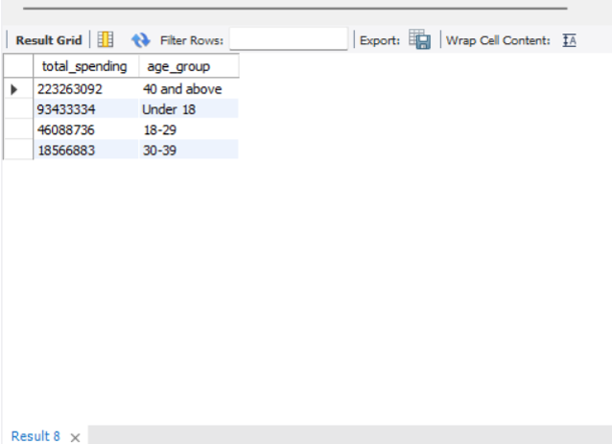
Snippet Of the Solution
Which age group is spending more money?
SELECT SUM(Amount) AS total_spending ,
CASE
WHEN Age < 18 THEN 'Under 18'
WHEN Age >= 18 AND Age < 30 THEN '18-29'
WHEN Age >= 30 AND Age < 40 THEN '30-39'
ELSE '40 and above'
END AS age_group
from cb
join spend on cb.customer = spend.costomer
GROUP BY age_group
ORDER BY total_spending DESC;

Slide 7
PROJECT-2: INDIAN CREDIT CARD SPENDING ANALYSIS
PURPOSE:
The Indian Credit Card Spending Analysis project aims to delve into a dataset offering insights into credit card transactions conducted across various cities in India. The primary goal is to gain a comprehensive understanding of spending habits, utilizing data on transaction dates, card types, expense categories, gender, and transaction amounts. The project involves employing SQL queries to extract meaningful patterns and trends from the dataset.
SCOPE :
This project's scope encompasses an exploration of spending behaviors within Indian credit card transactions, with a focus on cities, card types, expense categories, and gender-related insights. The objective is to identify trends, anomalies, and key contributors to credit card spending, facilitating strategic decision-making for various stakeholders.

Slide 8
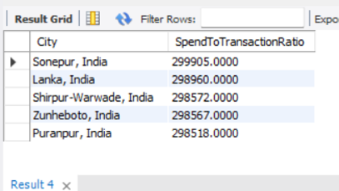
Snippet Of the Solution
During weekends which city has highest total spend to total no of transaction’s ratio?
SELECT
City,
SUM(Amount) / COUNT(*) AS SpendToTransactionRatio
FROM (
SELECT
City,
STR_TO_DATE(Date, '%d-%b-%y') AS TransactionDate,
Amount
FROM
credit_card_transaction -- Replace with yur actual table name
) AS converted_data
WHERE
DAYOFWEEK(TransactionDate) IN (1, 7) -- Assuming 1 is Sunday and 7 is Saturday
GROUP BY
City
ORDER BY
SpendToTransactionRatio DESC
LIMIT 5;

Slide 9
Week 5
Week-5: Power-BI Learning
Introduction to Power BI and its components.
Connecting to various data sources and importing data.
Basics of data modeling and creating relationships.
Visualization techniques and dashboard creation..
Advanced data modeling with DAX language.
Complex visualization techniques and interactivity.
Data governance, security, and compliance.

Slide 10
Week 6
Week-6: Power-BI Learning
Course PL-300T00--A: Microsoft Power BI Data Analyst
Outcome Of the Course:
Proficiency in Microsoft Power BI
Data Analysis Skills
Data Modelling
Report Creation and Visualization
Collaboration and Sharing
Data Connectivity
Power BI Desktop and Power BI Service

Slide 11
Week 7
Project 1 - Analyze the E-commerce platform sales
Focus: The project aims to analyze their online sales across India.
Goal: Develop an interactive Power BI dashboard for actionable insights.
Objective: owner of this store wants to track and analyze their online sales across India.
Week 7 - Data Gathering and Preparation
Data collection: imported the data from online resources.
Data cleaning: Conducted data pre-processing tasks, including cleaning, formatting, and transforming the data to make it suitable for analysis.
Data manipulation: through this one extra column average order value added in data report by dax in power bi.
Implemented the data model in Power BI for analysis.

Slide 12
Week 8
Week 8 - Dashboard Development and Analysis
Developed an interactive Power BI dashboard.
Developed an interactive dashboard in Power BI, created bar column chart ,donut chart, pie chart, line chart, slicer, card etc for visualization.
Implemented navigation features for user exploration.
Add interactivity to the dashboard elements, such as filters, and drill-down functionalities, to allow users to explore the data dynamically.

Slide 13
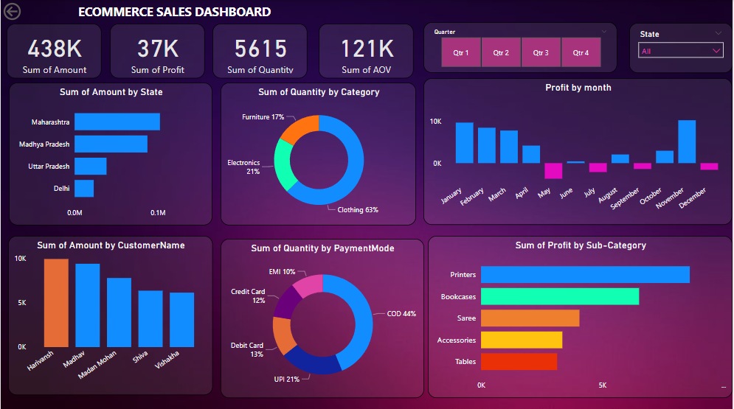

Slide 14
Week 9
Week 9 - Week 12: Project 2 : Analytics Dashboard to Improve Employee Performance and Retention
Objective: The purpose of this project is to help an organization to improve employee performance and reduce attrition by creating an HR analytics dashboard. The dashboard provides valuable insights into employee data, which can be used to make data-driven decisions and improve employee satisfaction and retention.
Week 9 - Data Gathering and Pre-processing
Data Source : The raw data for this project was obtained in the form of a CSV file with 38 columns and approximately 1.5k rows. The data contained information about employee demographics, job roles, salaries, and tenure, among others.
Data Cleaning and Processing: Several steps were taken to prepare the data for analysis. Null values were removed and duplicate values were eliminated.
Key Performance Indicators (KPIs): To start the analysis, I have identified the key performance indicators (KPIs) to track and monitor employee performance and attrition.

Slide 15
Week 10
Week 10 - Dashboard Planning and Development
Planned and designed interactive dashboards in Power BI to visualize used several charts and visualizations.
Developed Demographics dashboards with appropriate visualizations, including charts, graphs, and matrix table, to showcase key insights effectively.

Slide 16
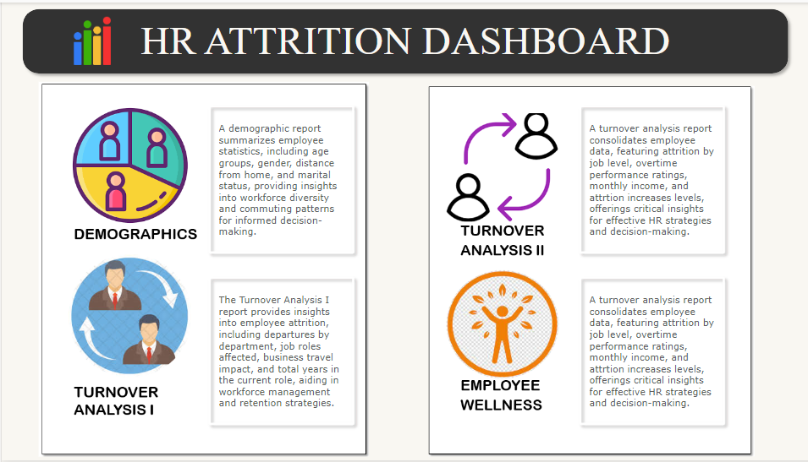

Slide 17
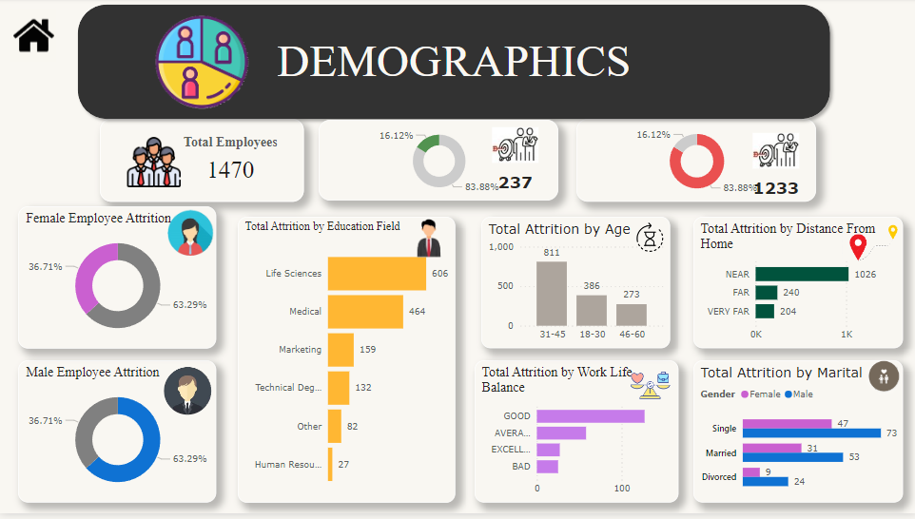

Slide 18
Week 11
Week-11:
Created Turnover Analysis 1 report provides insights into employee attrition including departures by department, job roles affected , business travel impact and retention strategies.
Created a turnover analysis 2 report consolidates employee data, featuring attrition by job level, overtime performance ratings, monthly income, and attrition increases levels, offerings critical insights for effective HR strategies and decision-making.

Slide 19
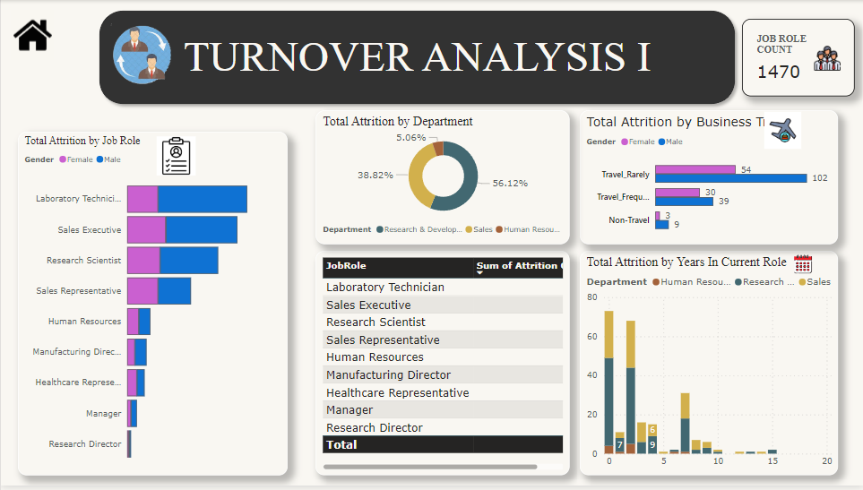

Slide 20
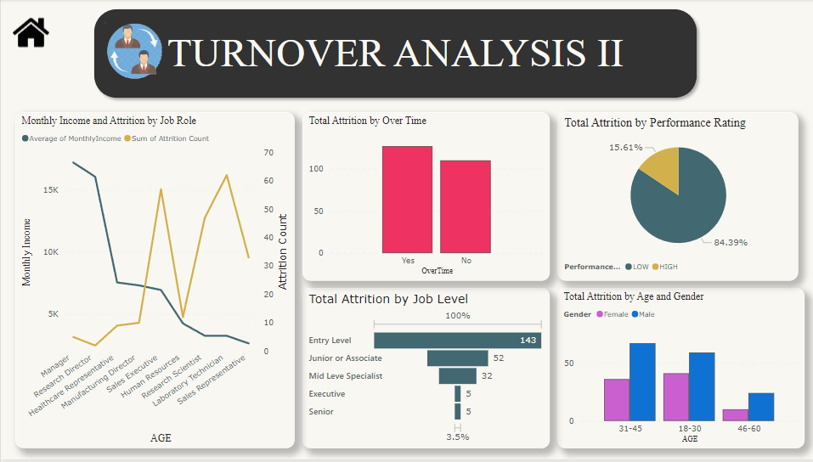

Slide 21
Week 12
Week-12: created a Employee wellness report
Conclusion:
This HR analytics dashboard showed important information about employees that can help make better decisions and keep employees happy and working for the organization. By taking actions to address the issues that employees face and creating a positive work environment, the HR department can help employees perform better and stay in their jobs longer. This can help the organization make more money and be more successful

Slide 22
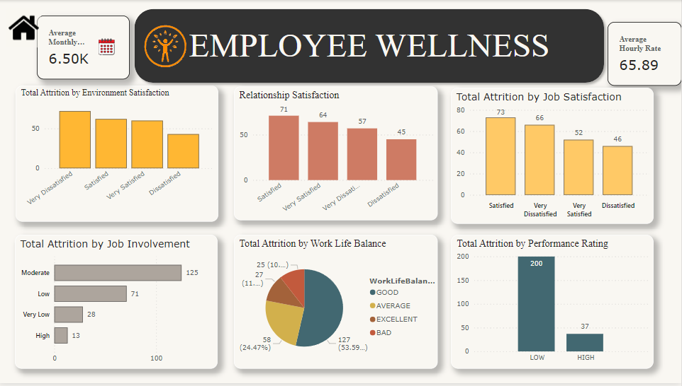

Slide 23
Week 13
Week 13 – Week 15: Project 3: Sales Analysis Dashboard
Overview: The Sales Analysis Dashboard project aims to provide comprehensive insights into sales performance, customer behavior, and product trends through interactive visualization using Power BI. By integrating sales overview, customer details, and product details, this dashboard empowers stakeholders to make informed decisions, optimize strategies, and enhance business outcomes.
Week 13: Data Collection and Preparation.
Get data from Kaggle
Load CSV to Power BI
Clean data eliminating null/blank
Identify metrics to extract from the report
Present the data visually with key metrics

Slide 24
Week 14
Week-14: worked on sales overview report
Visualizations depicting sales metrics such as revenue, units sold, profit margins, and sales growth over time.
Comparative analysis of sales performance across regions, products, and time periods.
Key performance indicators (KPIs) highlighting targets versus actual performance.
Week-14: Worked on Customer Details
Customer segmentation based on demographics, purchasing frequency, and buying preferences.
Customer lifetime value (CLV) analysis to identify high-value customers.
Visualization of customer churn rates and retention strategies.

Slide 25
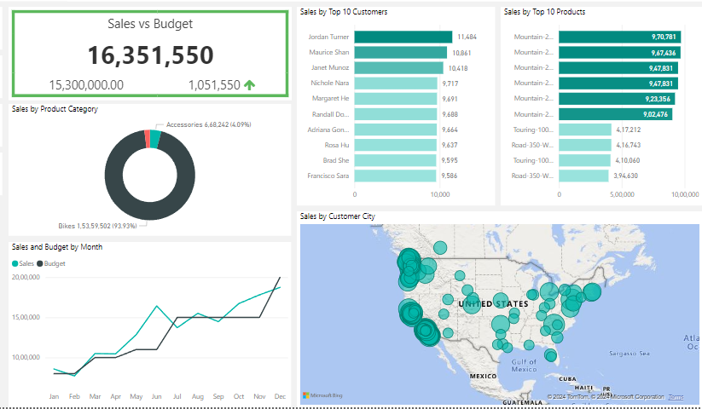

Slide 26
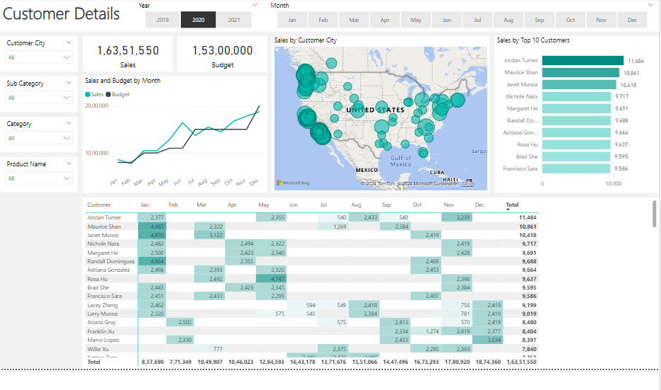

Slide 27
Week 15
Week-15: Worked on product Details report
Product sales distribution by category, brand, or SKU.
Analysis of product profitability, including gross margin and contribution to overall revenue.
Product performance trends, highlighting top-selling items, slow movers, and seasonality effects.
Conclusion:
The Sales Analysis Dashboard serves as a powerful tool for driving sales performance, understanding customer dynamics, and optimizing product strategies. By leveraging the capabilities of Power BI, this project empowers organizations to harness the full potential of their sales data and gain a competitive edge in today’s dynamic market landscape.

Slide 28
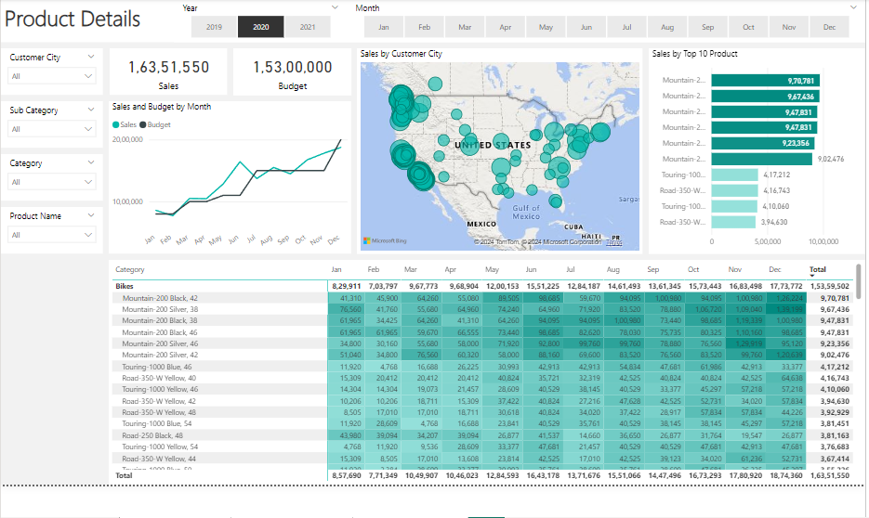

Slide 29
Thank You !!

