Slide 1

Industry Work
by
Vishwarajsinh Rathod (20162171024)
Working as
Cyber Security Analyst
Institute of Computer Technology, Ganpat University
Date: 12th May, 2024

Slide 2
Introduction
As a Cyber Security Intern, I conducted thorough vulnerability assessments, executed penetration testing, and specialized in web application security testing. Proficient in identifying and addressing bugs, I actively contributed to strengthening the organization's security posture through hands-on experience in detecting and mitigating potential threats.

Slide 3
Tools and Technology
Wazuh
Nessus
Nmap
BurpSuite
Msfconsole
DirSearch
SQLMAP
Shuffle
IRIS
Cortex

Slide 4
Week-1
Penetration Testing on Metasploitable (Linux) and Windows 10.
Port scanning using Nmap tool.
Exploiting vulnerability using Msfconsole.
Gathering information about SMB service, affected systems, it’s impact and type of vulnerability. (For Windows 10)
Practical exposure to utilizing Wazuh in real-world scenarios.
Review and Evaluation of Security Events, along with Security Configuration Assessment, within the Wazuh tool.
Aiding in the detection of vulnerabilities and ensuring compliance alignment using Wazuh's features.

Slide 5
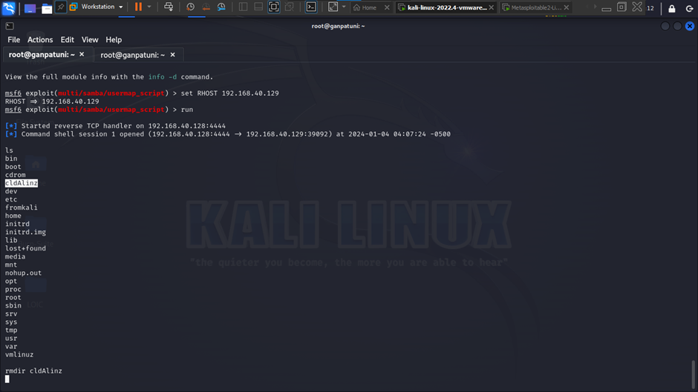
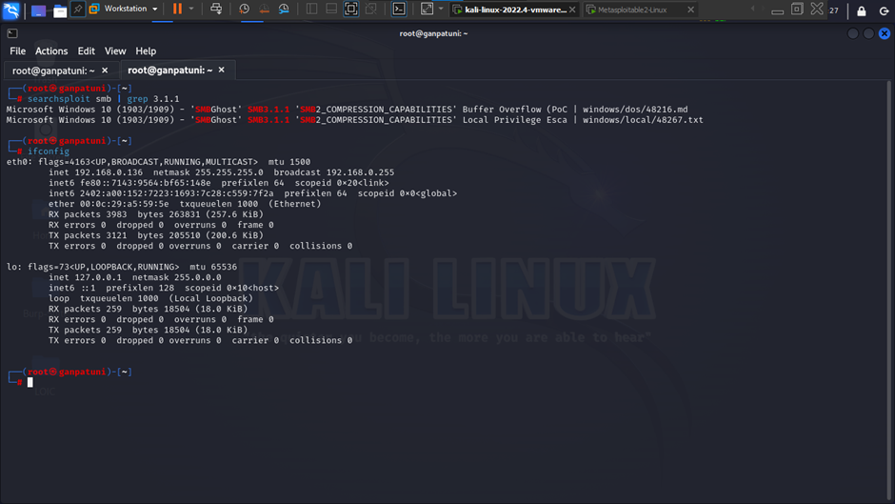
Screenshot

Slide 6
Week-2
System scanning of client company.
Found different vulnerabilities using Nessus Tool.
Mitigated vulnerabilities and applied necessary security updates.
Performing a comprehensive rescan of all systems to identify and address any potential issues if present.

Slide 7
Week-3 & Week-4
Systematically detecting bugs across various websites.
Web application security testing using BurpSuite.
Analyzing the communication between a web application and its users.
Performed automated and manual testing, analyzing request and response data.
Aiding in the identification security issues like cross-site scripting (XSS), SQL injection and many more.

Slide 8
Month-2
Successfully executing a penetration test on a client’s website.
Successfully conducted SQL Injection (SQLI) and gained access to the Admin Panel.
Gained unrestricted access of customer-related information, such as personal details, contact information, and potentially sensitive data.
Additionally, obtained access to confidential customer records, including account credentials and transactional data, posing significant privacy and security risks.

Slide 9
Month-2
Creation of an Open-Source Security Operations Center (SOC):
We devised and put into action an extensive Security Operations Center (SOC) framework with the ability to monitor in real-time, detect incidents, and respond automatically using Wazuh, Shuffle and IRIS. Furthermore, we incorporated workflow automation and established automated case management within Iris, greatly enhancing our organization's cybersecurity capabilities.

Slide 10
Month-2
Shuffle is a tool designed to streamline incident response by automating tasks and facilitating seamless coordination between different tools and systems. It operates through a series of apps and nodes, each serving specific functions within the workflow. When integrated with Wazuh, Shuffle enhances the handling of security events by automating alert retrieval, case creation, and incident response actions. This integration enables smoother collaboration between security teams and improves the efficiency of incident detection and resolution processes.

Slide 11
Month-2
DFIR-Iris is a comprehensive platform designed for digital forensics and incident response (DFIR) tasks. It offers a wide array of features such as case management, evidence collection, analysis tools, and reporting capabilities. DFIR-Iris streamlines the entire investigative process, from initial incident identification to evidence collection, analysis, and resolution, enabling security teams to effectively handle security incidents and mitigate risks.

Slide 12
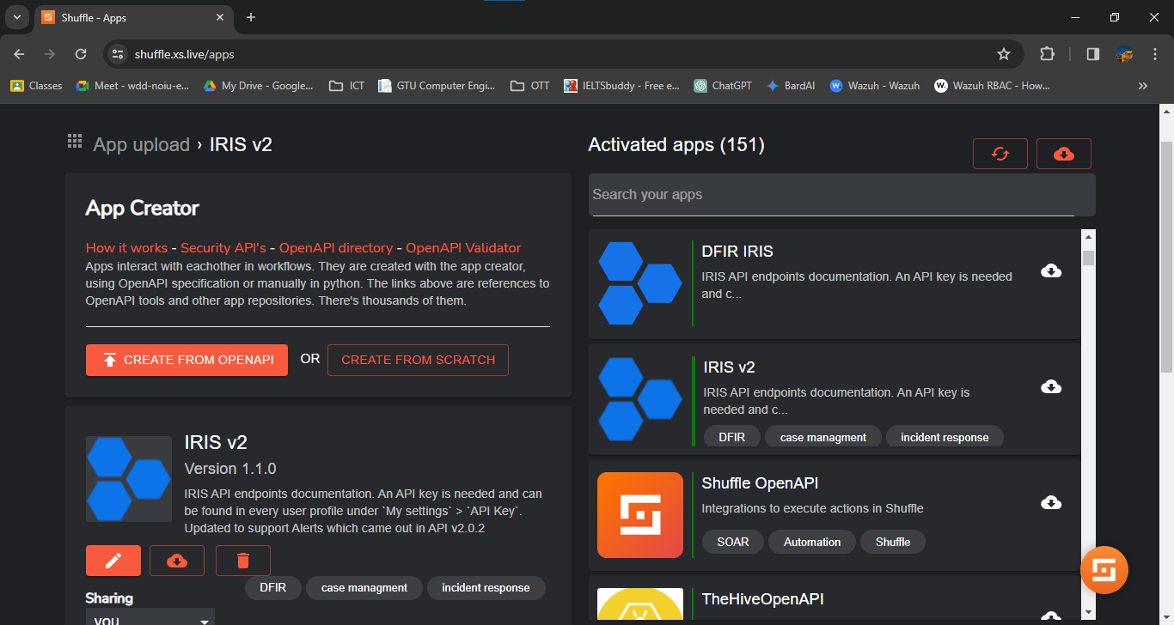
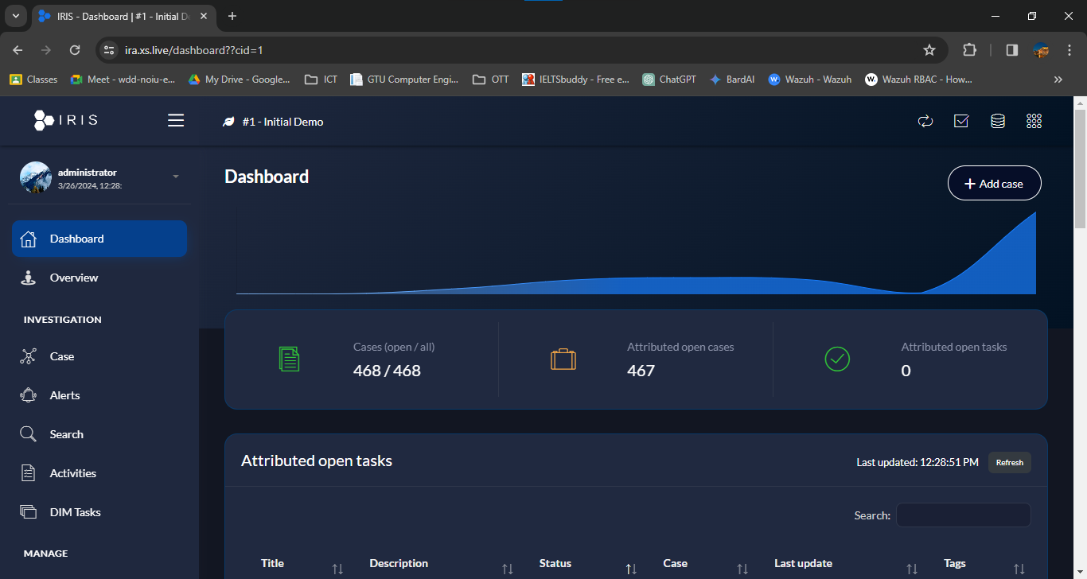
Screenshot

Slide 13
Month-3
Offered remediation for cases generated within the Iris platform and conducted auditing of security events:
The first part involves analyzing the problem, identifying appropriate actions or steps to mitigate it, and implementing those solutions to ensure the safety of the client's organization.
The second part includes analyzing logs, monitoring system activity, and investigating potential security incidents or breaches to ensure the integrity and security of the system. The auditing process helps identify vulnerabilities, assess risks, and strengthen overall security measures.

Slide 14
Month-3
In the initial stage, analysts pinpointed the issue, evaluating its scale and potential consequences. After thorough examination, they establish appropriate actions or mitigation strategies, such as applying security patches or revising policies. These measures are swiftly put into effect to enhance the organization's security stance. Collaboration with stakeholders and rigorous testing validate the efficacy of these solutions. Ultimately, this proactive strategy aims to shield the organization's assets and data from looming threats.

Slide 15
Month-3
At the same time, cybersecurity specialists meticulously analyze system logs and monitor activity to detect potential security incidents or breaches. They meticulously investigate any suspicious activities or anomalies to identify the root cause of security breaches. This thorough auditing process aims to identify vulnerabilities, assess risks, and fortify overall security measures to safeguard the system against future threats. Ultimately, the goal is to ensure the integrity and resilience of the system against evolving cyber threats.

Slide 16
Month-4
Enhance the workflow by automatically incorporating IOCs:
IOC Enrichment: The extracted IOCs are enriched with additional context and metadata, such as threat classifications, severity levels, and associated threat actor groups.
Parsing and Analysis: The collected data is parsed and analyzed by the MISP module through Cortex, which automatically extracts information about indicators of compromise (IOCs) from the incoming threat intelligence reports.

Slide 17
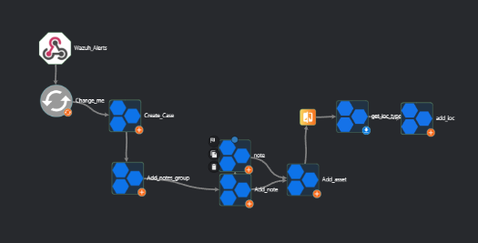
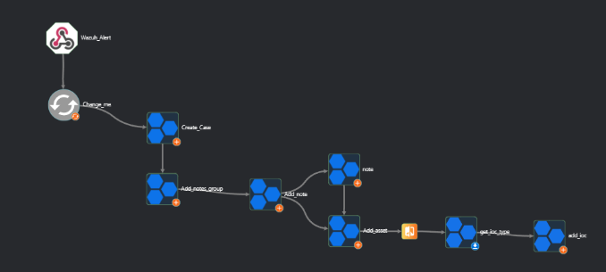
Screenshot

Slide 18
Month-4
Leveraging the MISP Module in Iris for Enhanced Cybersecurity Analysis and Response:
The MISP (Malware Information Sharing Platform) module in Iris through cortex facilitates detailed cybersecurity analysis and response, offering insights into threat intelligence data. By leveraging this module, organizations gain proactive defense capabilities, enhanced collaboration, and more effective threat detection and response.

Slide 19
Month-4
Concurrently addressing cases generated in Iris by tailoring remediation strategies to mitigate vulnerabilities, bolster security posture, and safeguard assets against cyber threats. Utilizing Wazuh for monitoring security events enables timely detection and response to ongoing threats, ensuring comprehensive protection across the organization's infrastructure.

Slide 20
Conclusion
During my internship in cybersecurity, I gained invaluable hands-on experience in diverse areas, including vulnerability assessments, penetration testing, web application security testing and . This opportunity allowed me to apply theoretical knowledge in real-world scenarios, enhancing my skills in identifying and mitigating security risks. The exposure to tools like Wazuh, Shuffle, IRIS and others enriched my understanding of security event monitoring and configuration assessment, preparing me for the role as a SOC analyst. Overall, this internship has been instrumental in shaping my cybersecurity expertise and providing a solid foundation for my future endeavors in the field.

Slide 21
THANKYOU…

