Slide 1

Industry Project Presentation on “WAF and Network Firewall”
By
20162171022 Prajapati Sahil Kantibhai
21162172006 Urmik Pandya
Institute of Computer Technology, Ganpat University
Date:12/05/2024

Slide 2
Table Of Contents
●Introduction
●Objectives
●Related Background
●Expected Outcome
●Tools & Technology
●Methodology (Modules)
●TimeLine Charts with Milestones
●Implementation Details
●Conclusion
●References

Slide 3
Network Firewall

Slide 4
Introduction-1
In today's digital environment , safeguarding network security is paramount due to the escalating complexity of cyber threats. Organisations must deploy strong defenses to their sensitive data and infrastructure. A pivotal aspect of this effort involves creating a stateful firewall system , which effectively monitors and manages network traffic based on predetermined security protocols

Slide 5
Objectives
Develop a firewall solution capable of inspecting network traffic at the packet level.
Implement advanced filtering mechanisms to enforce security policies based on application protocols, IP addresses, ports, and other parameters.
Enhance network visibility and monitoring capabilities to detect and mitigate suspicious or malicious activities.
Ensure scalability and performance optimization to accommodate high-volume network traffic without compromising security.
Provide a user-friendly interface for configuration, management, and reporting of firewall rules and security events.

Slide 6
Related Background
A firewall plays a critical role in network security , acting as a protective barrier between a trusted internal network and potentially harmful external networks, such as the internet. It scrutinized both inbound and outbound network traffic, enforcing predefined rules to authorize or prohibit specific types of data packets, considering factors like source and destination IP addresses , ports , and protocols, firewall comes in various forms,including software-based solutions and hardware appliances and are typically classified into packet-filtering , stateful inspection, or proxy firewall.

Slide 7
Expected Outcomes
Real-time inspection and filtering of network traffic.
Documentation covering design, implementation and deployment of of procedures
Performance benchmarks demonstrating scalability and efficiency.
Integration with existing network infrastructure and management tools.
Provision of training materials and user guides for network administrators.

Slide 8
Tools and Technology
Programming languages : Python , MYSQL
Network Protocols: TCP/IP,UDP,ICMP
Firewall Framework: Netfilter/ IPtables(linux),pfSense(FreeBSD), Windows Firewall (windows).
Packet Inspection Libraries: libpcap, Scapy
Web Interface Frameworks: Flask , Django
Database System: SQLite, MySQL, PostgreSQL
Logging and monitoring Tools: syslog,SNMP,ELK Stack(Elasticsearch, Logstash,Kibana

Slide 9
Methodology (Modules)
Packet Inspection Module: Captures and examines network packets to enforce firewall rules.
Tracking Module: Records active connections for packet filtering.
Rule Evaluation Module: Determines whether to allow or block traffic based on firewall rules.
Logging and Reporting Module: Logs security events and traffic statistics for analysis.

Slide 10
Methodology (Modules)
Configuration Management Module: Provides an interface for configuring firewall settings.
Alerting and Notification Module: Notifies administrators of security incidents in real-time.
Performance Optimization Module: Enhances firewall performance through optimization techniques.
Filter Malicious request sent in different methods
Blocking and Unblocking TCP and UDP rules
Capturing and Detecting Malicious Packet

Slide 11
Timeline Charts and Milestone
Task: - 1 Research work and Requirements Gathering
Task: - 2 Define Modules of the project
Task: - 3 Packet Capturing and Tracing Module
Task: - 4 Discover Live Hosts on the network Module
Task: - 5 Define Dataset of Inbound and Outbound Rules for packets captured Module

Slide 12
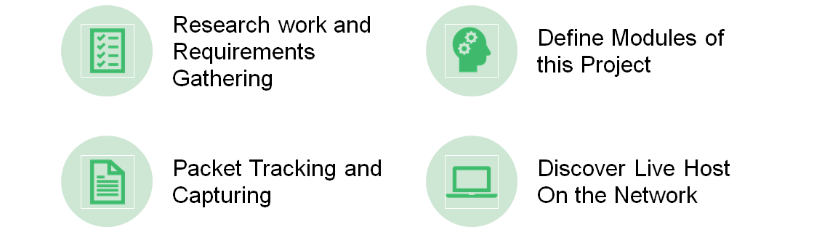
Implementation Details

Slide 13
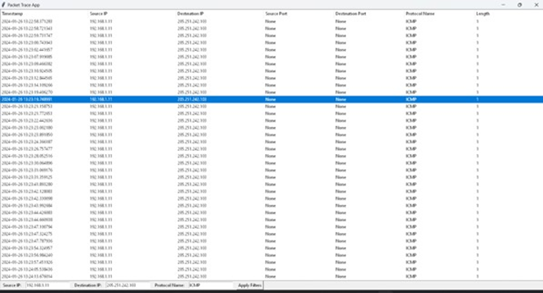
Packet Tracking and Capturing
•Packet tracing code this code trace all the traffic of network and captures the details like source ip , destination ip , source port , destination port , Port number and length of packets.

Slide 14
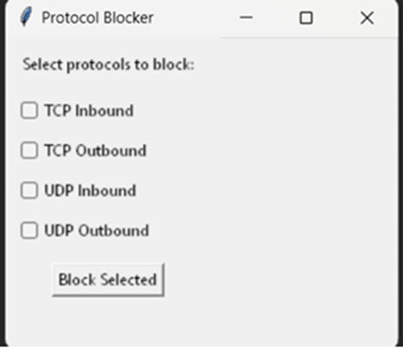
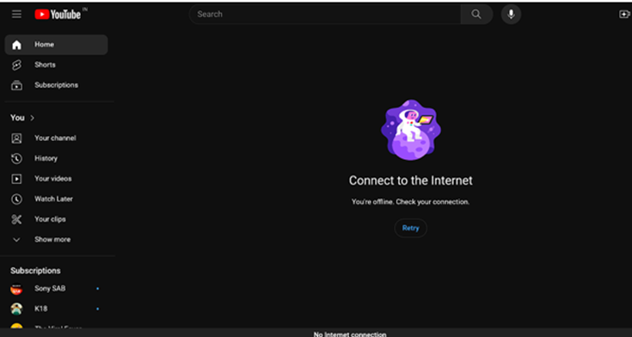
Poc (Blocking and Unblocking TCP and UDP rules)

Slide 15
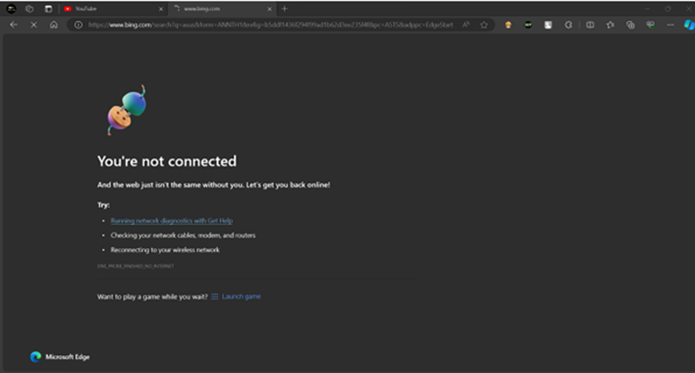

Slide 16
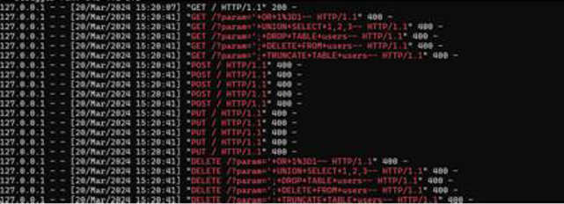

Poc(Filter Malicious request sent in different methods)

Slide 17
Discover Live Hosts on Network
Performs network scanning to identify live hosts within the network or specified IP ranges. Utilizes techniques such as ICMP ping sweeps, ARP scanning, or TCP SYN scans to probe for active hosts. Collects information about discovered hosts, including IP addresses, MAC addresses, and hostnames and OS information

Slide 18
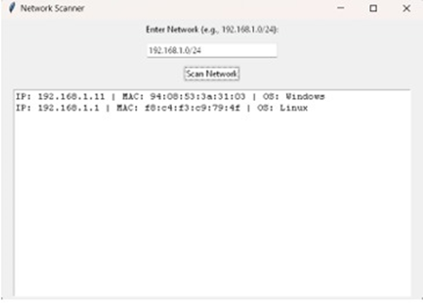

Slide 19
Conclusion
•The development of a firewall solution represents a crucial step towards strengthening network security and mitigating cyber threats. Through the implementation of advanced packet inspection, state tracking, and rule evaluation mechanisms, the firewall offers enhanced protection against unauthorized access, malicious activities, and data breaches. The user-friendly interface, robust configuration management, and real-time alerting capabilities ensure that network administrators can effectively manage and monitor the firewall to maintain a secure network environment. Moving forward, continued research and development in the field of network security will be essential to adapt to evolving cyber threats and ensure the resilience of network infrastructures.

Slide 20
References
•WWW.GOOGLE.COM
•WWW.YOUTUBE.COM
•WWW.GEEKSFORGEEKS.COM
•WWW.FORTINET.COM
•WWW.RESEARCHGATE.NET
•WWW.IEEEXPLORE.IEEE.ORG

Slide 21
Web Application Firewall

Slide 22
Introduction
A Web Application Firewall (WAF) serves as a specialized security measure for safeguarding web applications against online threats. Positioned as a barrier between the web application and the internet, it continuously monitors and filters HTTP traffic, detecting and blocking malicious requests like SQL injection and cross-site scripting based on predefined rules. By preventing unauthorized access and potential data breaches, WAFs play a crucial role in enhancing the overall security of web applications

Slide 23
Objective
To enhance the security of the Flask web application.
To detect and prevent SQL injection, XSS injection, OS command injection, and path traversal attacks.
If user tries to do some malicious activity send a email notification on administrator’s email address and user see 403 error on application.
SSL certificate added and secure web application on https.

Slide 24
Related Background
web vulnerabilities: SQL injection, XSS injection, OS command injection, path traversal.
Flask framework and its role in web application development.
Created UI in the html, Bootstrap and JS scripts , and CSS
For notification on email use python library ”smtp” and MIME for text email notification

Slide 25
Expected Outcome
Improved security posture of the web application.
Prevention of common web attacks.
Enhanced user trust and confidence in the application's security.
Create a proper UI for user easily access the application.
Send a alert to the administrator on email
Add UUID for fetch the user os details

Slide 26
Tools & Technology
Flask: Python-based micro web framework.
Python: Programming language for backend development
Bootstrap: user for creating the UI part (front end Development)
WAF rules and policies : for detecting and blocking malicious activity and requests.

Slide 27
Methodology (Modules)
Homepage
About-us page
Contact-us page
Input Validation Module: Validate user inputs to prevent injection attacks.
XSS Protection Module: Implement measures to prevent cross-site scripting attacks.
OS Command Injection Prevention Module: Sanitize inputs to prevent OS command injection.

Slide 28
Methodology (Modules)
Path Traversal Detection Module: Implement checks to detect and prevent path traversal attacks.
RFI/LFI: secure the web application through remote file inclusion, local file inclusion if user try to do malicious request such as http://, php://, https:// and others.
SSL CERTIFICATE: used for securing the web application run over the HTTPS.

Slide 29
Methodology (Modules)
Platform module: platform module is used for retrieve the information of user operating system.
Werkzeug: used for (web server gateway interface ) its library of the python used for handing the requests
ProxyFix:A middleware in werkzeug used to handle request forward by the proxy server.

Slide 30
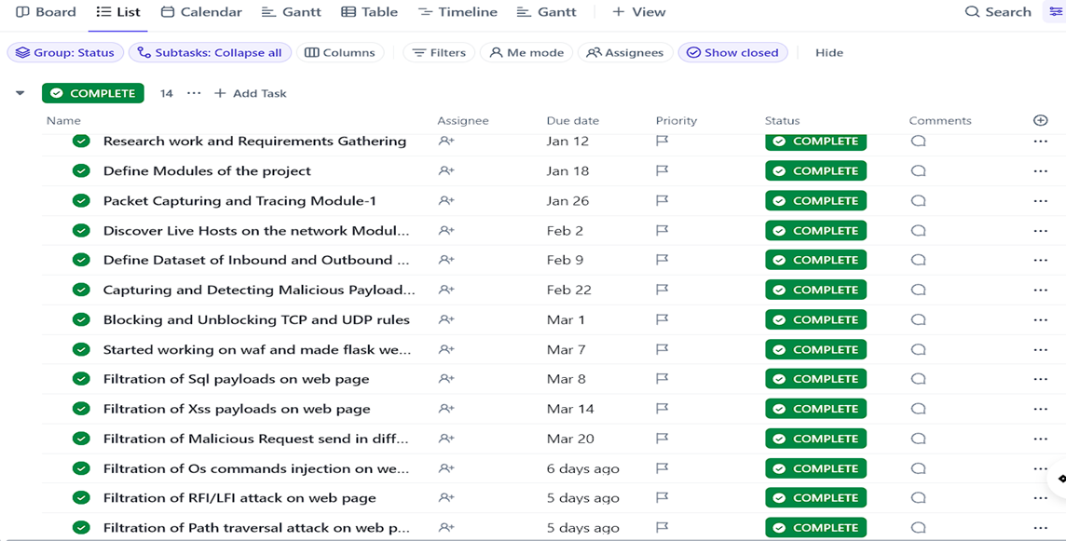
TimeLine Charts with Milestones

Slide 31
Implementation Details
Create web page used by the flask python application home page, contact page, about us page.
SQL Detection module.
XSS Detection module.
OS Command Detection module.
Path traversal Detection module.
RFI \ LFI Detection module .

Slide 32
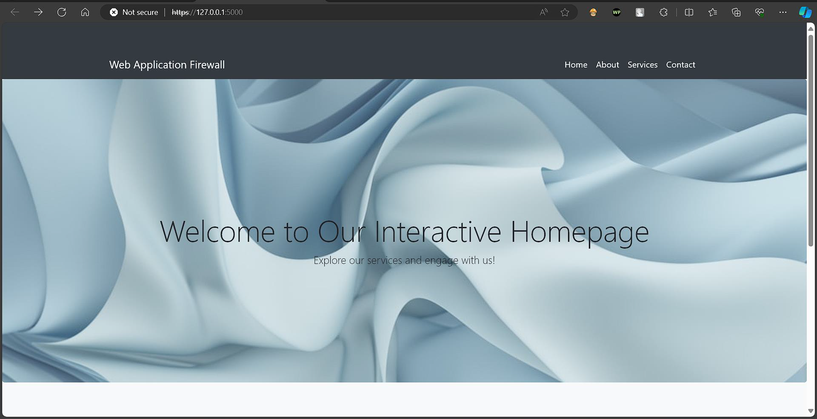

Slide 33
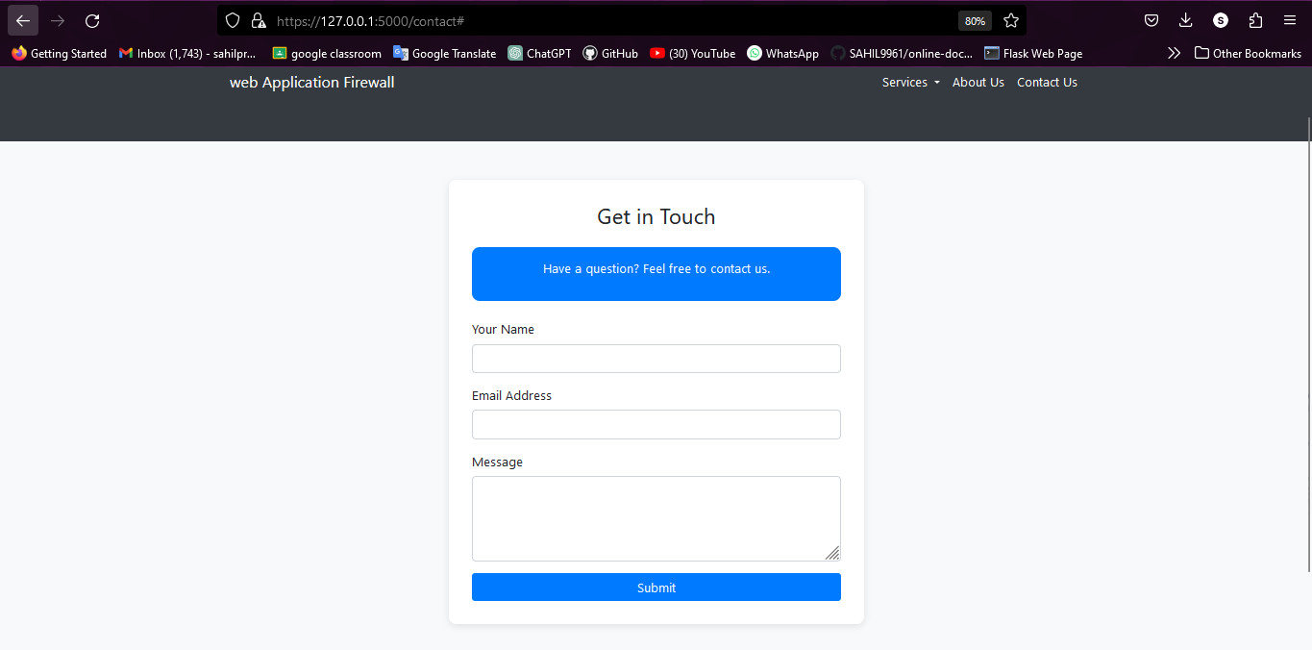

Slide 34
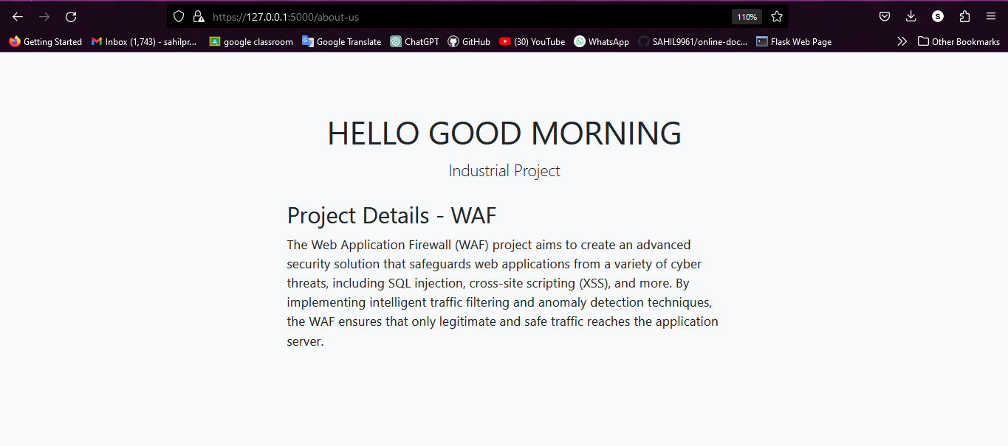

Slide 35
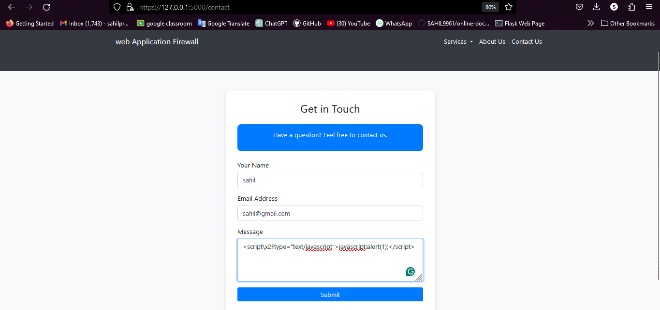
Poc(XSS Detection Module.)

Slide 36
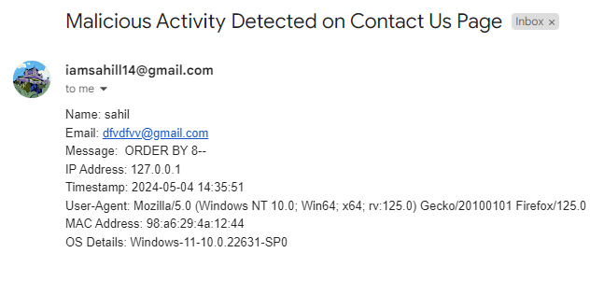
Alert Notification on Email

Slide 37
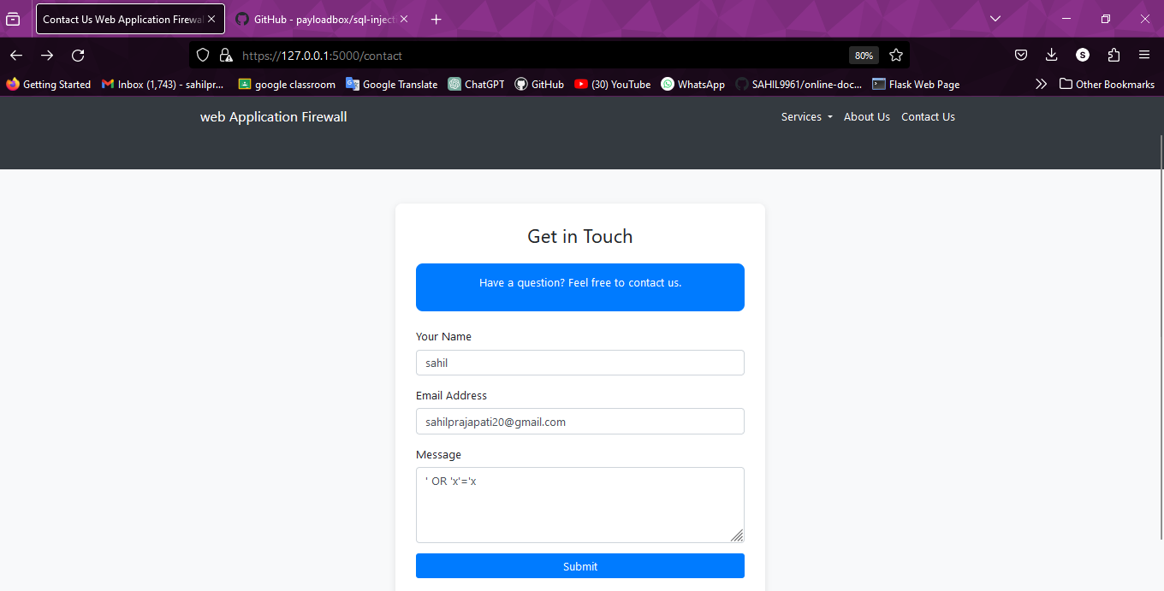
Poc(SQL Injection Detection Module)

Slide 38
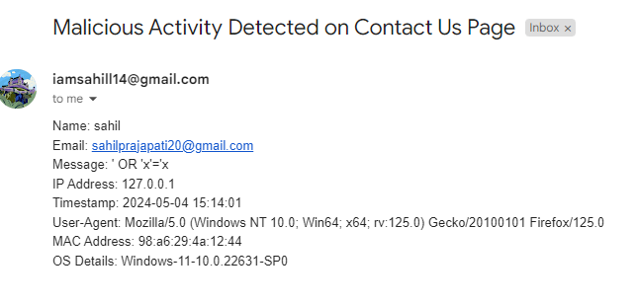
Alert Notification on Email

Slide 39
References
●www.google.com
● www.youtube.com
● www.geeksforgeeks.com
● www.fortinet.com
● www.researchgate.com
● http://www.securityfocus.com/infocus/1716
● http://www.securityfocus.com/infocus/1817
●https://www.techtarget.com/searchapparchitecture/tip/XML-F irewalls
● https://www.sei.cmu.edu/about/divisions/cert/index.cfm

Slide 40


