Slide 1
Good Cyber Security Practices

Slide 2
What is Cyber Security?
Cybersecurity is the protection of computer software, systems and networks from threats that can lead to unauthorized information disclosure, theft or damage to hardware, software, or data, as well as from the disruption or misdirection of the services they provide.

Slide 3
Common threats
Ransomware
Phishing
Social Engineering
Weak Passwords

Slide 4
How can we protect ourselves?
By following some common good practices while using your system.

Slide 5
Password Management
Use strong passwords
Enable Multi Factor Authentication
Use Password managers to store your passwords
Avoid password reuse.

Slide 6

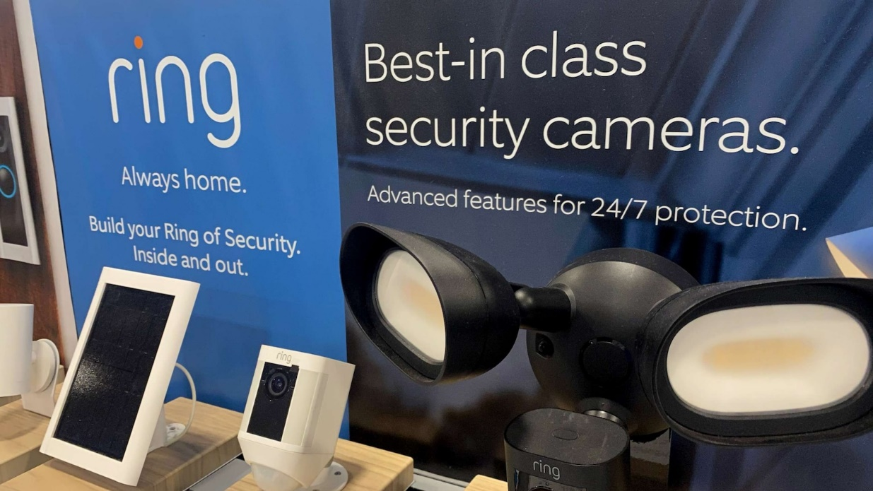
Incident: In 2019, reused and weak passwords led to hackers accessing Ring camera accounts, enabling them to spy on users and even communicate with families. Lesson: Strong, unique passwords and multi-factor authentication (MFA) are crucial for account protection.

Slide 7
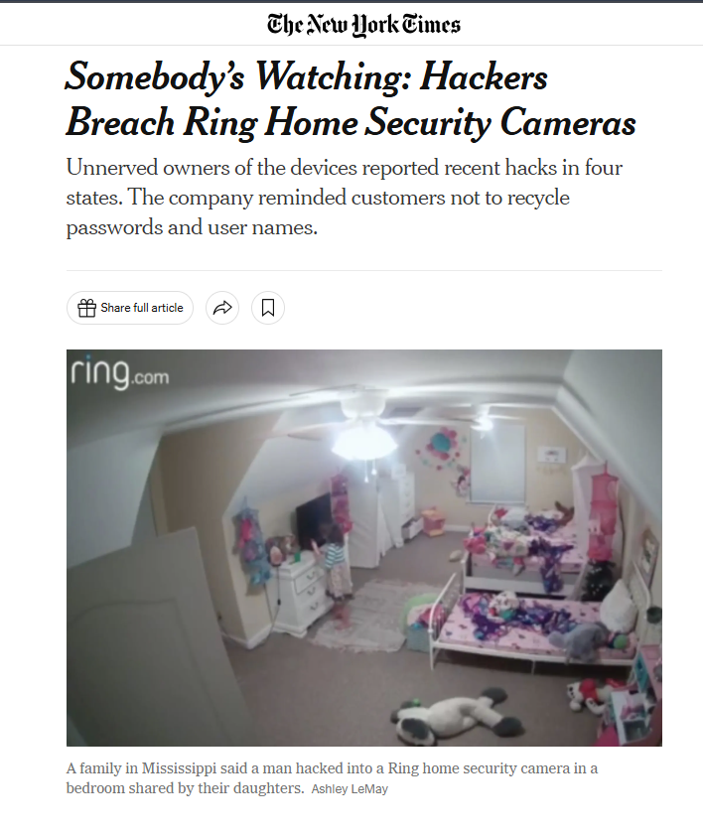
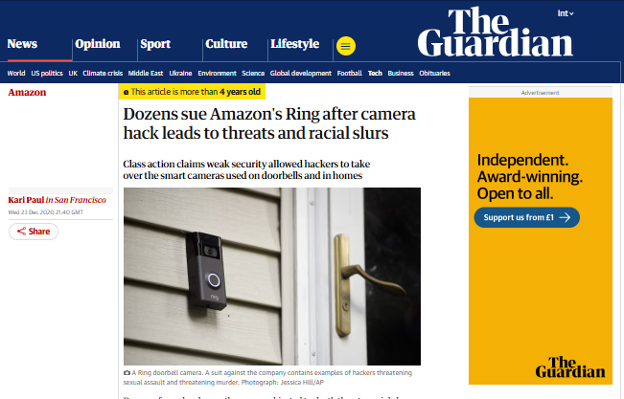

Slide 8
Device Security
Ensure endpoint security by installing softwares like EDR, and Anti Virus.
Regularly update your devices with the latest patches released by the Manufacturer.
Use a VPN while using public or unsecured networks.

Slide 9
Incident: In 2017, the WannaCry ransomware spread globally, exploiting unpatched systems to encrypt data and demand payment. The attack affected hospitals, businesses, and government entities. Lesson: Keeping software and operating systems updated with security patches can prevent exploitation of vulnerabilities.

Slide 10
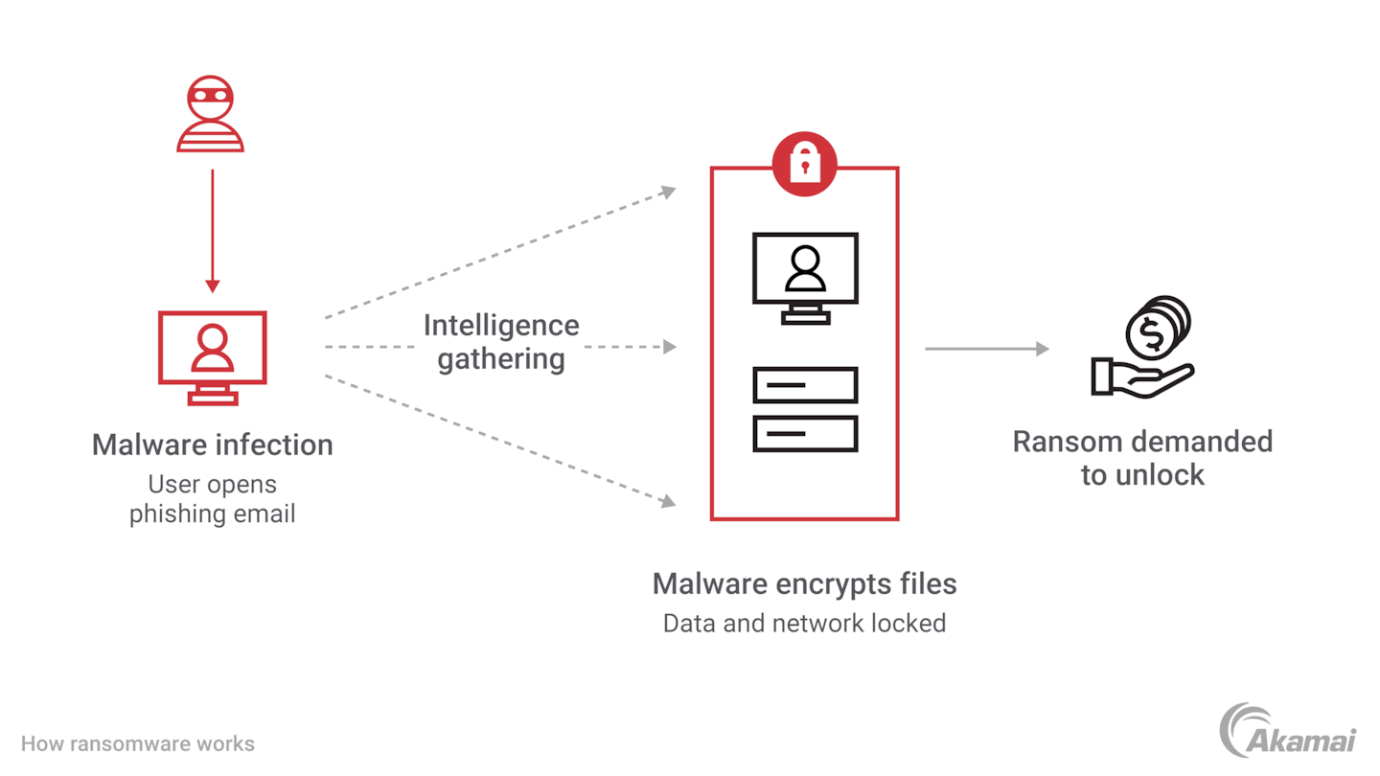

Slide 11
Email and Communication Security
Verify the sender’s email address and scrutinize links before clicking.
Verify the sender’s email address and scrutinize links before clicking.
Open only trusted and expected attachments, and scan them with antivirus software.

Slide 12
Incident: In 2019, Toyota Boshoku Corporation, a subsidiary of Toyota, lost $37 million in a Business Email Compromise (BEC) scam. Cybercriminals impersonated an executive through email, tricking an employee into transferring funds to a fraudulent account. Lesson: Always verify email requests for sensitive actions, especially involving financial transactions, through a secondary communication method like a phone call or in-person confirmation. Avoid acting on urgent, high-risk email requests without additional verification.

Slide 13


Slide 14
Data Security
Backup Data regularly which includes critical files.
Only share data with authorised individuals.
Shred paper documents and securely delete digital files no longer needed using tools like file shredder and zero fill.

Slide 15
Incident: In 2020, UCSF paid $1.14M after ransomware encrypted research data. Attackers exploited weak security measures to gain access. Lesson: Regular data backups, limited sharing of sensitive data, and secure data disposal are essential to minimize the impact of such attacks.

Slide 16
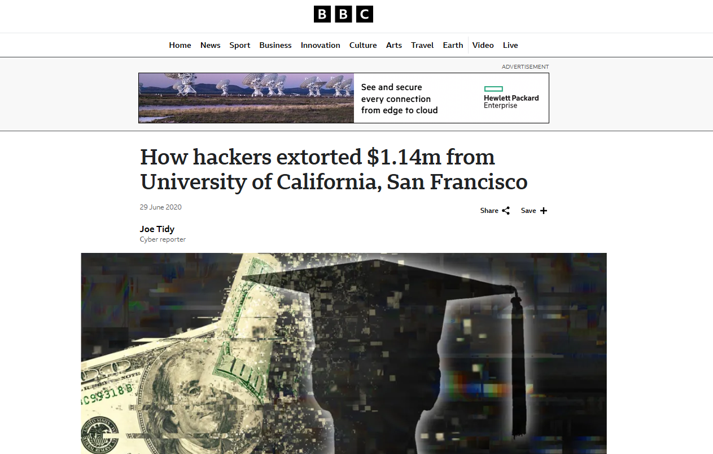

Slide 17
Access Control
Always log out after using shared systems or accounts.
Notify IT to remove access of an employee when he/she changes roles or leaves the organization.
Give access to data and systems required for the particular role.

Slide 18
Incident: In 2023, a fired NCS employee, upset over his termination, used old administrator credentials to access the company's test system remotely. Over multiple sessions, he ran scripts that deleted 180 virtual servers, causing a financial loss of S$918,000.
Lesson: Promptly revoke system access for departing employees and monitor systems for unauthorized access to prevent such disruptions.

Slide 19
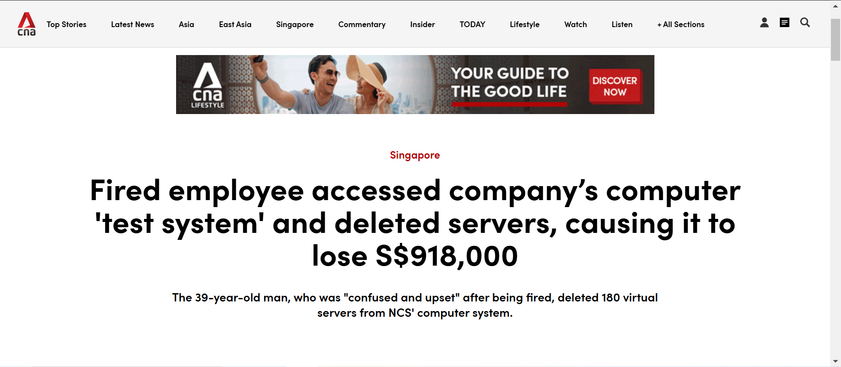

Slide 20
Safe Internet Practices
Do not visit untrusted or unfamiliar websites.
Verify website URLs before entering sensitive information.
Avoid downloading software or files from unknown or unverified sources.
Avoid sharing organizational information on personal social media accounts.
Avoid using personal social media accounts on organizational devices to prevent potential cybersecurity risks and distractions.

Slide 21
Incident: In 2016, hackers used a fake login page on an untrusted website to steal the credentials of John Podesta, chairman of Hillary Clinton's presidential campaign. He clicked on a phishing link in an email and entered his login information, which hackers later used to access sensitive emails.
Lesson: Always verify website URLs before entering sensitive information and avoid interacting with unfamiliar or untrusted sites. Double-check the authenticity of links and avoid sharing organizational credentials on personal devices or accounts.

Slide 22
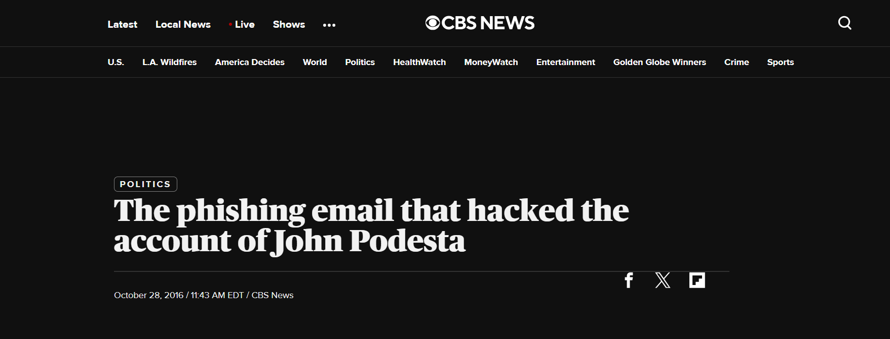

Slide 23
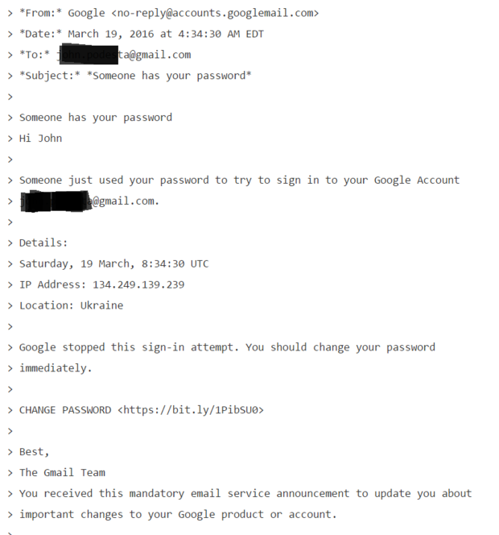
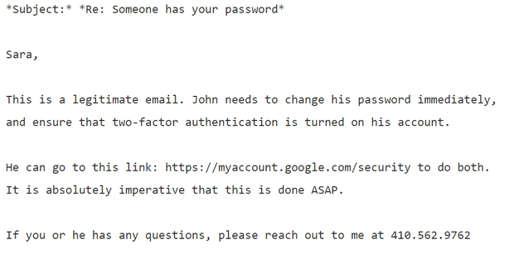

Slide 24
Physical Security
Ensure that laptops, USB drives, and other devices are not left unattended instead store them properly.
Do not write sensitive informations like passwords, etc on the desk openly.
Do not let unauthorized individuals into secure areas.
Do not permit other employees to use your device unless absolutely necessary. When others do use your device, monitor their activity closely. Never leave your device unattended

Slide 25
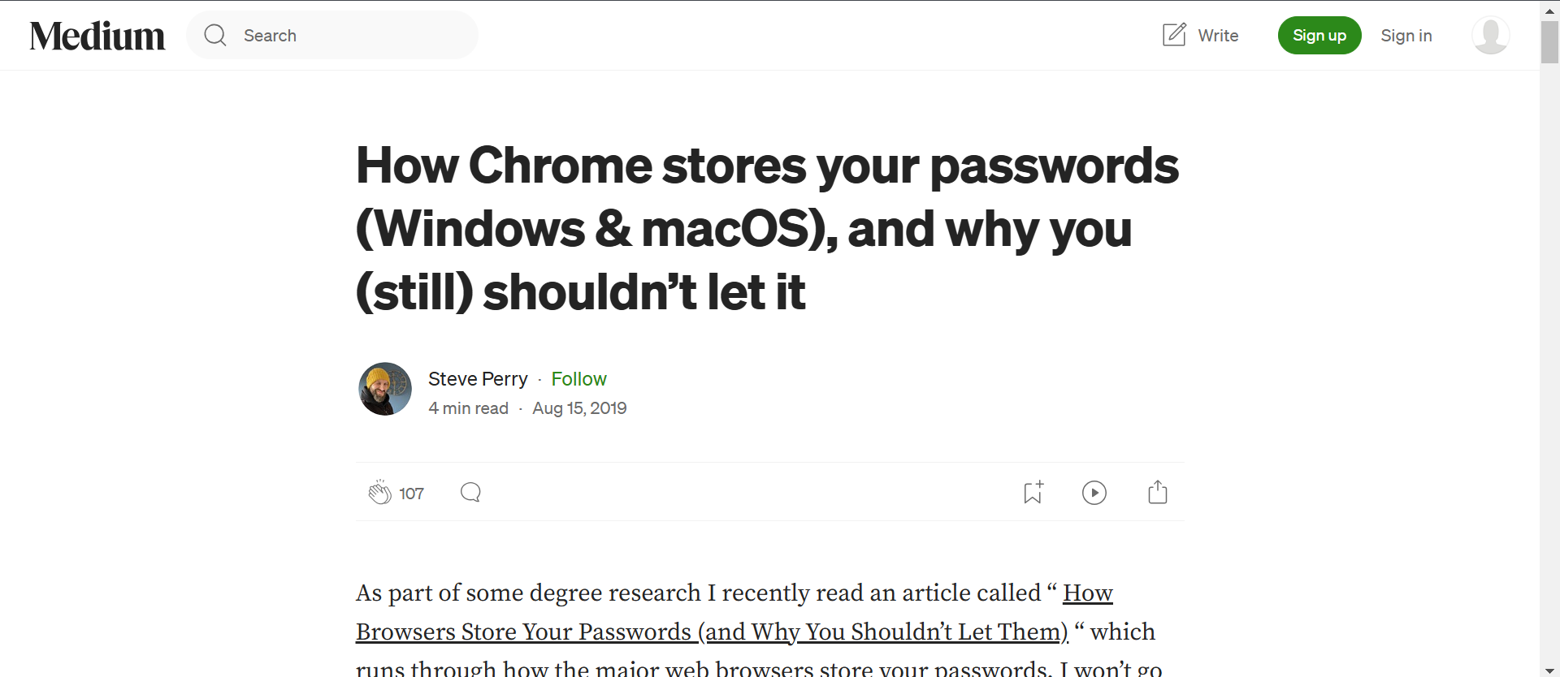

Slide 26
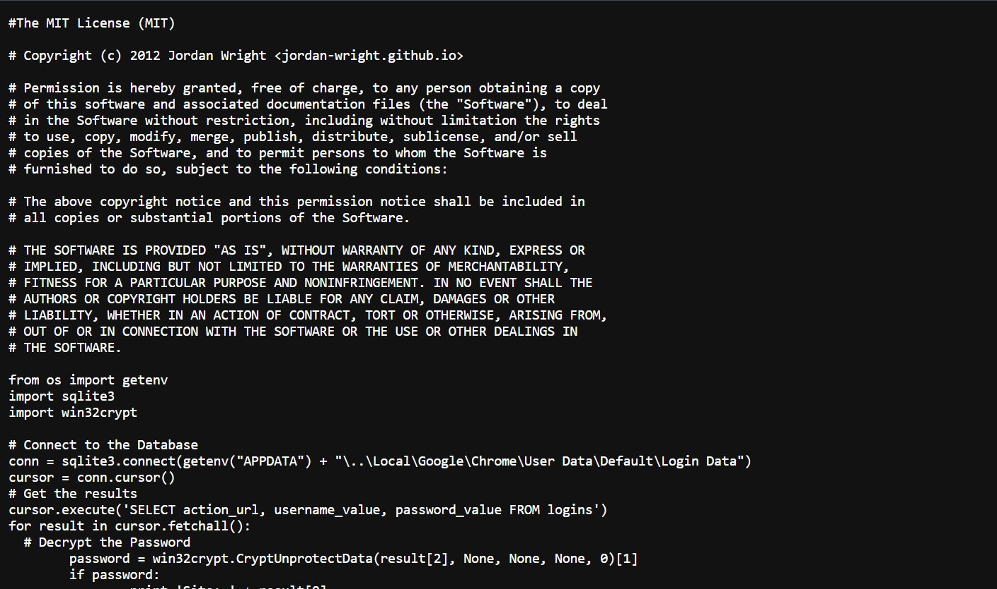

Slide 27
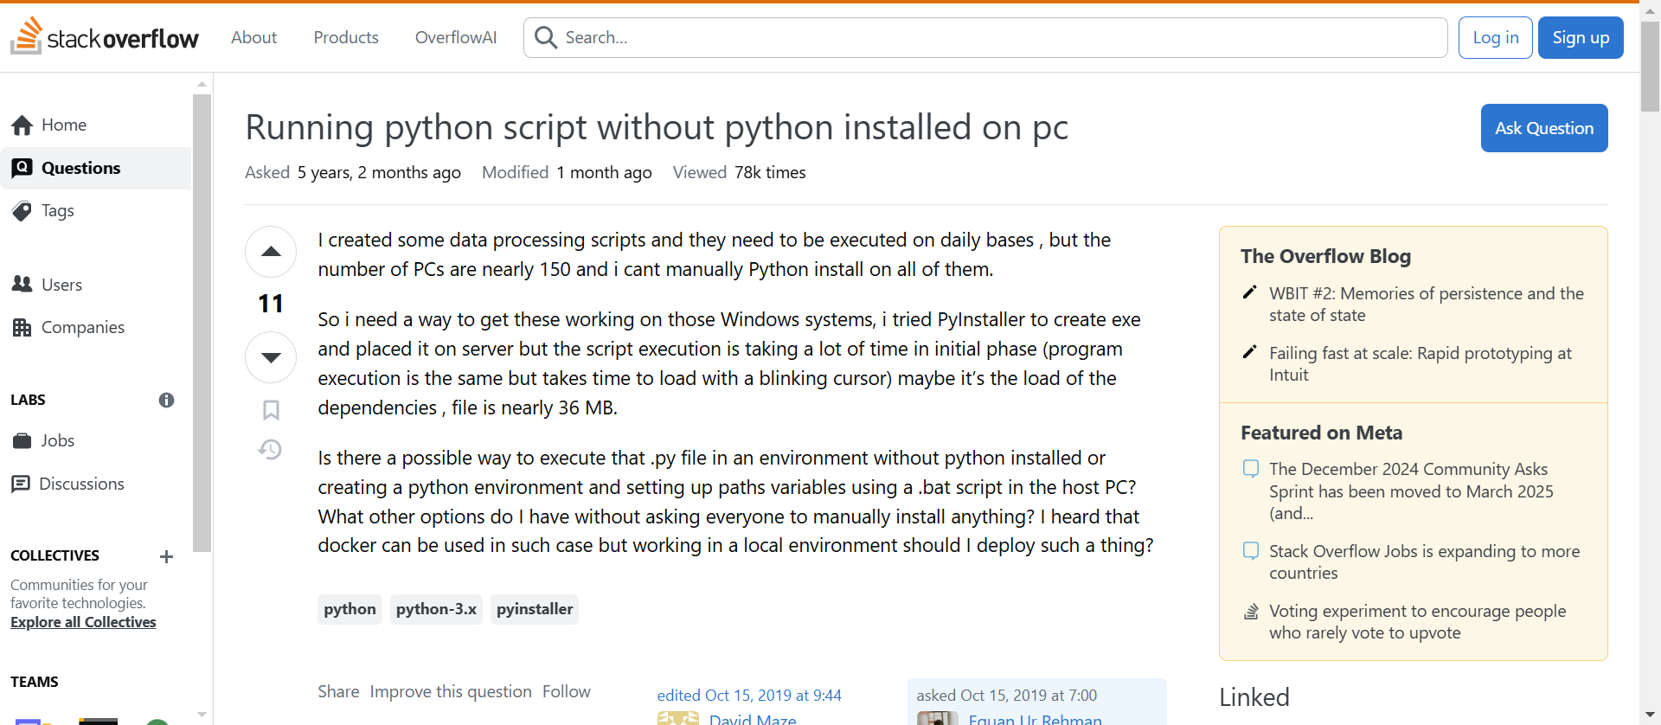

Slide 28
Remote Work Security
Use company issued devices, avoid using personal devices for work unless explicitly authorized.
Use strong wifi passwords and change default credentials.
Avoid using work accounts for personal use and vice versa.
Do not use public wifi for Work related tasks, use mobile data if possible.
Use secure and well known platforms for remote work.

Slide 29
Incident: In 2020, the video conferencing platform Zoom faced significant security issues as remote work surged during the COVID-19 pandemic. Weak security measures, such as inadequate encryption and users not enabling meeting passwords, led to "Zoom-bombing" incidents where unauthorized individuals joined meetings, disrupting business operations and exposing sensitive discussions.
Lesson: Use secure platforms with strong encryption for remote work, enforce meeting passwords, and educate employees about safe online practices. Ensure personal devices and home networks are properly secured with strong passwords and updated software.

Slide 30
Cybersecurity Culture
Stay updated on latest cyber threats.
Adopt “Zero trust policy” towards systems, individuals and devices.
Conduct regular training of employees regarding good practices.
Conduct regular security incident drills.

