Slide 1

IBM Project Presentation
On
“A Solution to Healthcare”
By
Group ID: 31
Aakarsh Vyas [21162121038]
Krish Patel [21162171023]
Yash Sathwara [22162122009]
Institute of Computer Technology, Ganpat University

Slide 2

A Solution to Regulate Private Healthcare Sector
Presented by Aakarsh Vyas, Krish Patel, Yash Sathwara
Guided by Prof. Ravindra Patel and Mr. Parwinder S

Slide 3
Project Overview & Goals
Challenges
Solution
Lack of transparency in private healthcare
Web platform for hospital search
Uneven service distribution
Doctor and bed availability check
Difficulty finding right facility
AI-driven patient admission forecasting

Slide 4

Key Features of the Platform
Disease-Based Hospital Search
Real-Time Doctor Availability
Find hospitals by illness or condition
View doctor schedules before visits
Appointment Booking
Doctor Recommendation
Book appointments directly online
Machine learning suggests suitable doctors

Slide 5

Technology Stack & Security
Frontend
React.js for responsive user interface
Backend
Django with PostgreSQL database
Security
OTP-based login, encrypted passwords, JWT tokens
Scalability
Robust architecture for growing users

Slide 6





Implementation Highlights
Frontend Pages
Home, Login/Register, Patient & Doctor Dashboards
API Integration
Axios for real-time data fetching
Backend APIs
RESTful services for users and appointments
Machine Learning
XGBoost for doctor recommendations

Slide 7
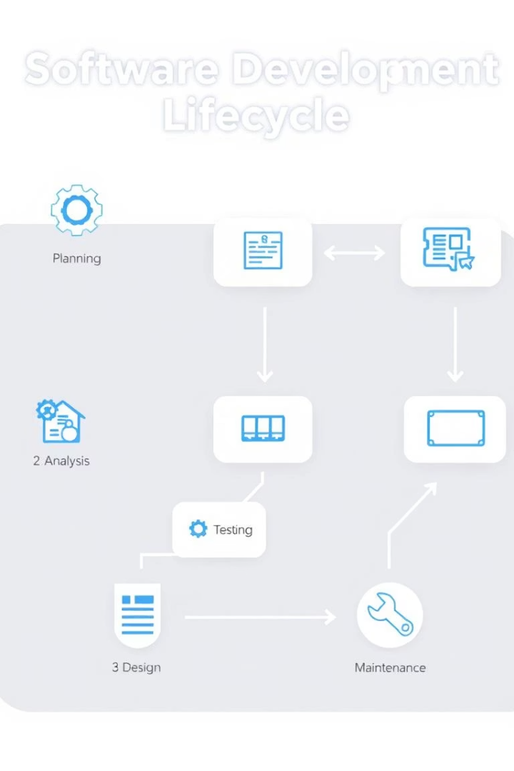
Process Model & Workflow
1
Requirement Gathering
Identify user needs and challenges
2
Design & Development
Build frontend and backend components
3
Testing & Deployment
Ensure functionality and launch platform
4
Maintenance & Updates
Continuous improvements and support

Slide 8
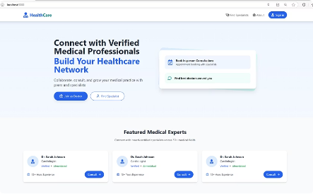
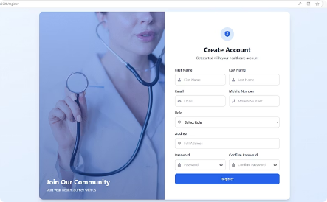
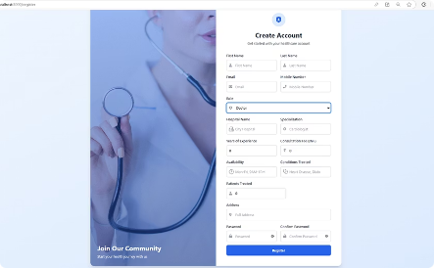
Screenshots & User Interface
Homepage
Clean layout with featured hospitals
Patient Dashboard
Search and filter doctors by disease
Doctor Dashboard
Manage availability and appointments

Slide 9
Conclusion & Impact
Transparency
Accessibility
Efficiency
Security
Improves clarity in private healthcare services
Faster hospital and doctor discovery
Streamlines appointment booking and resource use
Protects patient data with strong authentication

