Slide 1

User Experience Design Project
Presentation
On
Medical Shop Online
By
Group ID: G28
Jinay Shah (20162121025)
Purav Shah (20162121026)
Tirth Patel (20162121029)
Institute of Computer Technology
Ganpat University
Date:11-03-2022

Slide 2
Introduction
The establishment and improvement of doctor-patient (student/staff) interaction system is a very important requirement, especially now when the communication technology is developing rapidly. The advantages of web can be made full use of to make up the time and distance gap between doctors and patients and to provide fast and adequate medical services. Through the connection between user terminals and specific service, both doctors and patients are able to obtain required data to achieve a better interaction. The platform, Web services and database technology are all gradually maturing, so that we can develop a doctor- patient (student/staff) interaction system on web application platform to meet the needs of the patient and provide doctors more efficient and convenient means of communication with patients. Doctor can see the complaint and provide the necessary solutions for the patients. Admin can manages the patient record in efficiently. Using the web portal admin can also generate the day/weekly/monthly reports.

Slide 3
Implementation
CSS
BOOTSTARP
MDBOOTSTARP
JSP
Request Dispatcher
HTTP Session
Connection
Statement
Prepared Statement
Result Set
JSP Include Action Tag

Slide 4
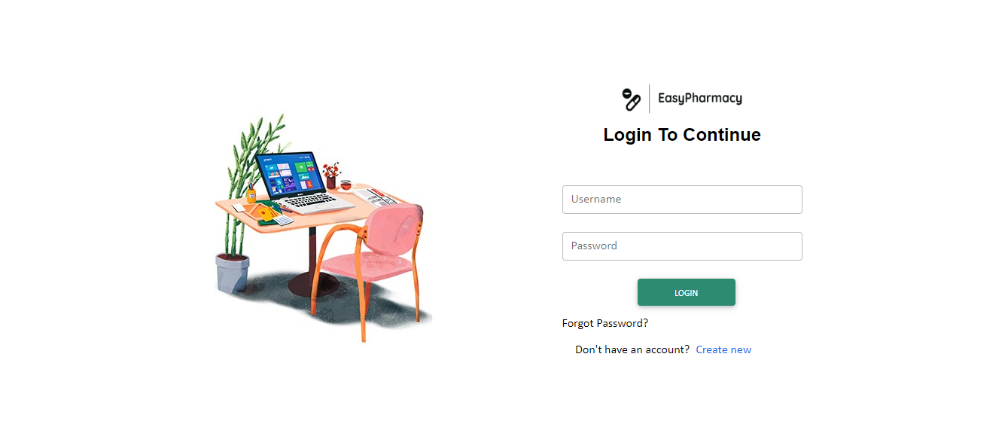
Snapshots

Slide 5
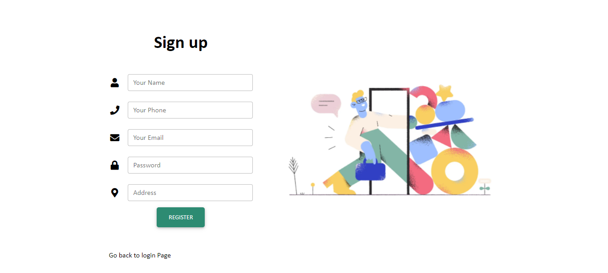

Slide 6
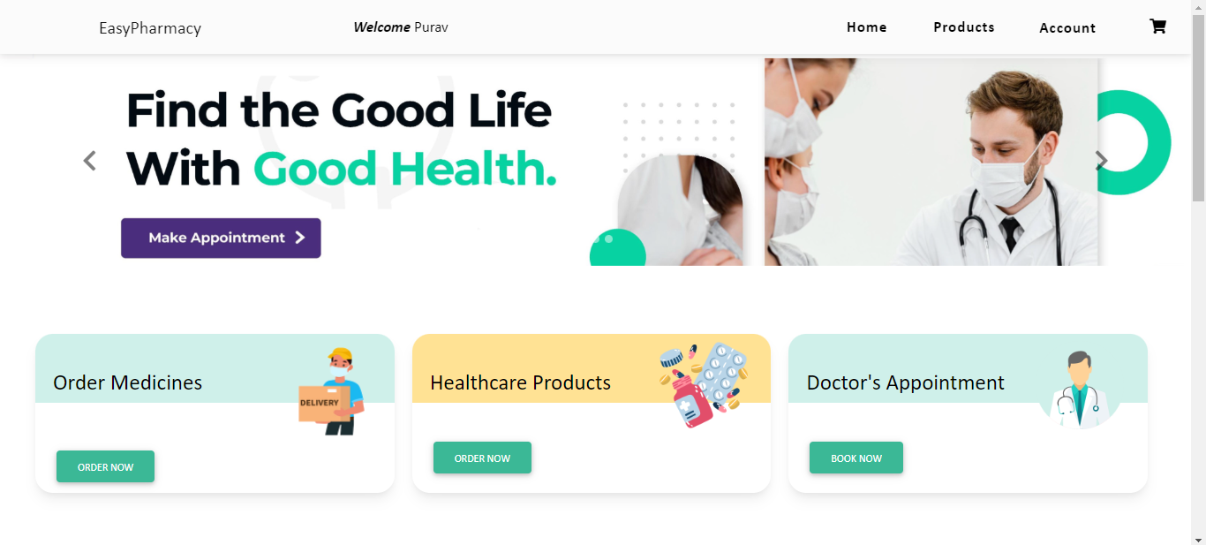

Slide 7
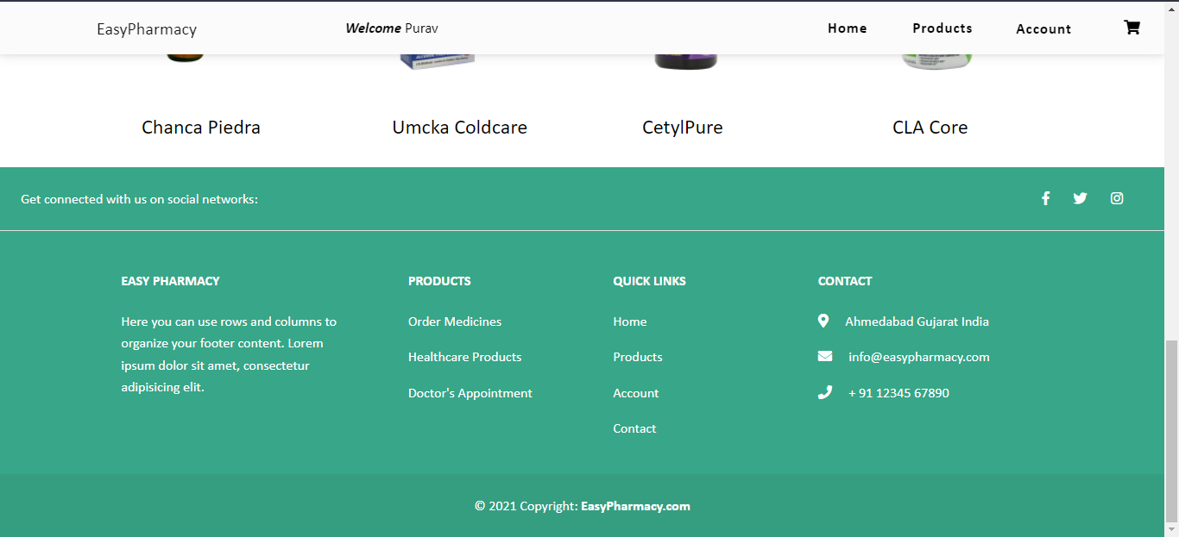

Slide 8
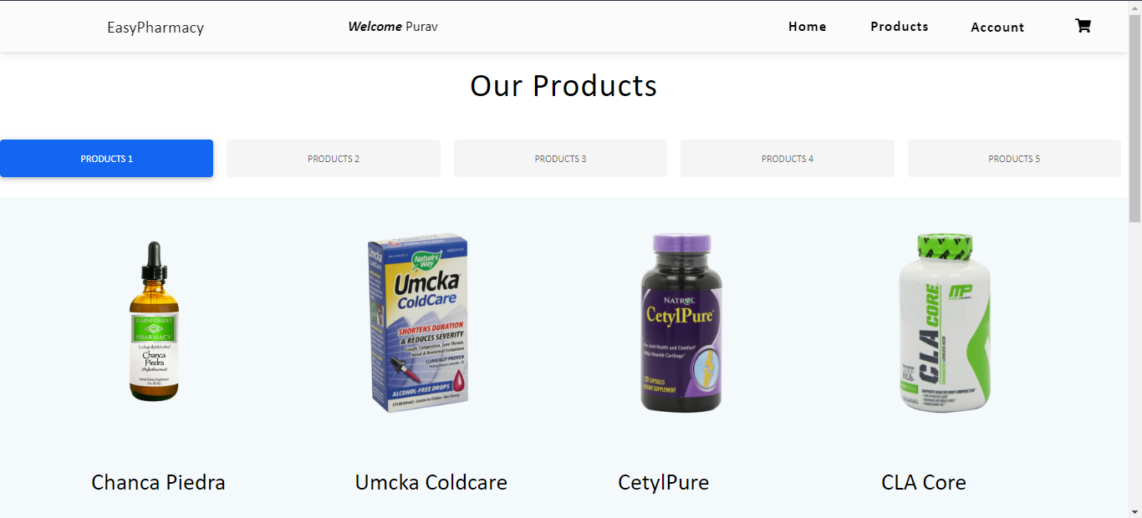

Slide 9
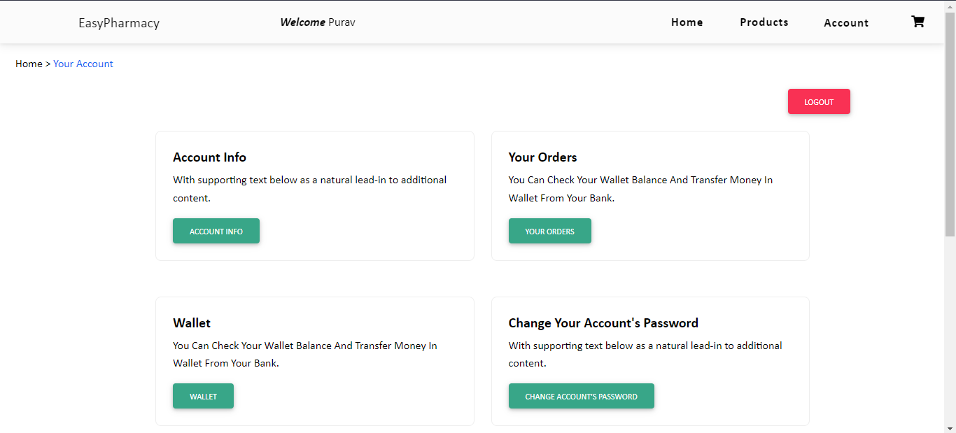

Slide 10
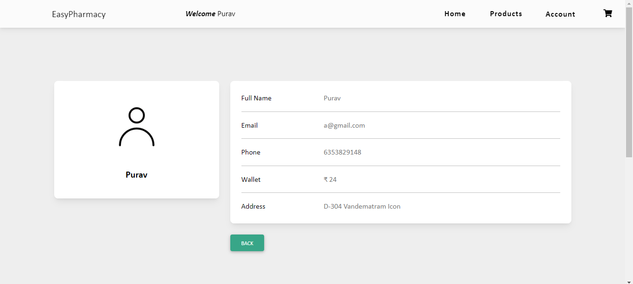

Slide 11
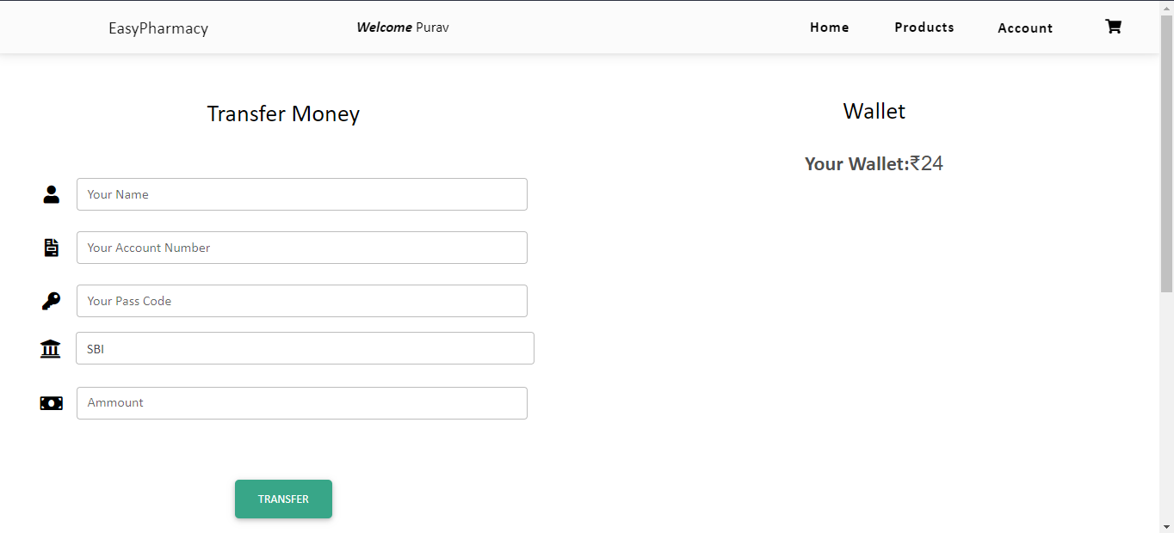

Slide 12
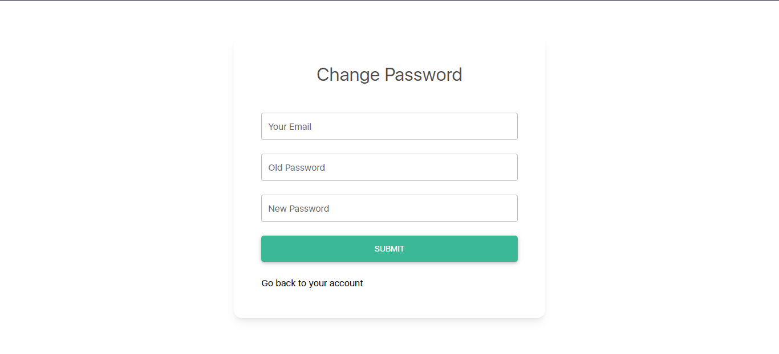

Slide 13
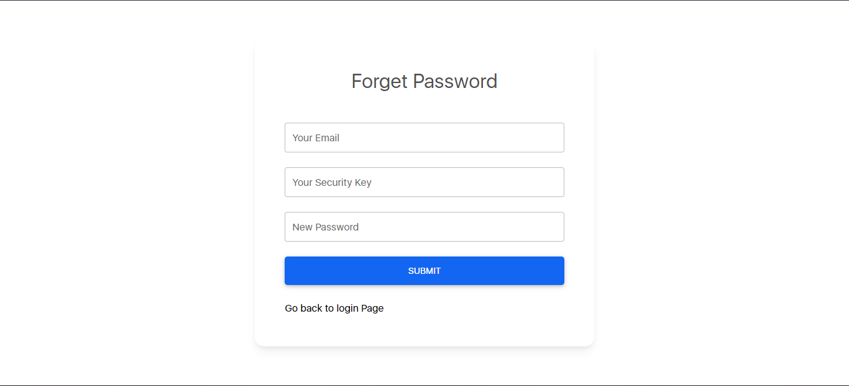

Slide 14
Process Flow Diagram
Click Here To See:
https://drive.google.com/file/d/1Eksv9YB9IDAbbgvSebWkgByAMW3dEZJK/view?usp=sharing

Slide 15
Conclusion
Our project conclusion is to make patient and doctors interaction in a much easier way. With the help of online interaction doctor patient transportation cost will be null. Also our goal is to supply every medicines and medical related product in a affordable price by giving patient different types of discount.

Slide 16


