Slide 1
HDL implementation of an ASIC testing interface
Professor Luca Bertulessi
Simone Ranfoni - 10934656
PhD candidate Michele Rocco
AY 2024/2025
Computer Science and Engineering Project

Slide 2
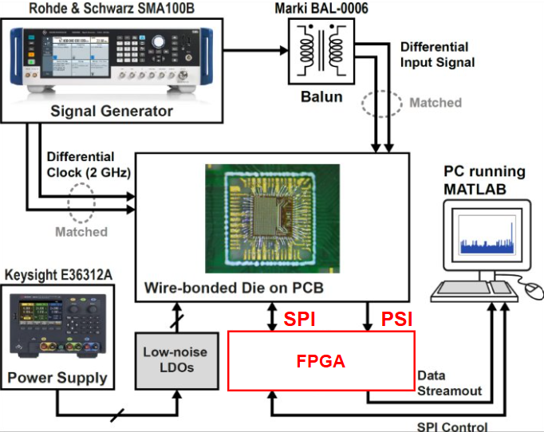
The Core Challenge: A High-Speed Data Puzzle
The Mission: Taming a 500 MHz Data Stream
A groundbreaking chip from Polimi's Electronics Dept. generates data at an incredible 500 MHz – too fast for direct use.
It cleverly uses internal SRAM to buffer data "chunks," streaming them out via a Parallel Stream Interface (PSI) at up to 100 MHz.
The Goal: Develop an FPGA system to reliably:
Configure this chip (via SPI).
Capture every bit of the fast PSI data.
Send it over standard Ethernet for analysis.

Slide 3
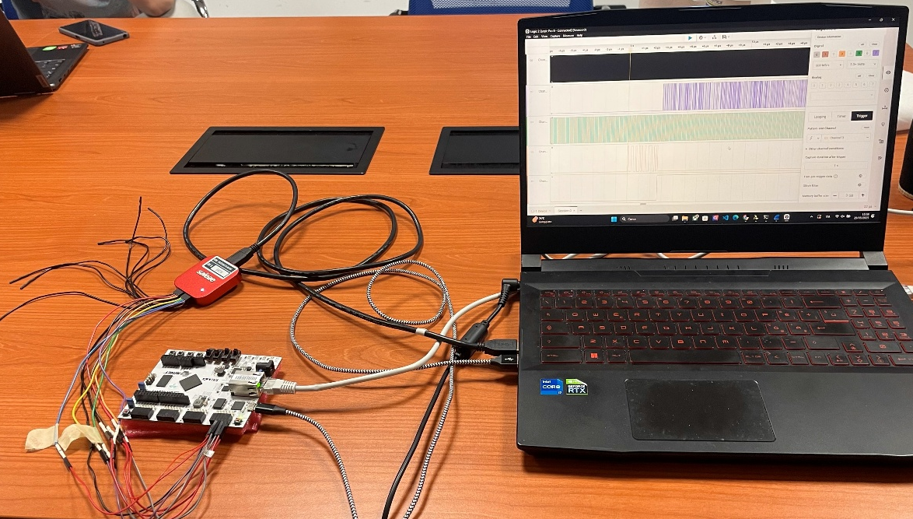
More Than Just an Interface
Key Objectives We Targeted:
Flawless PSI Data Capture: Up to 100 Mbps throughput – no data left behind!
Smart Chip Control: A flexible SPI writer for easy chip configuration.
Rock-Solid Ethernet Link: Ensuring continuous, reliable data for researchers.
Clear Data Insights: Python/MATLAB tools to easily unpack, understand, and visualize the results.
Final test in laboratory with a Saleae logic analyzer.

Slide 4
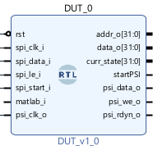
Problem #1: Building for an Invisible Target
The "Phantom Chip" – How Do You Test for What Isn't There?
The actual custom chip wasn't available during the crucial development and testing phases. As a solution, I engineered a VHDL "Mock-up DUT" . This wasn't just a placeholder; it intelligently mimicked key chip behaviors:
It "listened" for specific SPI commands (like address '50’).
It then "pretended" to start the PSI data stream, just like the real chip would.
Vivado block design view of the DUT. Ports used both for debugging and communicating with other entities.

Slide 5
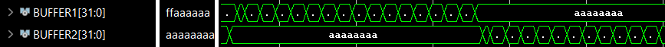
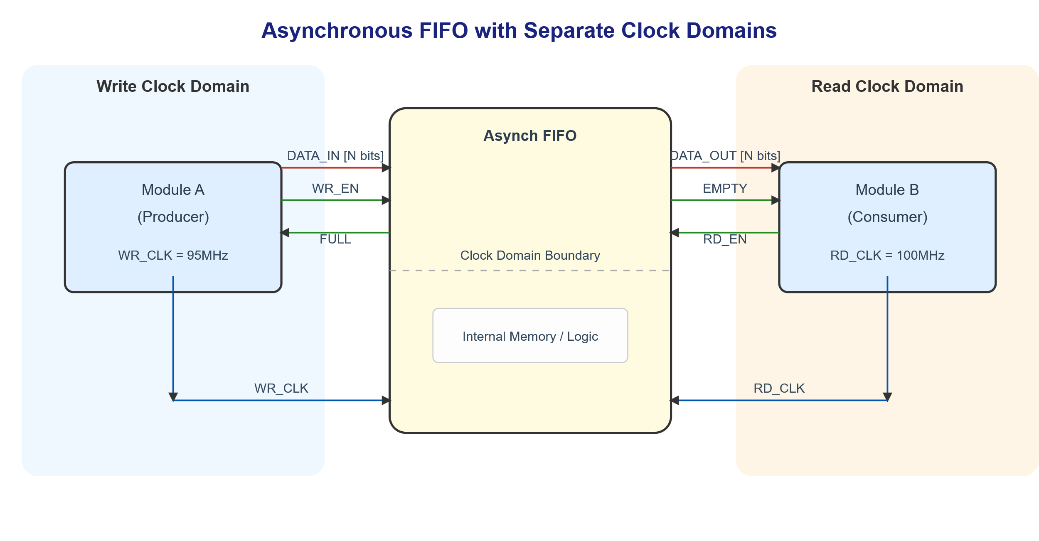
Problem #2: The 100 Mbps Data Deluge
PSI to Ethernet: Not Losing a Single Drop!
The Hurdle: Continuously capturing PSI data words arriving every few nanoseconds (up to 100 MHz) and seamlessly preparing them for Ethernet without dropping data or creating a traffic jam.
A section of the simulation highlighting the behavior of the two buffers.
My Multi-Layered Solution:
Lightning-Fast Reflexes (Dual Input Buffers): Inside the AXI_interface_PSI, two 32-bit buffers worked in a "ping-pong" fashion, one filling while the other offloaded, ensuring no incoming PSI bit was missed.
Bridging Two Worlds (CDC FIFO): A dedicated FIFO safely passed these assembled 32-bit data words from the potentially fluctuating PSI clock speed to the steady 100 MHz AXI system clock.

Slide 6
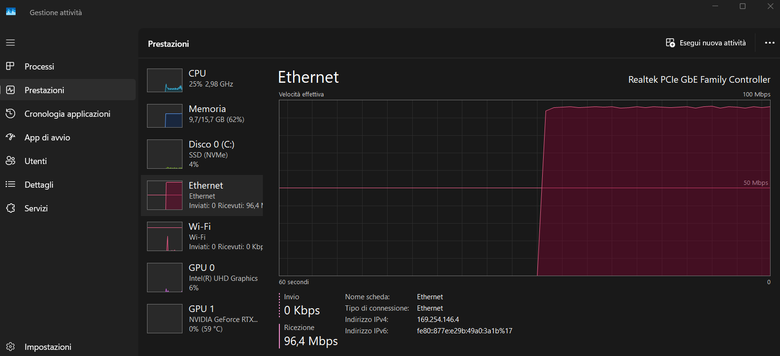

Problem #3: Hitting Nearly 100 Mbps on Ethernet
The Hurdle: Standard Ethernet operations can have overhead. How could I ensure the FPGA fed the Ethernet IP core fast enough to get close to the 100 Mbps network limit?
True Parallel Processing (AXI Ethernet Lite "Ping-Pong" Buffers): I didn't just use one Ethernet transmit buffer; I programmed the AXI_interface_PSI to intelligently write to two alternating transmit buffers within the Ethernet IP core.
The Impact? Massive Speedup! While one packet was physically being sent over the wire, the FPGA was already busy filling the next packet in the alternate buffer. This eliminated critical wait times.
Getting Bytes in Order (Endianness): I also meticulously ensured the byte order within data words was correct for the PC to interpret seamlessly.
The Result: clocked a stable ~98 Mbps throughput in continuous "freerun" mode – a testament to this optimization!

Slide 7
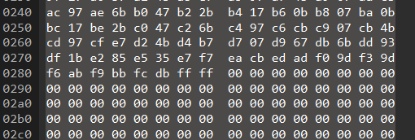
Problem #4: The "Last Packet"
No Data Left Behind: Solving the Partially Filled Packet.
What happens when the PSI data stream (a "chunk" from the chip's SRAM) ends, but the current Ethernet packet (e.g. 1400 bytes) isn't full? We can't leave data stranded or wait forever!
A Timeout Solution:
The AXI_interface_PSI kept an eye on the FIFO. If it stayed empty for a brief, defined period (127 AXI clock cycles) after data had been flowing, it signaled "time's up!" for the current data chunk.
The system then smartly finalized the current Ethernet packet – even if only partially filled – and sent it on its way.
Proof in the Packets: I deliberately tested with a dataset perfectly sized to demonstrate this: larger than one packet, smaller than two. The Python script received two packets, the second correctly containing the remainder followed by padding.
A slice of the second ethernet packet sniffed with WireShark and filled with zeros.

Slide 8
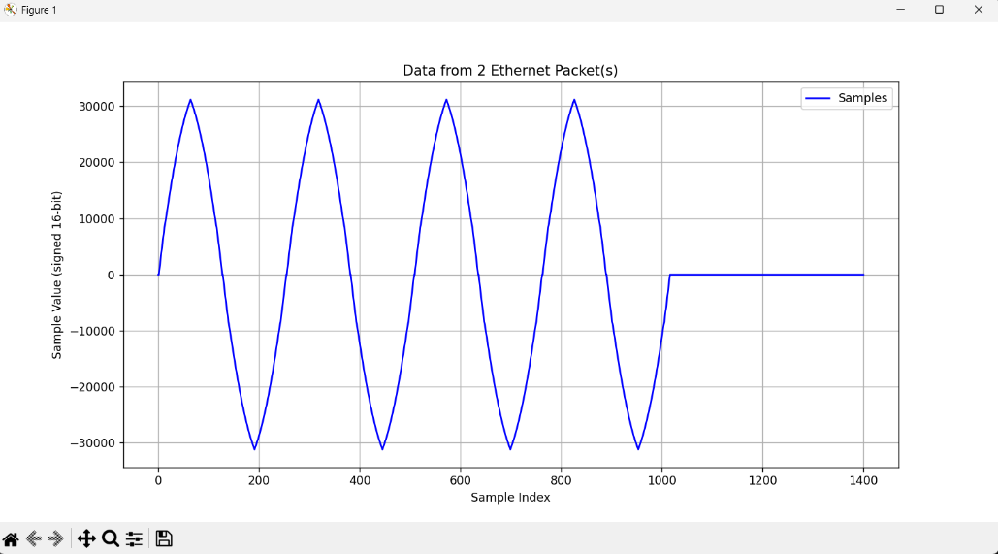
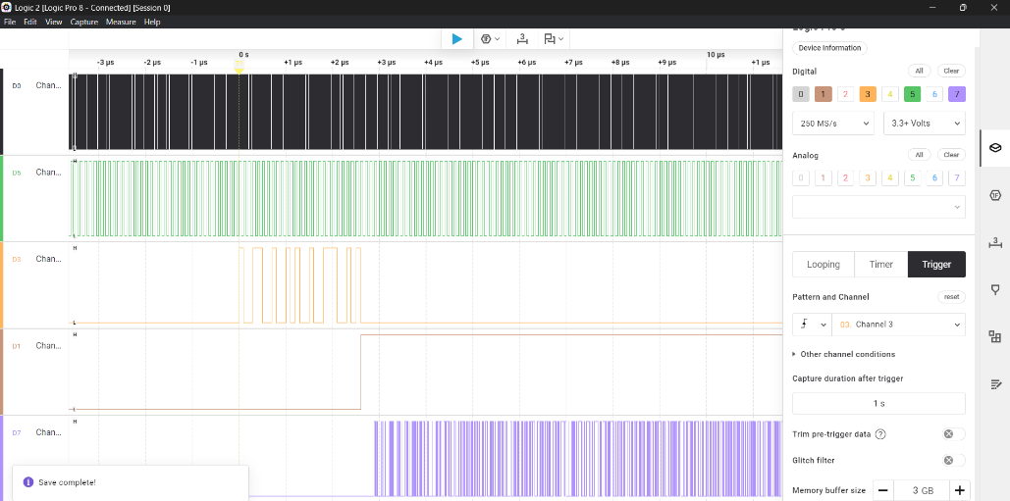
Final tests
A Multi-Angle Verification
Python ‘‘sniffer’’ (sniff.py): I wrote a script that captured live Ethernet packets sent by the FPGA, checking their origin (MAC address), and carefully extracting the precious data payload.
Visual Confirmation (Matplotlib): The extracted 16-bit data samples were plotted, beautifully re-creating the 4 periods of the test sine wave – a clear sign of end-to-end success!
Wireshark let us inspect every header and byte of the packets.
A Saleae Logic Analyzer showed us the real-time electrical signals on the FPGA pins, confirming SPI commands were read before the PSI stream began, exactly as designed.
Sinusoid plotted by the python script, including the final zeros of padding.
Saleae Logic Analyzer mesurements.

Slide 9

The Wins: Performance & Innovation
Key Achievements Unlocked:
Blazing Speed: Flawless capture of 100 MHz PSI data and approximately 98 Mbps Ethernet delivery.
Data You Can Trust: Confirmed end-to-end data integrity.
Built for Flexibility: Soft-programmable SPI for future chip interactions.
Perfect integration: Efficient and nearly invisible FIFO operations and AXI transaction parametrized by packet length.
User friendly result interpretation: Intelligent handling of the final data packet and clear display of results.

Slide 10
Looking Back & Forward: A Rewarding Journey
It has been a genuine pleasure to be part of this project. It offered a fantastic opportunity to explore the new and exciting world of hardware – an experience I might otherwise have never encountered.
Witnessing the results after overcoming numerous challenges and obstacles has been incredibly gratifying and highly motivating.
This project was a deep dive into serious hardware design – from the drawing board to high-speed reality. The thrill of optimizing for nanoseconds and synchronizing complex systems was immense!
Sincere Thanks To:
Professor Luca Bertulessi for this incredible opportunity and insightful guidance;
PhD Candidate Michele Rocco for invaluable support, discussions, and technical expertise throughout this journey.

