Slide 1

Smart Bill Boards
sovereigns

Slide 2
MAIN CONTENT Of BILLBOARD :
Bill Boards are just nothing but posters or advertisements.
Normally Posters are not so much attractive to the products, so the companies brings new advertising method called Smart Billboards
Which is used to communicate with people about the product in live.

Slide 3
SMART BILL BOARDS…
Smart Billboard also known as hoarding it is a large outdoor advertising structure typically found in high traffic areas and busy roads.
Billboards typically shows large with slogans and distinctive visuals.
Billboards are generally placed on highways, expressways where they command high density consumer exposure.
Poster is also a form of billboard advertising. viewed principally by residents and commuter traffic, with some pedestrian exposure.

Slide 4
BILL BOARDS
Billboards have been around since 1794.
The first one to be displayed was in 1889 in a Paris Exposition.
By normal Bill boards products are not attractive.
For cigarette ads they created bill boards
Now in 2007 cigarette ads can no long be on outside ads within the USA.

Slide 5
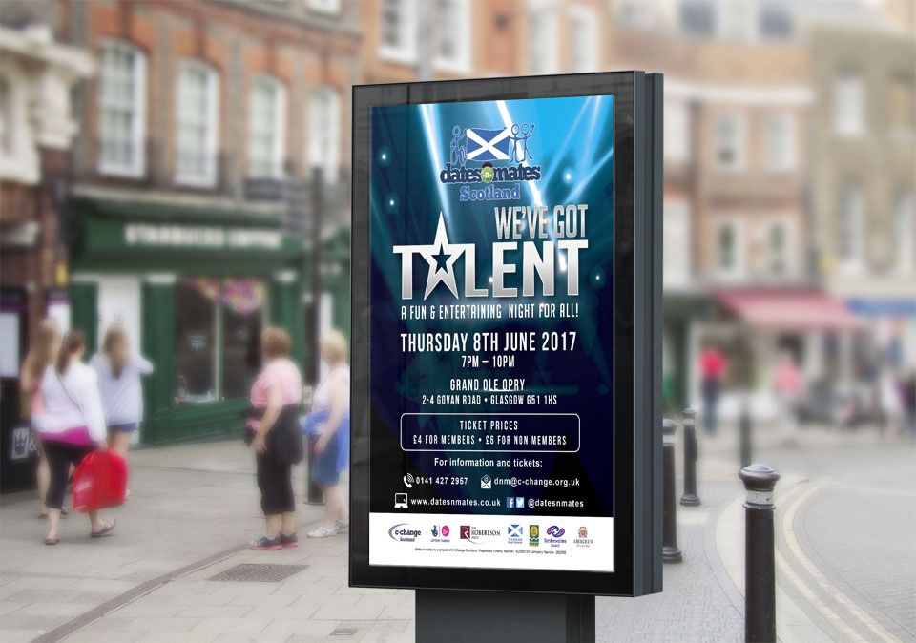
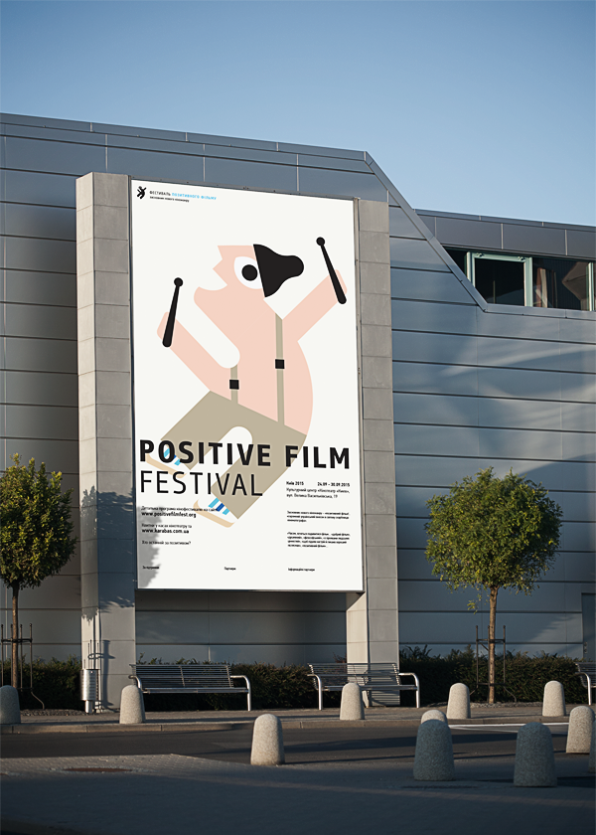
These are the Examples of smart bill boards :

Slide 6
Hardware & softwarwe
Hardware :
Node MCU
OLED
Buttons
Led’s
Software :
Arduino IDE
IBM watson cloud platform

Slide 7
Block Diagram :
NODE
MCU
OLED
LED’S
BUTTONS
MOBILE DEVICE
IBM CLOUD

Slide 8
Description:
Companies can attract the customers by doing advertisements. These smart bill boards will help them in attracting their customers and make their task easier. In this we can upload the required data on the bill board simply by giving inputs through user interface. And we can check the lamps working status which is connected to bill board through the UI.
The data can be entered through user interface which is created in Node Red. We can get the status of the lamps which are connected to the bill boards in the user interface. If any lamp fails we can send notifications to authorities.

Slide 9
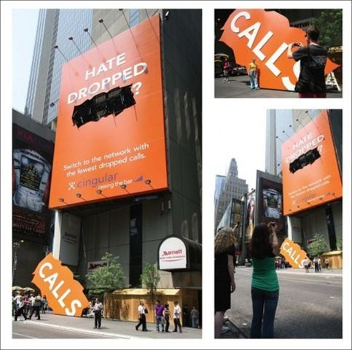
Larger billboards
Always get more
Attention.
Not only do they stand
Out more but the color and]
The creativity of the work
Gets people looking
more

Slide 10
ADVANTAGES :
They are highly successful at capturing people's
attention from a distance because of their huge size.
They are placed along highways and busy streets,
you'll be guaranteed that people will see your advertising
Billboard advertisements normally stay up for a set
period of days or weeks, so people will easily memorise.

Slide 11
DISADVANTAGES :
Messages Must Be Brief
Text must be brief because billboards placed by the roadside must only have less than a paragraph of text
Long-term Commitment
Billboard companies often have businesses enter
into contracts that involve long-term commitments this is because it takes a lot of time, energy and money to constantly change billboard ads.

Slide 12
conclusion OF TOPIC :
Hereby I conclude that media is a main part of communication and management system And its also using in our daily life. And there is no such universally accepted advertising medium which can be
considered best for all types of companies and every type of companies and every type of product/service.

Slide 13

Thank you
For being interested in our topic

