Slide 1

ReproAgent
AI-Powered Bug Investigation
& Reproduction
Run more. Capture more. Understand failures faster.
HUMAN-GUIDED
CHROME-FOCUSED
EVIDENCE-DRIVEN
Team Name: Team2Primary
Team Captain:
Gantantra Agrawal
Captain Email:
gantantra.agrawal@99acres.com
Team ID:
216 | Team Member: gantantra.agrawal@99acres.com
PROTOTYPE: ALMOST COMPLETE • CURRENTLY UNDER TESTING
Notes:
[Sources]
- Visual on this slide was generated with Microsoft Copilot.
[/Sources]

Slide 2
THE PROBLEM AND OUR ANSWER
Idea Summary
Intermittent web bugs are expensive to investigate because the evidence is scattered across repeated browser sessions, console logs, network traffic, screenshots and human memory.
ReproAgent enables QA engineers to describe or record a suspected Chrome flow, approve intelligent variations, and run each case repeatedly in controlled desktop or mobile-emulated sessions. For every run, the agent captures authorized client-observable evidence, including actions, console events, network activity, DOM state, screenshots, video and timing. DeepSeek then compares passing and failing sessions, highlights probable triggers, measures reproduction frequency, and helps reduce long sessions into concise reproducible steps and static Playwright tests. Human approval remains mandatory before execution, failure classification and final reproduction. The result is faster triage, stronger coverage and developer-ready defect reports without requiring QA to manually correlate every signal.
Not another test generator. An intelligent browser investigation agent.
Notes:
[Sources]
- Visual on this slide was generated with Microsoft Copilot.
[/Sources]

Slide 3
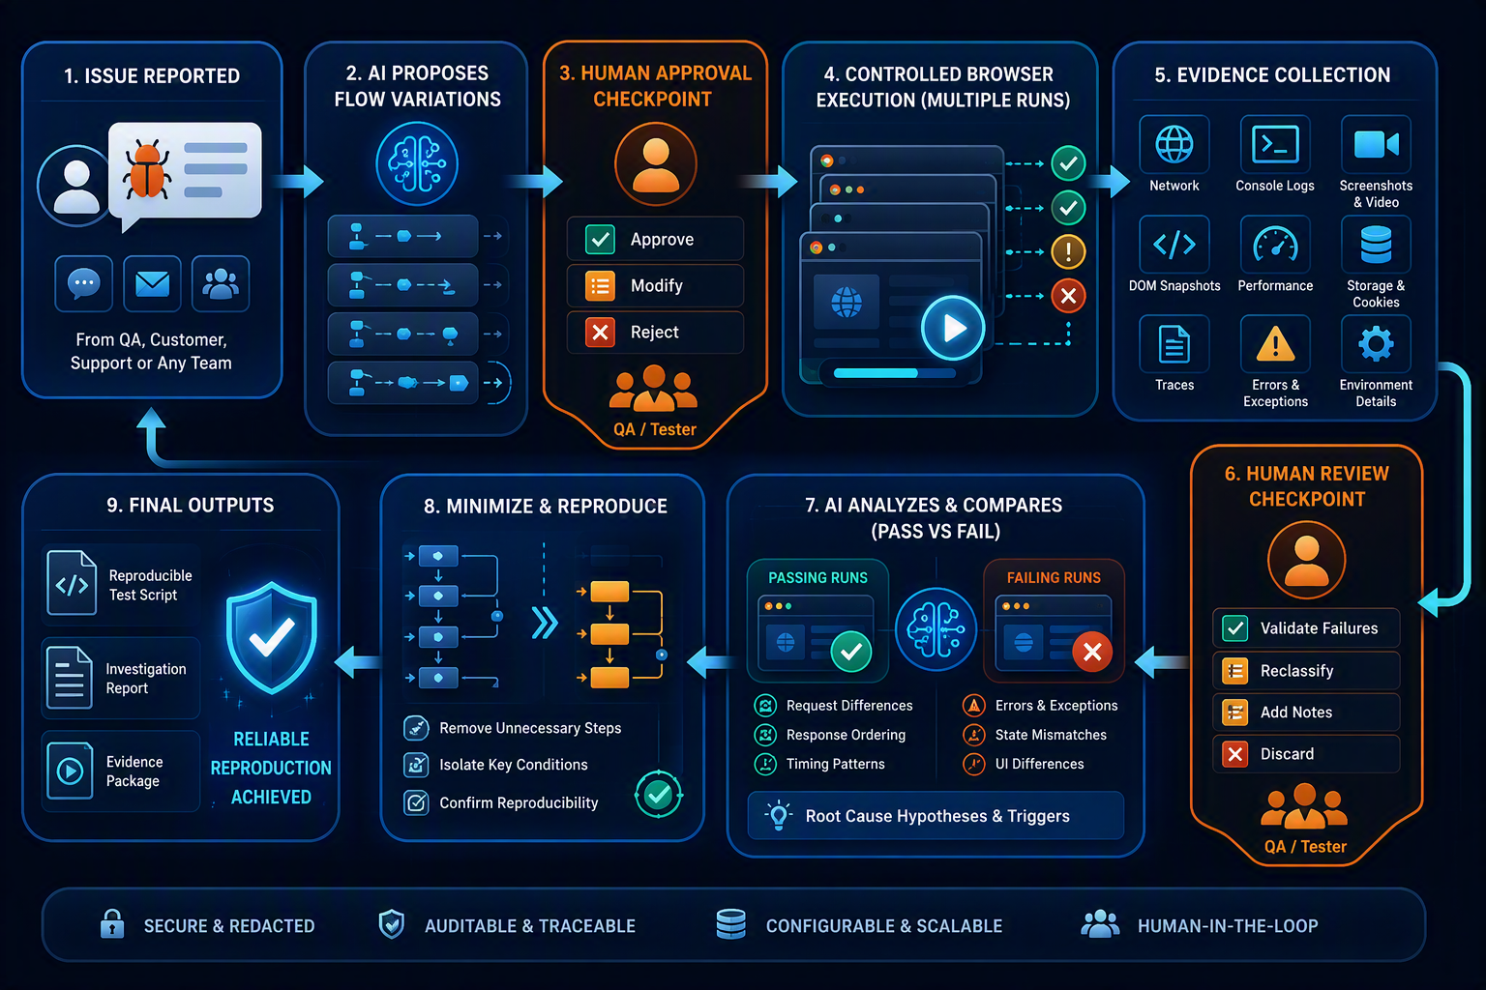
HUMAN-GUIDED AGENT WORKFLOW
How?
1
Issue intake
QA, customer or another authorized team reports the flow, expected result and observed symptom.
2
Plan + approve
DeepSeek proposes ranked variations. QA approves none, some or all.
3
Execute + capture
Playwright runs controlled Chrome sessions and preserves redacted evidence per run.
4
Review failure
AI clusters outcomes. QA approves the target failure signature and relevant runs.
5
Repeat + analyze
Approved cases run at configured frequency; deterministic metrics compare pass vs fail.
6
Minimize + export
Agent reduces steps, revalidates, and creates Playwright reproducer plus Jira-ready report.
Notes:
[Sources]
- Visual on this slide was generated with Microsoft Copilot.
[/Sources]

Slide 4
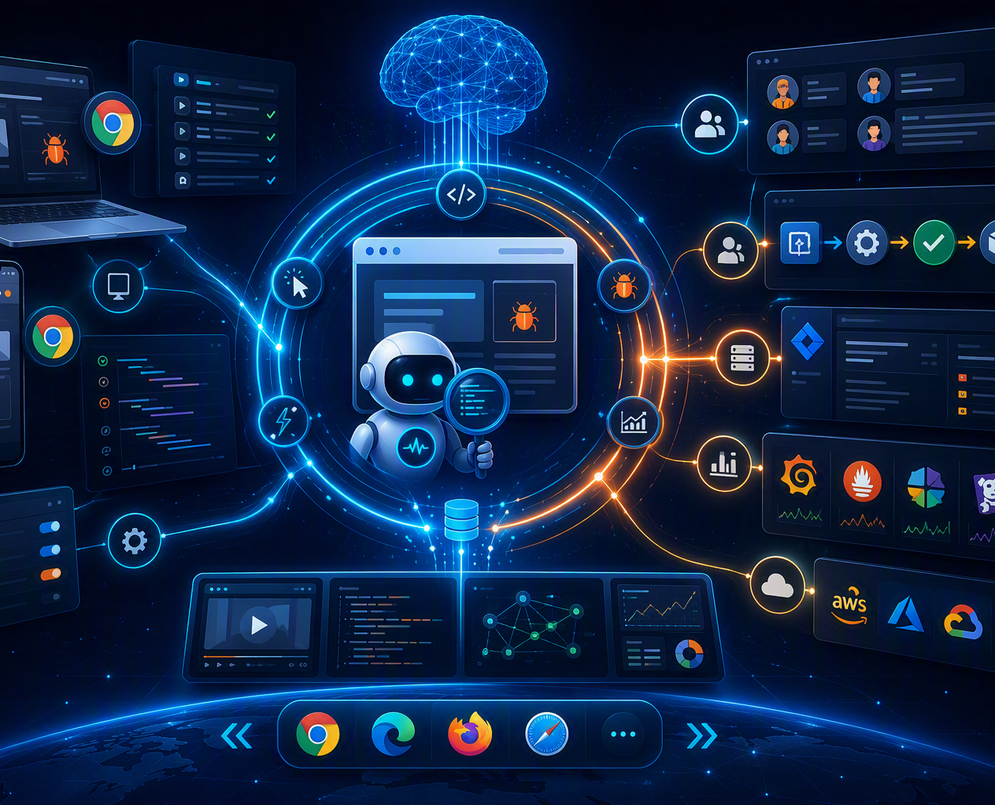
WHY IT MATTERS
Impact
Faster first-level investigation
AI reviews repeated session evidence and surfaces the differences most associated with the reported failure.
Broader repeat coverage
QA can run approved flows at configurable frequency across desktop and mobile-emulated Chrome profiles.
Stronger developer handoff
Every defect package contains steps, occurrence counts, timelines, evidence references and a reusable Playwright test.
INITIAL PILOT
Up to 20 QA engineers
Measure: investigation time • useful reproductions • evidence completeness • report quality
Notes:
[Sources]
- Visual on this slide was generated with Microsoft Copilot.
[/Sources]

Slide 5
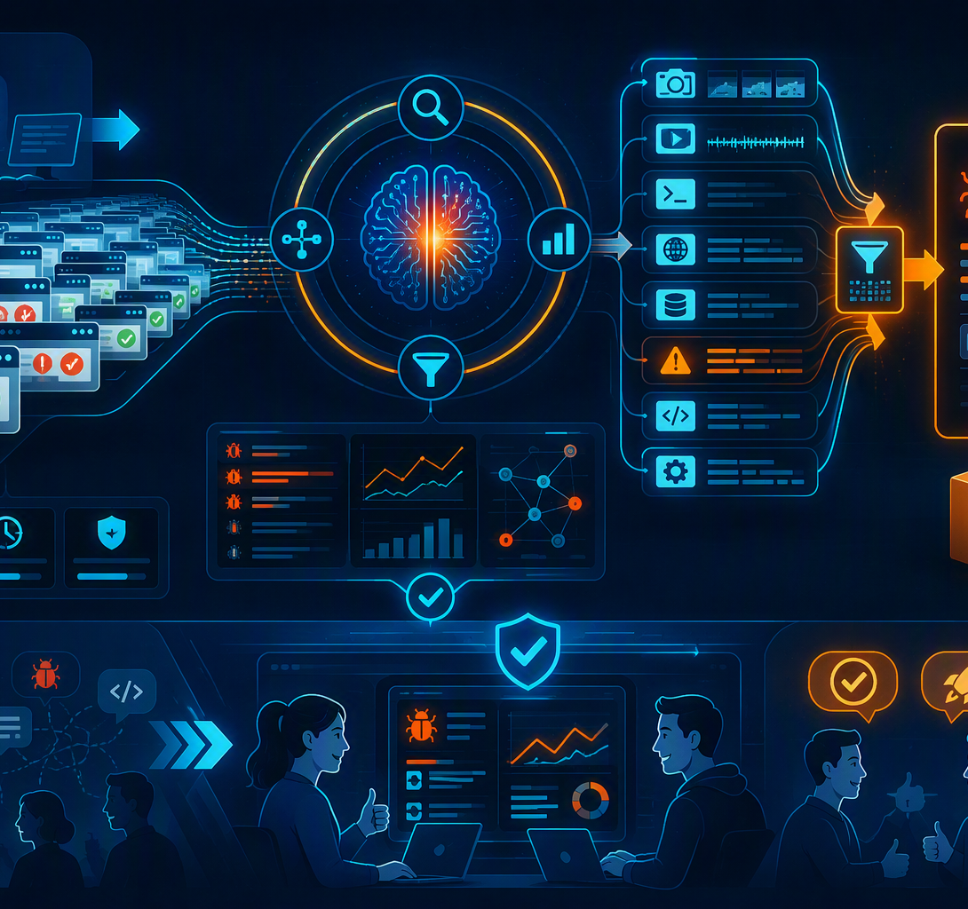
FROM LOCAL INVESTIGATOR TO TEAM CAPABILITY
Future Potential
NOW
Reliable local CLI
Chrome desktop + mobile emulation, repeated execution, client-observable evidence, DeepSeek analysis, human approvals.
NEXT
Team workflow
Shared UI, role-based access, reusable investigation templates, Jira creation and CI-triggered revalidation.
SCALE
Connected evidence
Optional tracing and observability adapters using browser-exposed request IDs, plus larger worker pools.
EXPAND
Wider coverage
Additional Chromium profiles, browser engines and real-device execution after separate reliability validation.
Scale only after deterministic reliability and AI evaluation gates pass.
Notes:
[Sources]
- Visual on this slide was generated with Microsoft Copilot.
[/Sources]

Slide 6
DETERMINISTIC EXECUTION, BOUNDED AI INTELLIGENCE
Technology & Architecture
CONTROL PLANE
EXECUTION + EVIDENCE
INTELLIGENCE PLANE
✓
Local TypeScript CLI
✓
Playwright + Chromium / CDP
✓
DeepSeek API through LlmProvider
✓
Three checksum-bound approval gates
✓
SQLite WAL + durable job table
✓
Versioned AI flow artifacts
✓
Versioned configuration + schemas
✓
Local artifact store + SHA-256
✓
Read-only evidence tools
✓
Immutable investigation lineage
✓
Redaction, normalization + metrics
✓
Schema + reference validation
Playwright produces evidence • Deterministic software measures it • DeepSeek interprets it • Humans approve consequential transitions
Notes:
[Sources]
- Technology choices reflect the proposed standalone MVP architecture supplied by the user.
[/Sources]

