Slide 1
Predictive Analytics for medlink data
WiTWORKERS

Slide 2
motivation
Medlink’s vision is providing low cost health care to everyone.
Data centric approach
To find the most critical social and economical features that keeps patient’s from visiting health centers

Slide 3
dataset
Zip code mapped with NPA
Users’ income data
Rental house data
Education
Population
Housing
Transportation
People using Medlink services for the particular zipcode

Slide 4
Random forest algorithm
Predicts the number of users that should be visiting the health care center every month
Gives the key features that could be utilized to overcome the socio-economical issue
Explains the variance

Slide 5
Tensor flow algorithm
Predictive model leveraging deep learning capabilities.
Predicts the potential number of people that could use the Medlink’s services.
With error rate of 0.0013, the model performs very well even with less data.

Slide 6
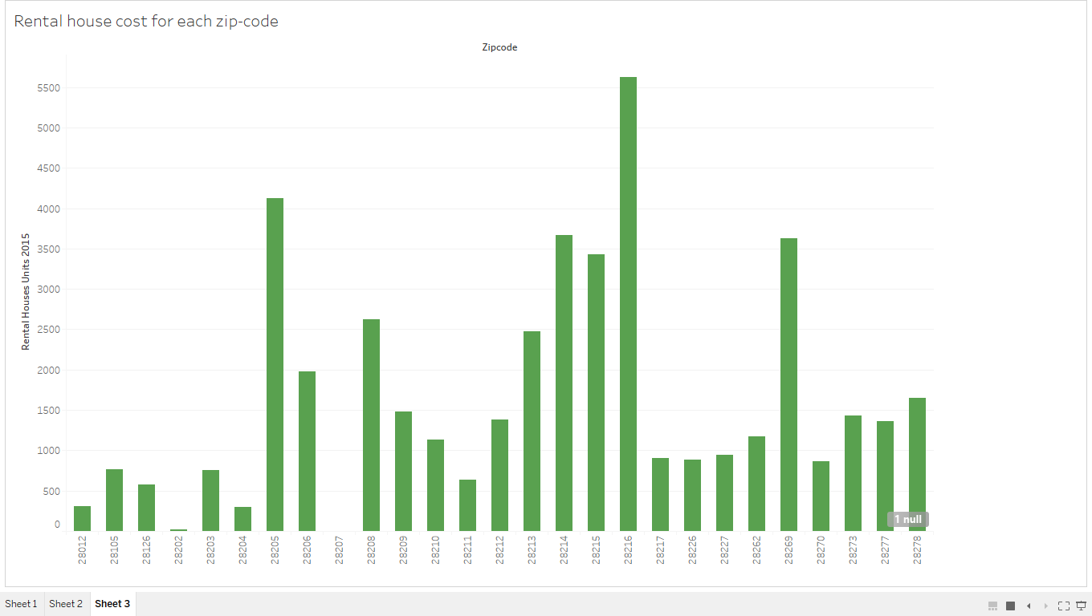
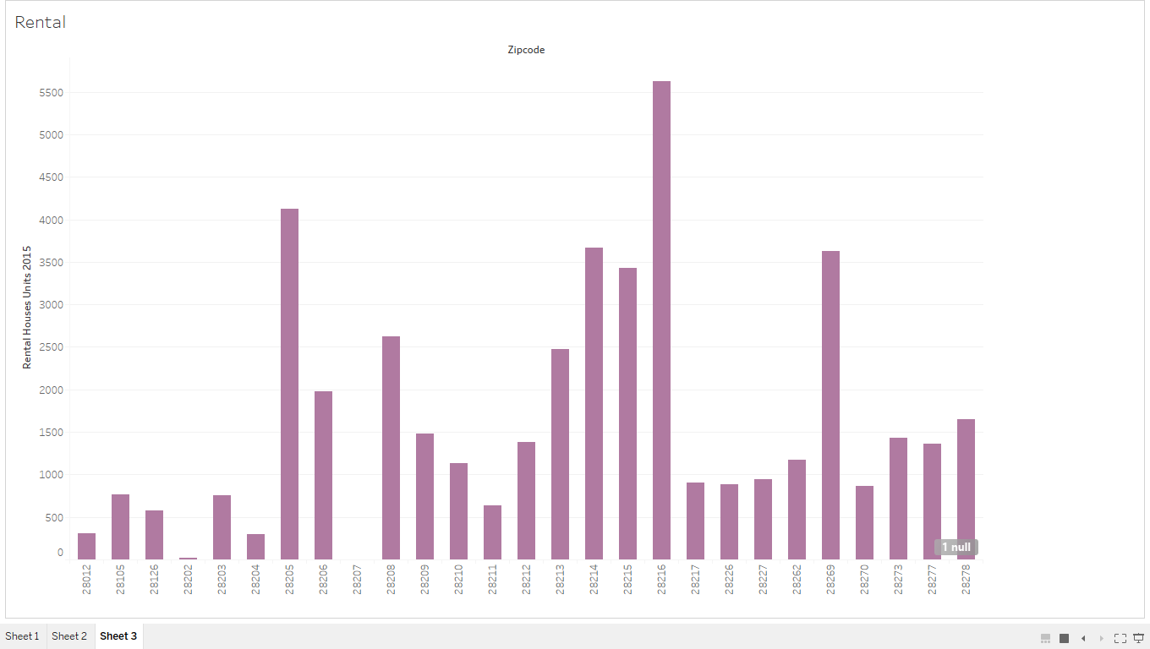
analysis

Slide 7
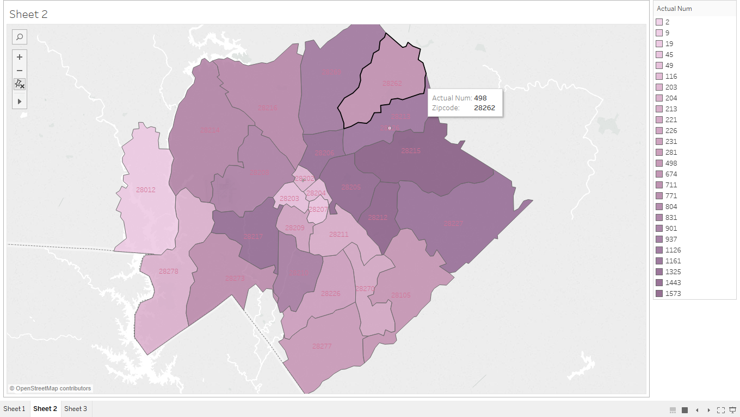
..analysis

Slide 8
Key Features Identified:
Income
Education
Housing

Slide 9
Conclusion
A scalable model that identifies key factors affecting the use of Medlink’s services
Predicting the pattern of visitors to Medlink’s clinics based on economic factors.

Slide 10
Thank you

