Slide 1

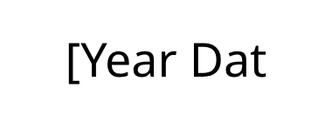

Process
Documentation

Slide 2
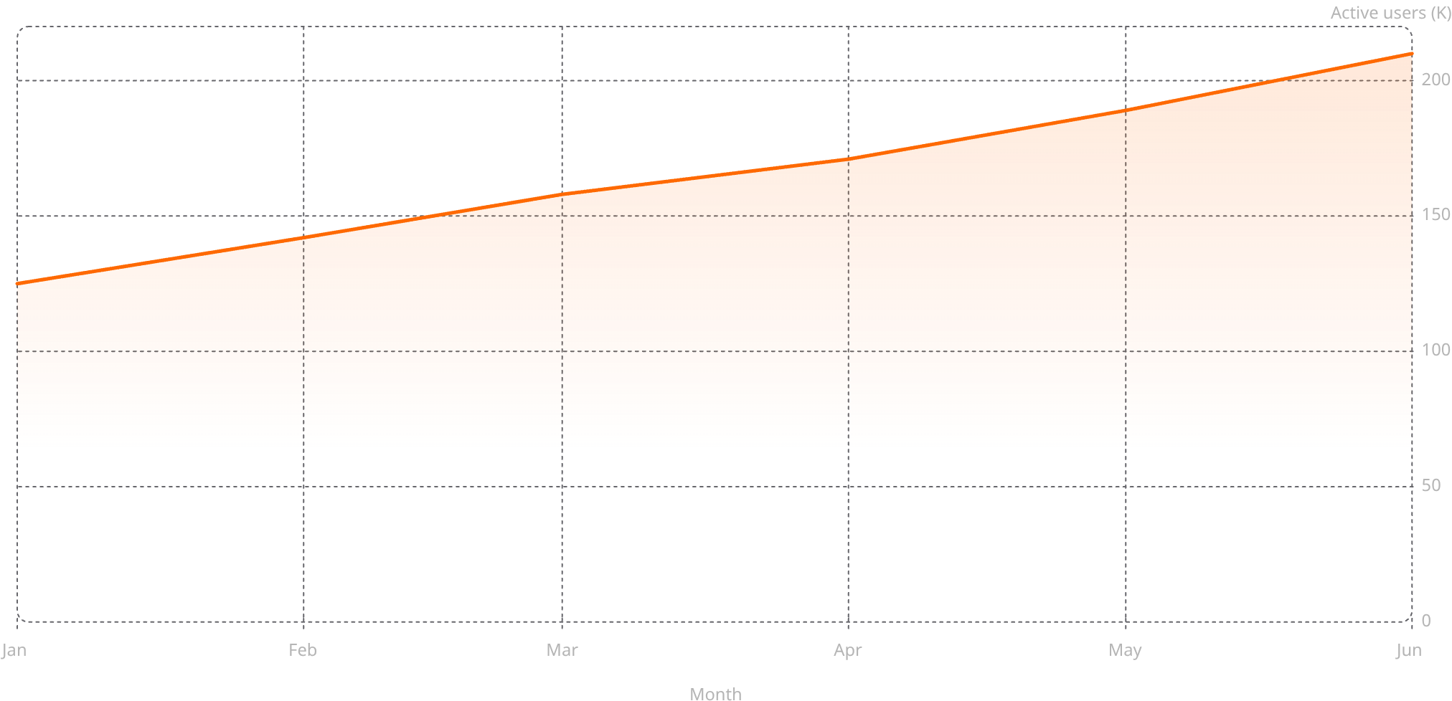
Why Process Documentation Matters
Clear documentation is the foundation of operational efficiency. Well-documented processes reduce errors, accelerate onboarding, and ensure consistency across teams.
Faster Onboarding
With documented processes
Error Reduction
Through standardization
Knowledge Retention
Improved information preservation

Slide 3



Key Stakeholders
Process documentation serves multiple audiences across the organization, from new hires learning procedures to managers optimizing workflows.
"Having clear documentation made my first month so much easier. I could find answers without constantly asking questions."
— New Team Member
"When processes are documented, we can identify bottlenecks and make improvements based on data, not guesswork."
— Operations Manager

Slide 4

Our Documentation Portfolio
Our robust documentation framework spans three essential categories, each tailored to empower our teams, streamline operations, and ensure consistent excellence.
Standard Procedures (SPs)
Essential for consistent daily operations and routine tasks.
In-Depth Reference Guides
Comprehensive resources for navigating complex projects and advanced functions.
Critical Incident Protocols
Definitive steps for managing high-priority situations and urgent responses.

Slide 5



Improvement Strategy
Standard Procedures
Reference Guides
New Categories
25 → 40 processes
15 → 25 guides
0 → 12 documents
Stakeholder interviews: Identify documentation user research
Template standardization: Consistent formats for easier creation
Review cycles: Regular updates with subject matter experts
Accessibility testing: Ensure usability across all user groups

Slide 6


Measuring Documentation Effectiveness
6%
Content Lifecycle & Update Frequency. Our rigorous quarterly review cycle ensures all documentation
Total conversion rate
XX$
This, combined with our low maintenance burden, confirms the effectiveness of our well-designed content in meeting critical user needs across the organization.

Slide 7

Value & Benefits
1
2
3
Efficiency Gains
Quality Improvement
Knowledge Preservation
Teams with documented processes complete tasks 30% faster, making documentation the highest-impact productivity investment.
Standardized processes reduce defects and errors by 40%, improving output quality and reducing rework.
Organizations with strong documentation show 50% better knowledge retention during staff transitions and organizational changes.

Slide 8

New Documentation Planned
Three additional documentation types address emerging needs, from cross-functional workflows to specialized procedures and compliance requirements.
1
Phase 1: Cross-Functional Workflows
Documentation covering processes that span multiple departments, ensuring clarity on handoffs and dependencies.
2
Phase 2: Specialized Procedures
Technical documentation for advanced tasks, including detailed step-by-step instructions and troubleshooting guides.
3
Phase 3: Compliance Guidelines
Regulatory and compliance documentation ensuring adherence to industry standards and organizational policies.

Slide 9

Change Management & Adoption
Launching through phased rollout to build user confidence and gather feedback. Goal: achieve 90% adoption across all teams.
Feedback Loop
Support Resources
Training Sessions
Continuous improvement
Help desk and FAQs
Hands-on workshops
Effective change management includes training, ongoing support, and continuous feedback mechanisms to ensure documentation meets evolving user needs.

Slide 10





Goals Summary
Documentation Growth
1
50 → 77 documents
54% increase across all categories
New Categories
2
3 documentation types
Cross-functional, specialized, compliance
Adoption Target
3
90% usage rate
Organization-wide engagement
Quality Standard
4
80%+ satisfaction
Maintaining high user approval ratings

