Slide 1

Customer Behavior
Connecting Finance, People, and Sentiment

Slide 2
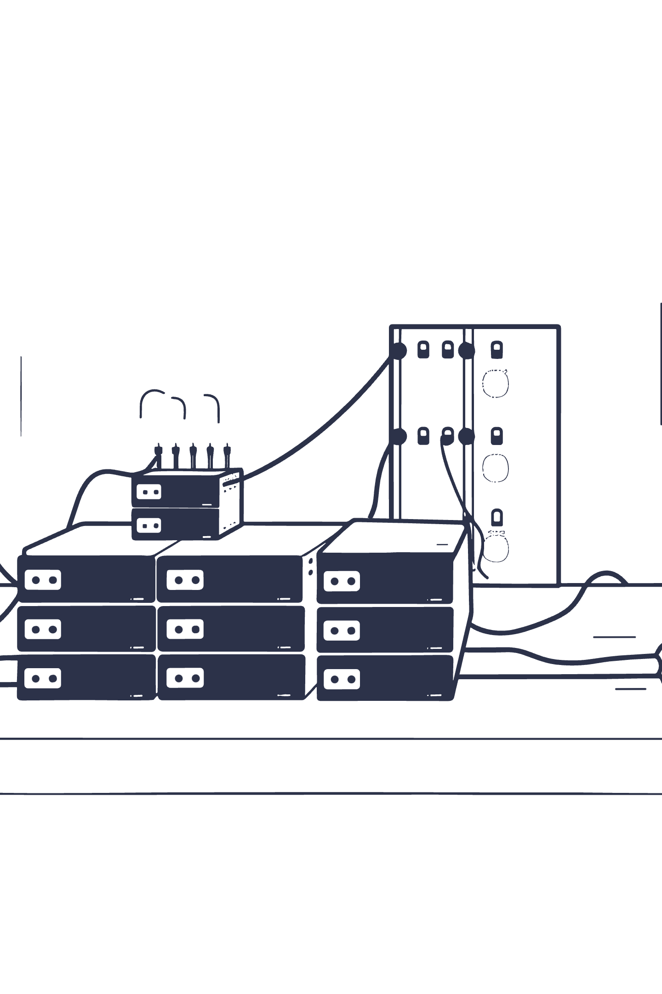
Beyond Standard Reporting
Traditional Approach
Isolated KPIs, disconnected metrics
Overflow Method
Integrated workflow where datasets communicate

Slide 3

The Three-Step Workflow
01
02
03
Ingest Financial Data
Layer Employee Interactions
Apply Sentiment Scores
Establish baseline metrics
Understand human drivers
Quality filter for insights

Slide 4

Step 1
Financial Data Foundation
Baseline Metrics
Data Ingestion
Revenue streams, cost structures, profit margins
Structured financial inputs form the foundation

Slide 5


Step 2
Human Driver Analysis
Employee Interactions
Track engagement patterns and touchpoints
Behavioral Data
Understand what drives performance

Slide 6
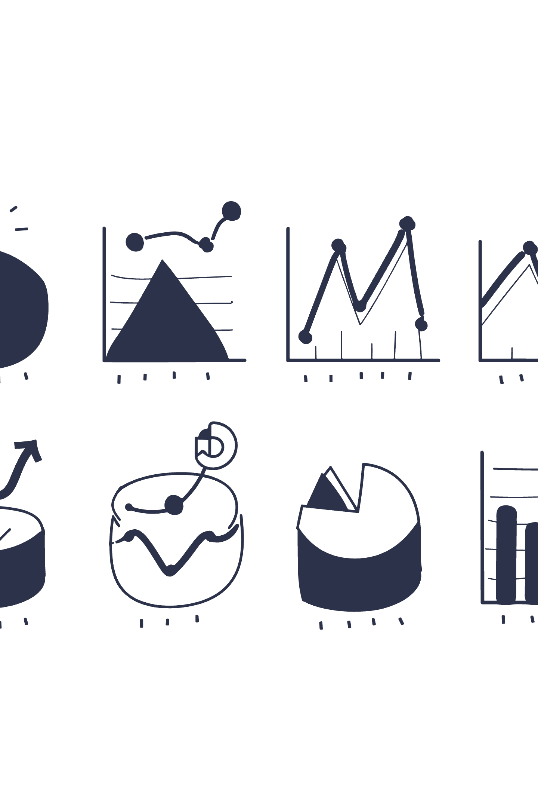
Step 3
Sentiment as Quality Filter
Customer Feedback
Satisfaction scores reveal quality
Sentiment Analysis
Filter signal from noise

Slide 7
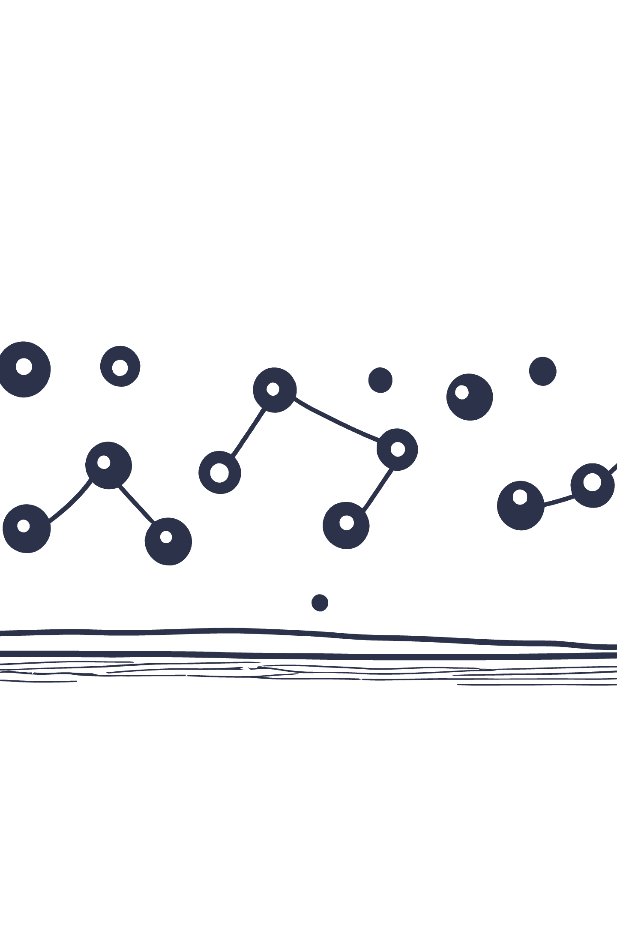



The Powerful Result
Pinpoint exactly who (which employee) is driving what (revenue) and how (customer satisfaction)
Who
Individual contributors
What
Revenue impact
How
Satisfaction levels

Slide 8

From Reporting to Analysis
Standard Sales Report
Behavior Analysis Tool
Correlates behaviors
Numbers only
Dynamic insights
Static view
Actionable intelligence
Limited insight

Slide 9
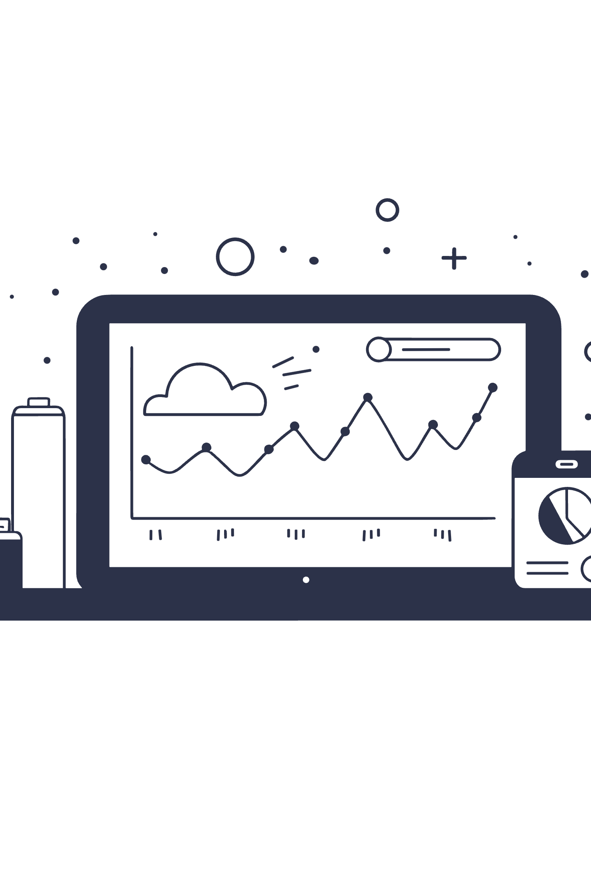
The Correlation Advantage
Stop Reporting Numbers
Move beyond surface metrics
Start Correlating Behaviors
Discover what truly drives results

Slide 10

The Overflow Impact
3
1
Data Layers
Unified View
Finance, People, Sentiment integrated
Complete picture of performance drivers
When distinct datasets communicate, insights overflow.

