Slide 1

Air Quality
Analysis
DATA ANALYTICS
Using Beijing Multi-Station Dataset
12 Monitoring Stations · 420,768 Records · 2013–2017 · PM2.5 / PM10 / SO₂ / NO₂ / CO / O₃
Source: Royal Society Publishing – Cautionary Tales on Air Quality in Beijing
Analyzed by: Ganuke Perera

Slide 2
DATASET OVERVIEW
About the Data
Source & Context
12
420,768
Source: https://archive.ics.uci.edu/dataset/501/beijing+multi+site+air+quality+data
Stations: 12 air-quality monitoring stations across Beijing
Period: March 2013 – February 2017 (hourly)
Pollutants: PM2.5, PM10, SO₂, NO₂, CO, O₃
Meteorological: Temp, Pressure, Dew Point, Rain, Wind Speed
Analysis Tools: Python · Pandas · Matplotlib · Seaborn
Monitoring Stations
Total Data Rows
6
18
Pollutants Tracked
Total Columns

Slide 3

STEP 2 – DATA CLEANING
Handling Missing Values & Duplicate Check
Missing Values — PM2.5
Duplicate Records Check
Cleaning Steps:
8,739
1.
Datetime index from year/month/day/hour
nulls
detected
Sorted by datetime for time-based fill
2.
3.
interpolate(method="time") applied
4.
bfill().ffill() for remaining edge nulls
0 Duplicates Found
5.
Verified: 0 remaining nulls ✔
Subset checked:
✔ After cleaning: 0 remaining null values confirmed
year · month · day · hour · station

Slide 4
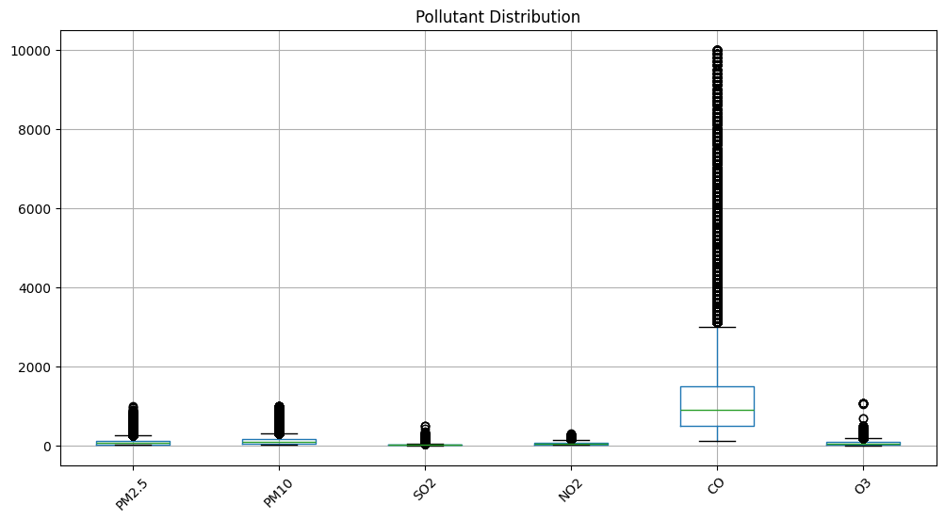
STEP 3 – OUTLIER DETECTION
IQR Outlier Analysis & Boxplot Distribution
IQR Method — PM2.5 Results
Lower Bound:
-116.5
Upper Bound:
247.5
Outliers Found:
19,642
⚠ Interpretation
The IQR method flagged a large number of outliers due to the heavily skewed nature of air pollution data and natural pollution spikes. Percentile-based filtering and domain-specific thresholds are more appropriate as they avoid misclassifying valid extreme pollution events.
Boxplot observations: PM2.5, PM10, NO₂, CO & O₃ show occasional spikes. SO₂ is relatively stable with low spread. CO is highly skewed with extreme values reaching ~10,000 μg/m³.

Slide 5

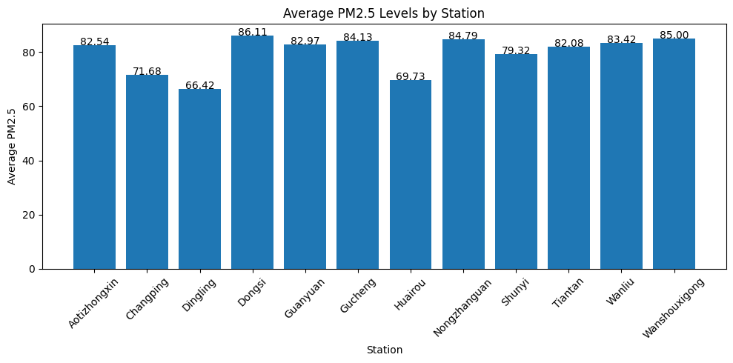
STEP 4 – STATISTICAL SUMMARY
PM2.5 Descriptive Statistics & Station Averages
79.85
55.0
2.0
999.0
81.08
8,739
Mean (μg/m³)
Median (μg/m³)
Min (μg/m³)
Max (μg/m³)
Std Dev
Nulls (cleaned)

Slide 6

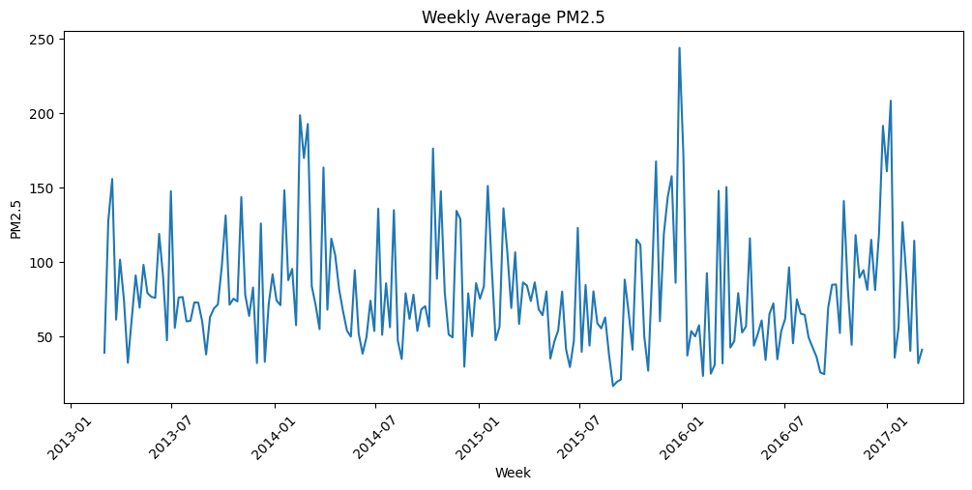
STEP 5A - WEEKLY TREND
Weekly Average PM2.5 Trend (2013-2017)
Conclusion
PM2.5 shows clear seasonal cyclicality across all 4 years. Winter months (Dec-Feb) consistently spike above 150 ug/m3 due to coal heating and atmospheric inversion, while summer months drop to 40-60 ug/m3. Notable extreme spikes appear in late 2015 and early 2016. No long-term improvement trend is visible over the 2013-2017 period.

Slide 7
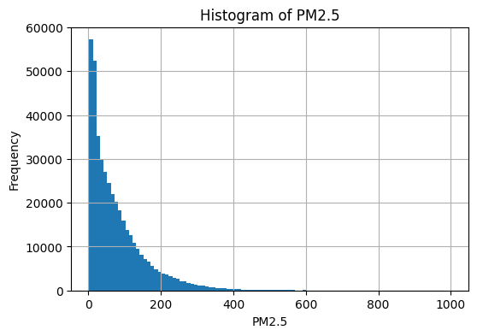
STEP 5B - DISTRIBUTION ANALYSIS
PM2.5 Histogram — Frequency Distribution
Conclusion
The distribution is heavily right-skewed. Most hourly readings fall between 0-200 ug/m3, but a long tail extends to 999.0 ug/m3. The mean (79.85) is significantly higher than the median (55.0), confirming skew from infrequent but extreme pollution events. This skewness explains why IQR-based outlier detection over-flags valid data points as outliers.

Slide 8

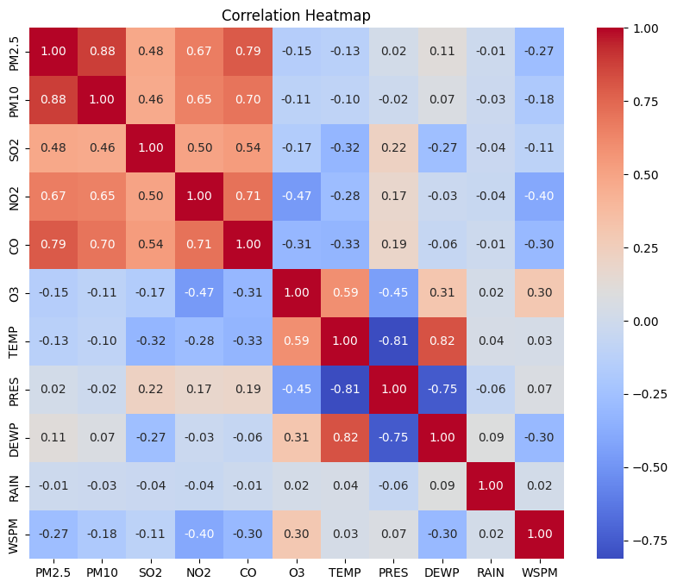
STEP 5C - CORRELATION ANALYSIS
Correlation Heatmap — Pollutants & Meteorology
Key Correlations with PM2.5
PM2.5 / PM10
+0.88
Very strong - shared combustion & dust
PM2.5 / CO
+0.79
Strong - both from combustion sources
PM2.5 / NO2
+0.67
Moderate - traffic & industry overlap
PM2.5 / SO2
+0.48
Moderate - coal burning contribution
PM2.5 / O3
-0.15
Weak negative - photochemical inverse
PM2.5 / WSPM
-0.27
Wind disperses surface pollutants
PM2.5 / TEMP
-0.13
Warmer air reduces stagnant buildup
Conclusion
PM2.5 is most strongly correlated with PM10 (0.88) and CO (0.79), confirming shared combustion and dust sources. Wind speed (-0.27) and temperature (-0.13) show negative correlations - higher wind and warmer conditions reduce accumulation. O3 shows a weak negative correlation (-0.15), consistent with photochemical formation being suppressed by high particle loading.

Slide 9
Thank You !!!
Air Quality Analysis Beijing 12-Station Dataset 420,768 Records

