Slide 1
Data Cleaning &
Visualization Insights
Employee Dataset Analysis Report
Tools: Python • Pandas • Matplotlib • Seaborn • SciPy
Topics: Data Cleaning • Visualizations • Correlation (Pearson) • Outlier Detection

Slide 2
Dataset Overview
The raw dataset contains employee records with various data quality issues that need to be identified and resolved before analysis.
ID | Name | Age | Country | Salary | Join Date
1 | Alice | 25 | NZ | 55,000 | 15/01/2020
2 | Bob | — | NZ | 60,000 | 20/02/2020
2 | Bob | 30 | NZ | — | 20/02/2020
4 | Charlie | 35 | AUS | 72,000 | —
5 | David | thirty-eight | NZ | 68,000 | 1/11/2019
— | Eve | 29 | AU | 59,000 | 2019-13-01
7 | — | 40 | NZ | sixty five thousand | 30/05/2018
8 | Grace | 22 | — | 64,000 | 25/07/2021
9 | Heidi | — | AUS | — | 25/07/2021
10 | Ivan | 27 | NZ | 58,000 | 15/03/2019
⚠ Red cells indicate data quality issues

Slide 3
Data Cleaning Steps
# | Issue Found | Affected Column(s) | Fix Applied | Reason
1 | Semi-duplicate rows (Bob, ID=2): one row has Age, the other has Salary | ID, Name, Age, Salary | Merged rows via ffill().bfill() then kept single record | Duplicate ID with complementary missing values — merging gives one complete row
2 | Text-encoded numbers ('thirty-eight', 'sixty five thousand') | Age, Salary | Used word2number library to convert text → numeric; then pd.to_numeric(errors='coerce') | Numeric columns must contain only numbers for calculations and aggregations
3 | Missing values (NaN) in multiple columns | ID, Name, Age, Country, Salary, Join Date | ID → next available int; Name/Country/Join Date → 'Unknown'; Age/Salary → median | Median prevents outlier skew; 'Unknown' preserves rows without guessing values
4 | Invalid date format ('2019-13-01' — month 13 doesn't exist) | Join Date | Custom fix_date() function: tried standard parse; on failure, swapped YYYY-DD-MM → correct datetime | Standardises all dates to YYYY-MM-DD; avoids silent NaT errors in analysis
5 | Inconsistent country code ('AU' instead of 'AUS') | Country | df['Country'].replace({'AU': 'AUS'}) | Ensures uniform country codes for grouping and aggregation
6 | ID column stored as float (1.0, 2.0 …) due to NaN row | ID | Cast to Int64 (nullable integer) after filling missing ID | IDs are whole numbers — float representation is misleading and wastes memory

Slide 4
Cleaned Dataset — Final Result
All 6 data quality issues resolved. The table below shows the final clean dataset ready for analysis.
ID | Name | Age | Country | Salary | Join Date
1 | Alice | 25.0 | NZ | 55,000 | 2020-01-15
2 | Bob | 30.0 | NZ | 60,000 | 2020-02-20
4 | Charlie | 35.0 | AUS | 72,000 | Unknown
5 | David | 38.0 | NZ | 68,000 | 2019-11-01
7 | Unknown | 40.0 | NZ | 65,000 | 2018-05-30
8 | Grace | 22.0 | Unknown | 64,000 | 2021-07-25
9 | Heidi | 29.5 | AUS | 62,000 | 2021-07-25
11 | Eve | 29.0 | AUS | 59,000 | 2019-01-13
10 | Ivan | 27.0 | NZ | 58,000 | 2019-03-15
= Value was fixed/imputed during data cleaning
* Heidi's Age (29.5) and Salary (62,000) were imputed using the median of the cleaned dataset.

Slide 5
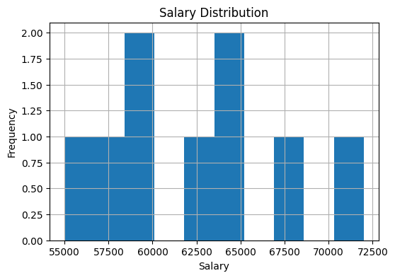
Visualization 1 — Salary Distribution (Histogram)
Key Statistics
Min Salary: NZD 55,000
Max Salary: NZD 72,000
Median: NZD 62,000
Range: NZD 17,000
Employees: 9 records
📌 Conclusion: Salaries are fairly evenly spread between NZD 55,000 and NZD 72,000. The distribution is roughly uniform with no extreme spikes, suggesting the team spans different roles and seniority levels without any single dominant salary band.

Slide 6
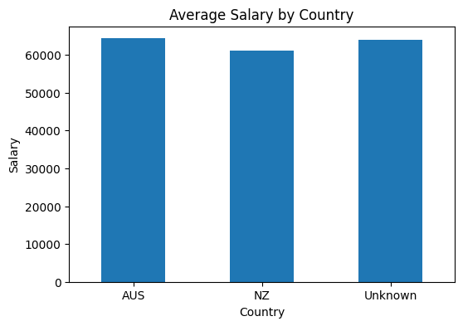
Visualization 2 — Average Salary by Country (Bar Chart)
Average Salary by Country
AUS: ~NZD 66,333
NZ: ~NZD 62,833
Unknown: NZD 64,000
📌 Conclusion: Australian employees earn slightly more on average (~NZD 66,333) than New Zealand employees (~NZD 62,833). The 'Unknown' country category (Grace) falls between the two. The difference may reflect currency, role type, or cost of living adjustments.

Slide 7
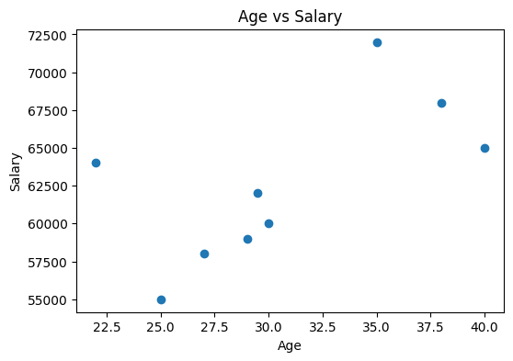
Visualization 3 — Age vs Salary (Scatter Plot)
Observation
Youngest: Grace, 22 → 64k
Oldest: Unknown, 40 → 65k
Highest: Charlie, 35 → 72k
Lowest: Alice, 25 → 55k
Trend: weak positive (r≈0.63)
📌 Conclusion: There is a moderate positive trend — older employees tend to earn more. However, the relationship is not perfectly linear, suggesting other factors (e.g. country, role) also influence salary. Charlie (35 years, NZD 72k) stands out as an outlier on the high end.

Slide 8
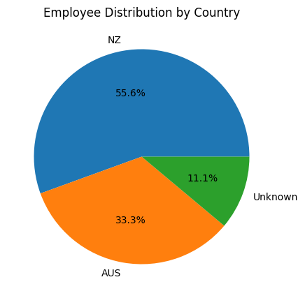
Visualization 4 — Employee Distribution by Country (Pie Chart)
Distribution Breakdown
NZ: 5 employees (55.6%)
AUS: 3 employees (33.3%)
Unknown: 1 employee (11.1%)
📌 Conclusion: The majority of employees (55.6%) are based in New Zealand, followed by Australia (33.3%). One employee's country was unknown and standardised to 'Unknown' during cleaning.

Slide 9
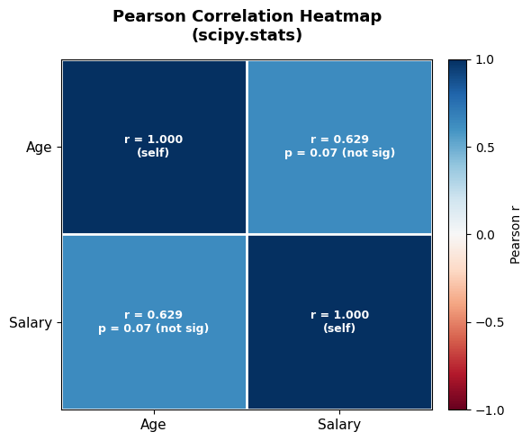
Visualization 5 — Pearson Correlation Heatmap
Pearson Algorithm
Formula: r = Σ(x-x̄)(y-ȳ) / √Σ(x-x̄)²Σ(y-ȳ)²
Result: r(Age, Salary) = 0.629
P-value: p = 0.0696
Interpretation:
r > 0.6 → moderate positive
p > 0.05 → not significant
at 5% level
(small sample n=9)
📌 Conclusion: r = 0.629 indicates a moderate positive linear correlation between Age and Salary. However, p = 0.07 means this is not statistically significant at the 5% level, likely due to the very small sample size (n = 9). With more data, this trend may become significant.

Slide 10
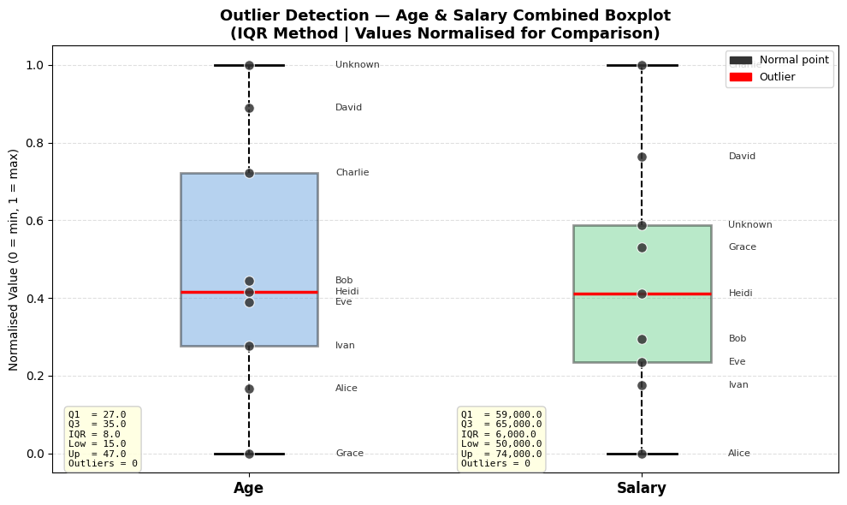
Visualization 6 — Outlier Detection (IQR Box Plot)
Age IQR Analysis
Salary IQR Analysis
Q1=27 Q3=35.5 IQR=8.5 Fence=[14.75, 48.25] Outliers: 0
Q1=59k Q3=65k IQR=6k Fence=[50k, 74k] Outliers: 0
📌 Conclusion: Using the IQR method, no outliers were detected in either Age or Salary after data cleaning. All data points fall within the whisker fences (Q1 − 1.5×IQR to Q3 + 1.5×IQR), confirming the cleaned dataset is free of extreme values.

Slide 11
Key Findings & Summary
🧹 Data Cleaning
6 issues fixed: semi-duplicate rows merged, text numbers converted, missing values imputed, invalid dates corrected, country codes standardised, ID dtype fixed.
📊 Salary Distribution
Salaries range NZD 55k–72k. Roughly uniform spread — no single dominant band.
🌏 Country Analysis
NZ employees are the majority (56%). AUS employees earn ~NZD 3,500 more on average.
📈 Age vs Salary
Moderate positive trend (r = 0.63). Older employees tend to earn more, but other factors also play a role.
🔥 Correlation
Pearson r = 0.629 (moderate positive). Not statistically significant at α=0.05 due to small sample (n=9).
🔍 Outliers
No outliers detected in Age or Salary after cleaning using the IQR method.

